Slide 1
Benign Termination of Runaway Electron Beams on ASDEX Upgrade and TCV
U. Sheikh, J. Cazabonne, J. Cerovsky, S. Coda, C. Colandrea, A. Dal Molin, J. Decker,
B. Duval, M. Faitsch, O. Ficker, M. Griener, M. Hoppe, E. Macusova, G. Papp, G. Pautasso,
C. Paz-Soldan, C. Reux, B. Sieglin, L. Simons, T. Wijkamp, the WPTE RT05, AUG and TCV Teams

Slide 2
Introduction and Outline
Benign termination has the potential to prevent RE impact damage -> Critical to ITER DMS
Recently been achieved on AUG, DIII-D, JET and TCV
  This presentation covers results on AUG and TCV
    Path to benign termination
    Recombination requirements
      How many particles do we need to inject?
    Method to approach low q_{e}
      How do we achieve the MHD instability?
    Partially recombined plasma (suboptimal scenarios)
  Results presented here are not mature
    Goal is present approach and generate discussion

Slide 3
Benign Termination Scenario

Slide 4
Benign Termination Scenario (TCV)
Comparison of non-benign and benign terminations
RE beam created with Neon injection at 0.7s
  Full I_{p} conversion on TCV

Slide 5
Benign Termination Scenario (TCV)
Comparison of non-benign and benign terminations
D2 injection beings at 0.8s
  Low injection rate case shown
    Neutral pressure maintained through fueling
  Density rise until plasma cools and recombines
    Energy loss through radiation and conduction
    I_{p} carried by REs
  Reduced V_{loop} and E
    Enables long duration beams
    Facilitates access to low q_{e}

Slide 6
Benign Termination (TCV)
Comparison of non-benign and benign terminations
Low q_{e} achieved through compression on center post
MHD instability expels REs over large wetted area
  I_{p} spike with benign termination
  No HXR emission during CQ
    No regeneration of REs

Slide 7
Benign Termination (AUG)
Argon injection at 1.0s
D2 MGI at 1.02s
  Plasma recombines immediately
    I_{p} carried by REs
  Neutral pressure maintained with fueling valves
Compression on center post to achieve low q_{e}
Benign termination achieved at 200, 500 and 600kA

Slide 8
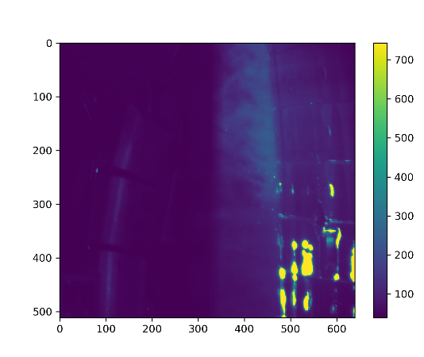
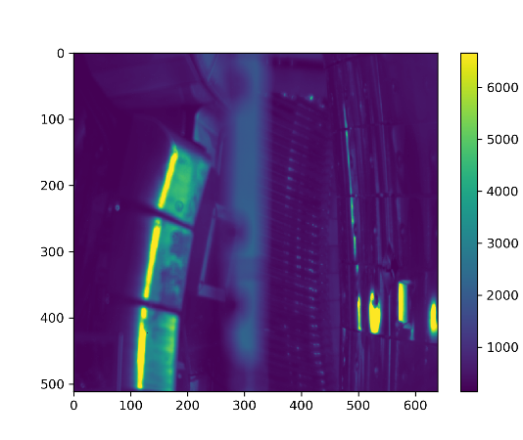
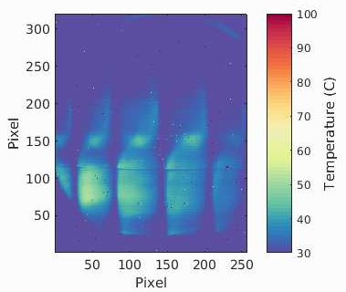
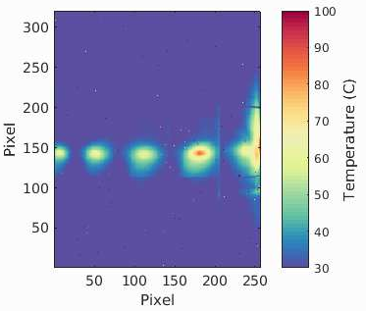
Benign Termination – Heat Flux
First frame after disruption shown
Orientation of images
  TCV: Viewing central column perpendicularly
  AUG: Tangential view with reflections on left, central column on right
TCV
AUG
Benign Termination
74638
Non-Benign
74640
Benign Termination
40890
Non-Benign
41326
Pixel
Pixel
Pixel

Slide 9
Benign Termination – Heat Flux
Heat flux significantly reduced through benign termination
  Increase in wetted area evident on IR camera
AUG data uncalibrated for temperature
  Varying color scale, normalized for exposure time
TCV
AUG
Benign Termination
74638
Non-Benign
74640
Benign Termination
40890
Non-Benign
41326
Pixel
Pixel
Pixel

Slide 10
Benign Termination – RE Energy
Gamma spectra during stable beam before compression
RE energy reduced with recombined companion plasma (benign termination case)
  Energy calibration not yet validated on TCV (trend evident)
TCV
AUG

Slide 11
Recombination Requirements

Slide 12
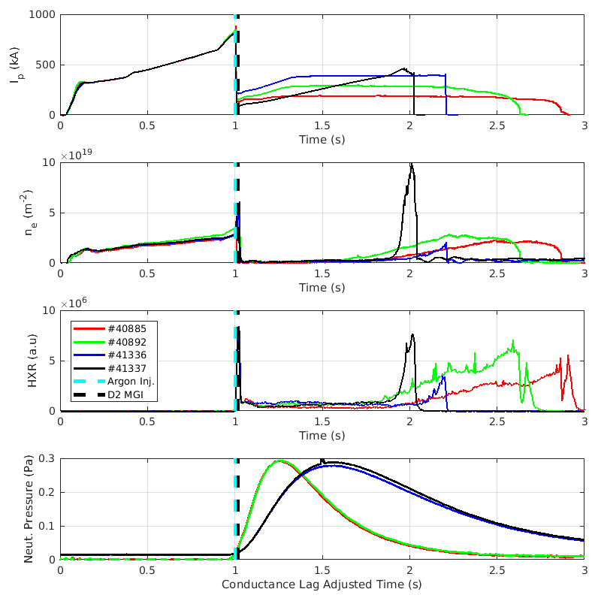
Recombination Requirements (AUG)
Scenario: D2 MGI for immediate recombination
Pumping reduces neutral pressure until re-ionization
  Allows inference of neutral pressure threshold
Scan: Fixed injection quantity with four I_{p}
  MGI pressure fixed, opening duration varied

Slide 13
Recombination Requirements (TCV)
Scenario: D2 MGI for immediate recombination
Pumping reduces neutral pressure until re-ionization
  Allows inference of neutral pressure threshold
Scan: Fixed I_{p} with 3 injection quantities
  MGI pressure fixed, opening duration varied

Slide 14
Recombination Requirements (TCV)
Scenario: Injection via fueling valves
  Detrimental for mitigation scheme but useful to explore recombination physics
  Slow neutral pressure rise
  Verification of neutral pressure threshold twice in one discharge

Slide 15
Recombination Requirements
Map density and neutral pressure to reveal threshold
Robust result for a given I_{p} on TCV
  Insensitive to injection method/rate
Threshold increases with I_{p} (observed on both machines)
  Similar threshold at 150kA on TCV and 200kA on AUG

Slide 16
Recombination Requirements (TCV)
Comparable threshold for D2 and H2 (0.06-0.08Pa)
  Dataset for 150kA on TCV
Higher n_{e} at same neutral pressure with more impurities
  Lower limit to be clarified in coming experiments

Slide 17
Recombination Requirements Max (AUG)
Upper limit for neutral pressure observed on DIII-D
Additional D2 via fueling valves
Benign termination successful on AUG up to 0.8Pa
  Lower limit at 200kA is ~0.08Pa
  Factor of 10 above lower limit was successful
Heat flux comparable to reference
No upper limited found on AUG

Slide 18
Recombination Requirements Summary
Neutral pressure threshold scales with I_{p}
  ~0.07Pa at 150kA to 0.24Pa at 500kA
  Similar threshold at 150kA on TCV and 200kA on AUG
Injection method or rate does not impact result
Comparable threshold for D2 and H2 (0.06-0.08Pa)
Higher n_{e} at same neutral pressure with more impurities
  Lower limit to be clarified in coming experiments
No neutral pressure upper limit observed

Slide 19
Path to Low q_{e}

Slide 20
Compression Rate Scan (AUG)
Compression rates at 500kA and 200kA
  Each plot marker represents 1ms
  q_{cyl} approximation used
Terminations at q_{e}~2 for 500kA
  Slow compression at q_{e} of 3 did not result in disruption
Terminations at q_{e} ~3 at 200kA at slow compression rates
  Faster compression rate led to q_{e}<3 at 200kA
Slow compression rate may allow benign termination at higher q_{e}

Slide 21
I_{p} and B_{t} Ramp to Low q_{e} (TCV)
Three methods to low q_{e}
Compression on center column for reference
Low q_{e} with I_{p} ramp up
  Bursts at q_{e} of ~3
  Large HXR spike at termination
Low q_{e} with B_{t} ramp down
  Numerous bursts leading to termination
All three methods have I_{p} spike and no HXR emission after disruption
  IR measurements not available

Slide 22
Partially Re-Ionised Companion Plasmas

Slide 23
Partially Re-Ionised Plasma
So far we’ve looked at benign termination of recombined plasmas
  Found the recombination threshold
  Explored paths to low q_{e}
What happens when we compress a partially ionized plasma?

Slide 24
Partially Re-Ionised Plasma (AUG)
Compression at different n_{e}
  Scan conducted at 200kA
  Compression densities range from <0.1e19 to 2.2e19 m⁻²
  Completely recombined reference discharge

Slide 25
Partially Re-Ionised Plasma (AUG)
Compression at different n_{e}
Immediate increase in HXR emission with increasing density
  Indicates increase in RE energy
  Gamma spectroscopy not available on these discharges
Clear I_{p} spike only observed with recombined plasma
Small I_{p} spike observed at lowest density
  Partial benign termination

Slide 26
Partially Re-Ionised Plasma (AUG)
Compression at different n_{e}
IR region of interest (ROI) as a proxy for heat flux
  Emission increases with increasing n_{e}
Partial benign termination heat flux significantly higher than benign termination
  Quantified heat fluxes to come

Slide 27

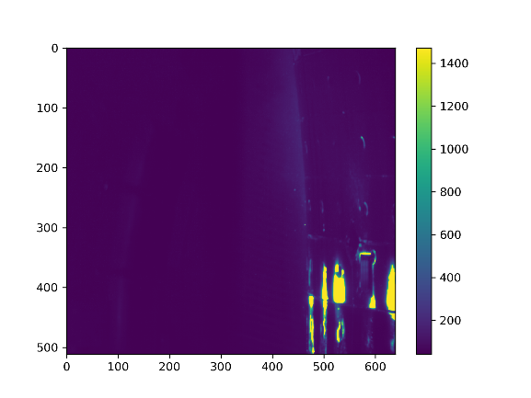
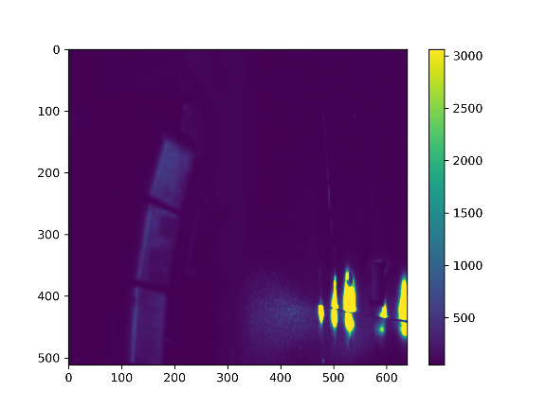

Partially Re-Ionised Plasma (AUG)
Frame immediately after disruption presented
Wetted area scales with plasma density
  Note: varying color scale, normalized for exposure time
Benign termination with large wetted area and low IR emission from wall
High IR emission with localized heating at highest density
Benign Termination
Increasing Density
Highest Density
<0.1e19m⁻²
40891
0.9e19m-2
41328
1.5e19m-2
41329
2.2e19m-2
41326
Pixels
Pixels
Pixels
Pixels
Pixels

Slide 28
Conclusions

Slide 29
Conclusions
Benign termination successfully developed on AUG and TCV
Recombination threshold explored
  Approximately constant on AUG and TCV at similar I_{p}
    Increases at higher I_{p} (and possibly with more impurities)
  No significant difference between H2 and D2
  No upper limit on neutral pressure found
Slower compression rates may lead to MHD instability at higher q_{e}
I_{p} and B_{t} ramps can also lead to benign termination
Heat flux significantly increase as companion plasma re-ionizes
  Scales with companion plasma density
Scenarios are now stable on AUG, DIII-D, JET and TCV
Experiments and analysis on-going through a global effort

Slide 30
Backups

Slide 31
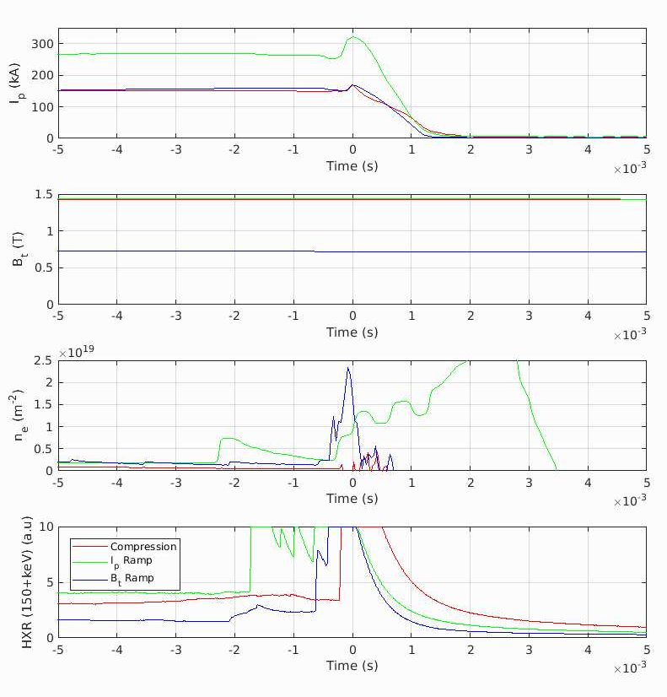
Path to Low qe on TCV
2 methods to low q_{e}
t=0 is I_{p} spike

Slide 32
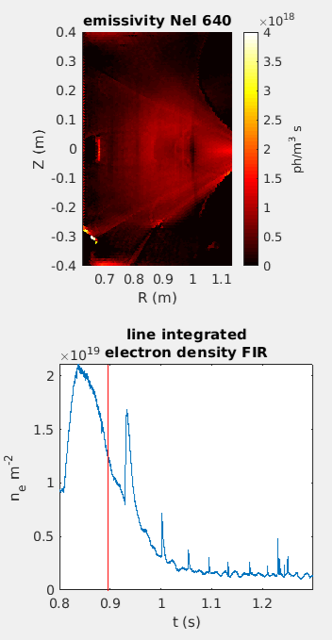
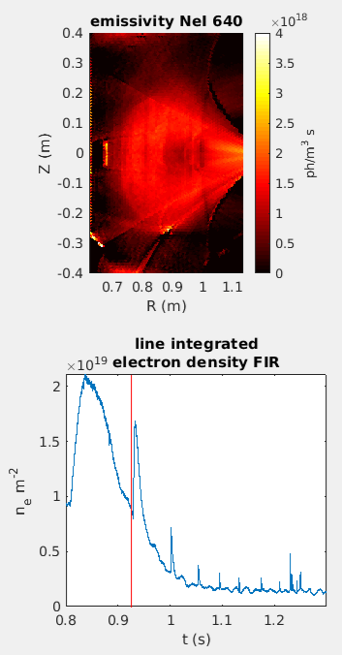
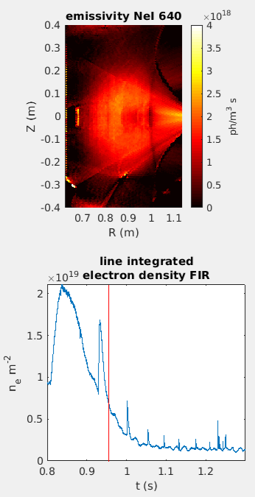
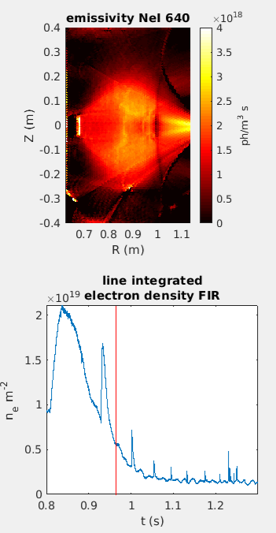
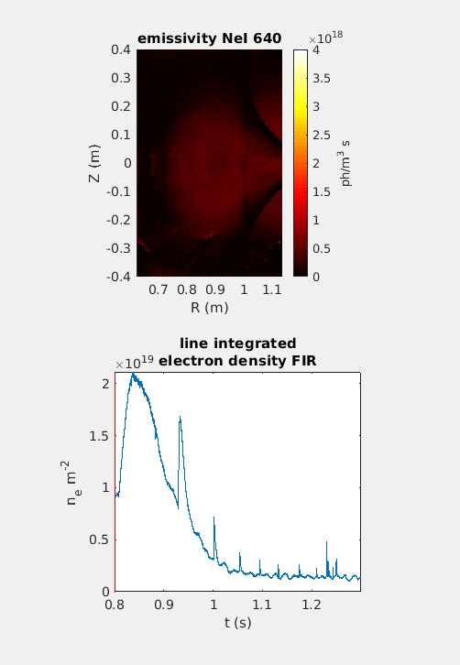
Recombination Requirements (TCV)
Spectral imaging allows observation of impurity recombination (and re-ionization)

Slide 34
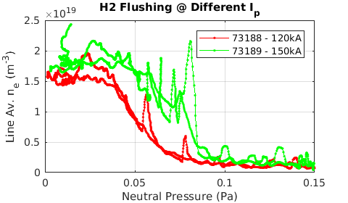
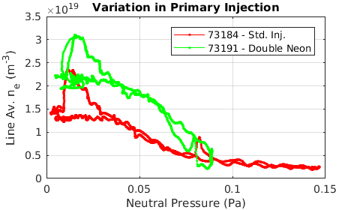
Damage Mitigation (TCV)
New approach allows sensitivity scans
  Reionisation occurs at higher neutral pressure for higher I_{p} and increased background impurity quantity
Open question: is there an optimal range for kink mitigation?
  Will be explored further on TCV and AUG

Slide 35
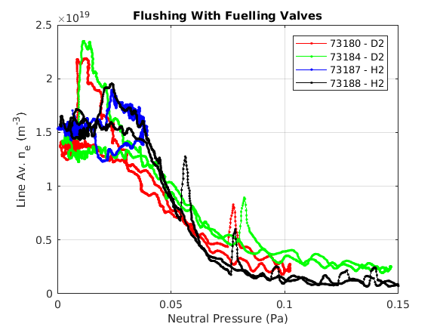
Damage Mitigation (TCV)
Dynamics slowed by using fueling valves
Density as a function of neutral pressure is a robust result!
Comparison of H2 and D2 flushing
  Slightly lower n_{e} with H2?

