Slide 1
The Dependence of Energy Confinement Time on Magnetic field
The 5th ASEAN School on Plasma and Nuclear Fusion (ASPNF2019)
and SOKENDAI Winter School 2019
At Mahidol University
Mentor: Bernard Pégourié and Peera Wongkitiwanichakul
Group 1

Slide 2
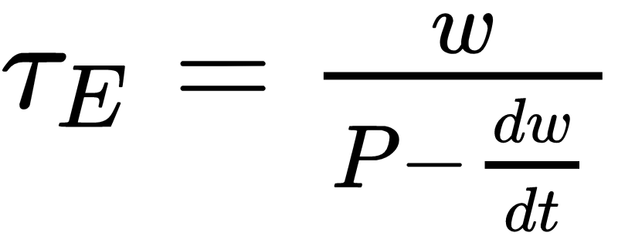
Energy Confinement Time
Definition: Average time taken for the energy to escape the plasma, usually define as the total amount of energy stored in the plasma divided by the rate at which energy is lost.
Notes:
Where k: Botzmann constant
Isn’t it here?

Slide 3
What we did
Shot Number | U_{CD} | P_{vv} | ?t | U_{B}
29216 | 500 V | 16 mPa | 5.5 ms | 600 V
29228 | 700 V
29236 | 800 V
29231 | 900 V
29232 | 1000 V
29233 | 1100 V
29234 | 1200 V
U_{CD} - Voltage of current drive
P_{W} - Pressure
?t - Delay time
U_{B} - Voltage of the Toroidal magnetic coil

Slide 4
Input
Discharge shots #29216 (600V)
Power ( )
Plasma current
Notes:
This is the first result from the first discharge (V_current drive=500V, P_H2=16mPa, V_magnetic field=600V), This is the raw result without any smoothing. Look at the flat (not too flat honestly) at about 12000 to 21000 us. In those region the plasma starts to circling the torus, so the plasma current start to increase until it drops to zero at the end. At the same time the loop voltage start to increase and drops exponentially. To get the great representation just do the power (ohm law) equation, with it, you can see the increment of the plasma power until at the end of the plasma current the power drops immediately. This 4 parameter were our basic parameter to do next calculation (tau_E and what follows it)

Slide 5
Input
Toroidal field
Loop Voltage

Slide 6
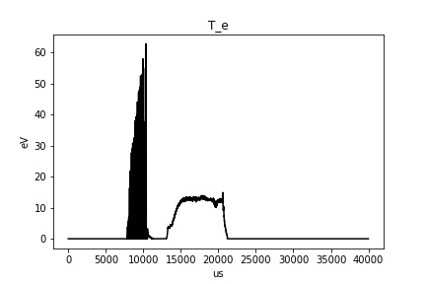
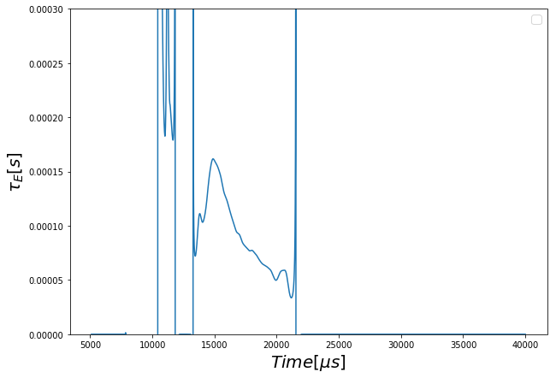
Discharge Characteristics
Notes:
From the input we can calculate our main goals which is the tau_E, as you can see in the T_e, the plasma start to stabilize its temperature/energy in certain range inside the grey line. In this range too, the Tau_e start to decrease after pulsing in 15000us. From this range we could determine our time of interest. Since ionization energy of hydrogen is 13.6 eV, there is no plasma in the chamber before that temperature. Thus, we choose our time of interest to be 17000-20000 micro second interval. On the next slide, we will compare the parameters from each discharge in this interval.

Slide 7
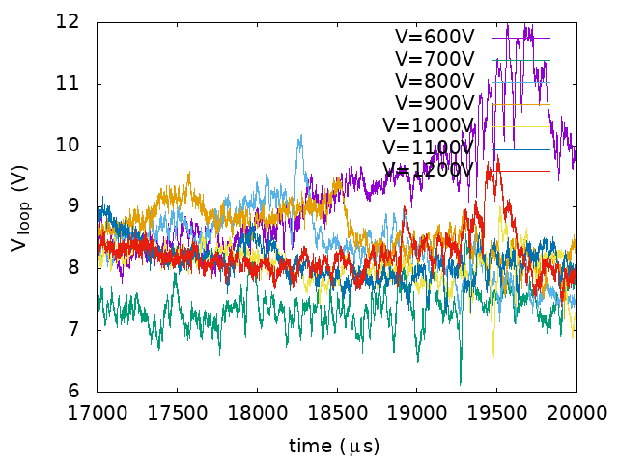
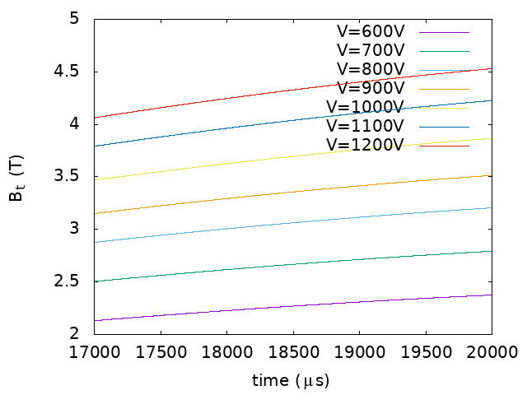
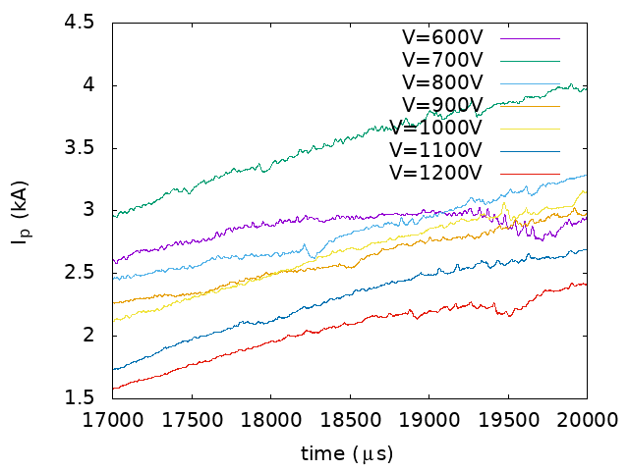
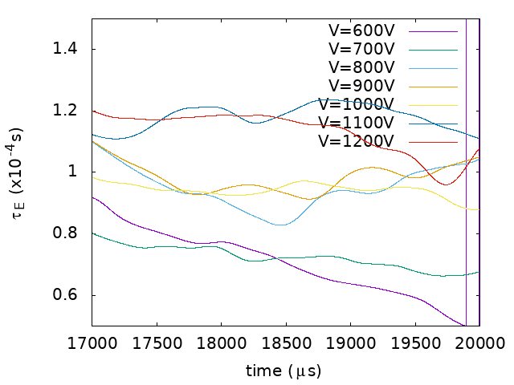
Global Results
Notes:
Well, any idea?
For me, apart from BT, everything seems to be invariant
For each shot Should we mention these with Ub = xxxx ?
We can but is it necessary?
For audience that sit far from the Monitor
Bernard told that
Can we change from the number of shot to Voltage that we vary because the audience can understand easily
I suggest that
Ok no problem
Done!

Slide 8
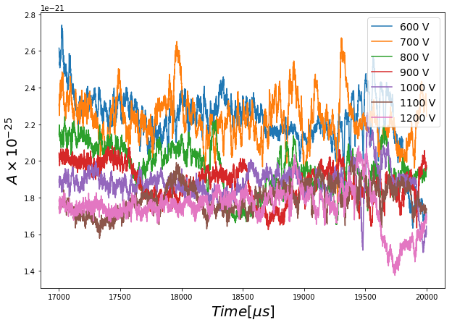
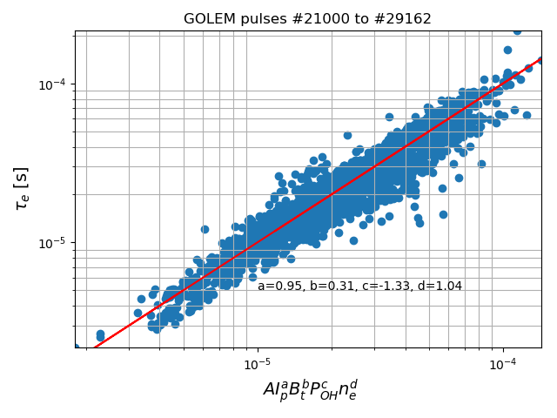
Benchmarking
Courtesy Jullien Hillairet
Notes:
From the experiment data, prof Jullien has fitted the data with an equation to see the relationship between confinement time and plasma current, toroidal magnetic field, voltage and density. Here A is constant. Base on his equation and our experiment data, we calculate the value of A for each shot in time range [1700:2000]. As you can see in the figure, A is packed together for each shot between the range [17000:20000] ms, especially around 20000. This means our chosen time of interest is correct and agree with Jullien’s equation in some short time. Dispersion our our calculated A (0,1-1.0.7) is smaller than that on Julien law (about 2)

Slide 9
Summary
Changing only the voltage of toroidal magnetic field while keeping others quantities including loop voltage, pressure and time delay the same, the value of other quantities will also change.
→ all of the quantities inside tokamak are related to each others. Once one quantity changes, it affects to all of the others.

Slide 10
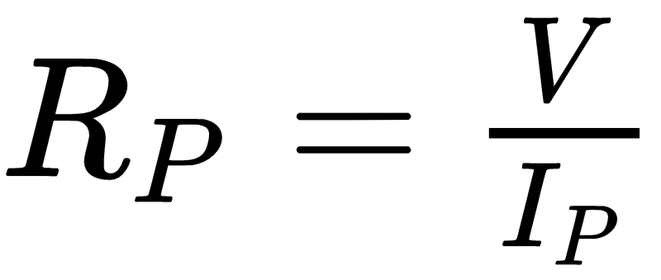
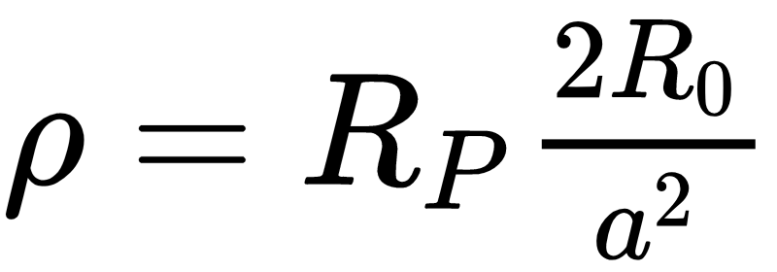
Appendix
Assume:

