Slide 1
Study the relationship between resistance and temperature on Tokamak Golem.
Mr. Rattacha Boonchoo
Department of Physics, Faculty of Science, Prince of Songkla University

Slide 2
Outline
01
Introduction
02
Motivation
03
Result
04
Sammary

Slide 3
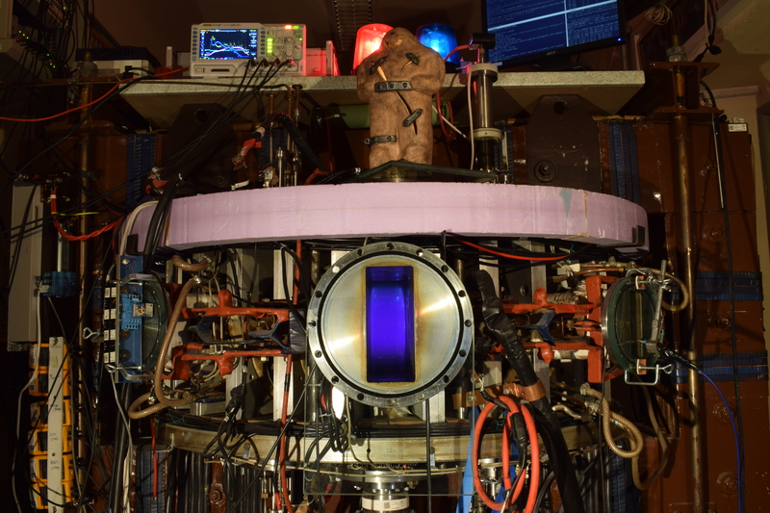
01
Introduction
Tokamak Golem
Notes:
Tokamak GOLEM is a device serving primarily education purposes on the Czech Technical University.
It was manufactured in the Soviet Union as TM-1 (“small tokamak no 1”)

Slide 4
01
Introduction
Control room

Slide 5
02
Motivation
Tokamak GOLEM for the 4th ASEAN School on Plasma and Nuclear Fusion
“Choosing the experimental results of group 3.”
The experiment can be planned.
The number of trials is appropriate.
Information is as required.

Slide 6
02
Motivation
“I’m interested in the problem of ohmic heating arises from the fact that resistivity decreases with temperature”

Slide 7
03
Result
Mean
Max
4.99 V
27.1 V
4.61 V
25.1 V
4.75 V
22 V
Notes:
From 400 , in increments of 250 to 1100
This graph show loop voltage dependent on time.

Slide 8
03
Result
Mean
Max
7.71 V
35.2 V
6.85 V
29.6 V
5.92 V
26.9 V
Notes:
And changing PS of transformer from 400, increments 150 to 700

Slide 9
03
Result
Mean
Max
10.1 V
34.3 V
8.45 V
27.1 V
8.41 V
21.6 V
Notes:
The graphs are shown relationship loop voltage with the time that there is a profile similarly.

Slide 10
03
Result
Within the red frame shows duration of the plasma lifetime and electron temperature
“The period in which the loop voltage increases is when the plasma is created and induced.”
“the induction of plasma increases the electron temperature.”
Notes:
When the loop voltage falls, the electron temperature drops quickly

Slide 11
03
Result
Within the red frame shows duration of the plasma resistivity
Notes:
The electrons temperature is obtained from ohmic heating.
But the temperature rises, the ohmic power decreases, so the plasma supply energy is not enough to allow the plasma to support itself
The biggest difficulty arises from the fact that the resistivity decreases with temperature
So, you can look on this graph at the same time plasma resistivity decreases

Slide 12
03
Result
“The increase in temperature causes the plasma resistivity to decrease.”
Notes:
The graph is right hand side. I will show that relationship between plasma resistivity with electron temperature
The decrease in plasma resistance versus time is similar to a decrease in temperature.

Slide 13
04
Summary
“Induction of the plasma to create a plasma current resulting in higher electron temperatures due to Ohmic power.”
“As the plasma resistivity decreases, the ohmic heating decreases as increasing the electron temperature.”

Slide 14
Thank you
For
Your attention

Slide 15
Q & A

