Slide 1
Remote tokamak operation
Jan Stockel,
Institute of Plasma Physics, Prague, stockel@ipp.cas.cz
Vojtech Svoboda – GOLEM operator currently at
Faculty of Nuclear Physics and Physics Engineering, CTU in Prague
Aims of this lecture
Prepare participants for the workshop on
remote operation of GOLEM this afternoon
(necessary technical details)
Explain very basics of tokamak physics
Kiten, June 26, 2016

Slide 2
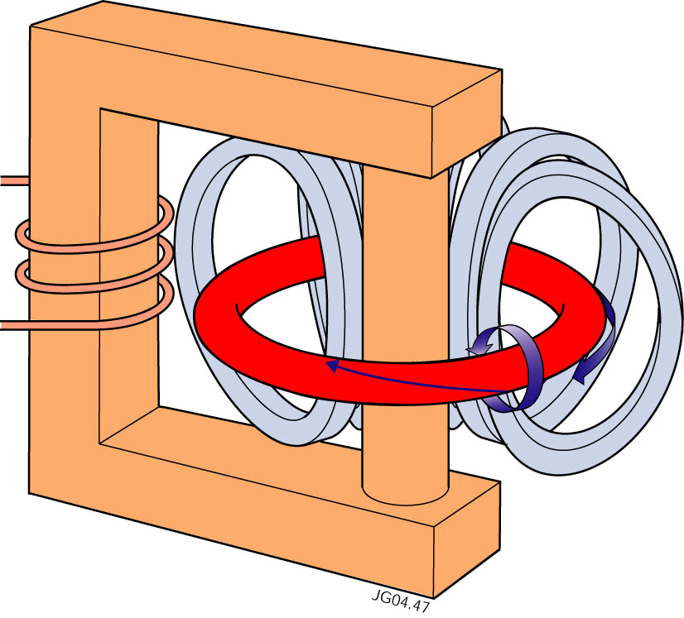
Tokamak basics
Tokamaks are composed of
three basic components
Large transformer with primary winding
Plasma ring as secondary winding
Coils for confinement of plasma ring by magnetic field (toroidal solenoid)
Electric current I generated in the plasma ring by the transformer
delivers the ohmic power P_{ohmic} = I²R_{plasma} to plasma (heating)
generates the poloidal magnetic field in the plasma ring B_{poloidal} ~I/2πa

Slide 3
Tokamak research
Tokamaks are the most promising concept to achieve the controlled thermonuclear fusion, and, in future to serve as the reactor for generation electricity
Around 180 tokamaks of different size were constructed and operated
since 1958 to reach this goal
In general, large tokamaks are quite complex facilities
The largest operational tokamak Joint European Torus (JET)
Operational costs ~50 MEuro/year, Several hundreds of employers
The prototype fusion reactor ITER – under construction in France
Construction costs ~ >15 billions Euro, first plasma > 2025
Today, you will try to operate the most simplest tokamak GOLEM located in Prague at the Czech Technical University

Slide 4
The GOLEM tokamak in Prague
The GOLEM is a small tokamak experiment, but the oldest tokamak in the world, which is still operational!
Unique feature: Can be operated remotely via Internet
Mission of GOLEM: Education of students
“Naked” GOLEM before connecting to power supplies and pumping system
Modest parameters
Toroidal magnetic field <0.5 T
Plasma current <10 kA
Plasma density <10¹⁹ m⁻³
Electron temperature <100 eV
(< 1 Million K)
Around 3 m

Slide 5
GOLEM tokamak – long story
The GOLEM tokamak is the oldest tokamak in the word which is still operational with a long term history!!
Built by the godfather of tokamak research, Lev Artsimovich in Kurchatov Institute. Moscow around 1960 as TM-1
The first real tokamak plasma was achieved simultaneously with the T-2 tokamak!
Moved to Institute of Plasma Physics Prague and baptised as CASTOR in 1977
Replaced by COMPASS tokamak 2007
Moved to Czech Technical University and baptised again as GOLEM

Slide 6
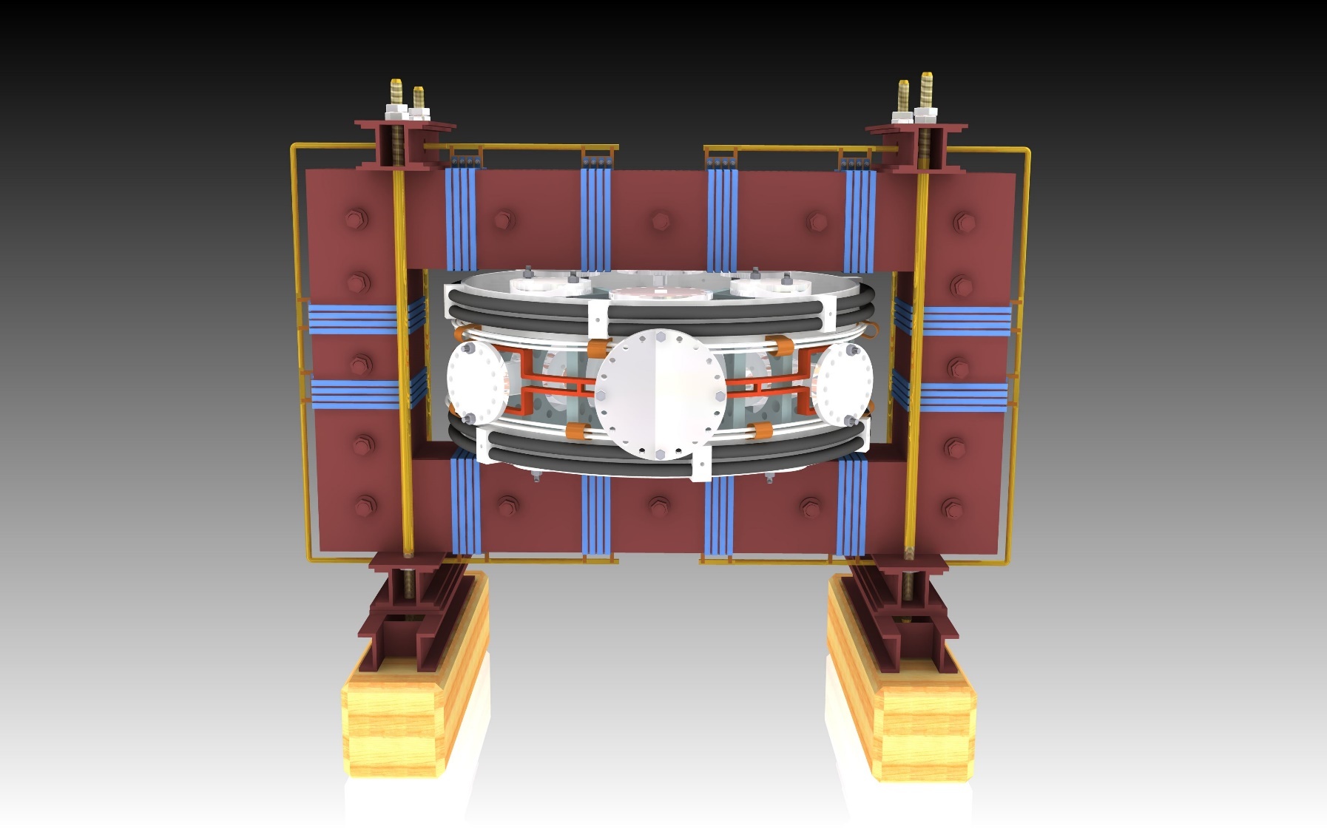
Front view of GOLEM (schematically)
Primary winding of
the transformer (24 turns)
Iron core of
the transformer
Vacuum vessel equipped by 18 diagnostic ports
Toroidal magnetic
field coils (28)
Any vertical magnetic field is not required for equilibrium position of the plasma column in the horizontal direction in the basic mode of operation (Iron core, copper shell, low plasma pressure, short pulse,….)

Slide 7
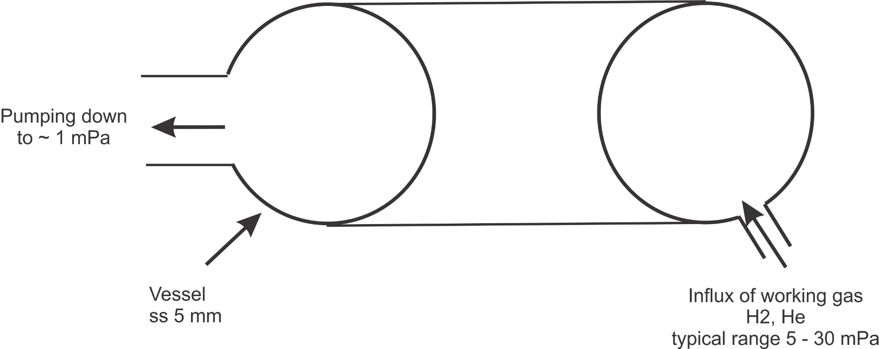
Tokamak vessel & pumping system
Plasma ring is generated inside the toroidal vessel
evacuated prior the discharge down to pressure ~ <1 mPa by the turbomolecular pump
b = 0.1 m
R0 =0.4 m
Then, the vessel is filled by a working gas.
Pressure of the working gas is adjusted according request!

Slide 8
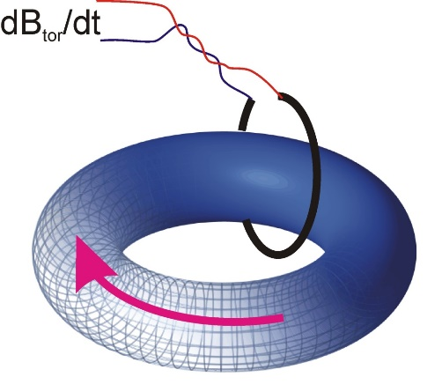
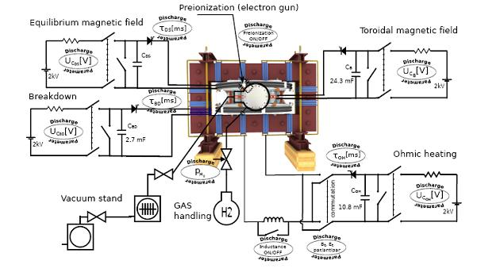
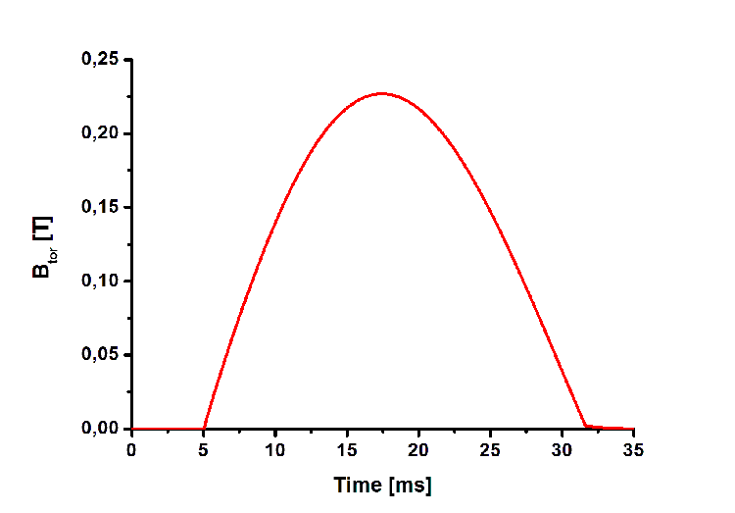
Toroidal magnetic field
28 TF coils - charged by the capacitor bank C = 24.3 mF
Thyristor switch
(always 5 ms after start of DAS)
Signal of the magnetic sensor
Is numerically integrated
Maximum charging voltage 1.4 kV!
Btor < 0.4 T
B_{tor} is triggered 5 ms after starting the data acquisition system

Slide 9
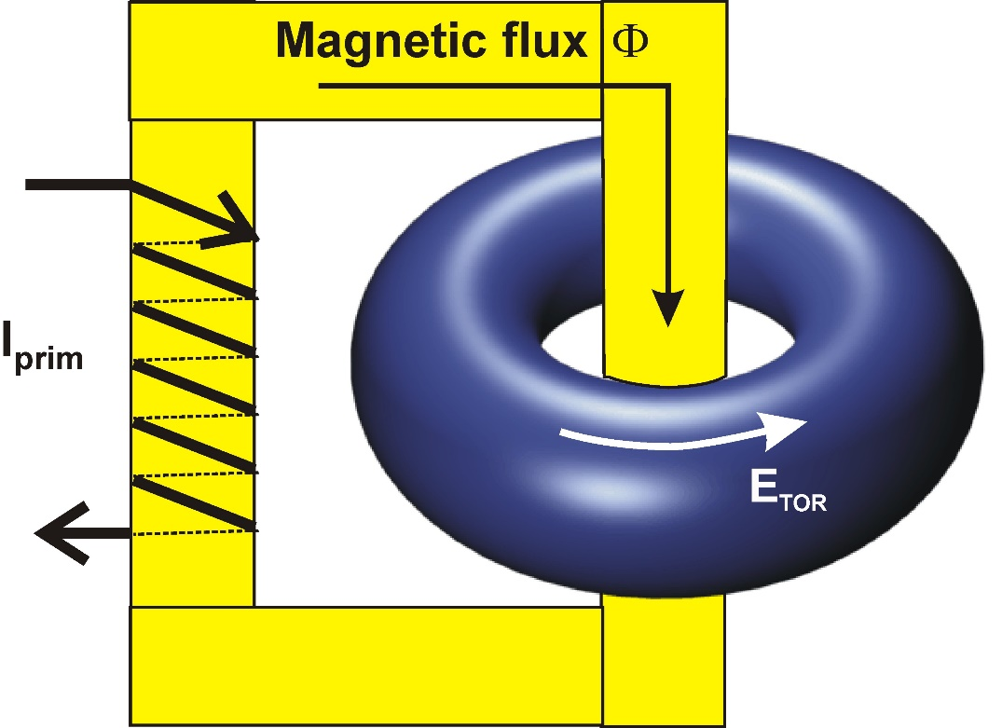
Toroidal electric field inside the tokamak vessel
Toroidal electric field E _{tor} at a sufficient level in the "empty" vessel is required for breakdown of the working gas and to generate plasma
E _{tor} is generated by by the time varying current in the primary winding of the tokamak transformer
M –mutual inductance between
primary winding and the plasma ring
R – major radius of the torus
Primary winding is charged by a condenser bank
Toroidal electric field at the breakdown should be as low as possible!!!!

Slide 10
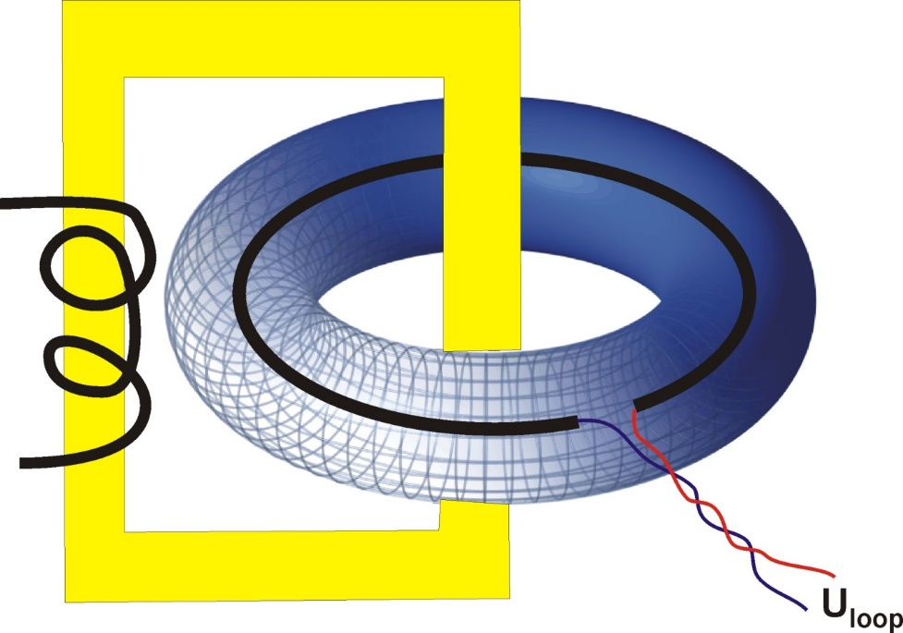
Toroidal electric field – how to measure?
The toroidal electric field is measured by a single loop located along the tokamak vessel (outside)
dψ/dt – magnetic flux
E _{tor} = U_{loop}/2πR
dI_{prim}/dt ≠ 0
Loop voltage U_{loop} = - dψ/dt
Notes:
10

Slide 11
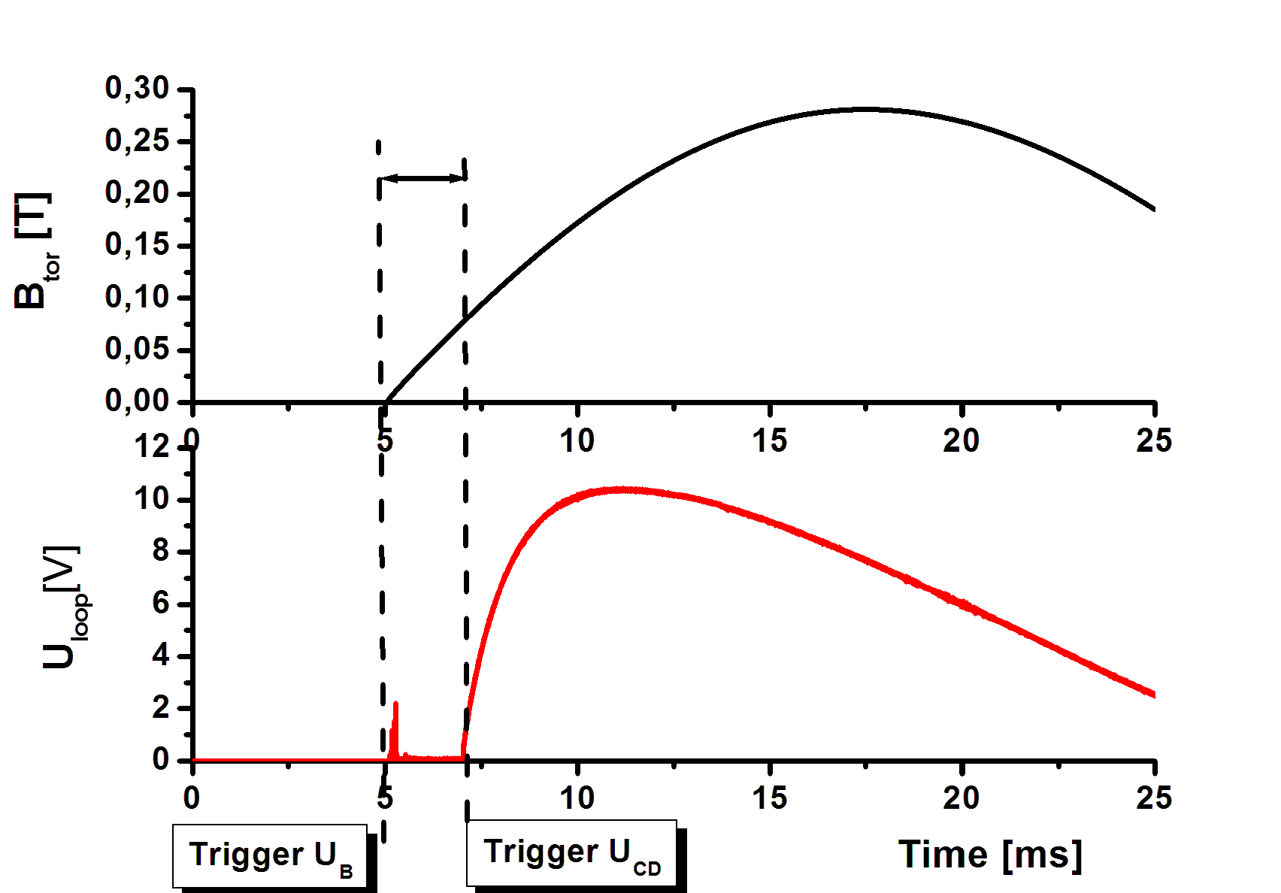
Vacuum discharge – no plasma
Time delay between trigger pulses Btor and Uloop can be selected
Selection of the time delay can be requested to optimize breakdown of the working gas

Slide 12
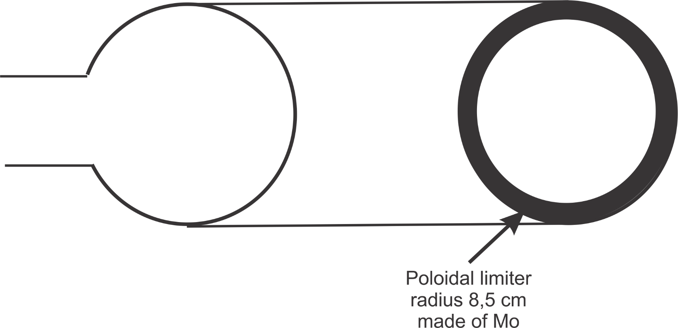
Poloidal Limiter & pre-ionization
Emitting filament
- Electron gun
A circular diaphragm to reduce interaction of plasma with the inner surface of the tokamak vessel
a = 85 mm
Some free electrons have to exist inside the vessel before plasma discharge –
Pre-ionization by an electron gun is used
But you may also exploit background cosmic radiation

Slide 13
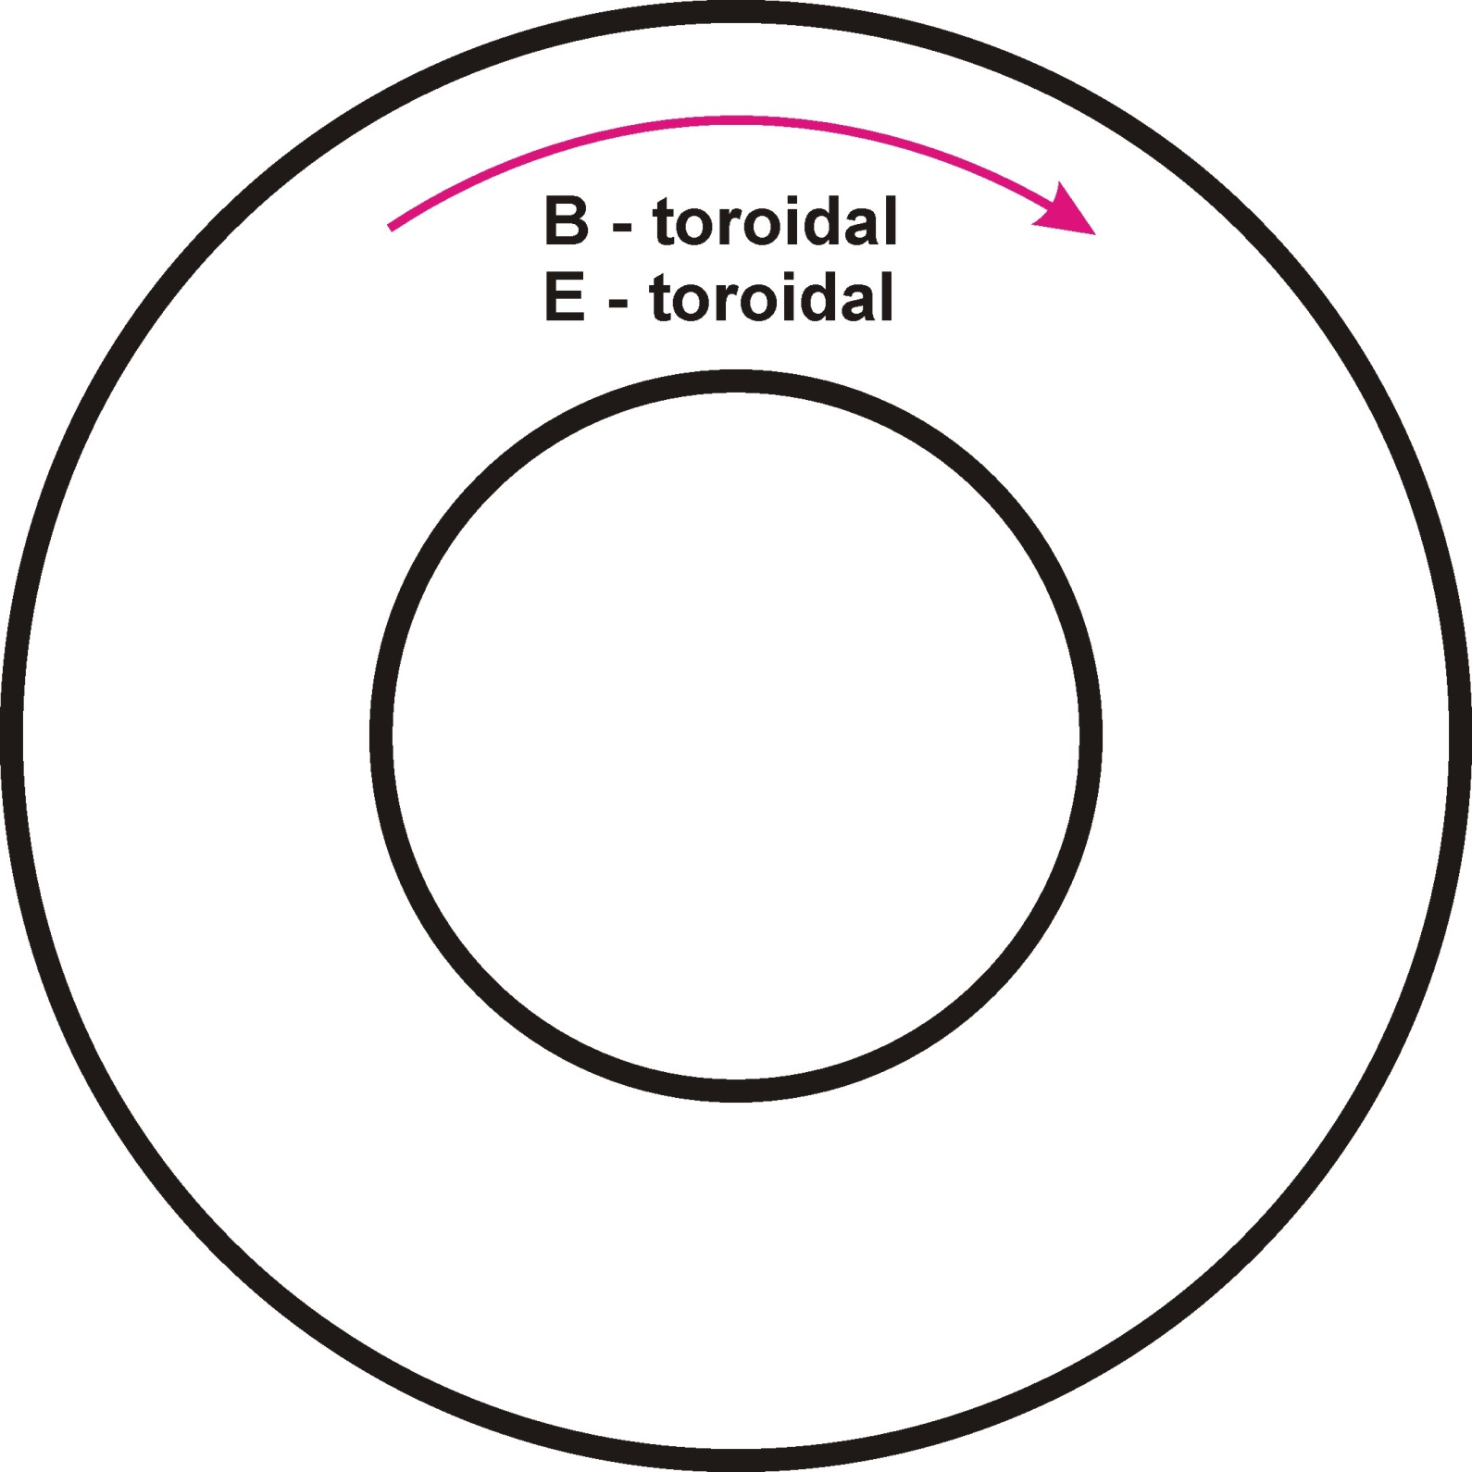
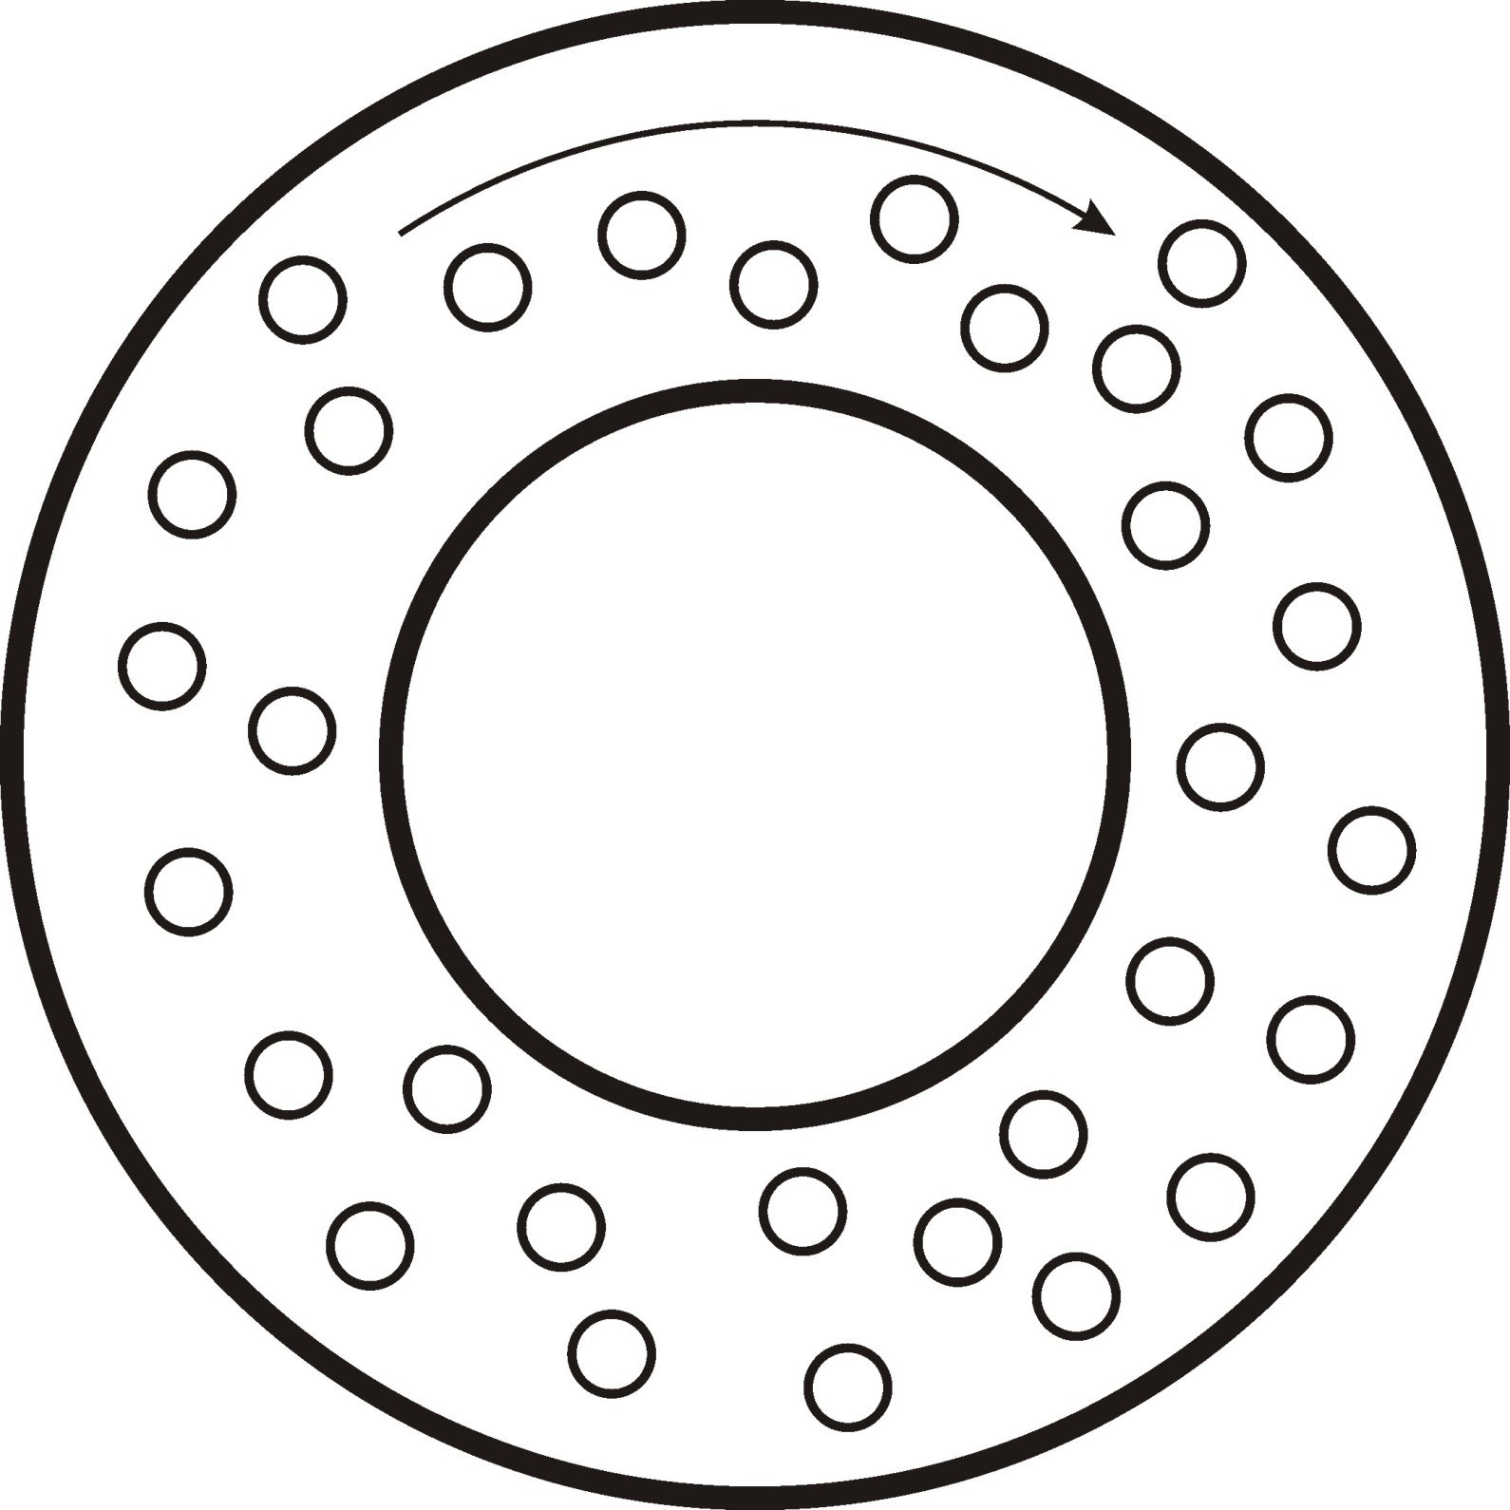
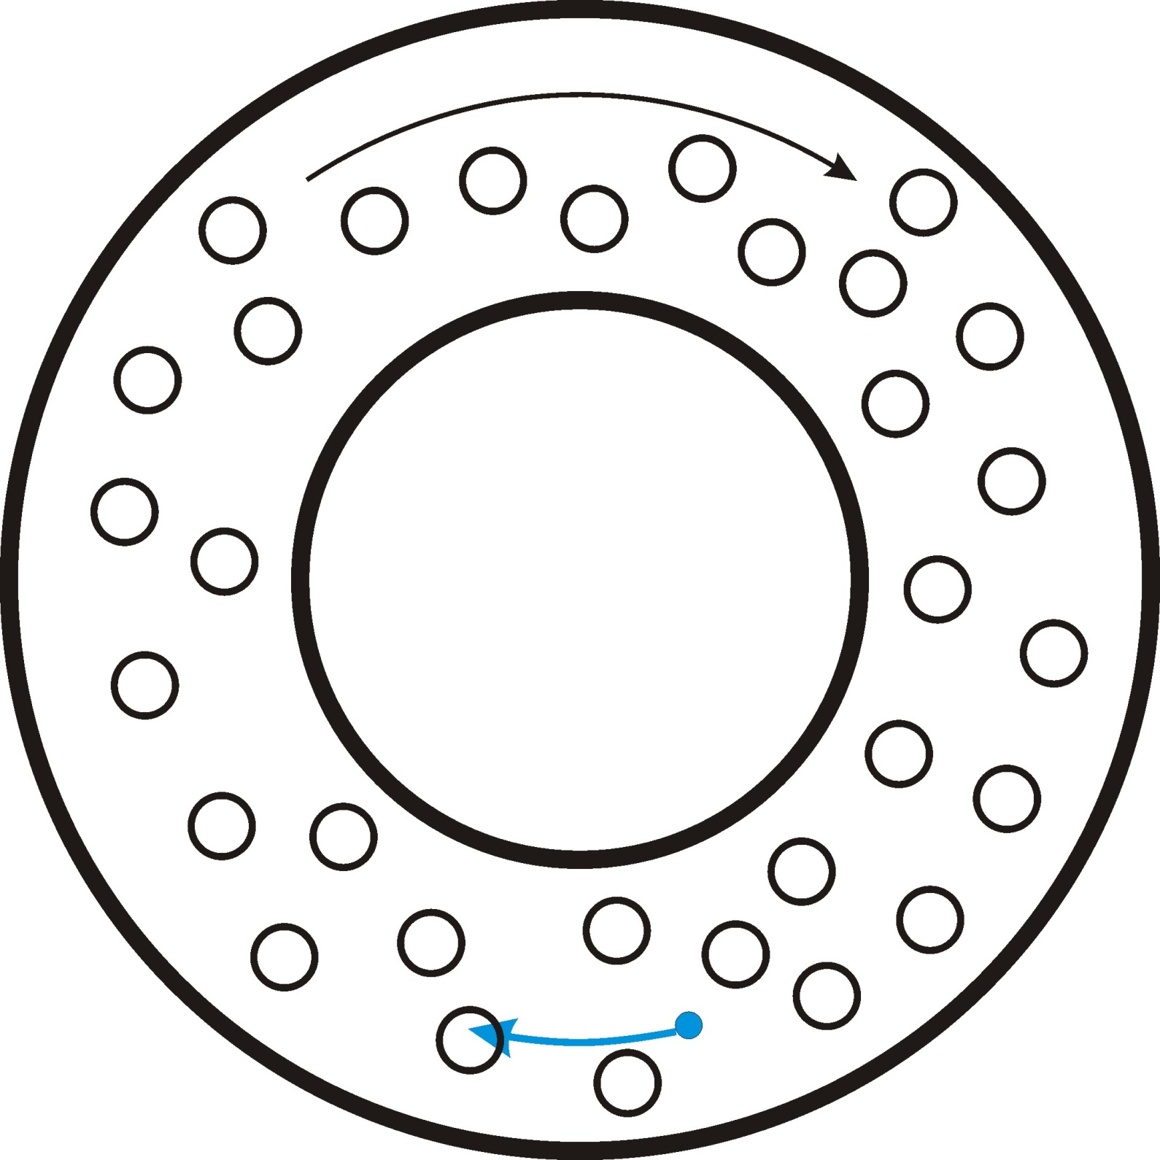
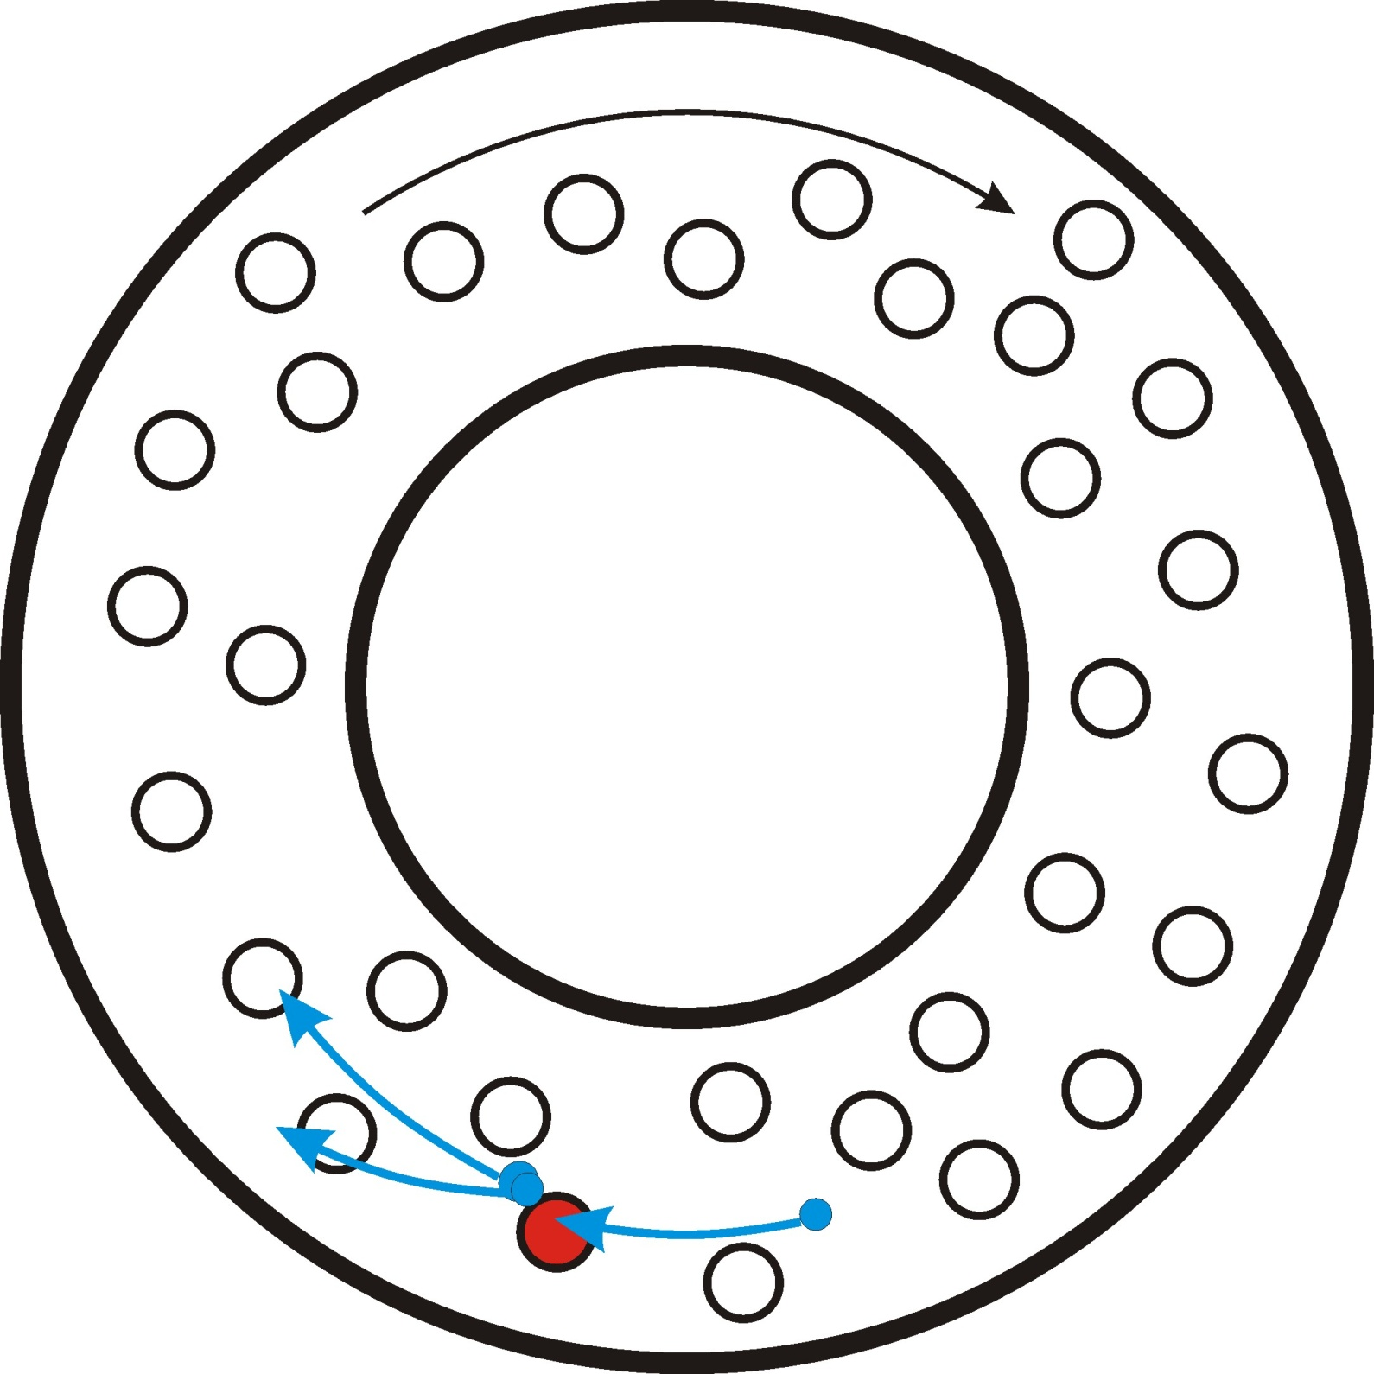
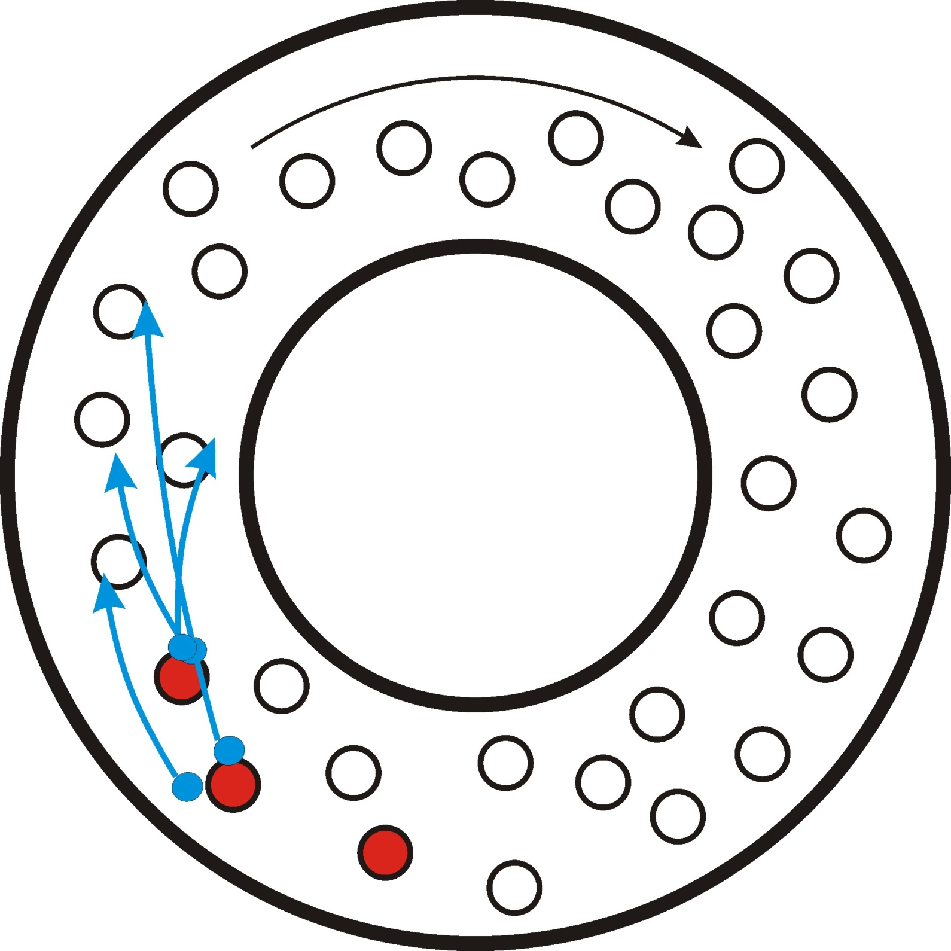
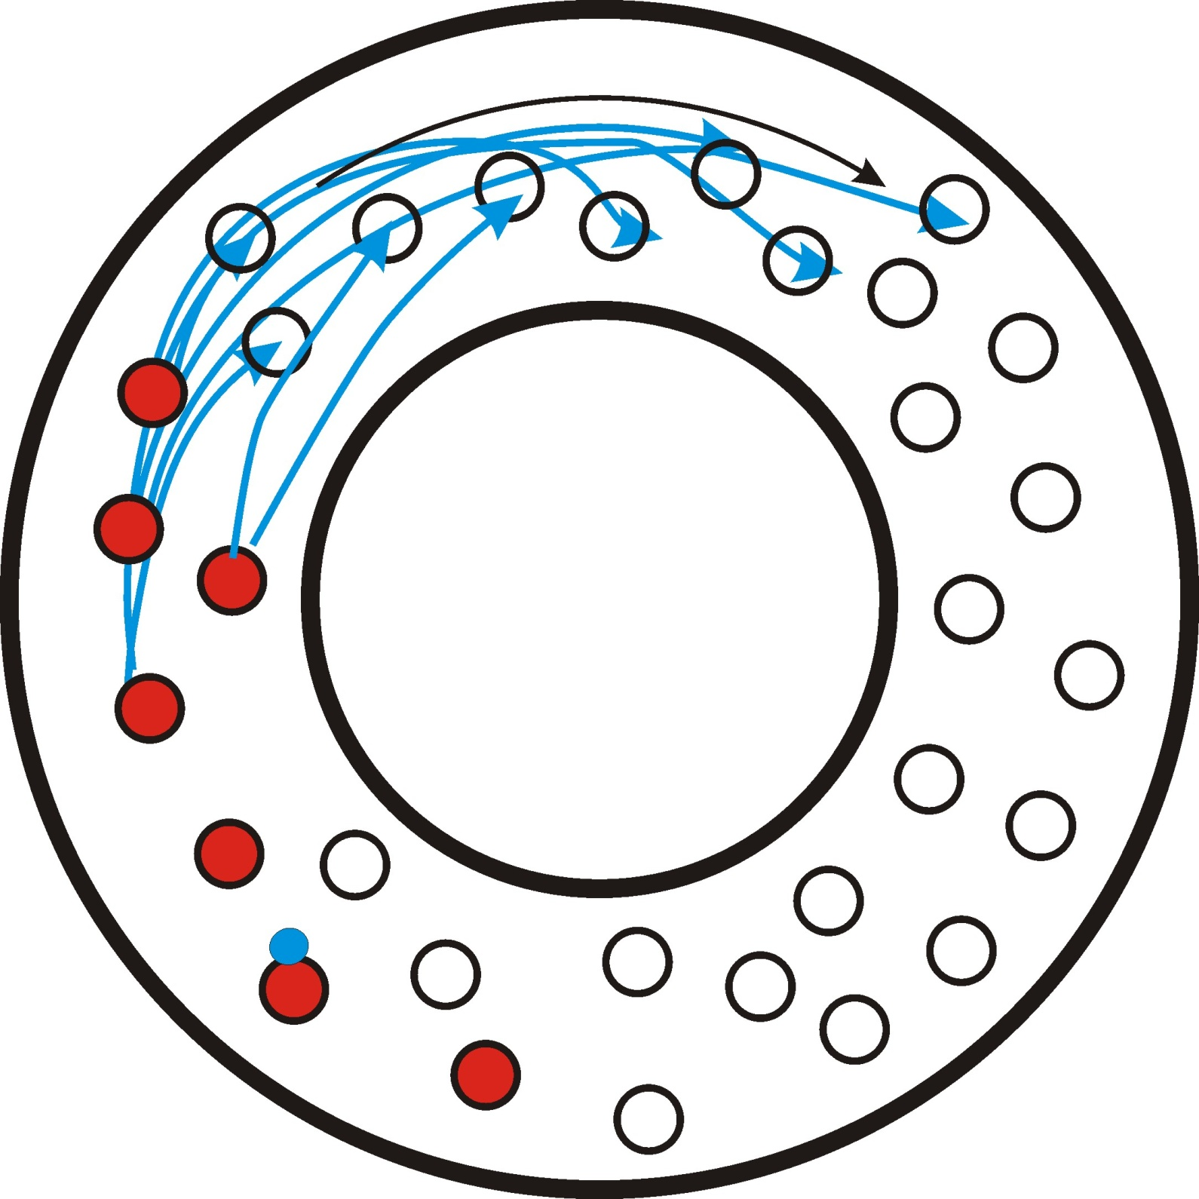
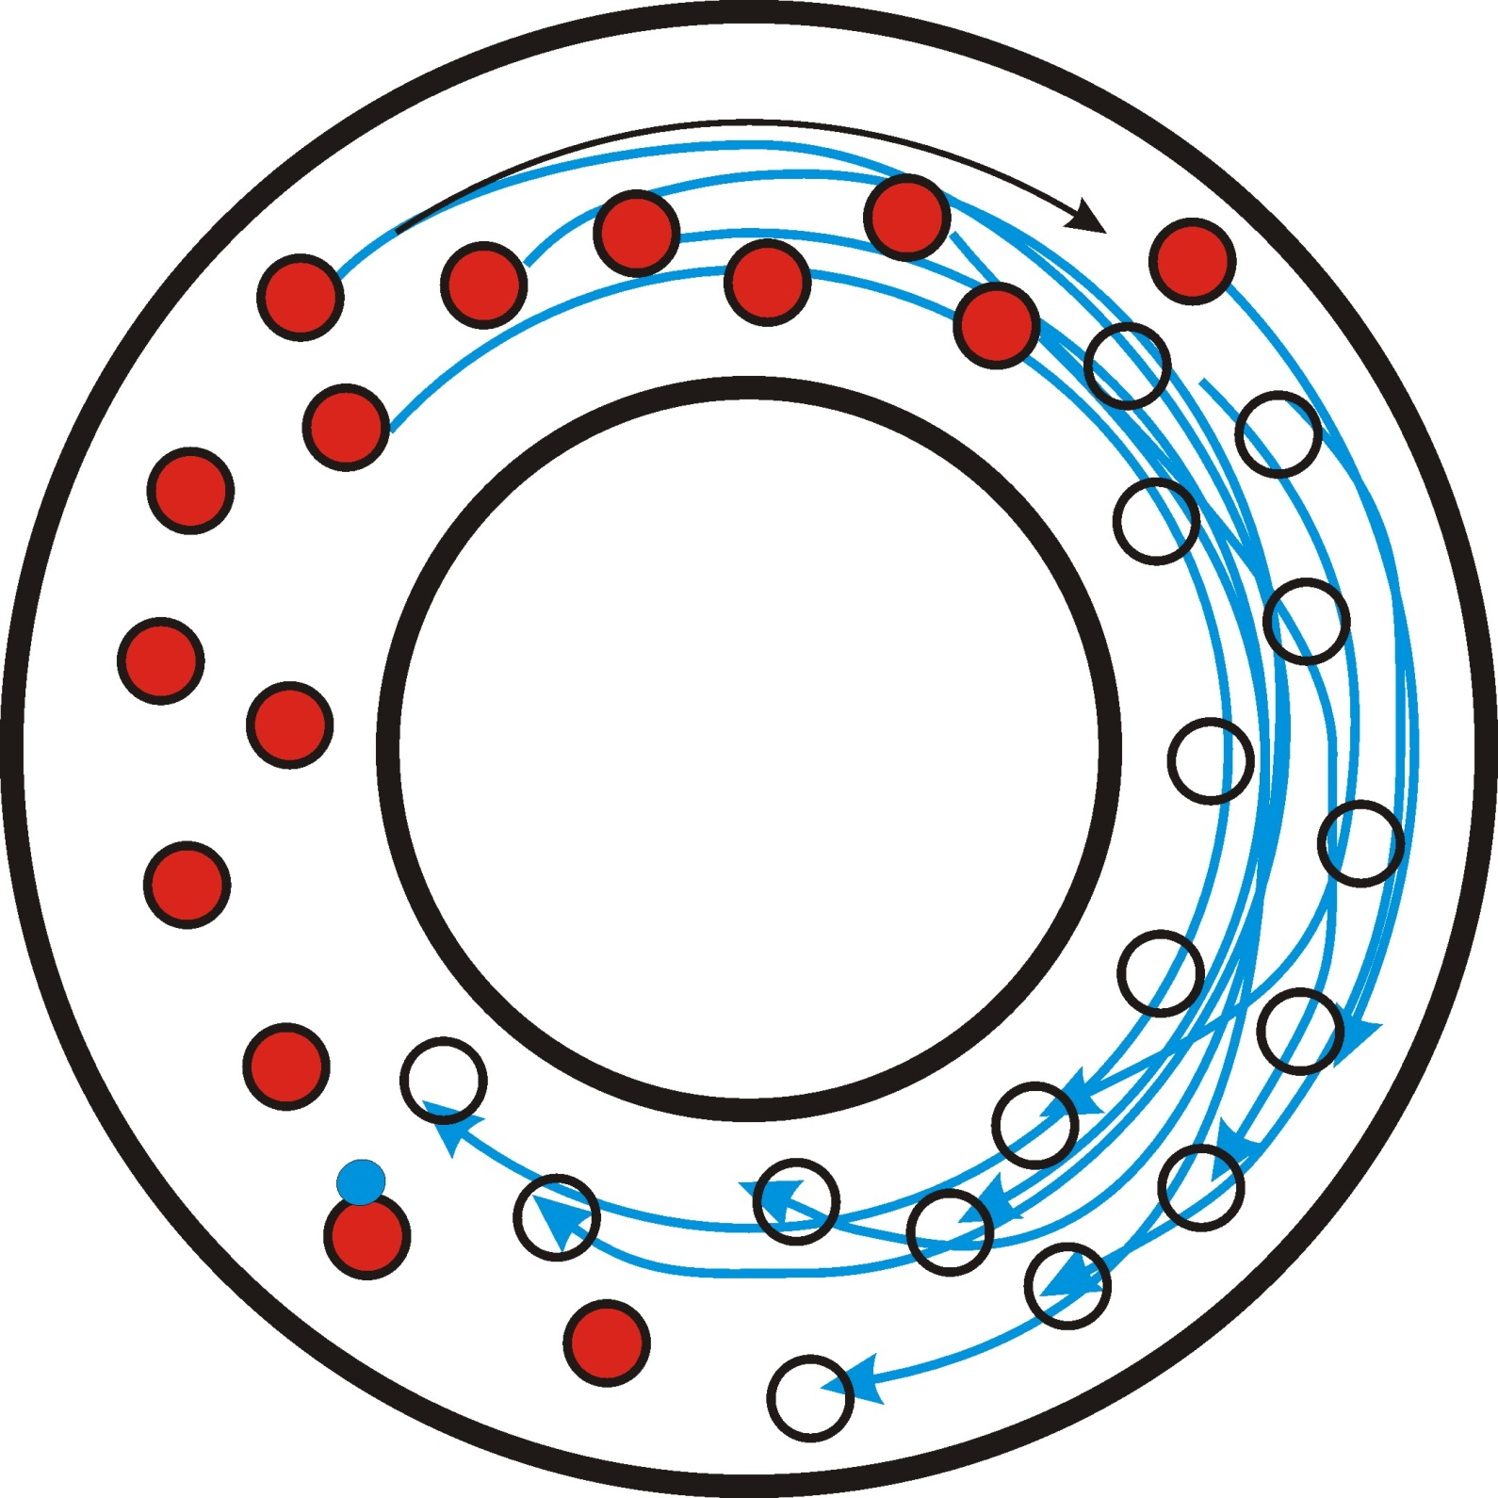
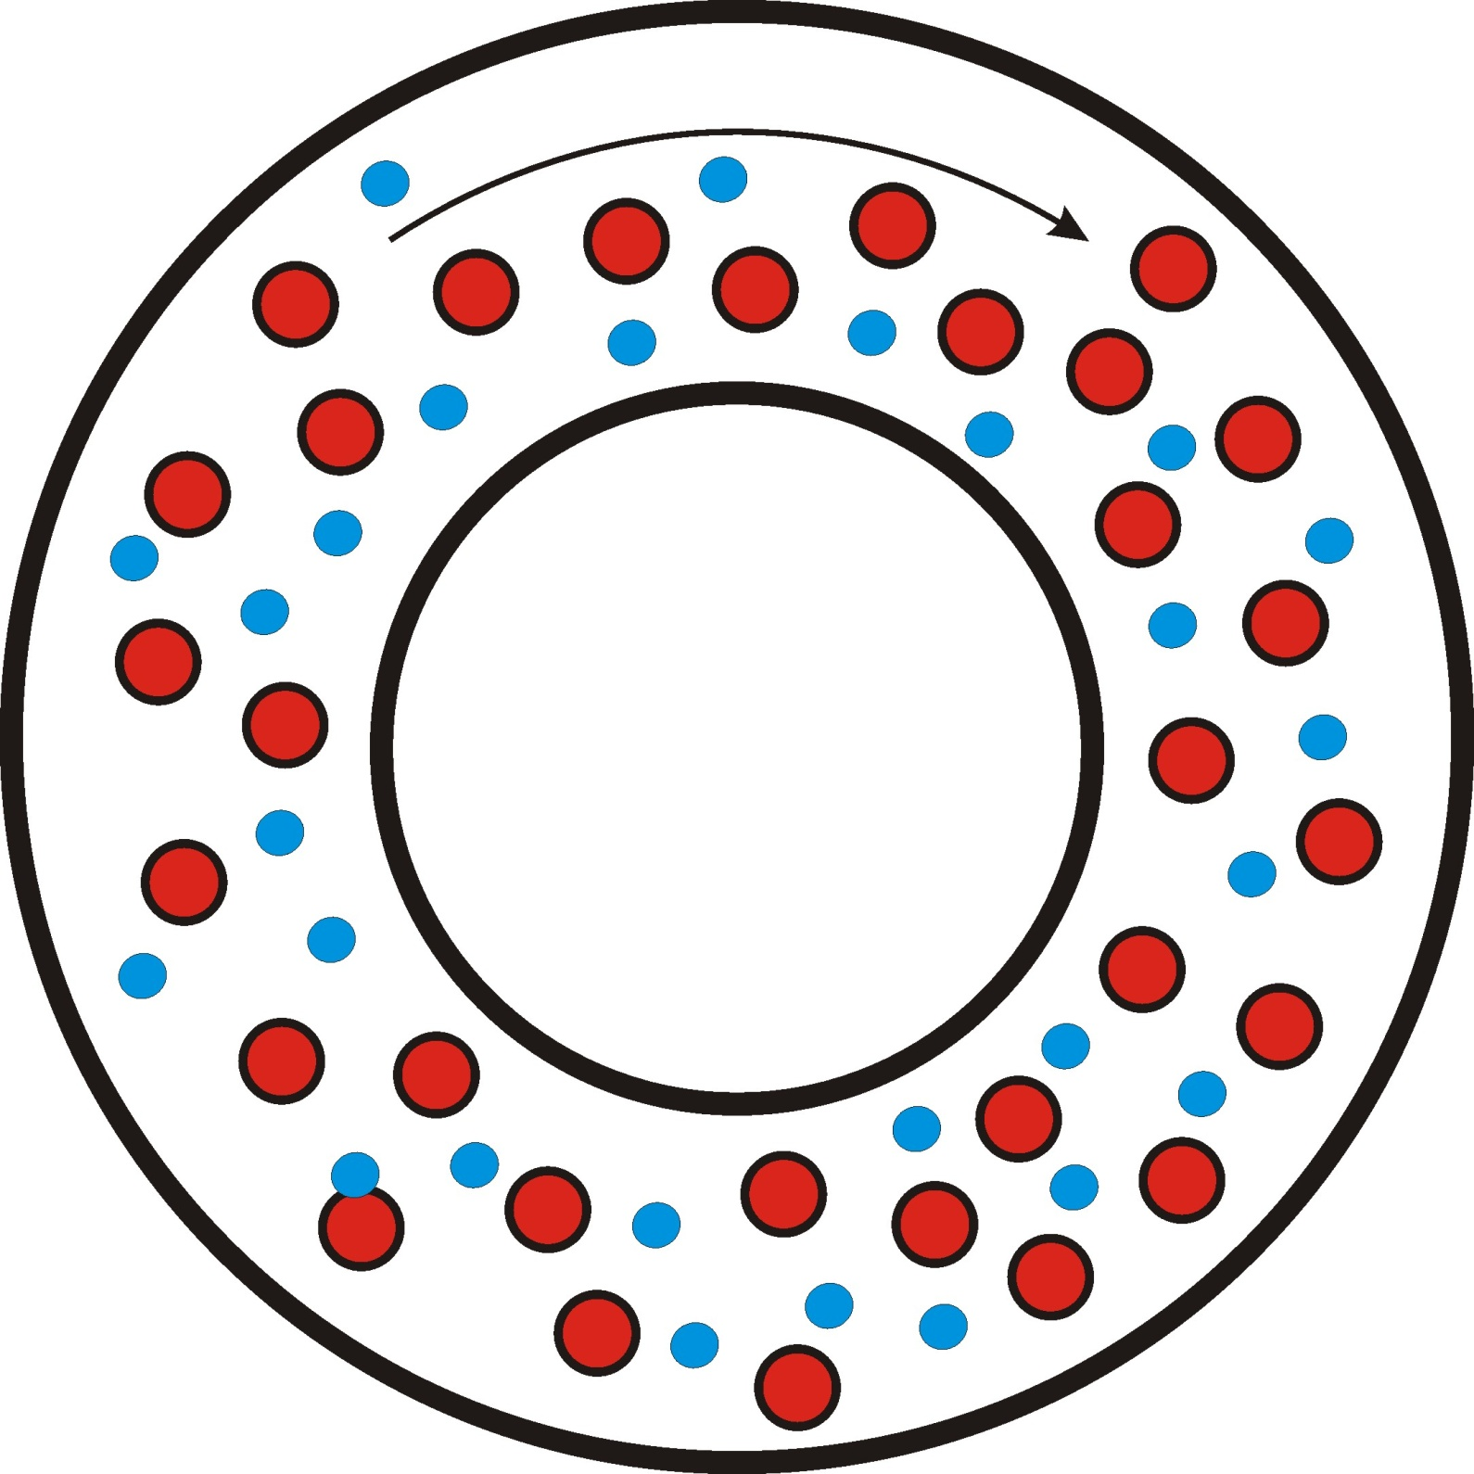
TOP view of
the tokamak
Electron are accelerated in toroidal direction and ionize the working gas
Fully ionized plasma fills the vessel (in 0.1-10 ms – depending on the size of tokamak)
Density of charged particles increases exponentially in time
Free electron(s) appear in the vessel

Slide 14
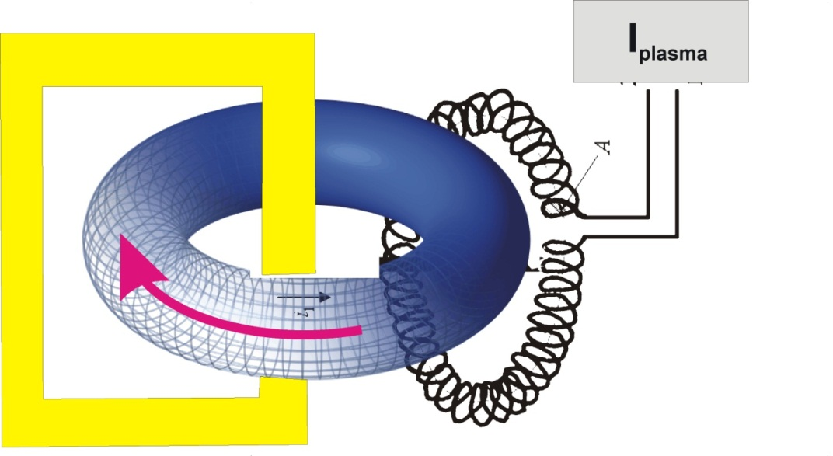
Toroidal current
Toroidal current is measured inductively by means of Rogowski coil
(a toroidal solenoid surrounding the tokamak vessel form outside)
The output signal of the RC has to numerically integrated!
Note: The RC measures the total toroidal current I_{total} = I_{vessel} + I_{plasma}
The vessel current must be subtracted to get plasma current
I_{vessel} = U_{loop}/R_{vessel} R_{vessel} = 10 mOhm
Notes:
14

Slide 15
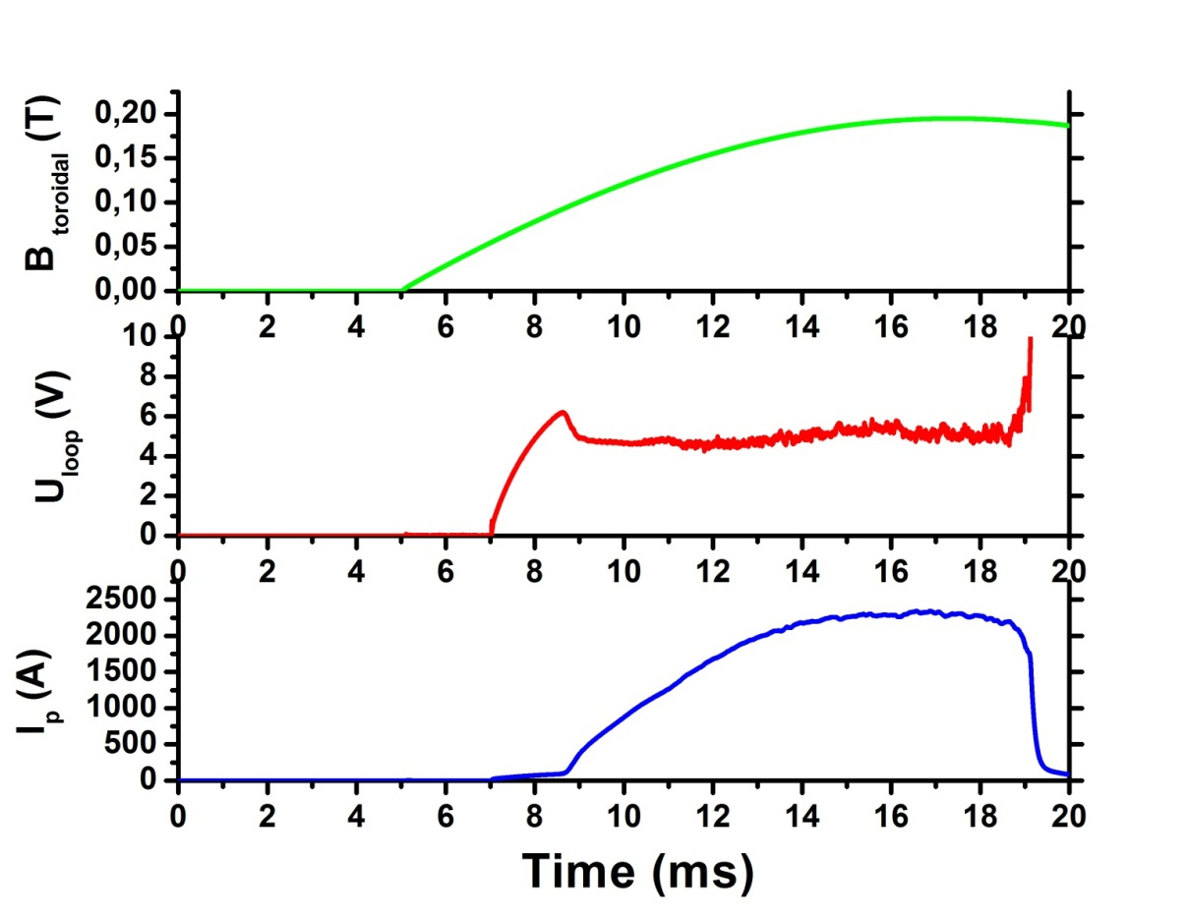
Breakdown of the working gas
Breakdown voltage
U_{breakdown} ~ 6.5 V
E_{tor} ~ !.2 V/m only!!!

Slide 16
Signature of good plasma performance
Steady state phase
U_{loop} ~ constant
I_{plasma} ~ constant
Duration of discharge
- as long as possible!

Slide 17
GOLEM - Basic engineering scheme

Slide 18
To summarize the remote operation
We need only five “buttons” to operate the GOLEM tokamak
We have to select:
Pressure of the working gas
Recommended range 5 – 30 mPa
Preionization of the working gas – ON or OFF
Charging voltage of the condenser bank of the toroidal magnetic field
Recommended range 100 – 1400 V
Charging voltage of the condenser bank to generate the toroidal electric field (current in primary winding)
Recommended range 300 – 1000 V
Time delay between triggers switching the toroidal magnetic field and the toroidal electric field (the loop voltage) –
Recommended range 0 – 10 000 μs

Slide 19
Basic data from GOLEM database available for the workshop
Toroidal magnetic field in Tesla
Total toroidal current (vessel & plasma) in Amps
Plasma current in Amps
Loop voltage in Volts
Visible light emission in a.u.
Time resolved pictures of GOLEM plasma measured by a fast camera (horizontal view)
Spectrum in the visible range of wavelengths
http://golem.fjfi.cvut.cz/shots/0/

Slide 20
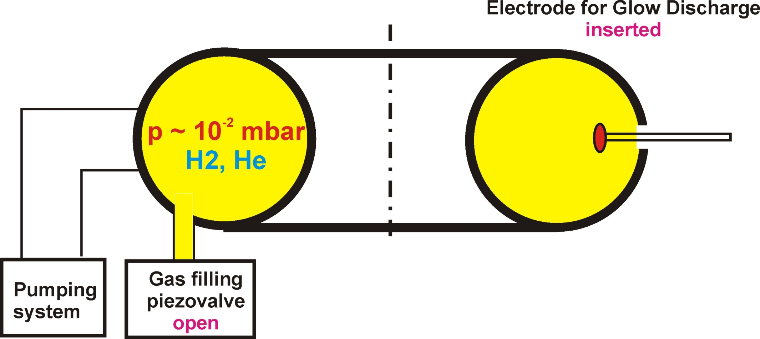
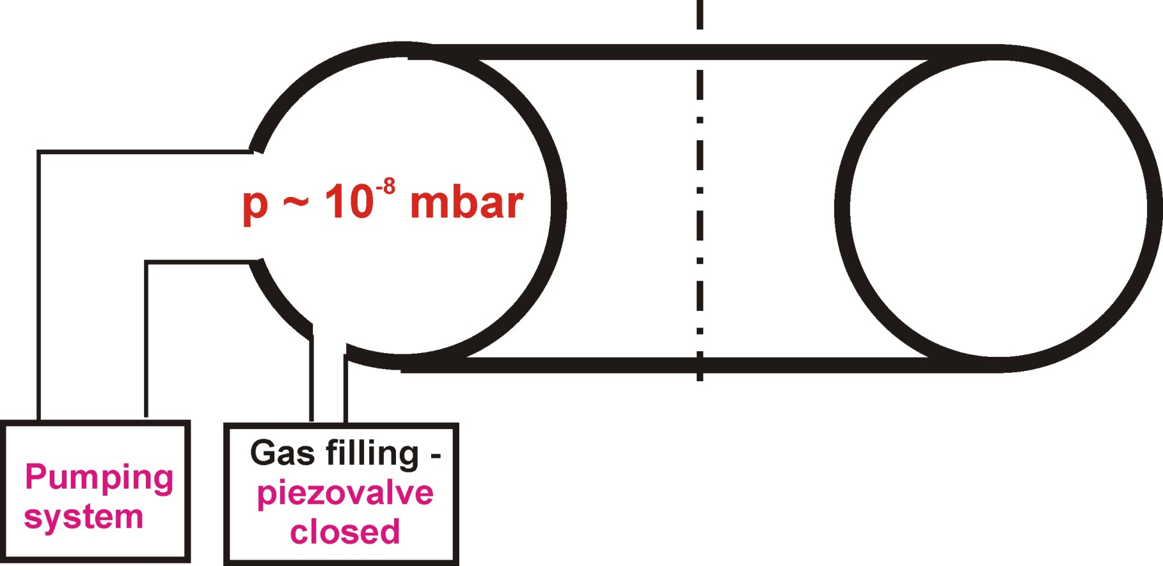
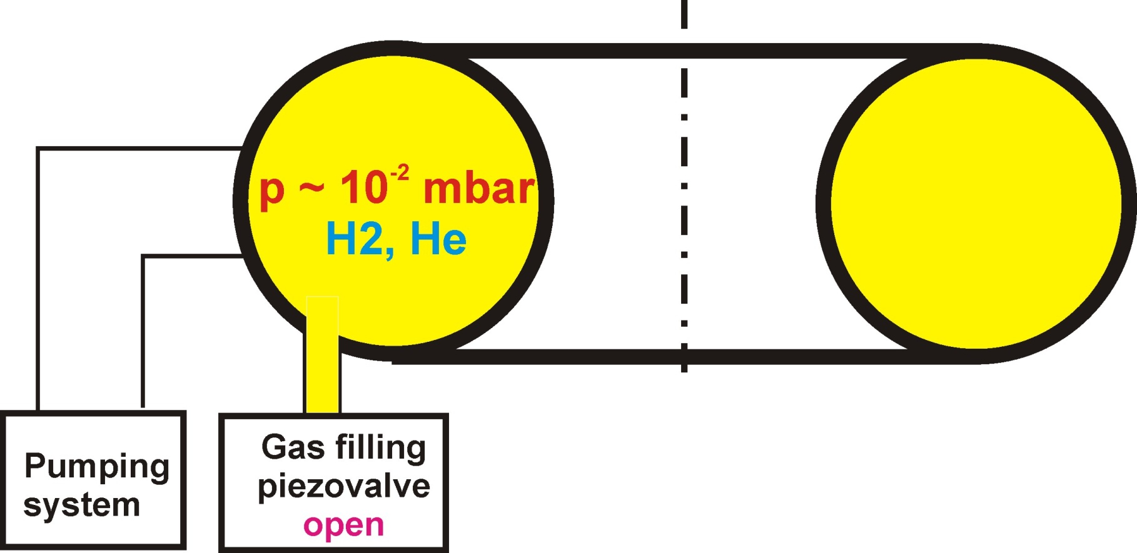
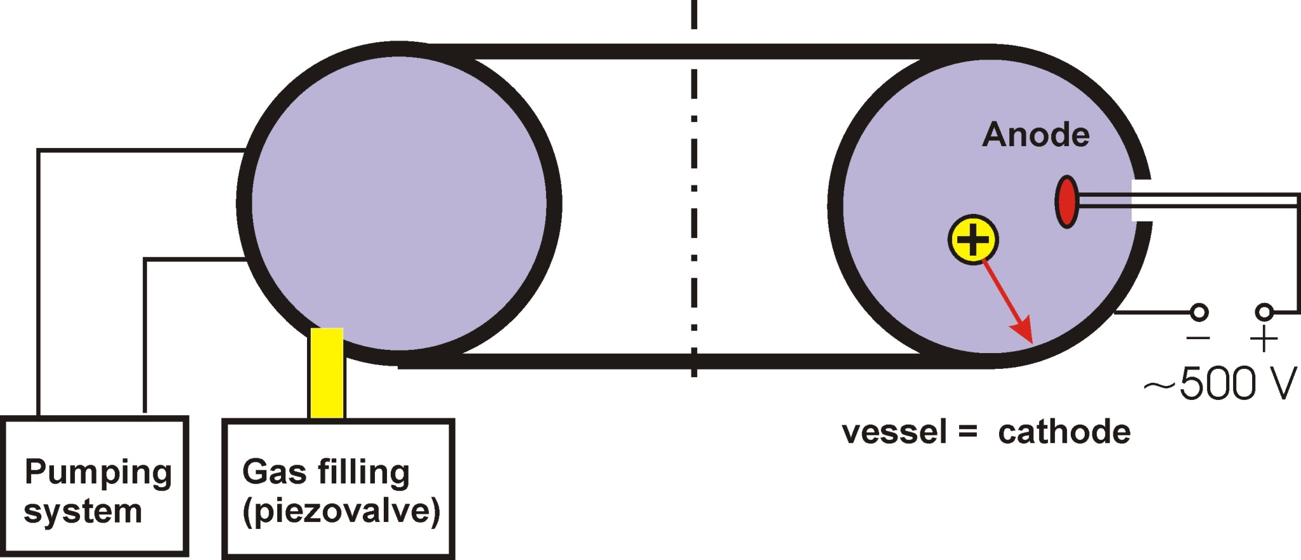
Impact of glow discharge cleaning of the tokamak vessel
Inductive heating of the vessel to 150 - 250º C (after opening the vessel to
atmospheric pressure
Glow discharge cleaning
Vessel is filled by Hydrogen or Helium gas (~ 1 Pa), electrode (anode) is inserted to the vessel and biased to positive voltage (~ +1000 V) with respect to the vessel.
Flux of positive ions desorbs molecules of residual gas from the inner wall of the vessel (cathode).
Continuous pumping during the GDC
Notes:
20

Slide 21
Organization of the workshop
Participants are divided in several experimental groups
Each experimental group is asked to bring at least one PC with internet connection
PC should be equipped with a software to process experimental data from GOLEM database (EXCEL, ORIGIN, …….), to plot figures, ….
Each group is supervised by my fiends – experts in tokamak research from the COMPASS team
Renaud Dejarnac
Miglena Dimitrova

Slide 22
Outputs of the workshop
Workshop will be competitive:
GOAL: To achieve best plasma performance on the GOLEM tokamak
Lowest loop voltage at the breakdown
Highest plasma current
Longest discharge
Active participation is highly required!!!!!
Winners of the competition will be announced to public at the conference banquet
The best experimentalist will be selected by the steering committee and awarded by a prize at the banquet
Registered students are cordially invited to assemble here at 16:00
Others are welcome!

Slide 23
Prague GOLEM
The word golem is used in the Bible to refer to an embryonic or incomplete substance
Similarly, golem is often used today in metaphor as
an entity serving man under controlled conditions but hostile to him in others.
Prague GOLEM was created by Rabbi Loew, who is buried at Jewish cemetery,
Just 50 meters from the Faculty of Nuclear Physics and Physical Engineering

Slide 24
Advanced data processing - 1:
Derive electron temperature
Measured loop voltage has resistive and inductive component
The inductance of
the plasma ring
on GOLEM is
The inductive component can be neglected, if the loop voltage is measured,
when the plasma current is maximum =>
The (Maxwellian) plasma resistivity is linked to the electron temperature.
A rough estimate for GOLEM

Slide 25
Advanced data processing - 2
Derive the safety factor at the plasma edge
Extremely important quantity, which characterize stability of the plasma ring
It denotes the number of turns a magnetic field line goes
around a torus toroidally to finalize a single poloidal turn
Poloidal magnetic field is a function of the plasma current
=>
In practical units

