Slide 1
Tokamak GOLEM
Work of Vojtech Svoboda and a team of CTU Prague students presented by Ondrej Kudlacek

Slide 2
Content
I. Introduction- basics of Golem
II. Engineering scheme
III. Aviable diagnostics
IV. Other activities

Slide 3
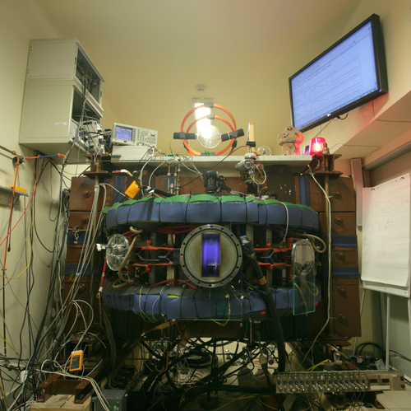
I. Golem basics
Small size tokamak:
R = 0.4 m
a = 0.085 m
B_{T} < 0.5 T
I_{P}< 8 kA
Discharge length < 20 ms
Density 0.2-3∙10¹⁹
T_{e}< 100 eV
Oldest operating tokamak
in the world

Slide 4
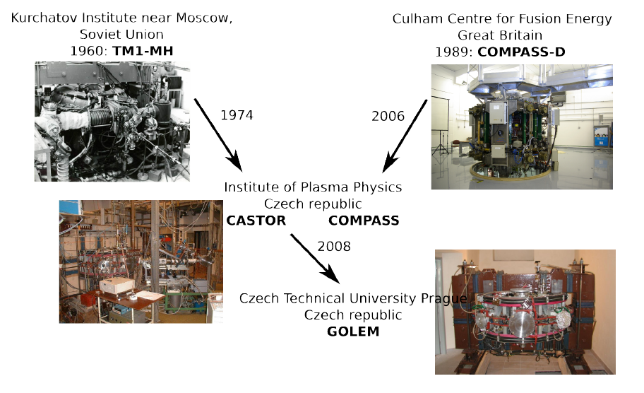
Historical overview

Slide 5
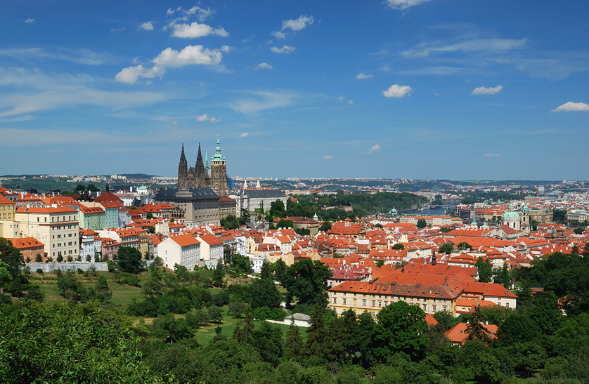
Golem site
Prague castle
Tokamak
Golem
Old town

Slide 6
Name origin

Slide 7
II. Golem systems

Slide 8
Basic tasks
Evacuate the chamber + fill working gas before the discharge
Toroidal magnetic field generation
Poloidal electric field generation- plasma current drive

Slide 9
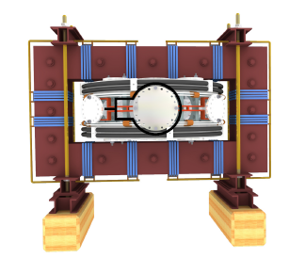
Golem- the machine

Slide 10
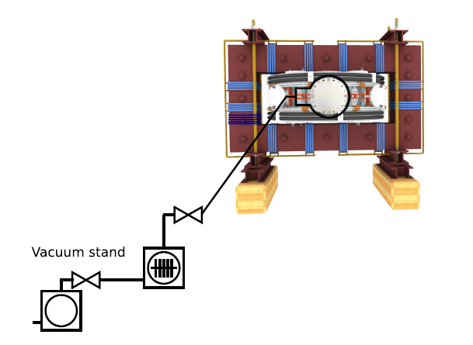
Vacuum system- 1 mPa

Slide 11
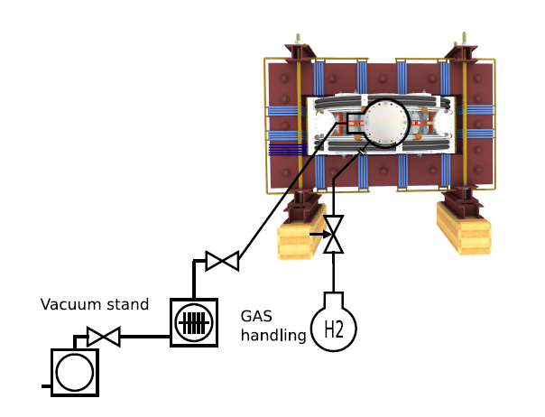
Gas filling (H₂ or He)

Slide 12
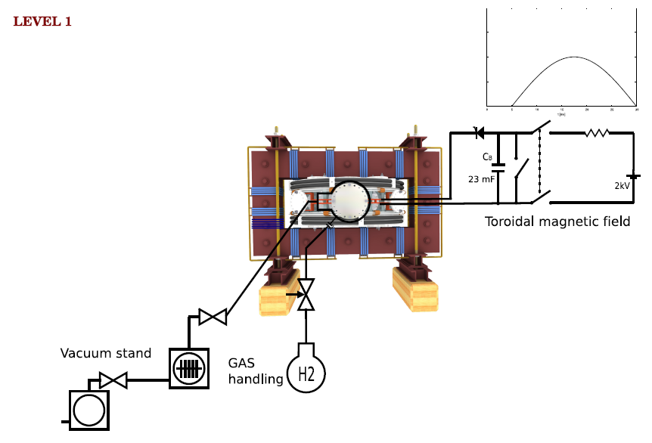
Toroidal magnetic field

Slide 13
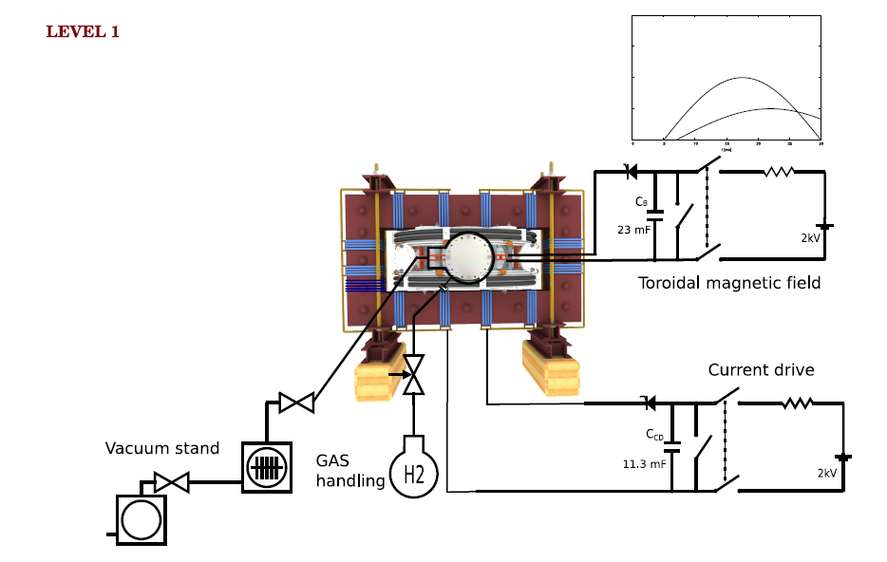
Current drive

Slide 14
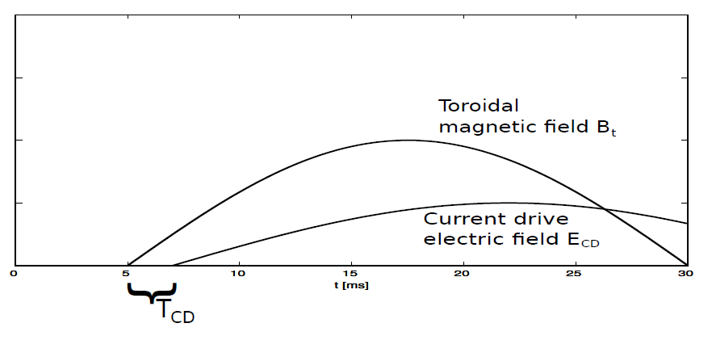
Triggering sequence

Slide 15
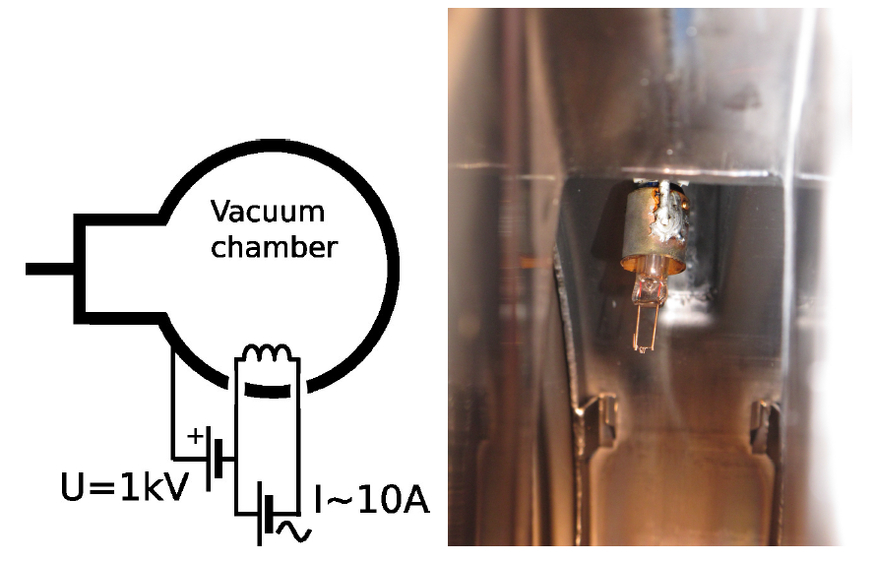
Preionization

Slide 16
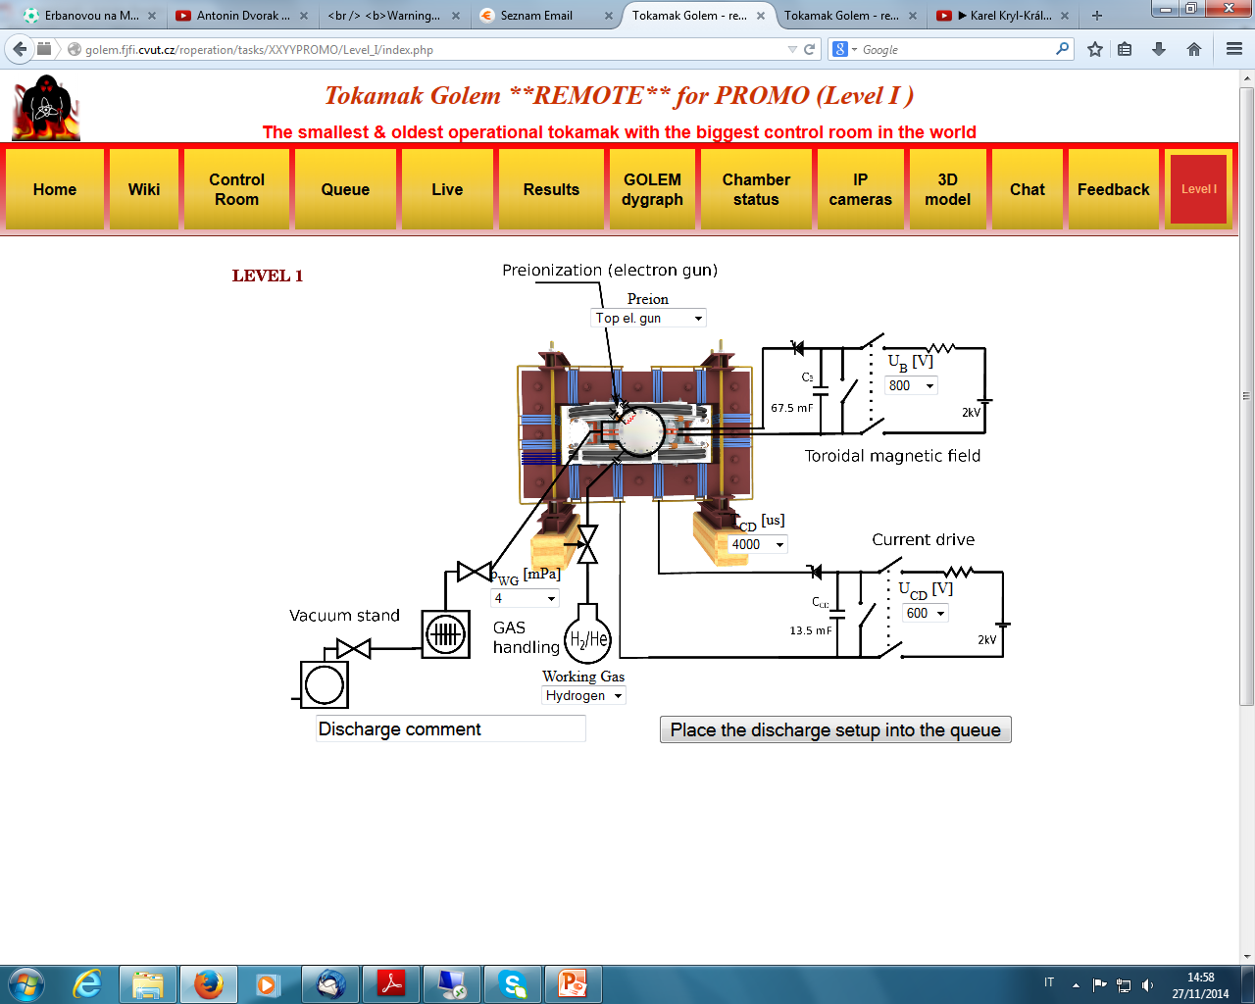
Control Room

Slide 17
Golem view

Slide 18
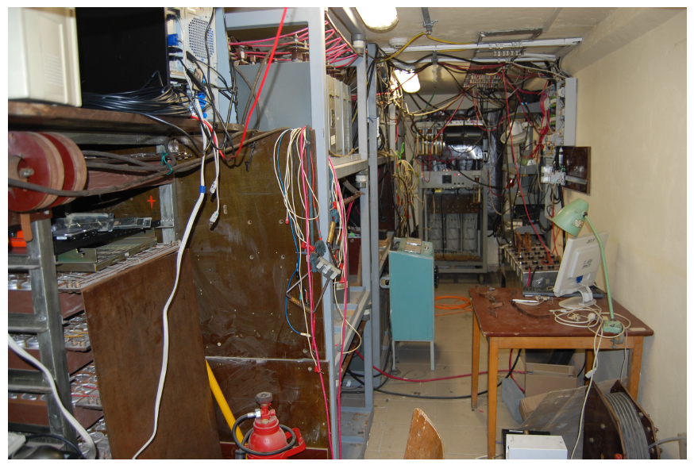
Infrastructure room

Slide 19
III. Basic diagnostics
Loop voltage- wire around tokamak
Toroidal magnetic field- pick-up coil
Plasma current- Rogowski coil
Visible and H_{α} radiation
More details during the experiments…

Slide 20
Vacuum vs. plasma shot

Slide 21
Data access
All experimental data can be accessed remotely
Software: Python, Matlab, IDL, Excel…

Slide 22
IV. Other activities

Slide 23
Gomtraic
A remote school of tokamak operation
Duration-3 months, a few remote experimental sessions during this period
Open for all students around the world
Tasks: breakdown studies, plasma position studies, electron temperature estimate, first wall conditioning…
No participation fee
Webpage: https://sites.google.com/site/gomtraic/home

Slide 24
Sumtraic
An experimental training course in Prague (usually in August/September)
2 weeks of experimental activity on COMPASS/Golem
Tasks: magnetic measurements, probe diagnostics, microwave measurement, optical diagnostics
Webpage: http://www.ipp.cas.cz/Tokamak/conf/SUMTRAIC2014

Slide 25
Remote laboratory session
Can be a part of summer school, course in plasma physics etc…
Tokamak operation demonstration
Simple (or more complicated) tasks can be prepared for training
Contact: svoboda@fjfi.cvut.cz

Slide 26
Acknowledgements
The Golem team: Vojtech Svoboda, Edita Bromova, Vladimir Fuchs, Ondrej Grover, Igor Jex, Jindrich Kocman, Jaroslav Krbec, Borek Leitl, Tomas Markovic, Lukas Matena, Michal Odstrcil, Tomas Odstrcil, Ondrej Pluhar, Gergo Pokol, Jan Stockel, Tereza Ruzickova, Gabriel Vondrasek, Ondrej Vrba, Frantisek Zacek and Jiri Zara.

