Slide 1
Magnetic probe analysis
Group # 2: Ivan Kudashev, Ruslan Begishev, Ivan emekeev, Vladimir Kulagin

Slide 2
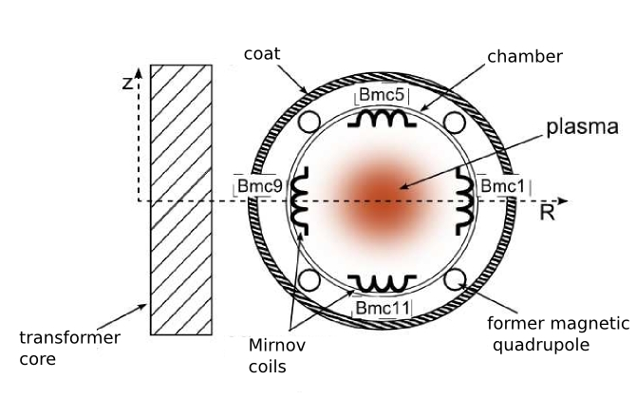
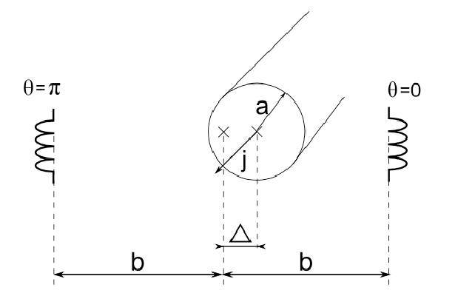
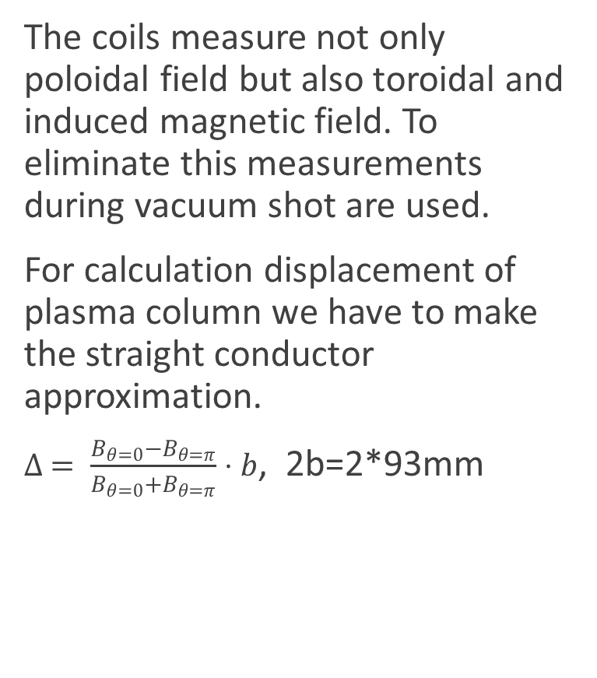

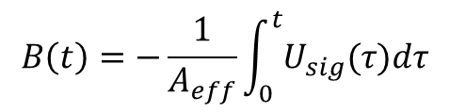
Introduction
The coils measure not only poloidal field but also toroidal and induced magnetic field. To eliminate this measurements during vacuum shot are used.
For calculation displacement of plasma column we have to make the straight conductor approximation.
$∆ = \frac{B_{θ=0}−B_{θ=π}}{B_{θ=0}+B_{θ=π}}⋅b$, 2b=2*93mm
Figure 1: Locations of Mirnov coils
$$B\left(t\right)=−\frac{1}{A_{eff}}\int_{0}^{t}{U_{sig}(τ)dτ}$$
$A_{eff}=3, 8 ⋅{10}^{−3}m$.

Slide 3
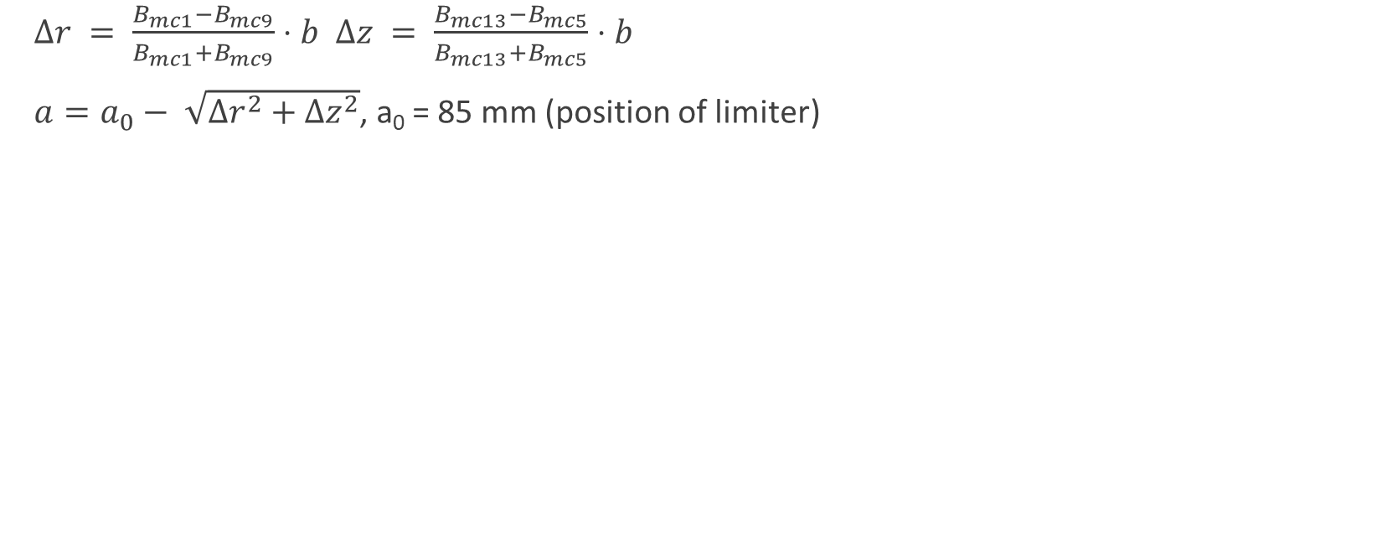
Introduction
$∆r = \frac{B_{mc1}−B_{mc9}}{B_{mc1}+B_{mc9}}⋅b$ $∆z = \frac{B_{mc13}−B_{mc5}}{B_{mc13}+B_{mc5}}⋅b$
$a=a_{0}− \sqrt{∆r^{2}+∆z^{2}}$, a₀ = 85 mm (position of limiter)

Slide 4
Hydrogen (1st week shots)

Slide 5
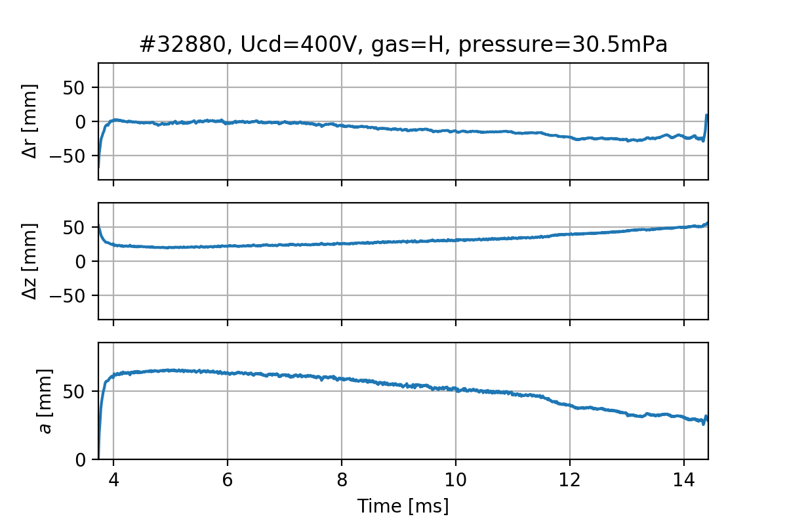
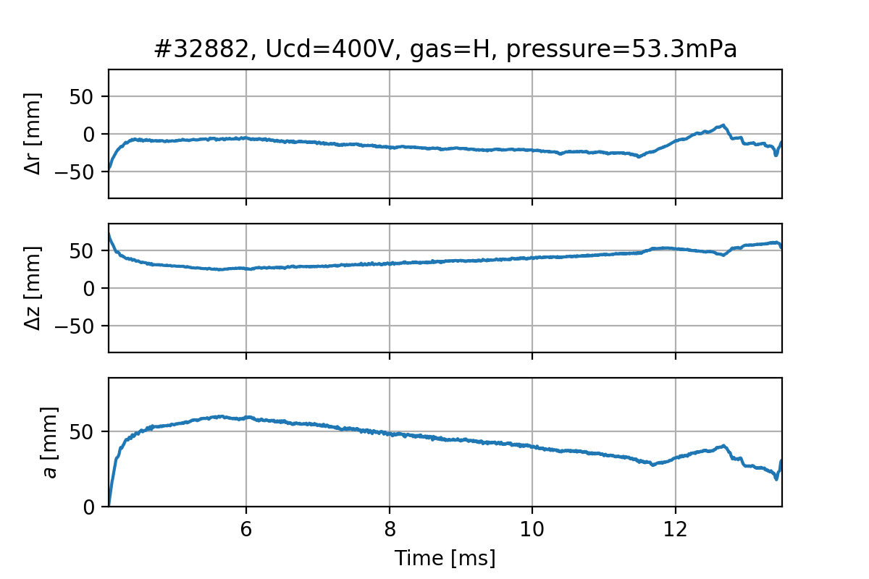
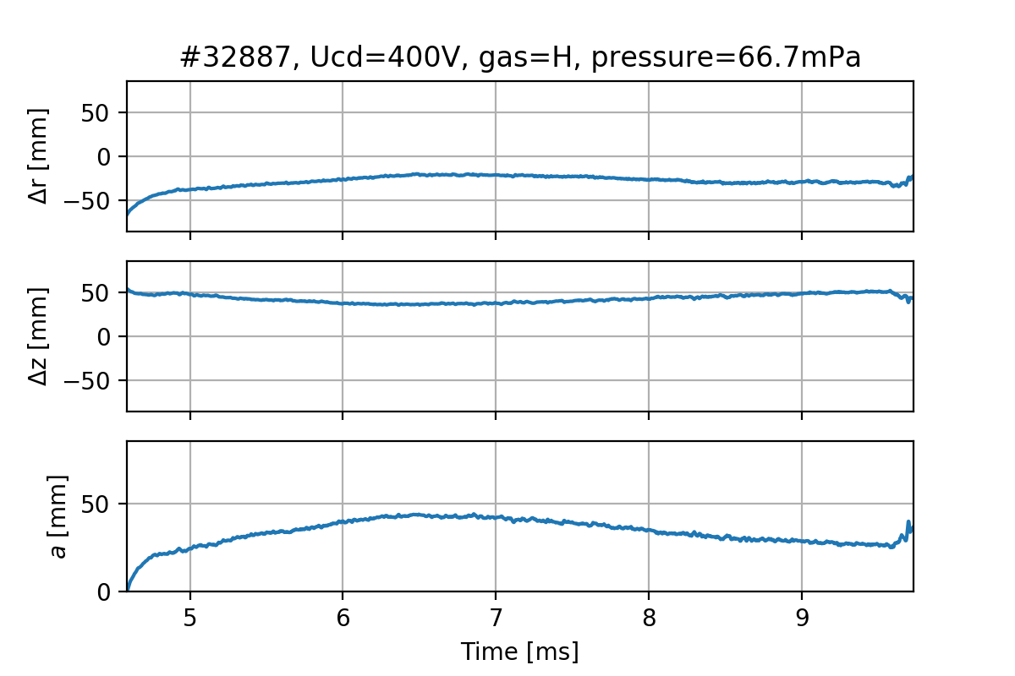
Fast scan over pressure

Slide 6
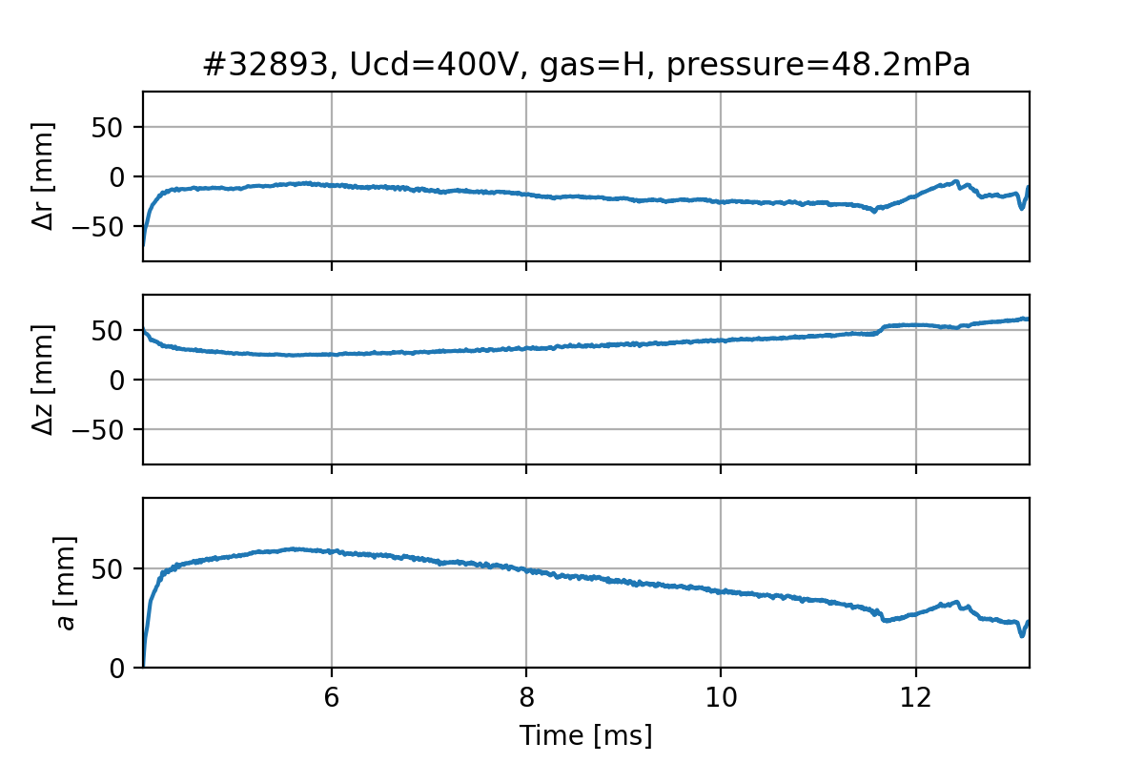
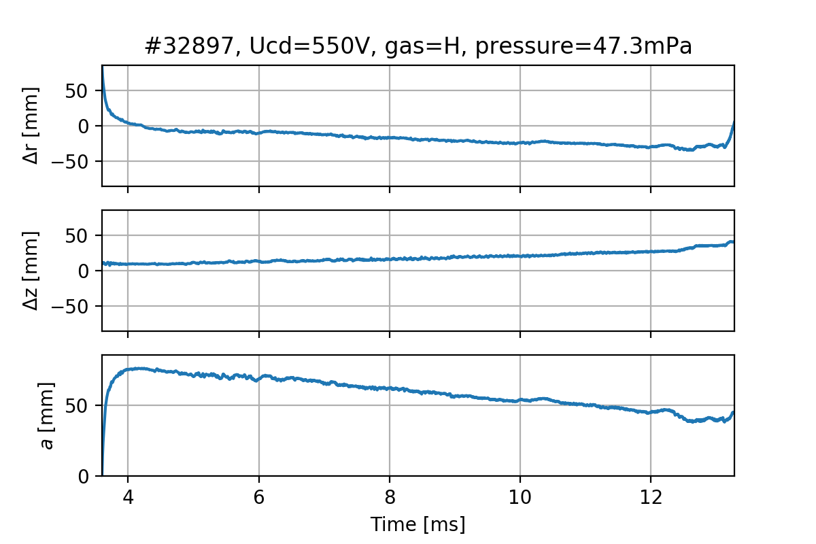
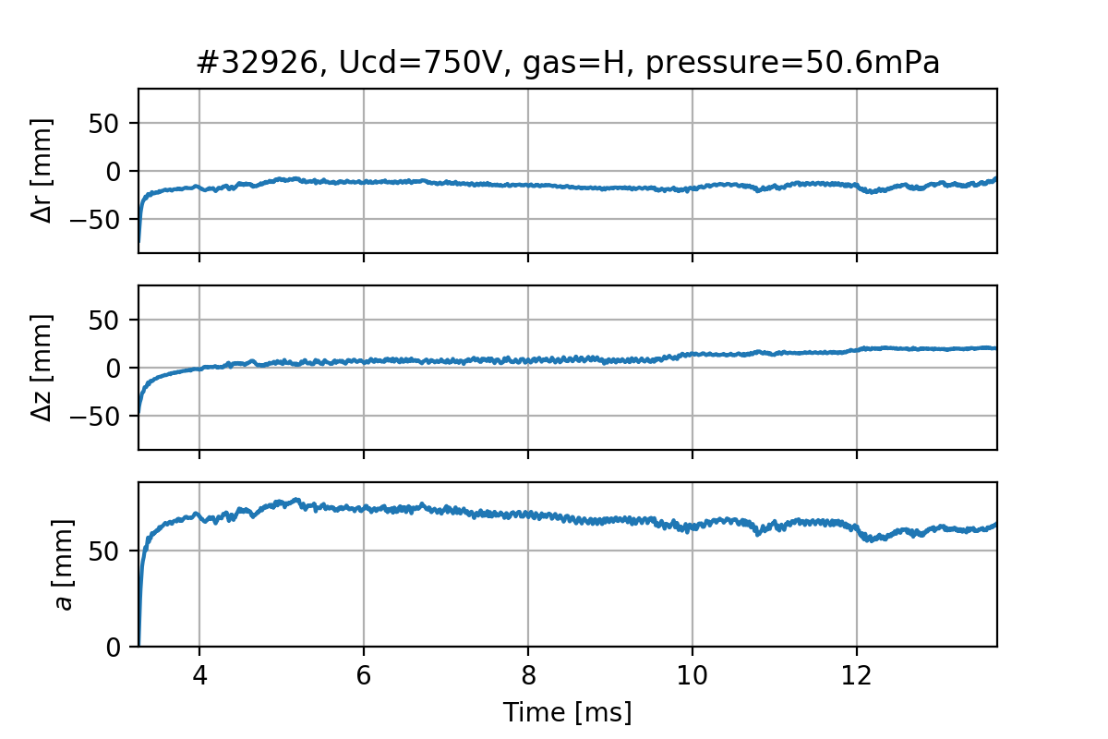
Fast scan over U_{cd}

Slide 7
Helium

Slide 8
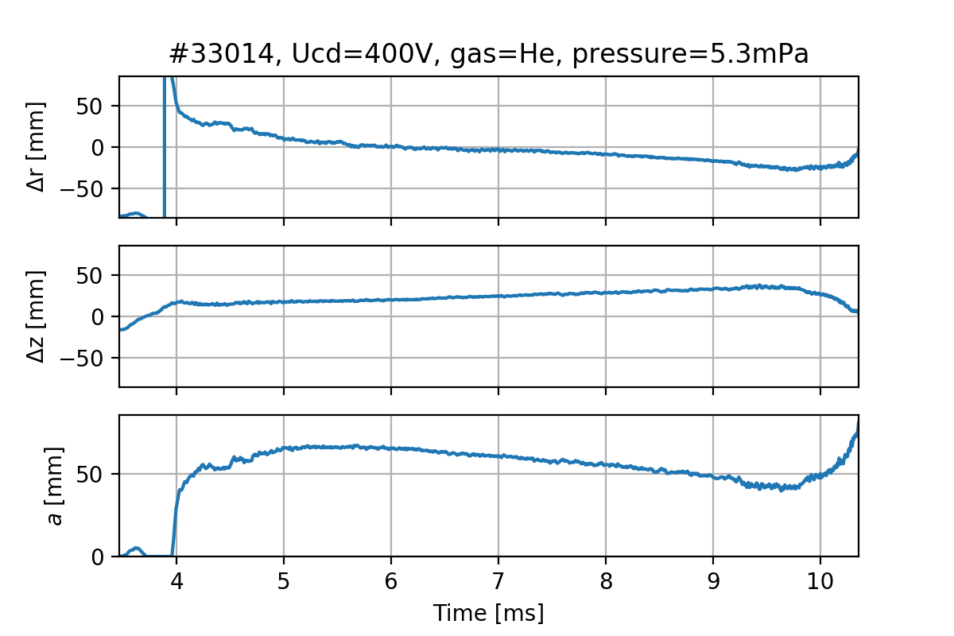
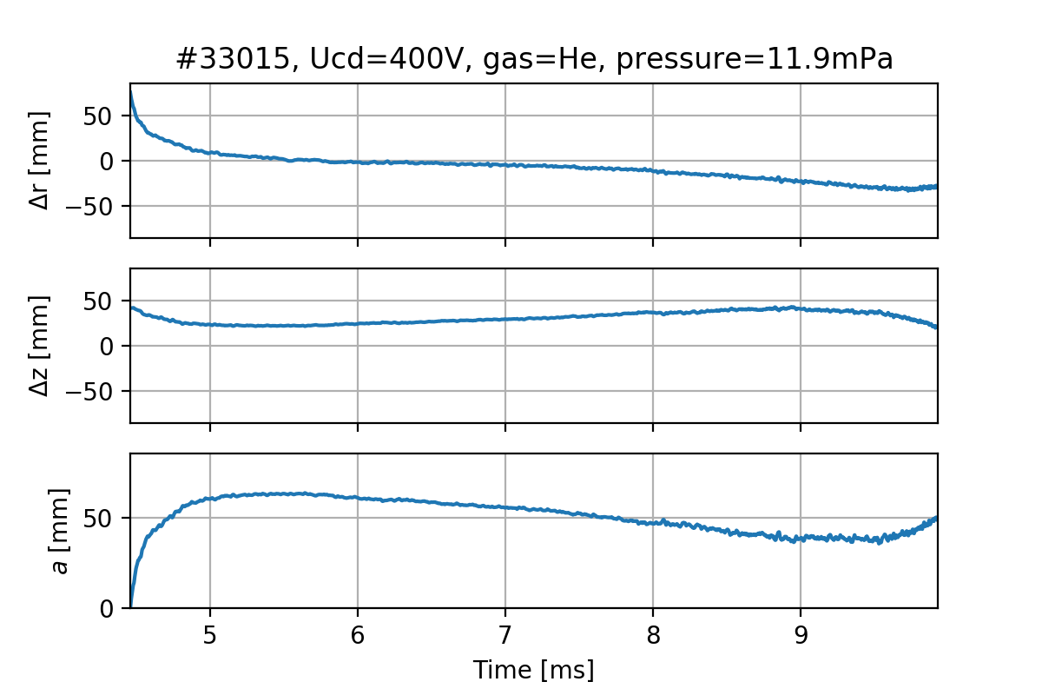
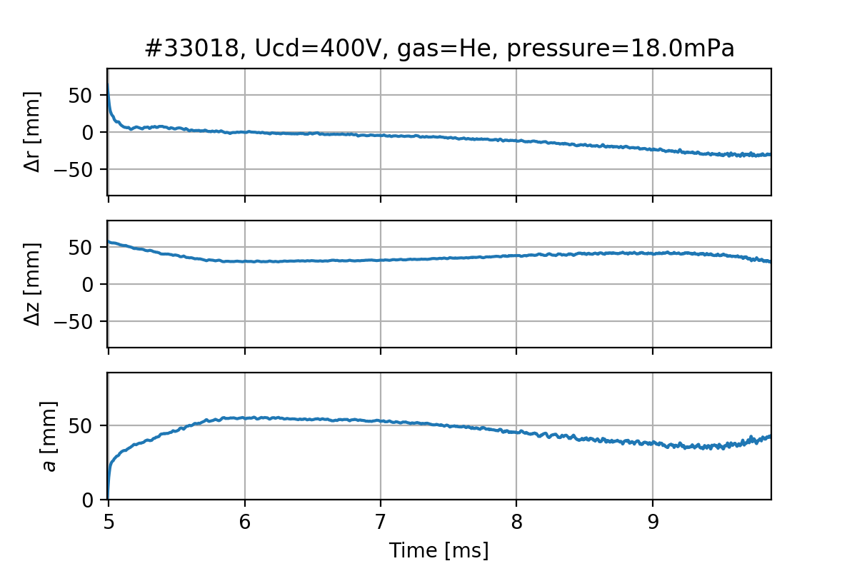
Fast scan over pressure

Slide 9
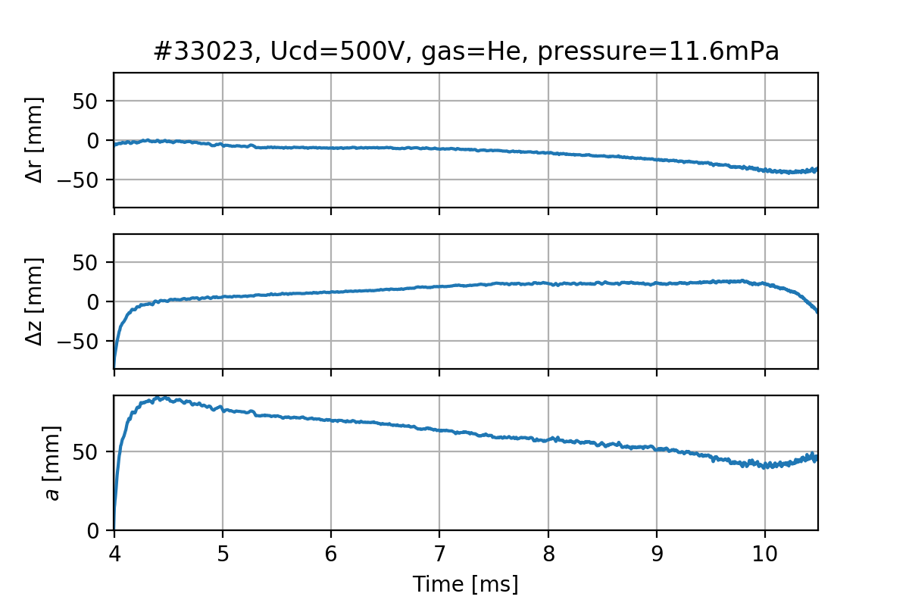
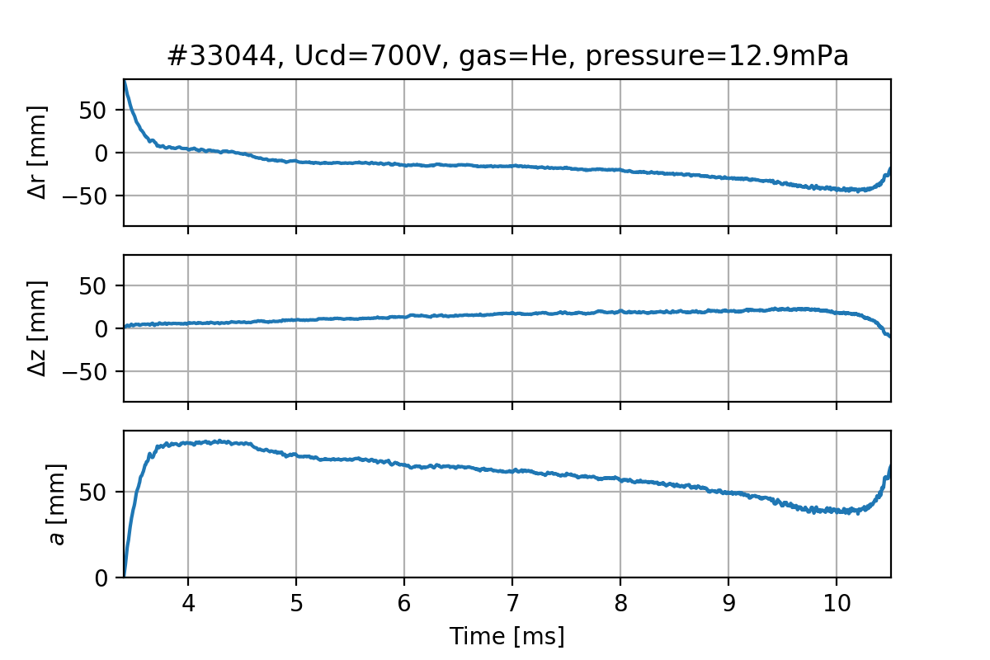
Fast scan over U_{cd}

Slide 10
Hydrogen (2nd week shots)

Slide 11
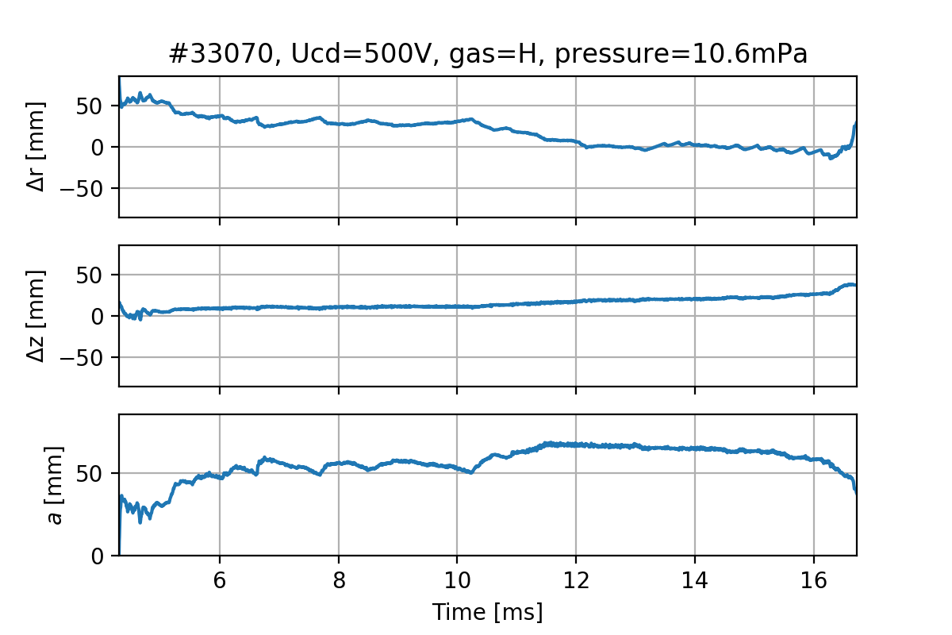
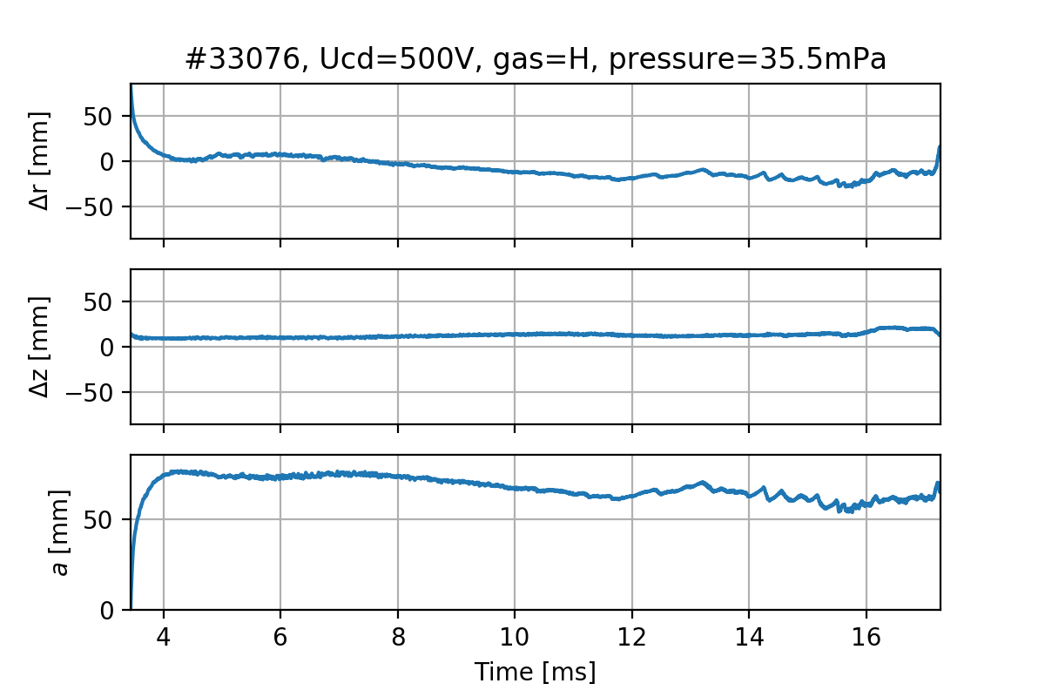
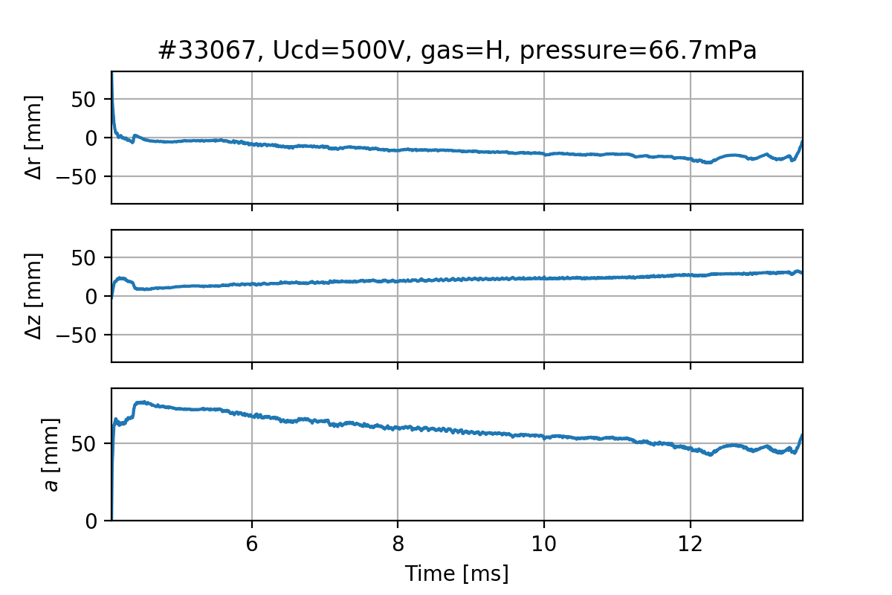
Fast scan over pressure

Slide 12
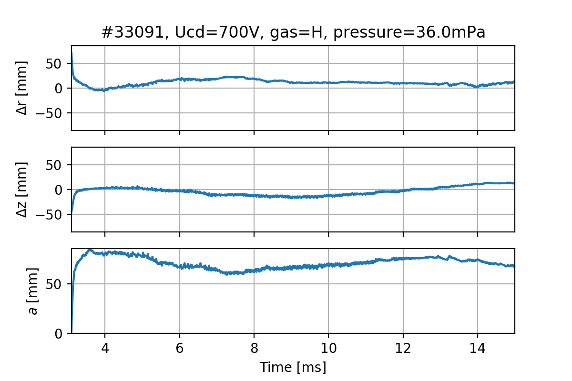
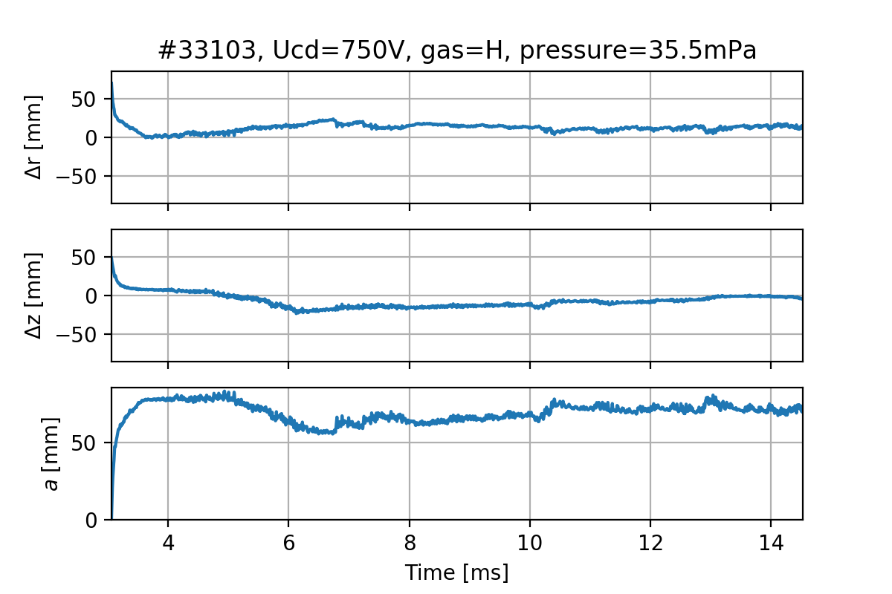
Fast scan over U_{cd}

Slide 13
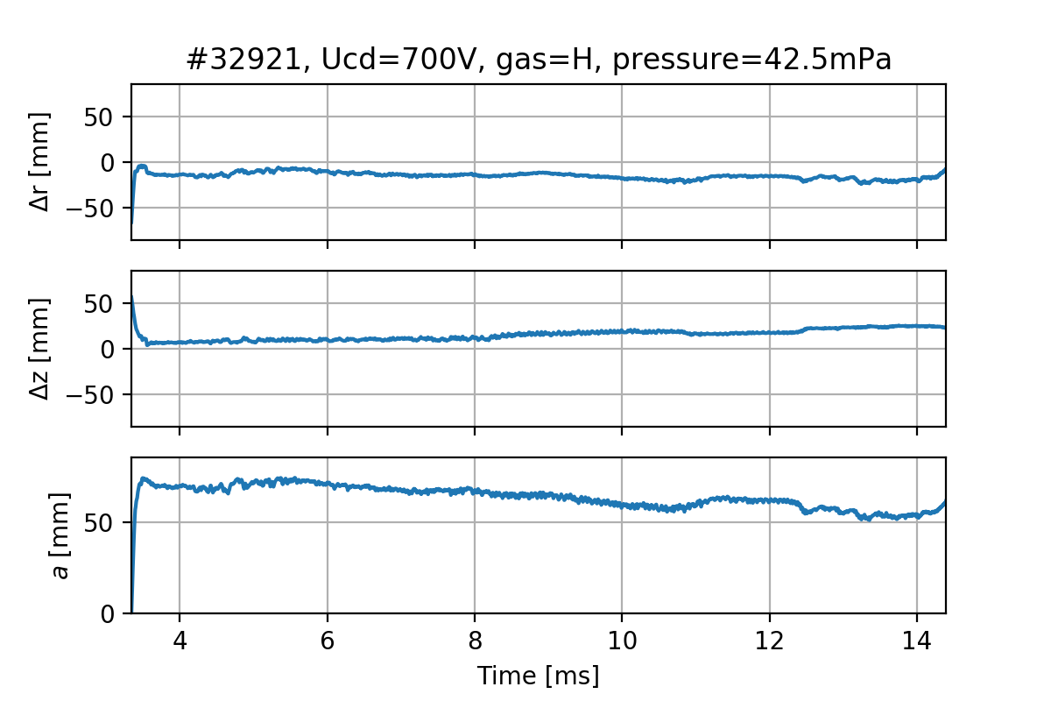
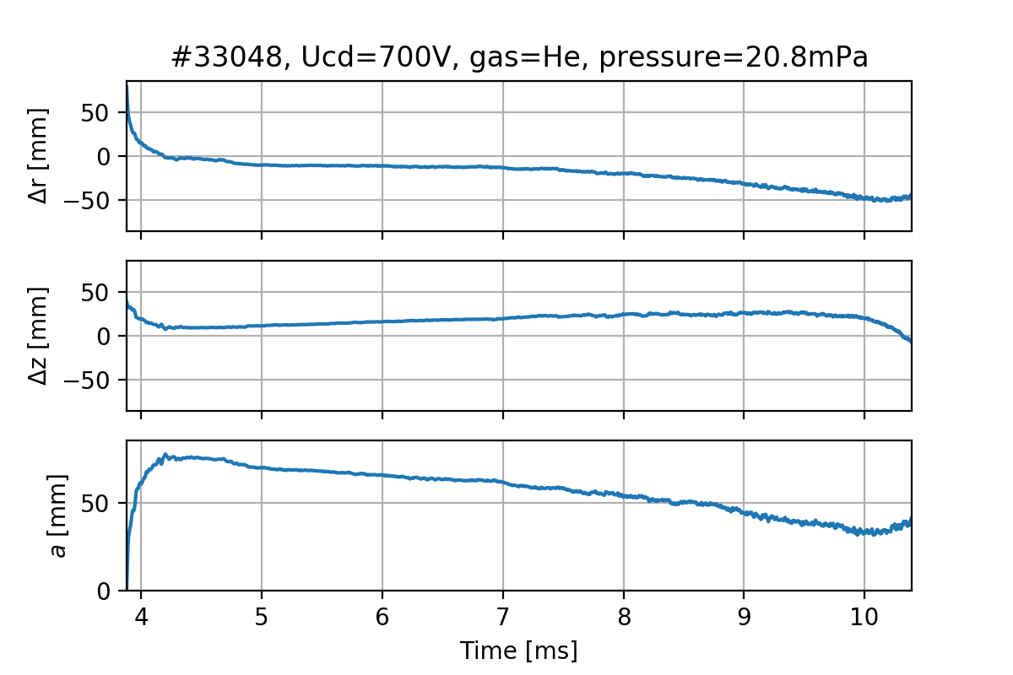
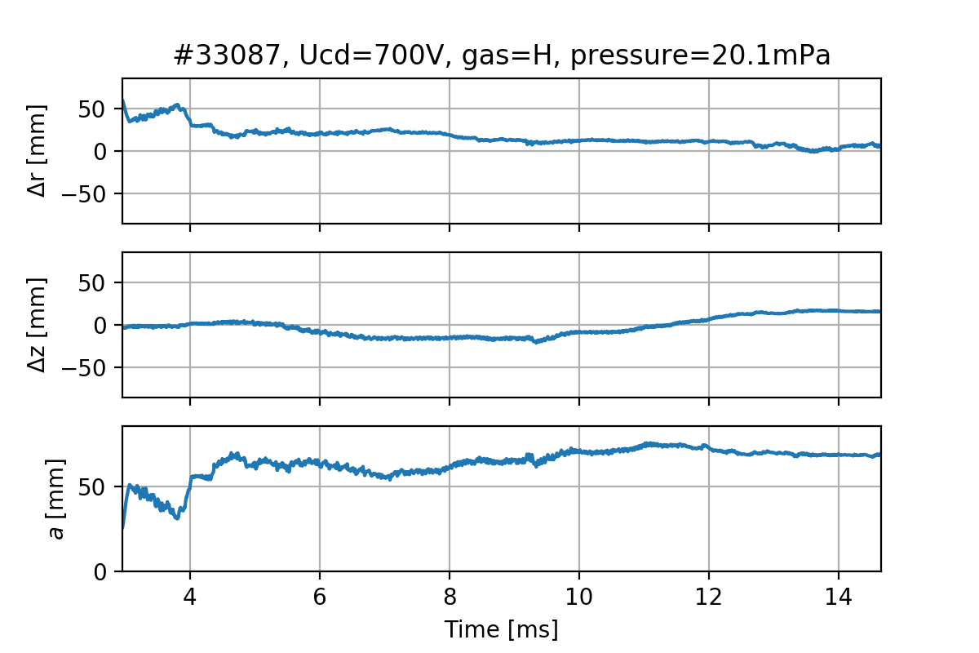
Scan over sets

Slide 14
Conclusion
Database consisting time dependencies and graphs of plasma column position was made
It was mentioned that during 2nd week hydrogen shots plasma column was placed more outwards
Also some dependencies on U_{cd} and pressure were seen
But they are unclear, so we decided to make scan over mean values of plasma position parameters.

