Slide 1
Magnetic probe analysis
Group # 2:
Leader: Ivan Kudashev
Members: Vladimir Kulagin, Ruslan Begishev, Ivan EMEkeev

Slide 2
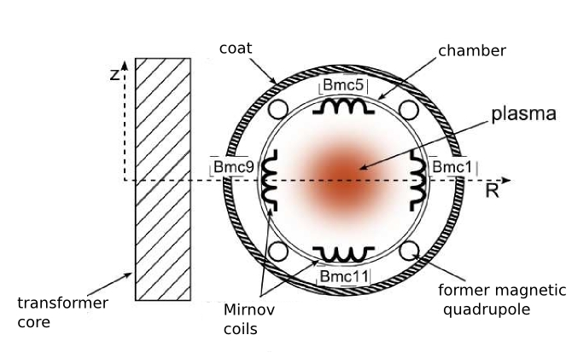
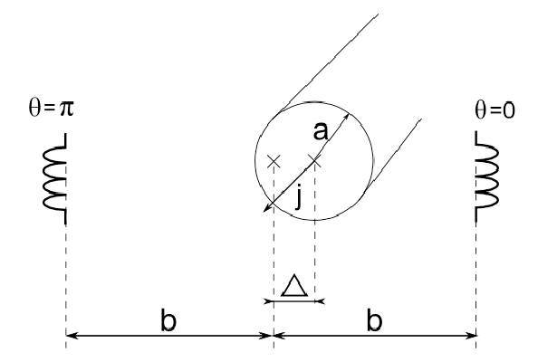
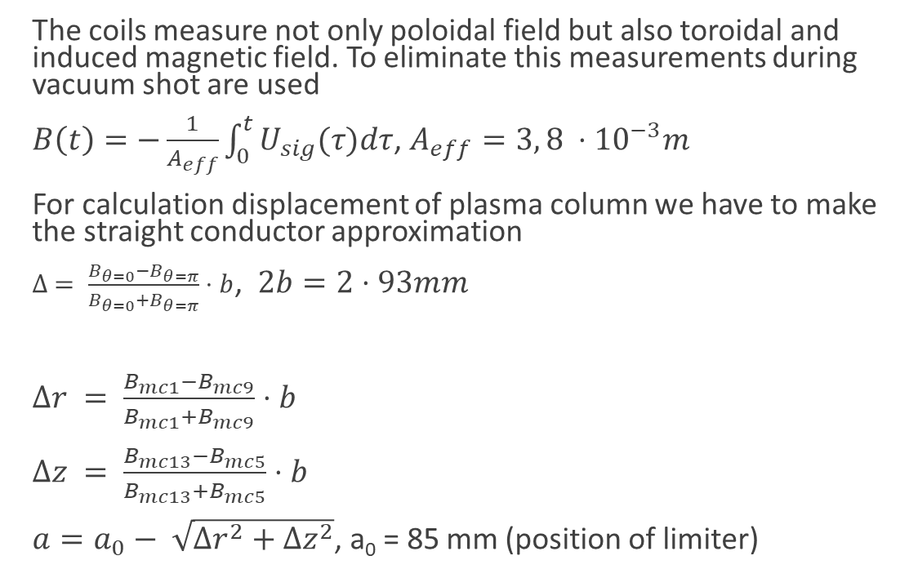
Introduction. Measurements
The coils measure not only poloidal field but also toroidal and induced magnetic field. To eliminate this measurements during vacuum shot are used
$B\left(t\right)=−\frac{1}{A_{eff}}\int_{0}^{t}{U_{sig}(τ)dτ}$, $A_{eff}=3, 8 ⋅{10}^{−3}m$
For calculation displacement of plasma column we have to make the straight conductor approximation
$∆ = \frac{B_{θ=0}−B_{θ=π}}{B_{θ=0}+B_{θ=π}}⋅b$, $2b=2⋅93mm$
$∆r = \frac{B_{mc1}−B_{mc9}}{B_{mc1}+B_{mc9}}⋅b$
$∆z = \frac{B_{mc13}−B_{mc5}}{B_{mc13}+B_{mc5}}⋅b$
$a=a_{0}− \sqrt{∆r^{2}+∆z^{2}}$, a₀ = 85 mm (position of limiter)
Figure 1: Locations of Mirnov coils

Slide 3
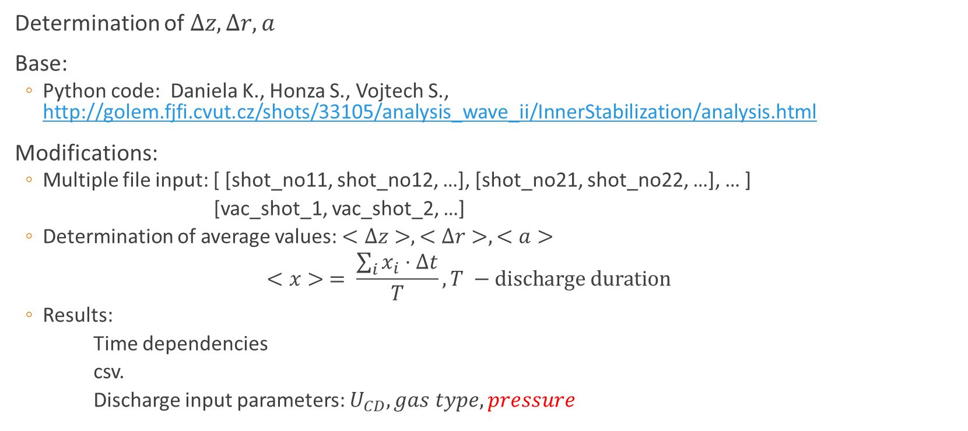
Introduction. Python code modifications
Determination of $∆z, ∆r, a$
Base:
  Python code: Daniela K., Honza S., Vojtech S., http://golem.fjfi.cvut.cz/shots/33105/analysis_wave_ii/InnerStabilization/analysis.html
Modifications:
  Multiple file input: [ [shot_no11, shot_no12, …], [shot_no21, shot_no22, …], … ]
  [vac_shot_1, vac_shot_2, …]
  Determination of average values: $<∆z>, <∆r>, <a>$
    $$<x> = \frac{\sum_{i}{x_{i}}⋅∆t}{T}, T −discharge duration$$
  Results:
  Time dependencies
  csv.
  Discharge input parameters: $U_{CD}, gas type, pressure$

Slide 4
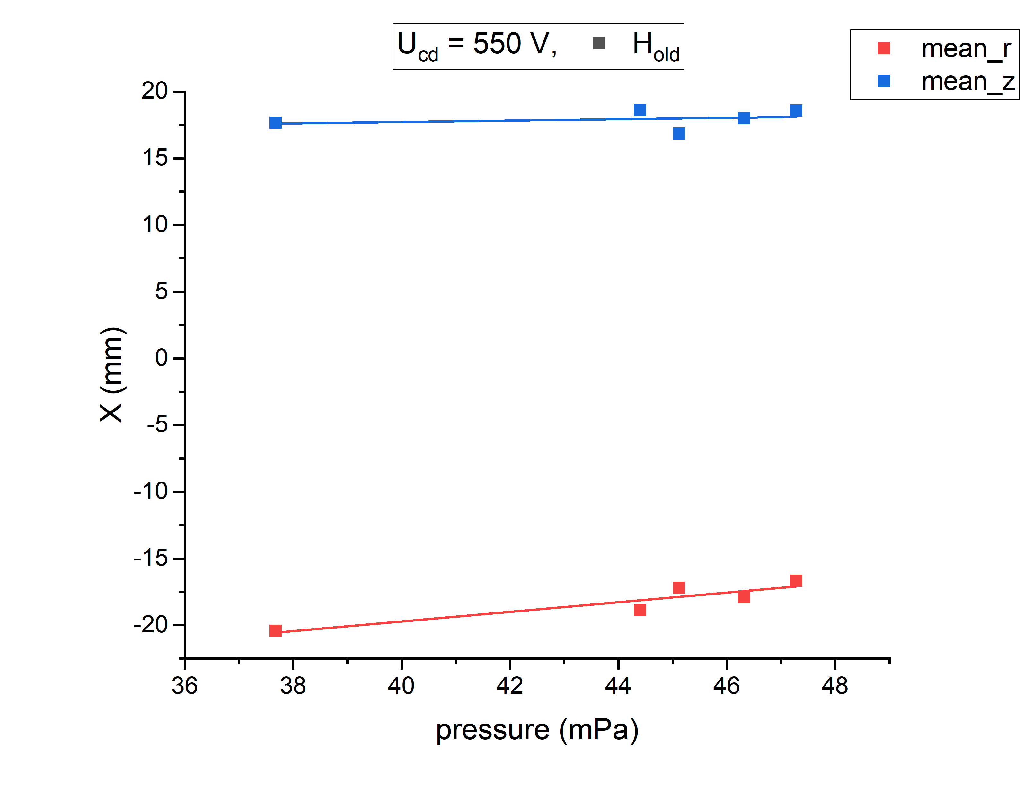
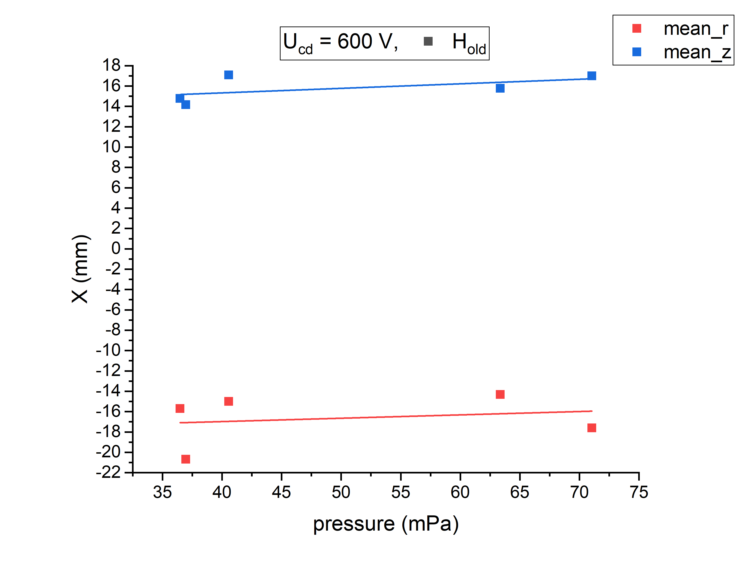
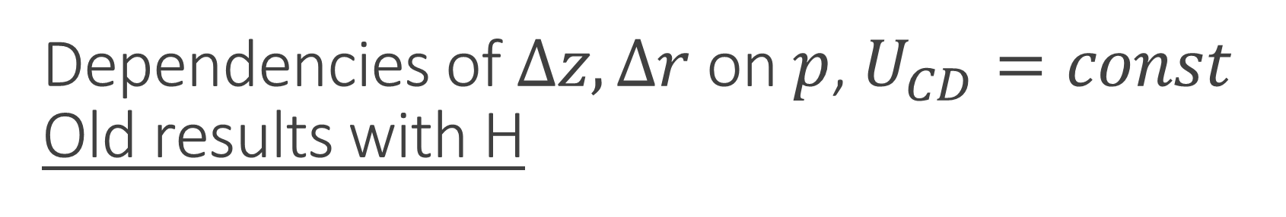
Dependencies of $∆z, ∆r$ on $p$, $U_{CD}=const$
Old results with H

Slide 5
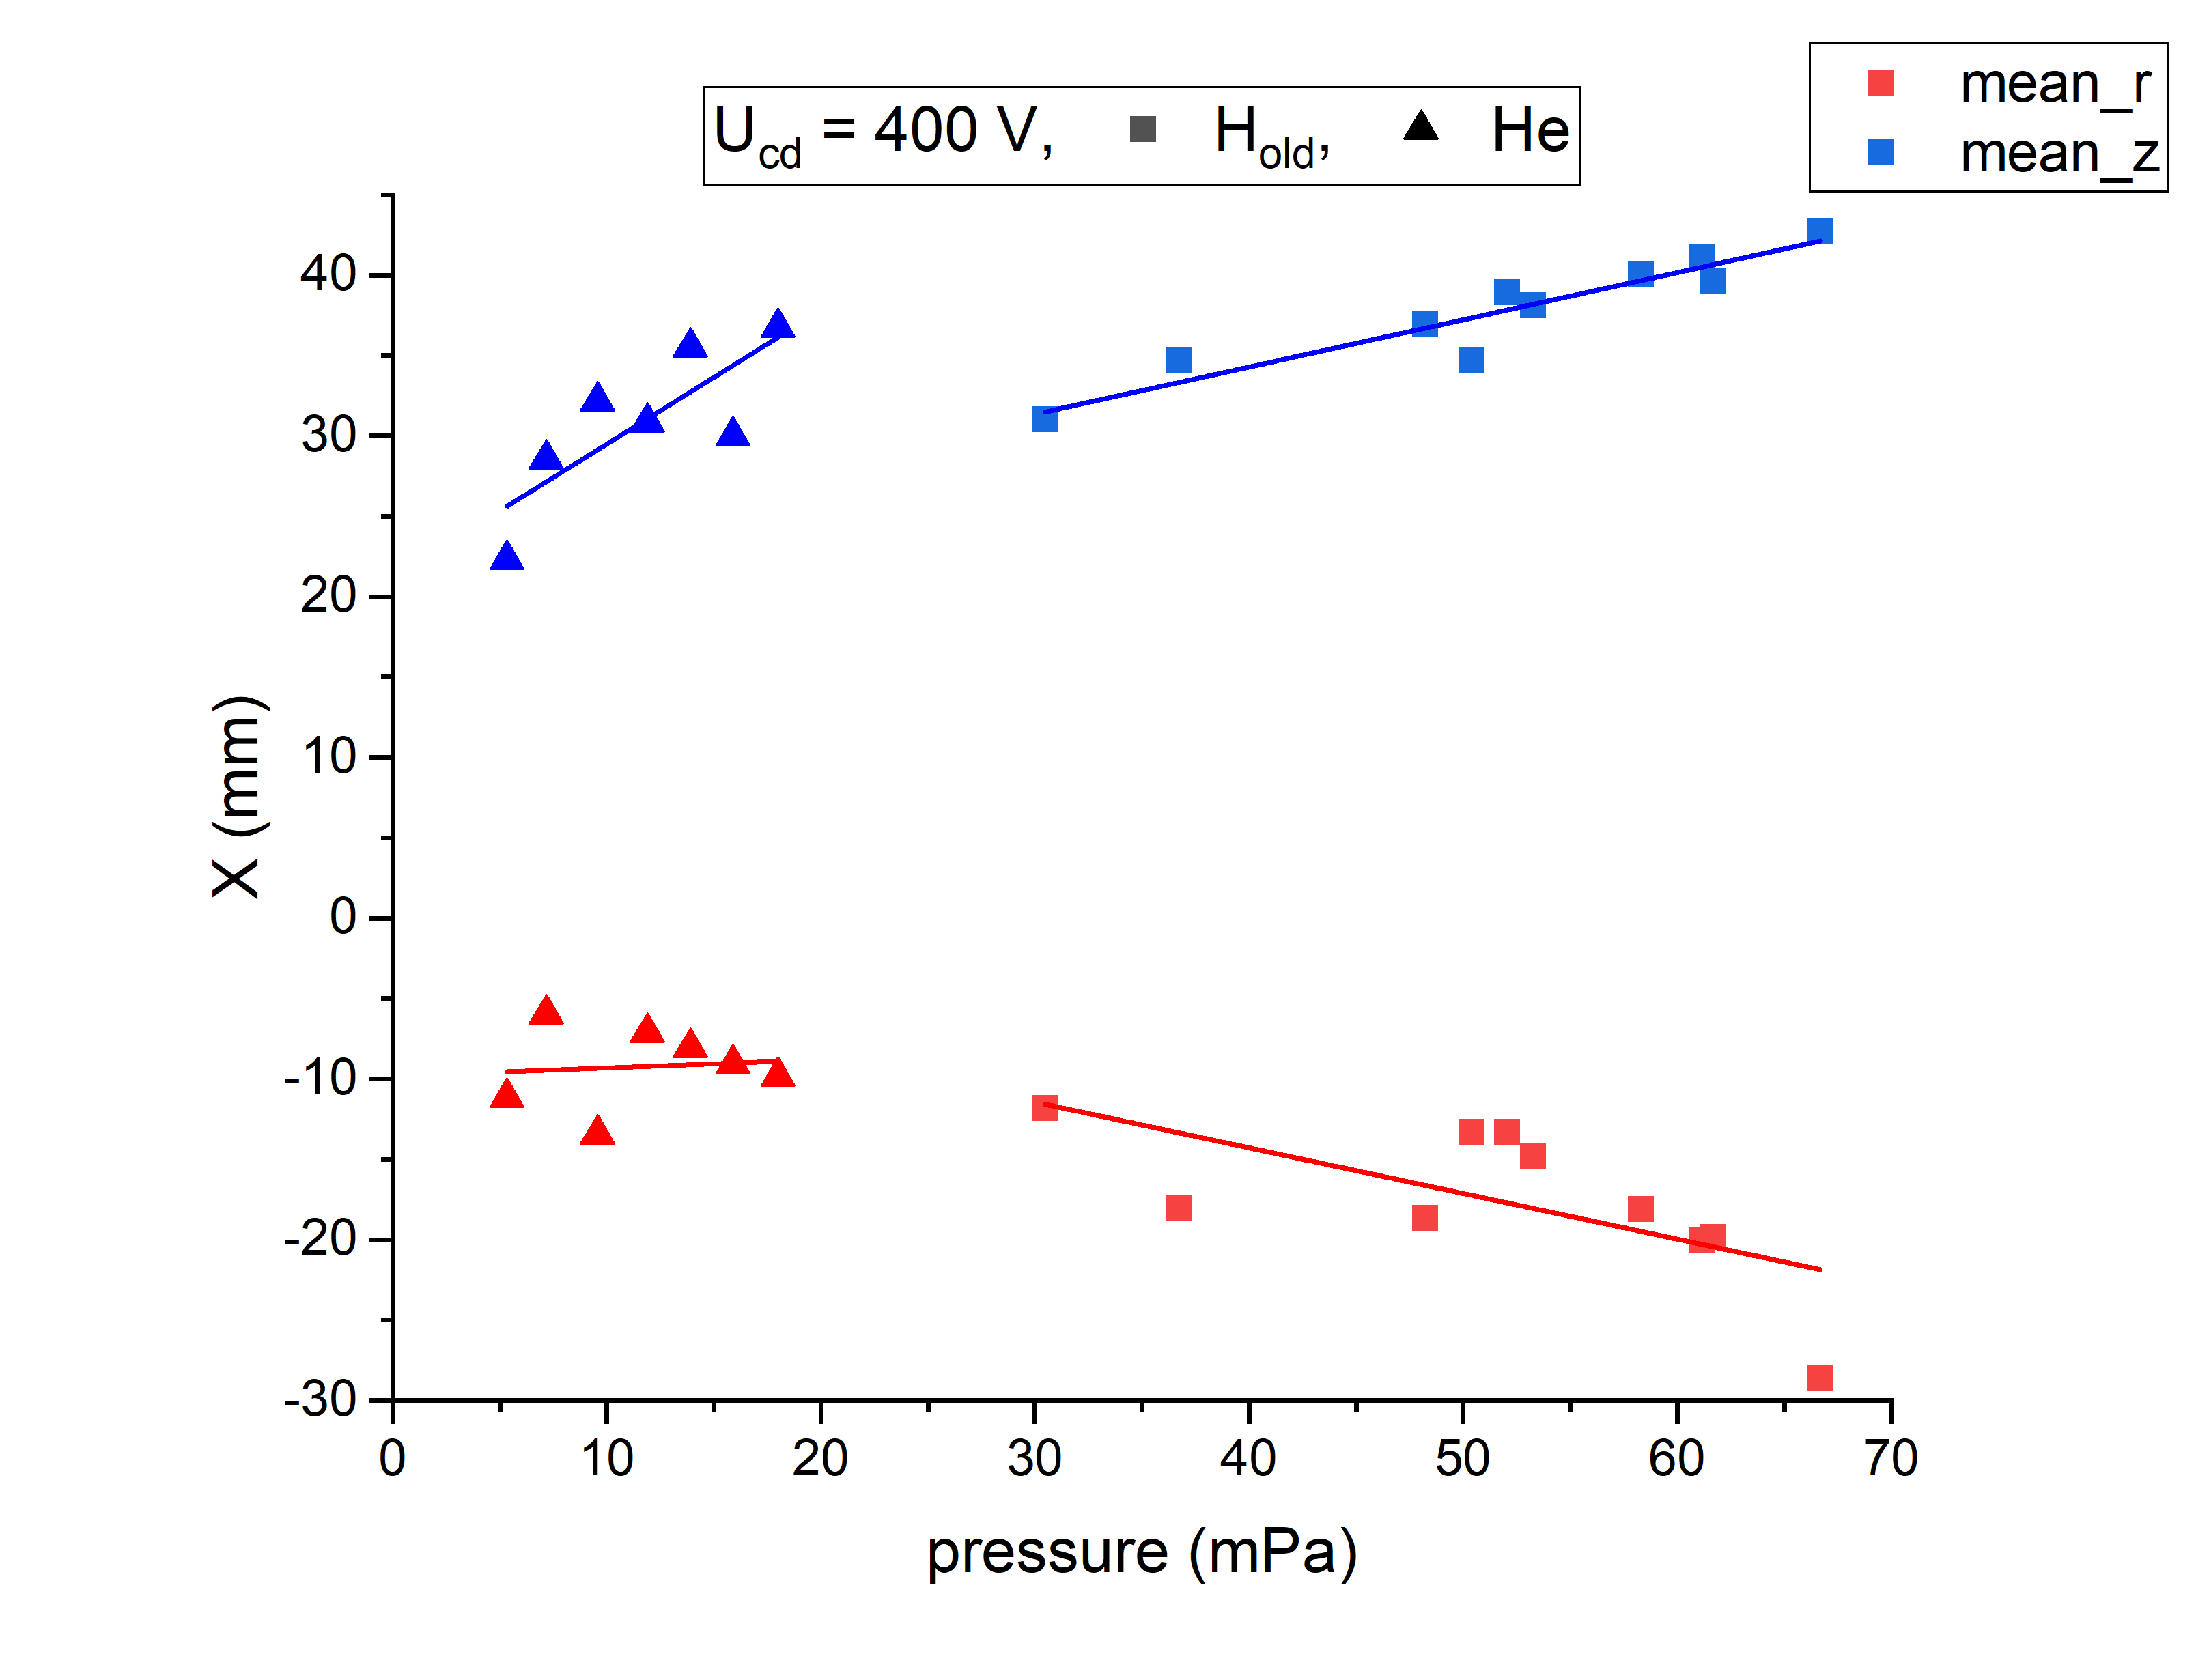
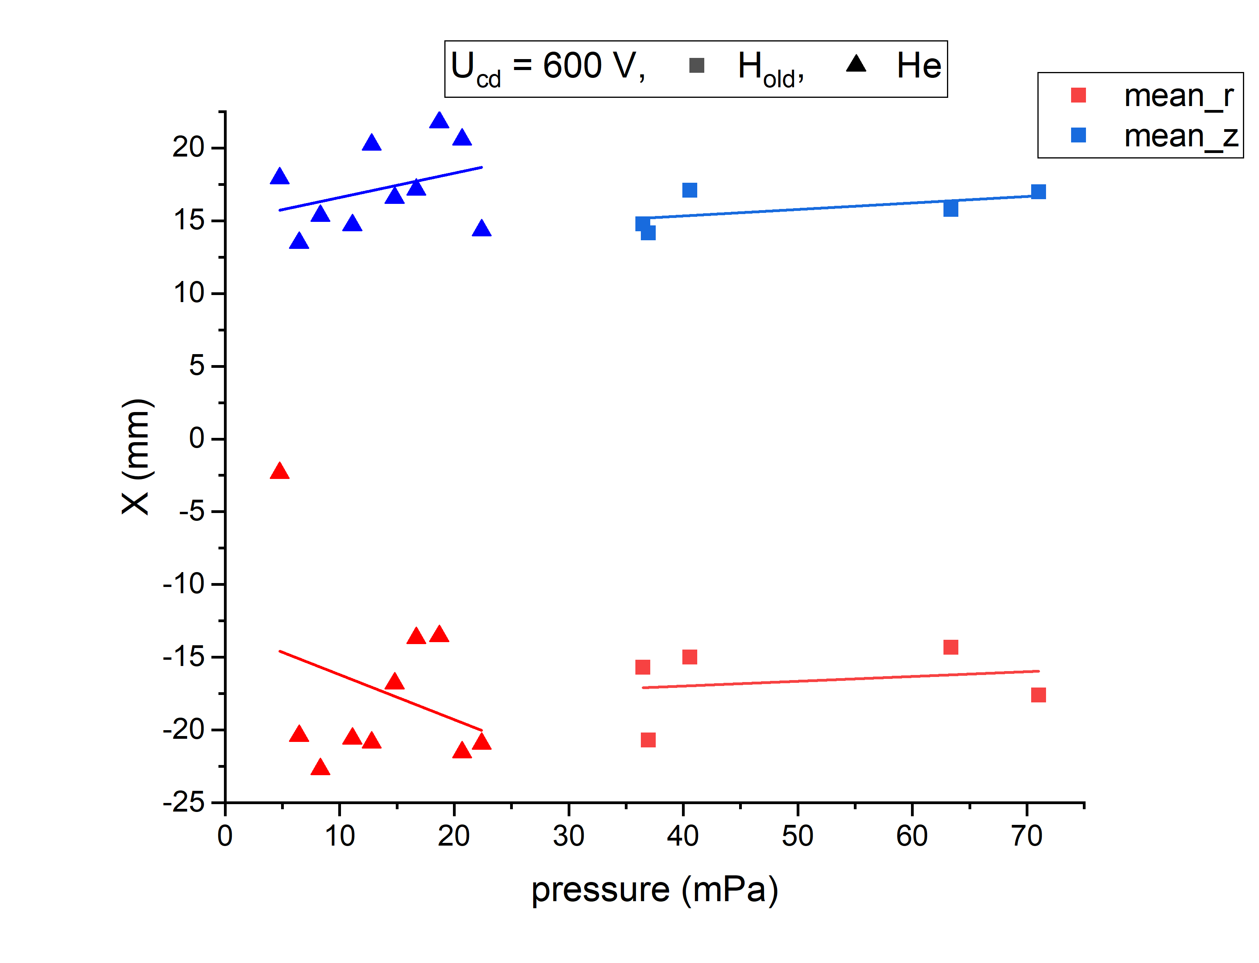

Dependencies of $∆z, ∆r$ on $p$, $U_{CD}=const$
H(old) and He

Slide 6
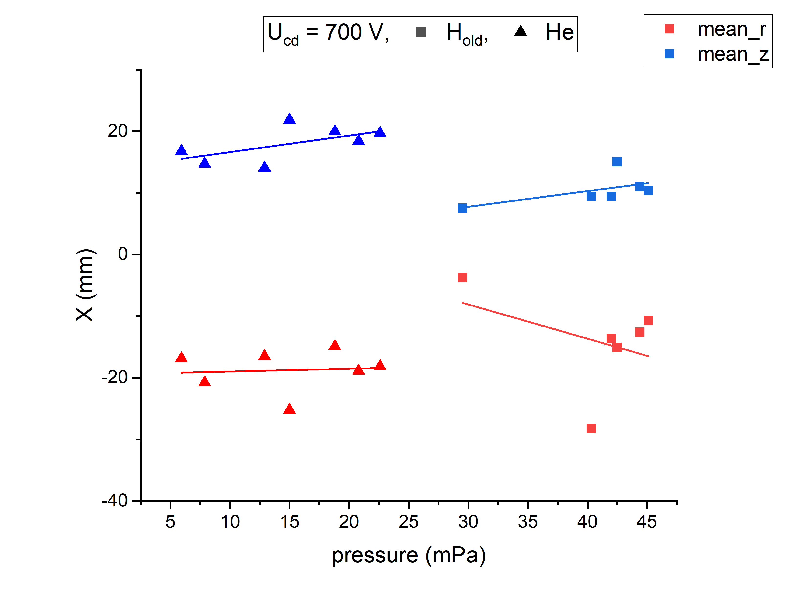
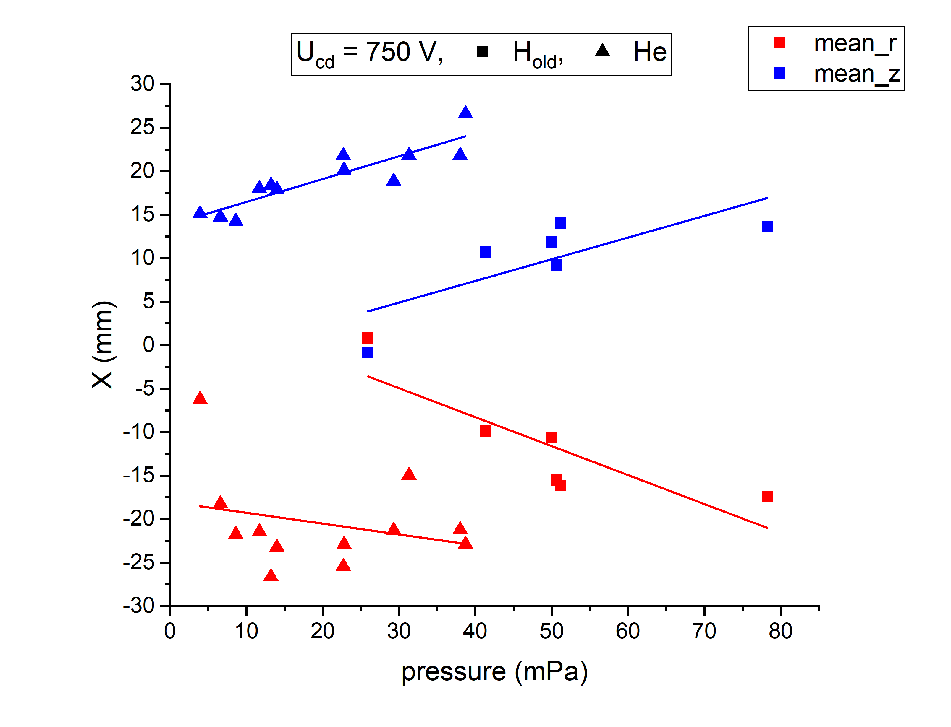
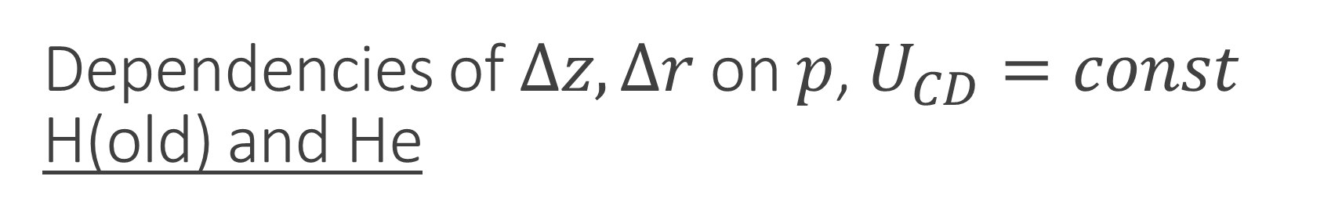
Dependencies of $∆z, ∆r$ on $p$, $U_{CD}=const$
H(old) and He

Slide 7
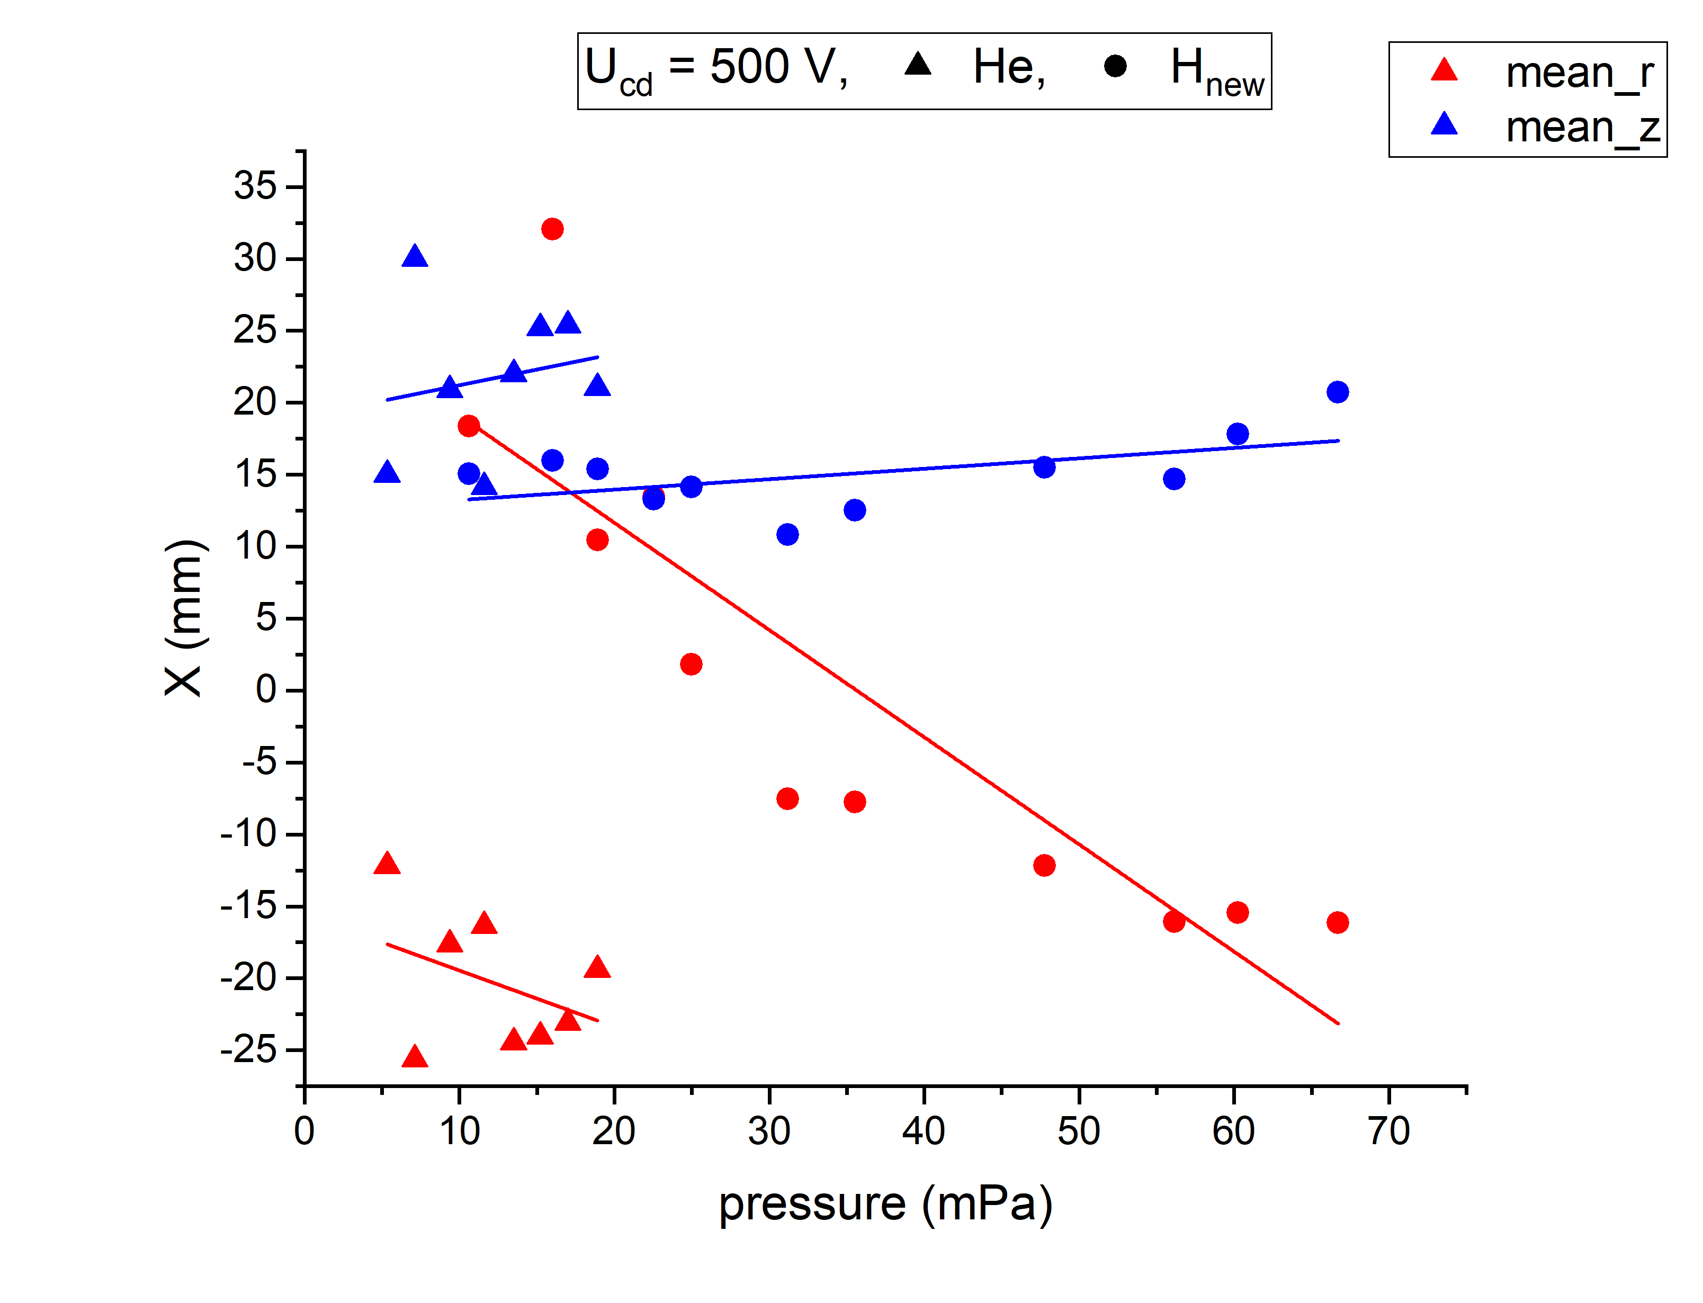
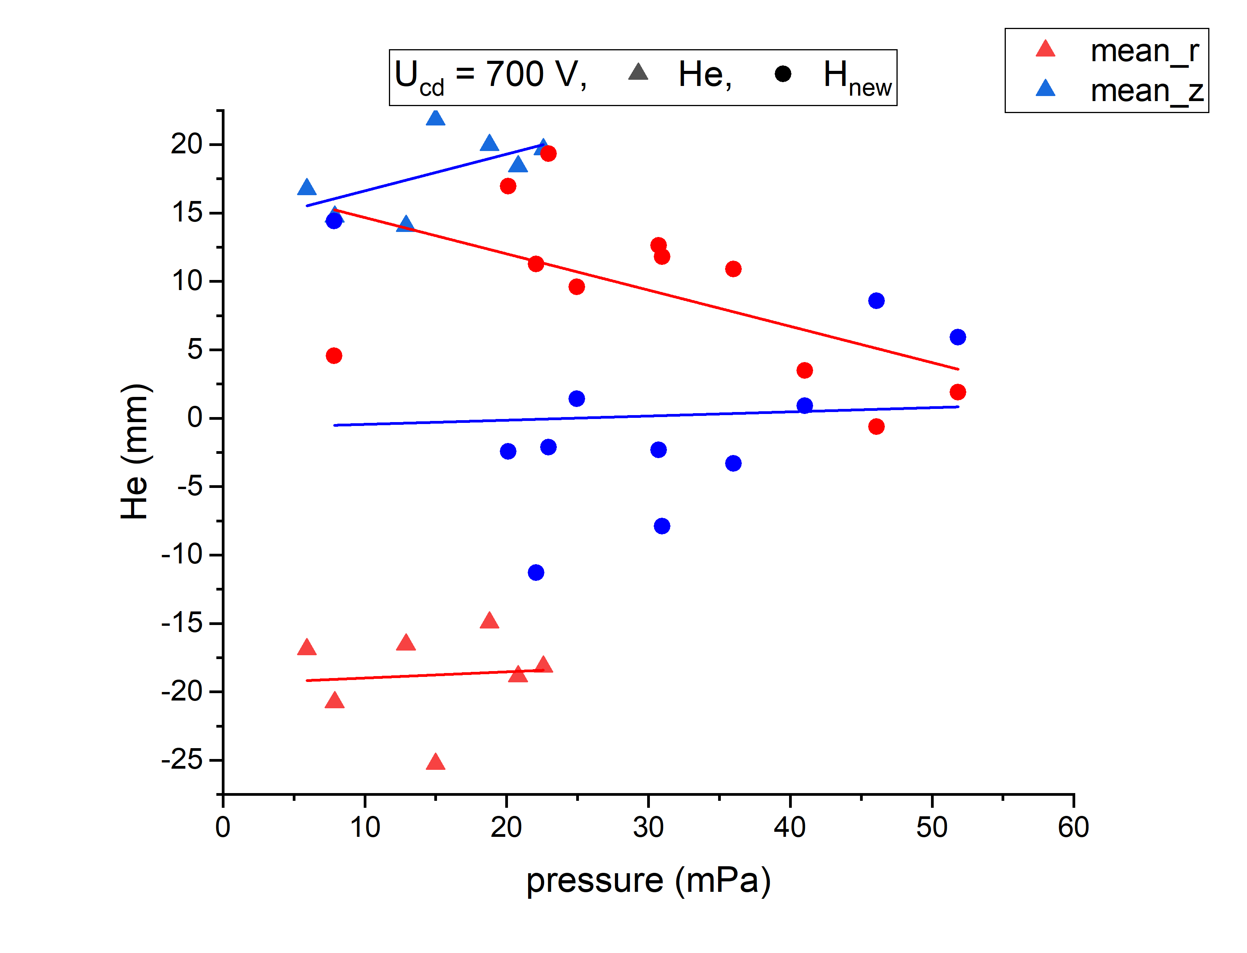
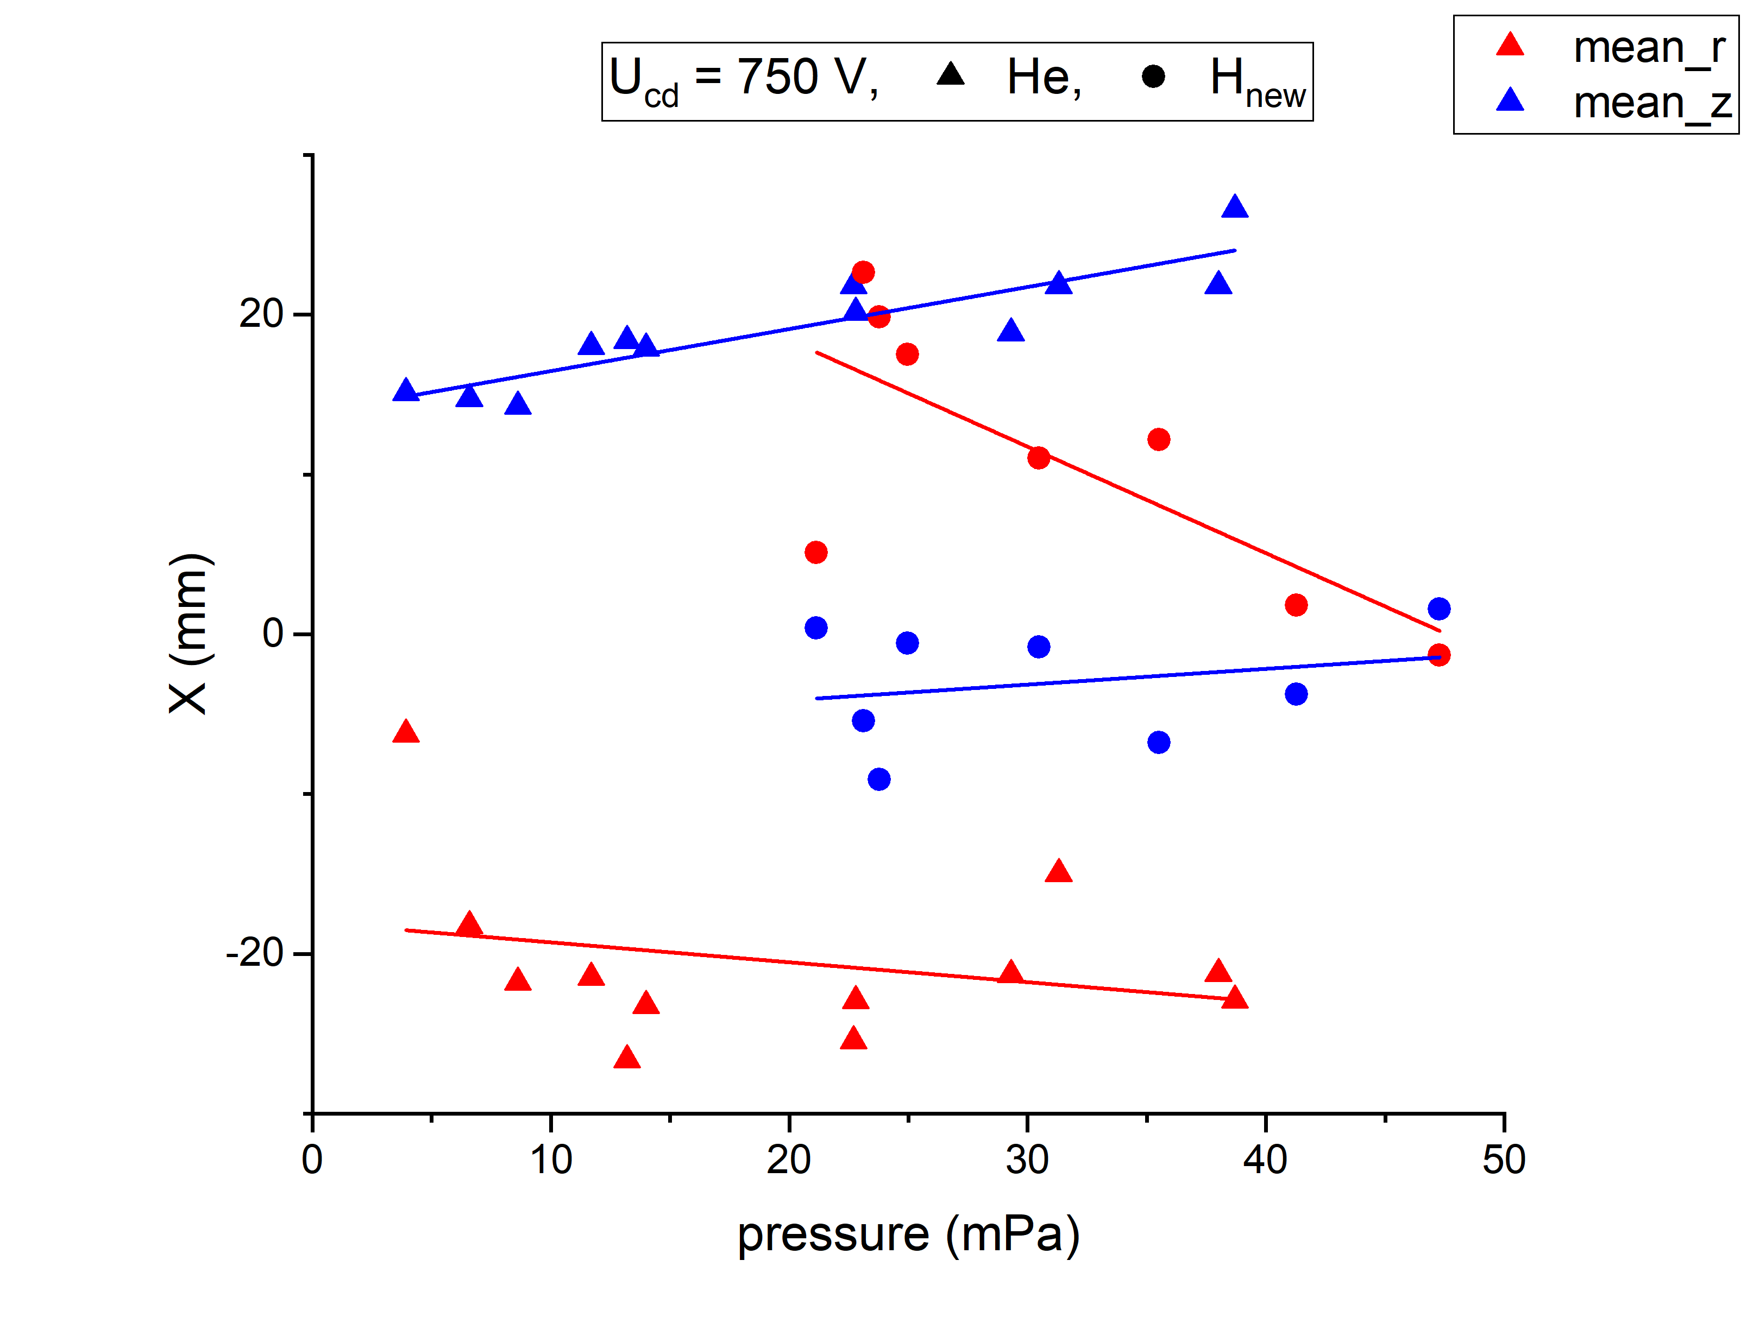
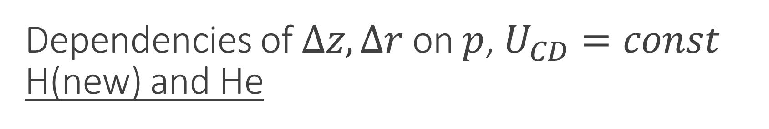

Dependencies of $∆z, ∆r$ on $p$, $U_{CD}=const$
H(new) and He
$∆r>0$ for last H experiments

Slide 8
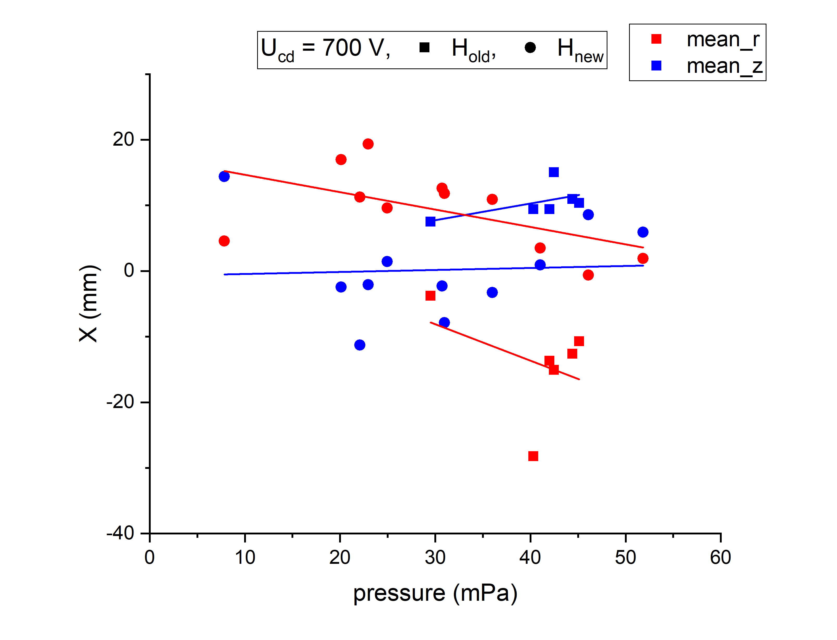
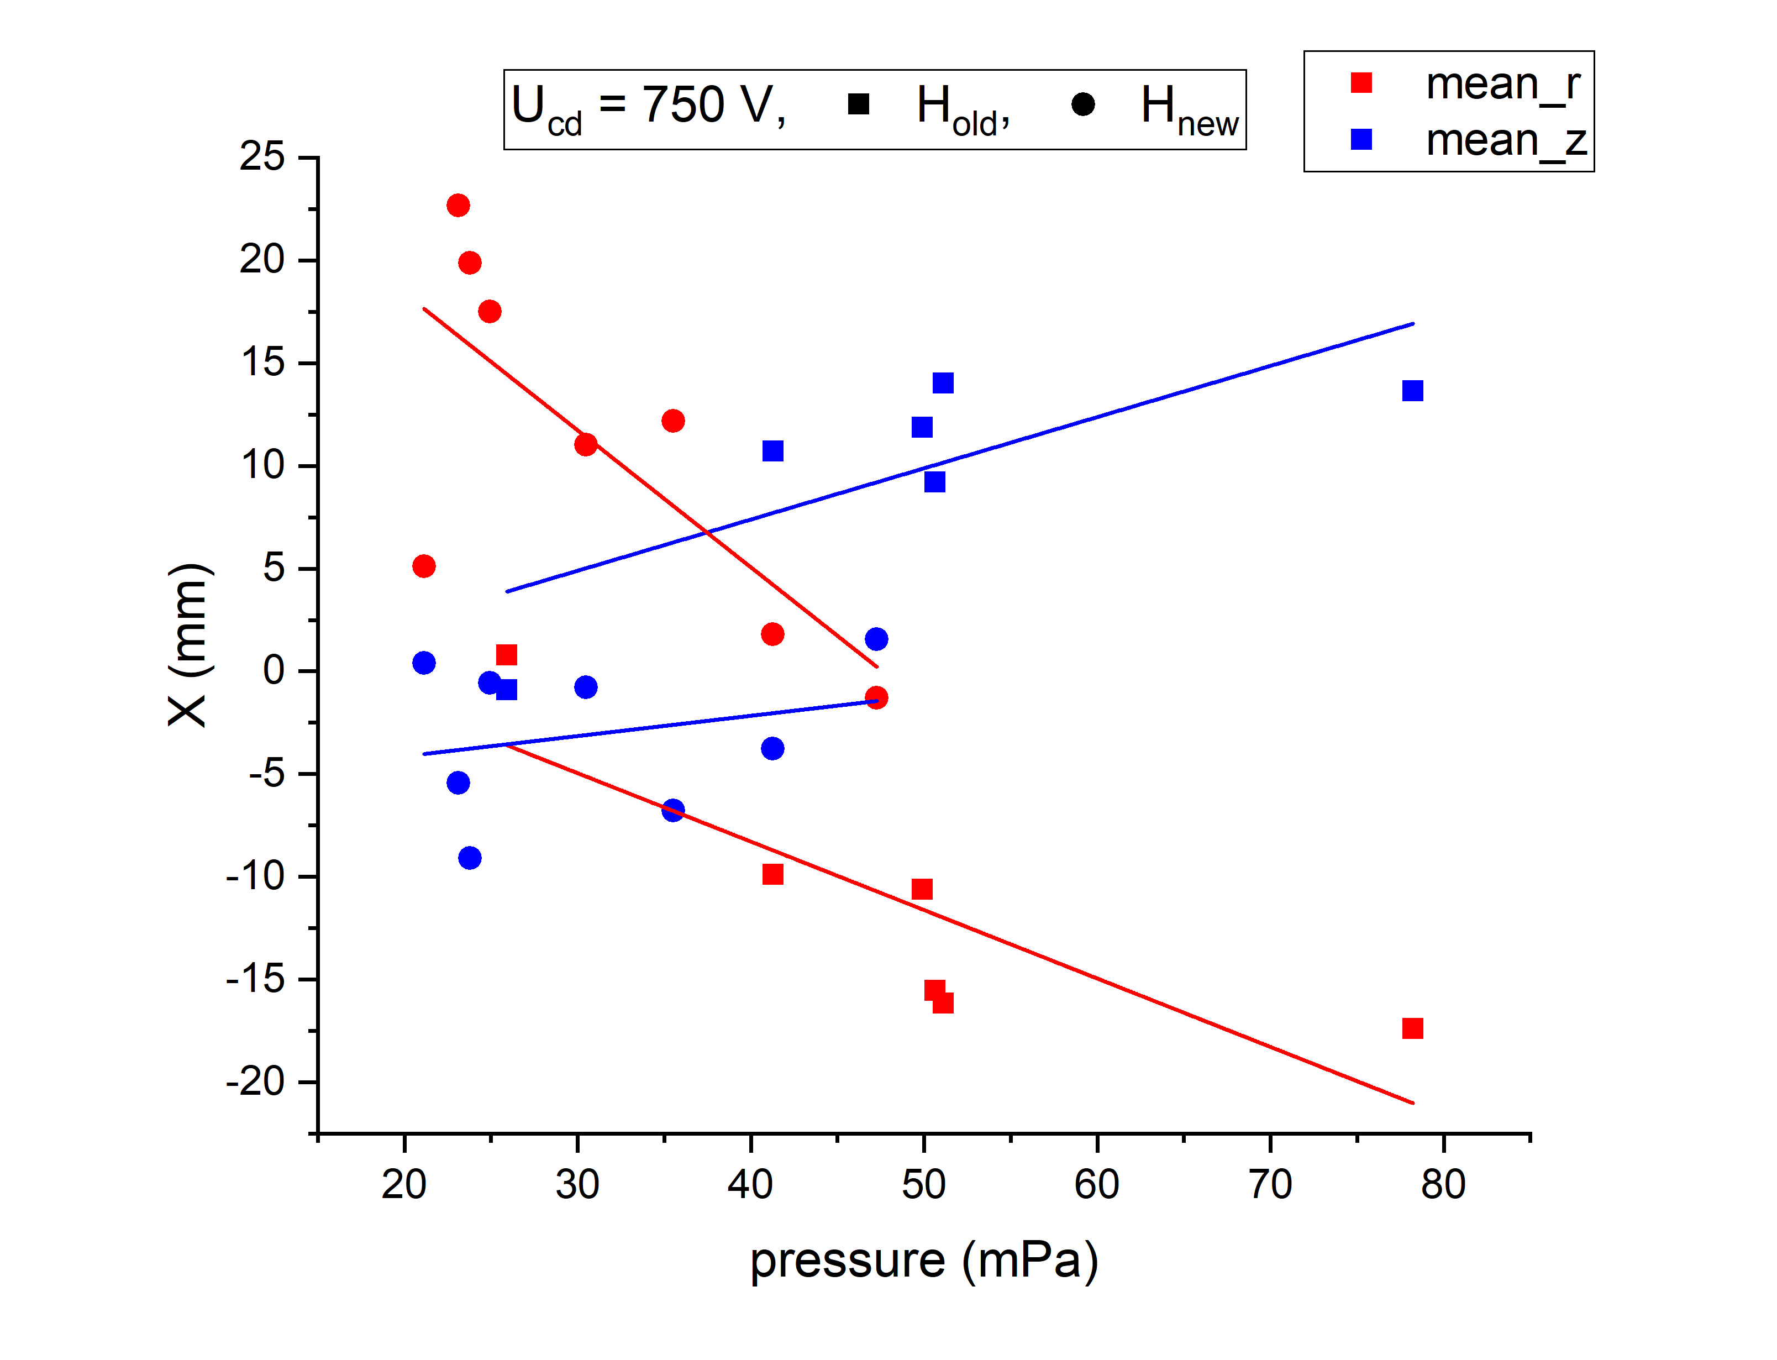
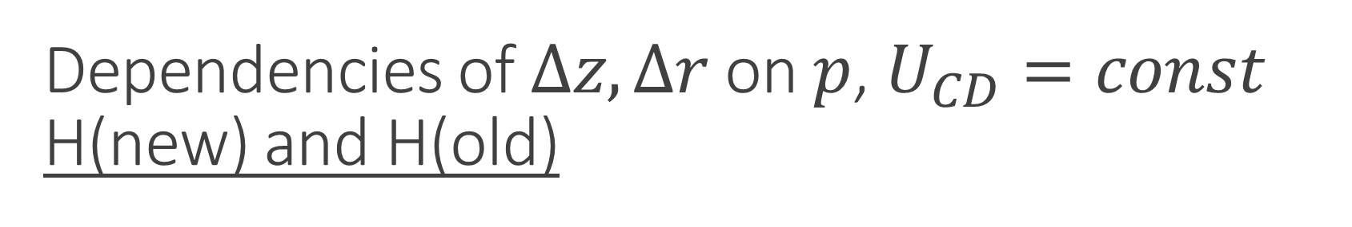
Dependencies of $∆z, ∆r$ on $p$, $U_{CD}=const$
H(new) and H(old)

Slide 9
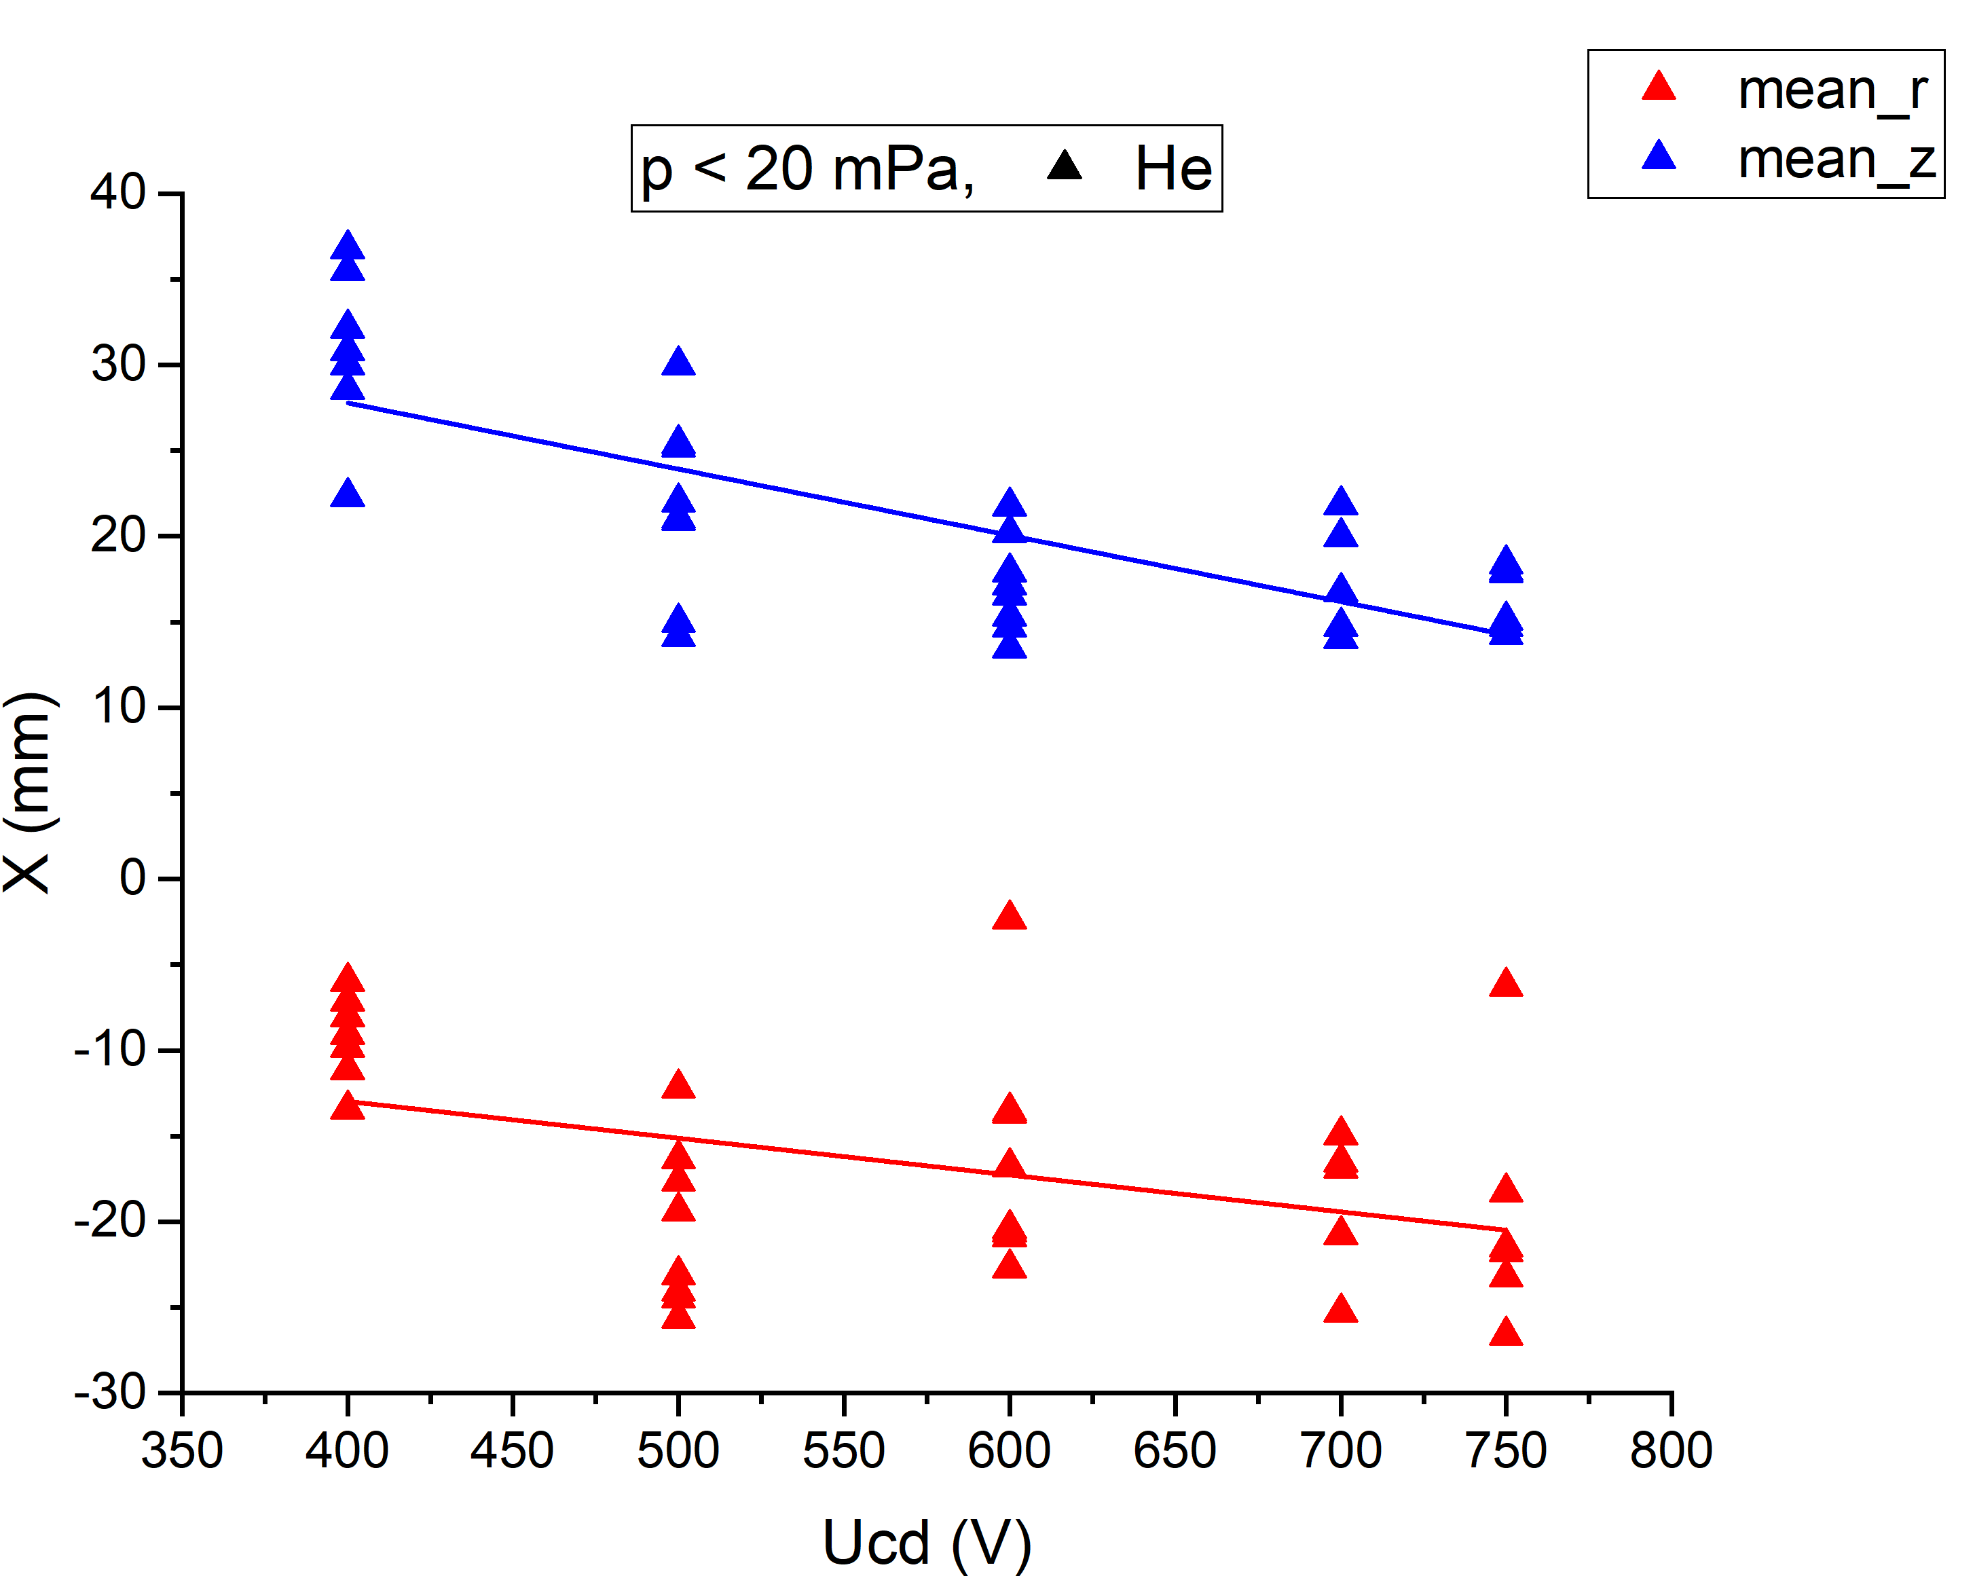
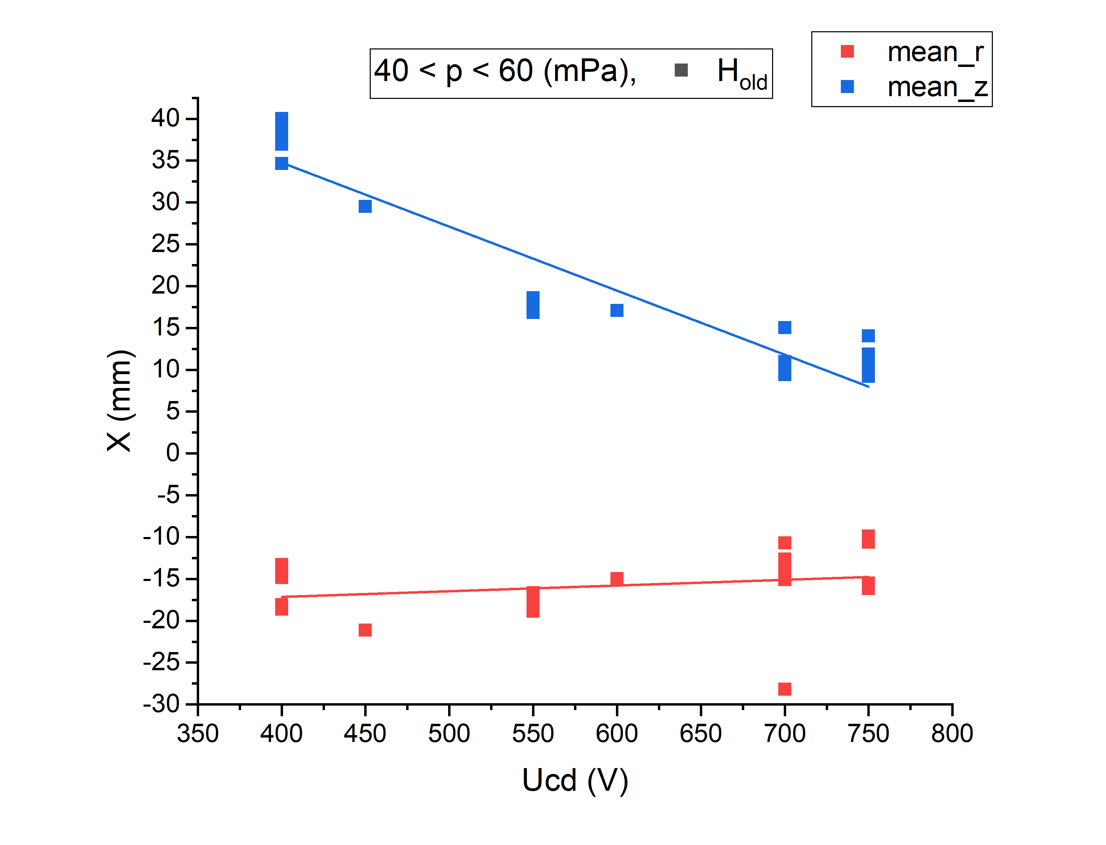
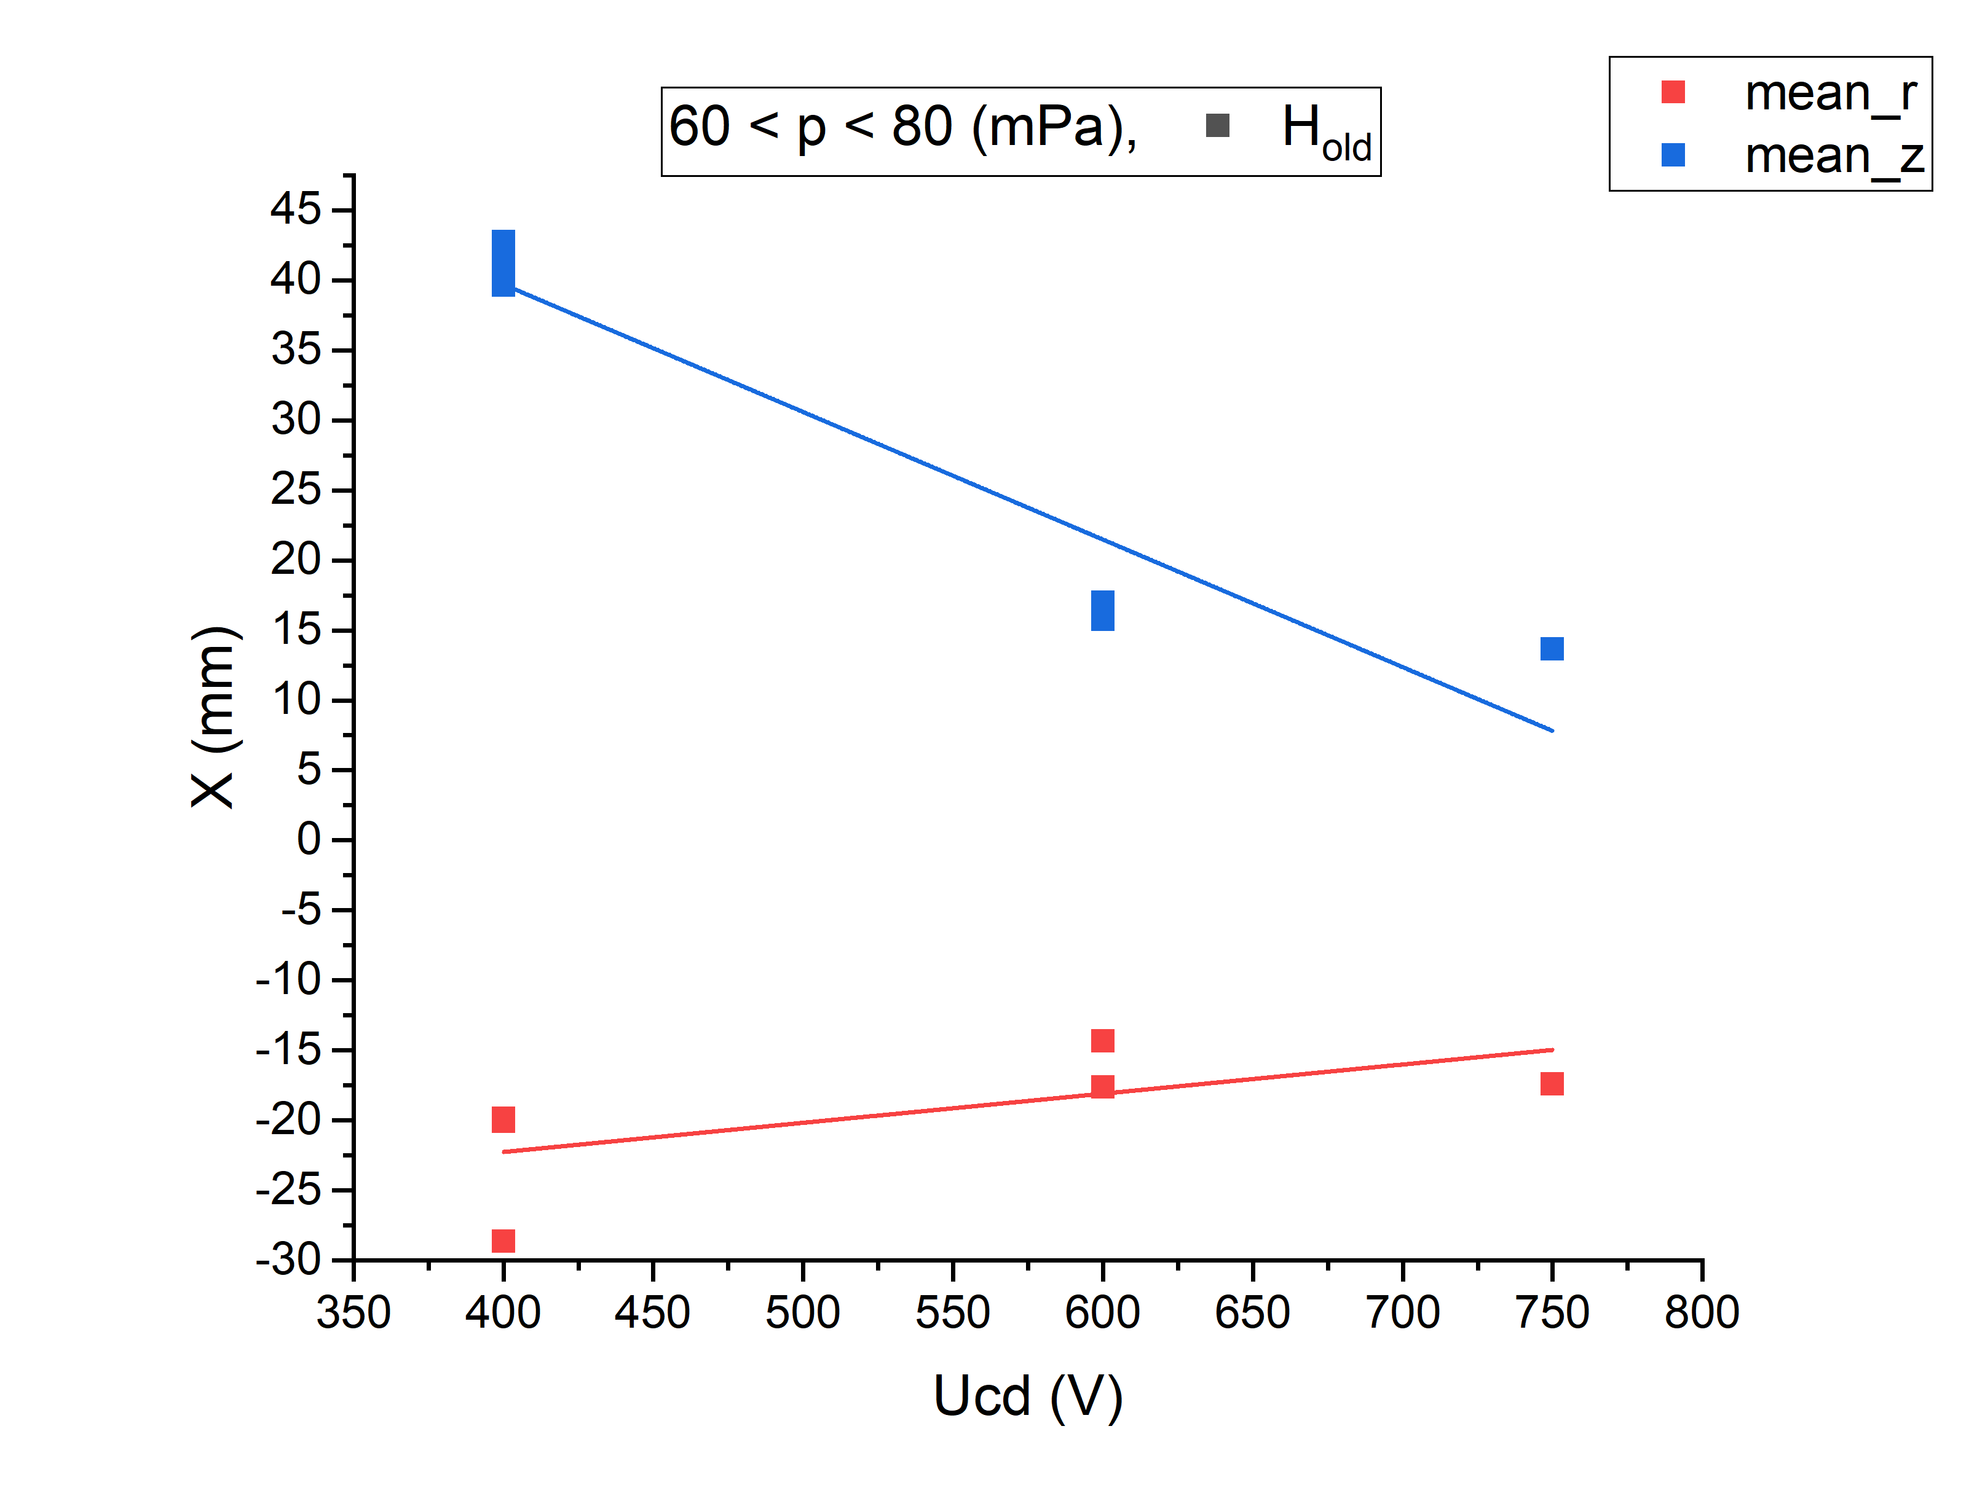
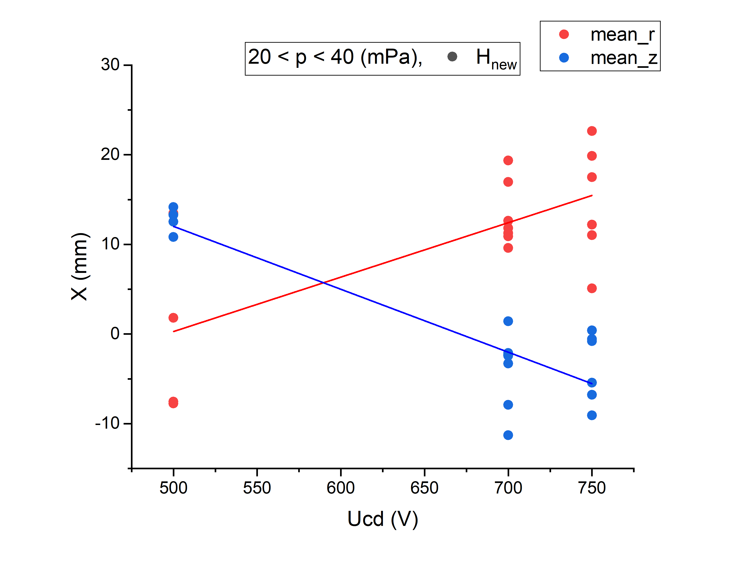
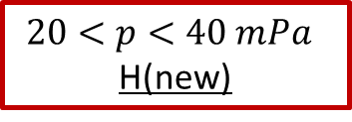
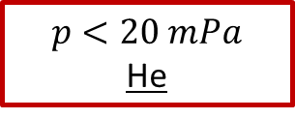


Dependencies of $∆z, ∆r$ on $U_{cd}$
$p<20 mPa$
He
$40<p<60 mPa$
H(old)
$20<p<40 mPa$
H(new)
$60<p<80 mPa$
H(old)

