Slide 1
X-ray diagnostics and runaway electron measurement at GOLEM
SUMTRAIC 2025
^{a*}Varun Dixit and ^{b*}Devesh Kumar
Affiliations:
Nanyang Technological University, Singapore; university level : ^{a*}Postdoctoral fellow, ^{b*}PhD
Supervisors: Marek Tunkl, Lukas Lobko, Ondrej Ficker, Stepan Malec
Helpers: Jaroslav Cerovsky

Slide 2
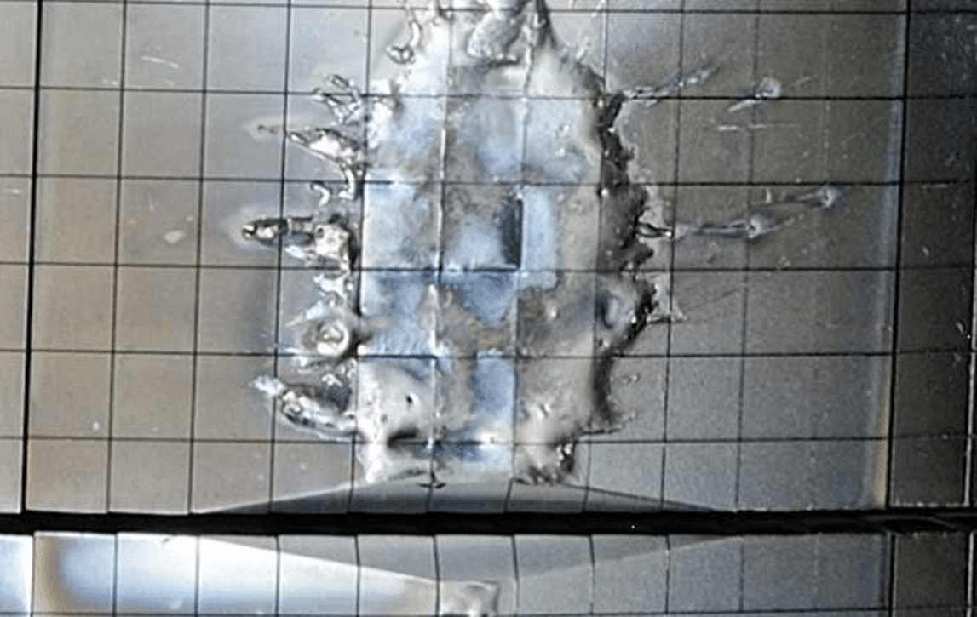
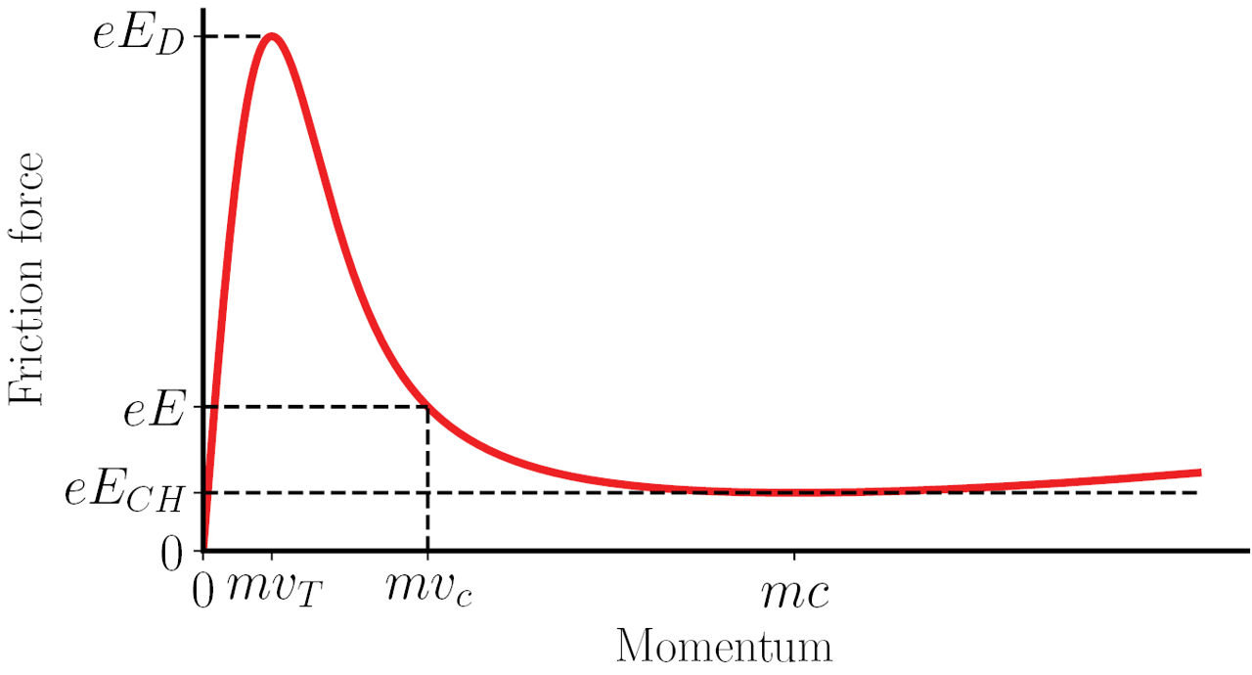
Fusion Challenge
  Runaway electrons (REs) can reach 10’s of MeV.
  Serious thread for plasma-facing components in large tokamaks like ITER.
Why X-ray?
  REs emits bremsstrahlung X-ray when colliding with plasma /vessel/limiter.
  X-ray provide a non-intrusive diagnostic for RE detection.
Why GOLEM?
  Good for diagnostics development and testing.
  Accessible for hands-on experiment and training.
Goal
  Analyse X-ray diagnostics to study RE dynamics
Courtesy: “ EUROfusion"
doi.org/10.1088/1741-4326/ab1822
Notes:
maybe ass sine figures
Figure from doi.org/10.1088/1741-4326/ab1822
eEeEeE: The accelerating force from the electric field.
eEDeE_DeED​: Dreicer field — critical field where collisional drag at thermal speeds can be overcome.
eECHeE_{CH}eECH​: Critical Connor-Hastie field — minimum field needed to sustain runaways at relativistic speeds.

Slide 3
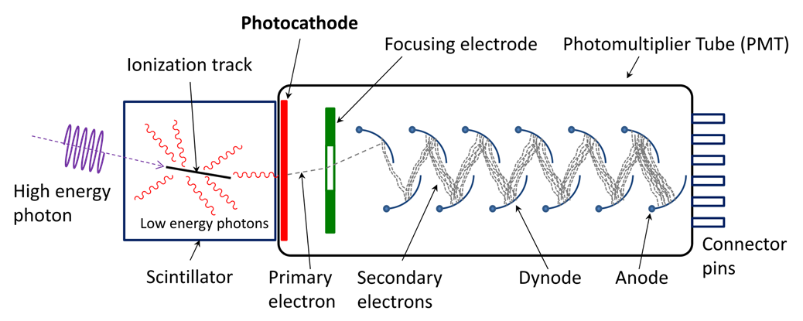
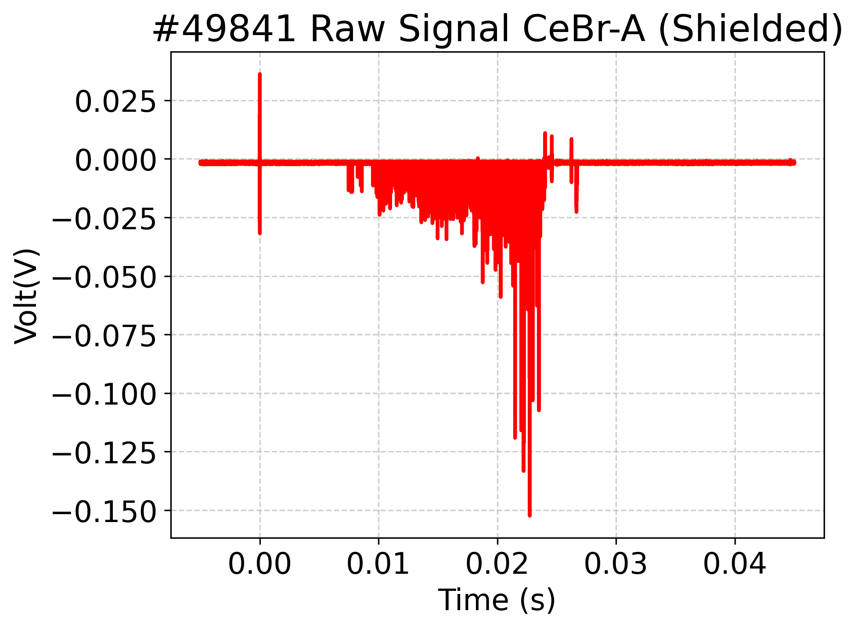
A radiation detector that converts ionizing radiation into light, which is then detected and measured.
Used for detecting alpha, beta, gamma rays, and neutrons
Importance
  Provides high sensitivity and energy measurement for radiation detection.
  Used in medical imaging, nuclear physics, and radiation safety.

Slide 4
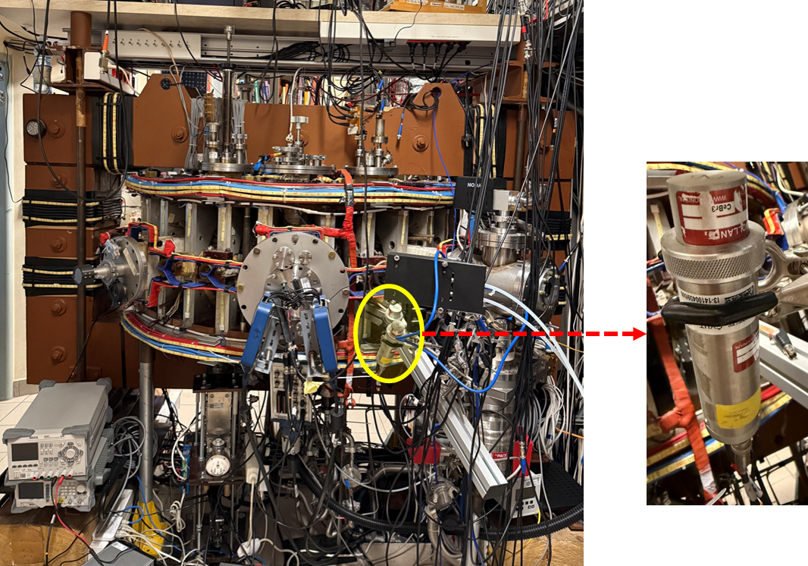
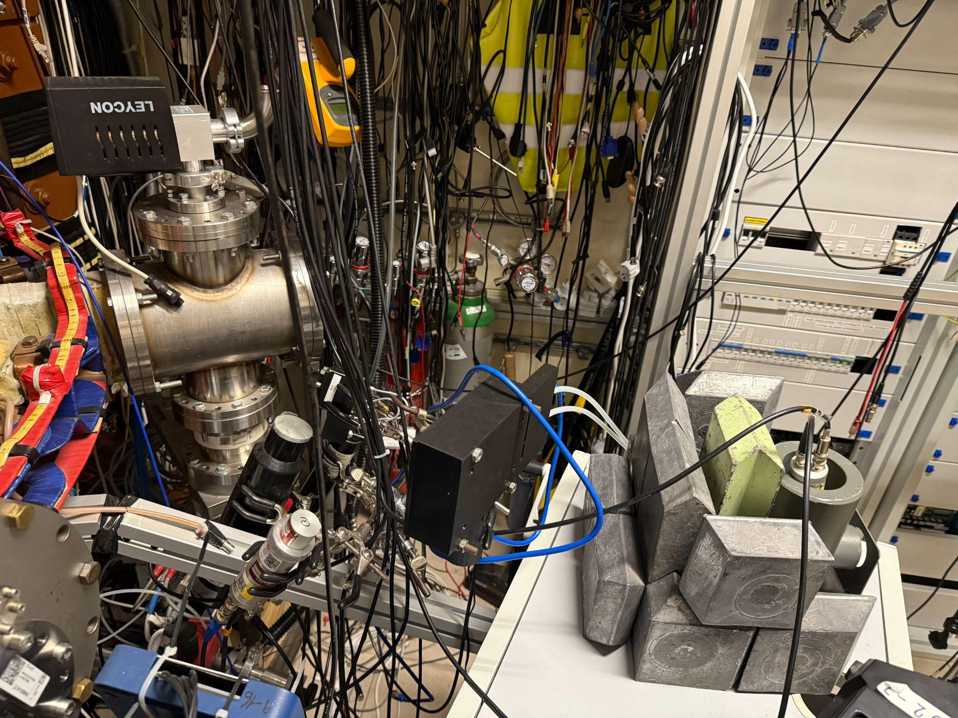
GOLEM
CeBr-B
(No Shielding)
CeBr-A (Shielded with Pb)
CeBr3

Slide 5
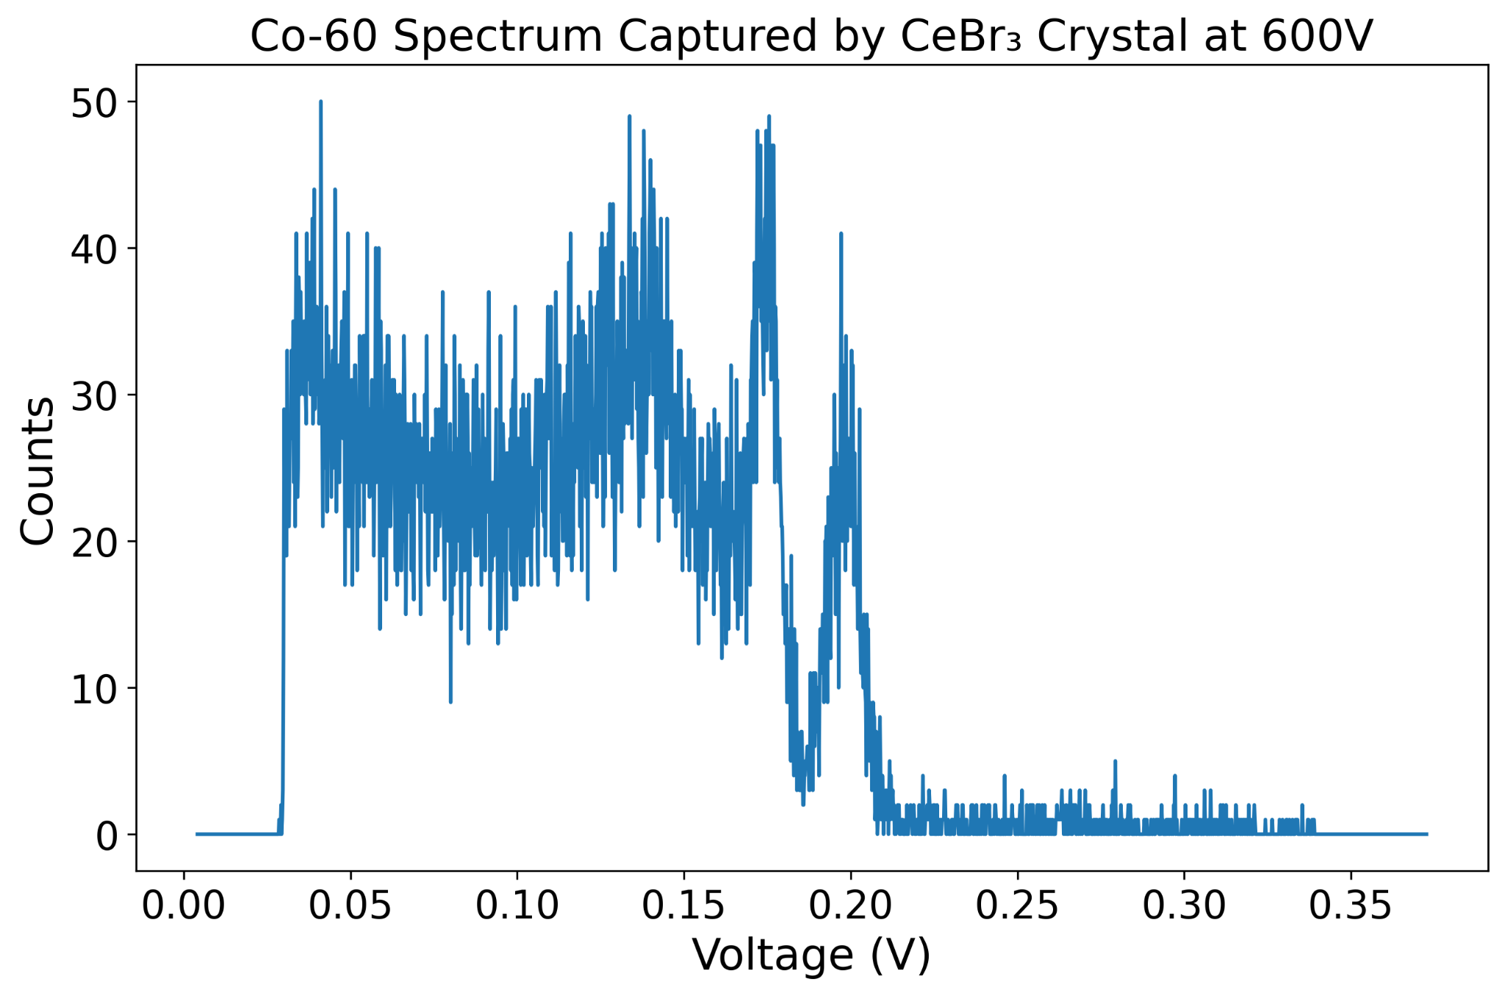
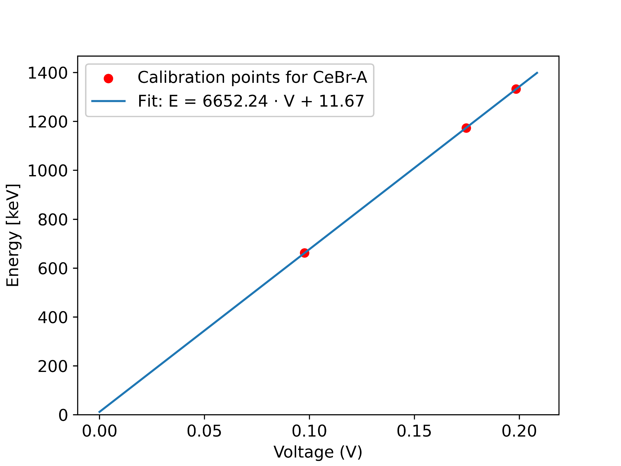
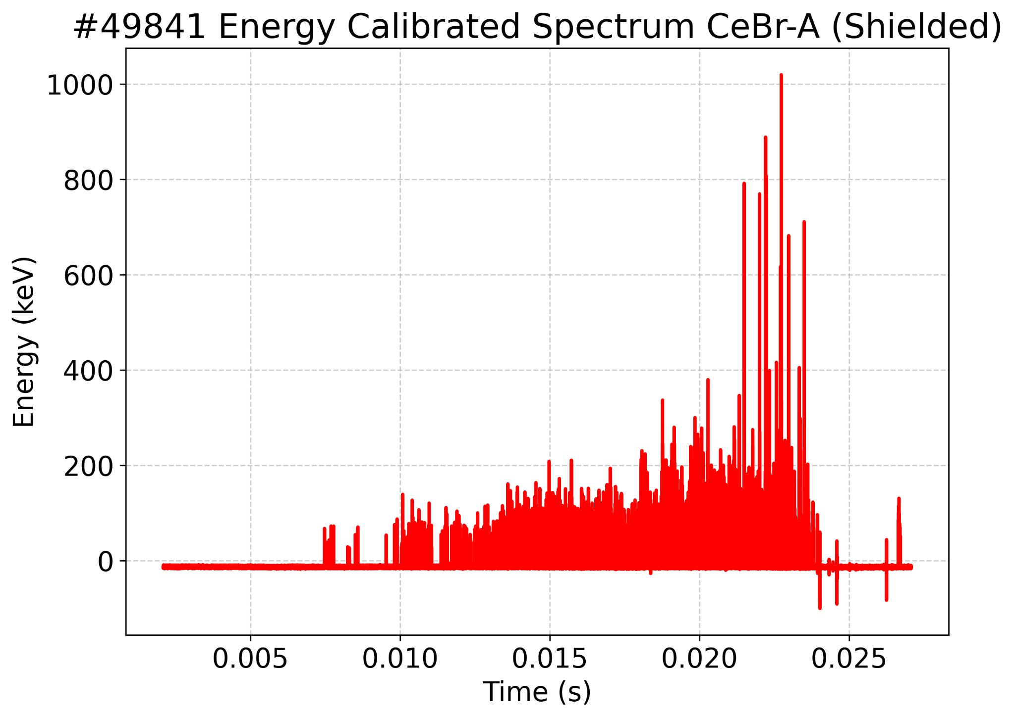
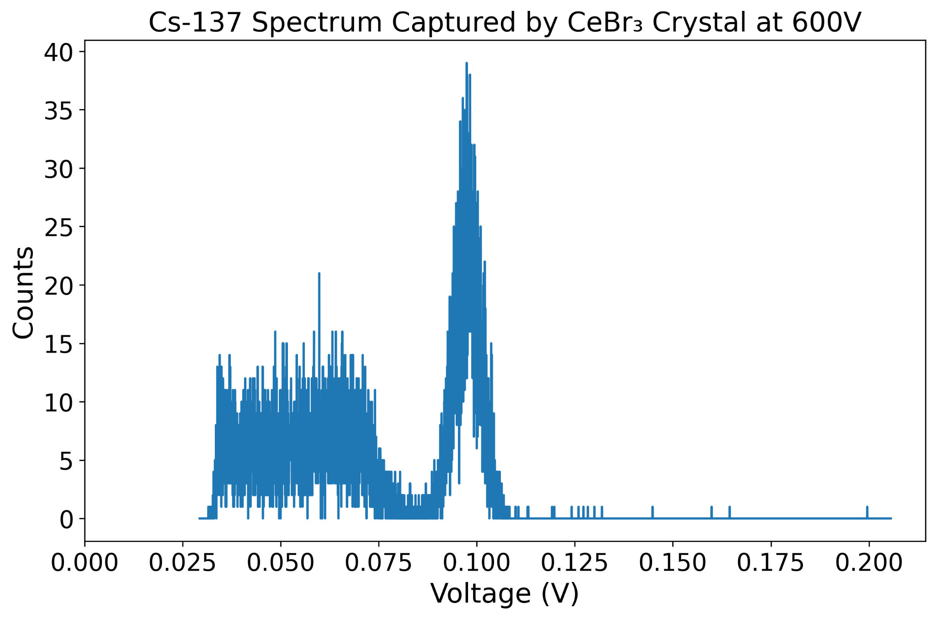
1173 keV
1332 keV
662 keV
Spectrum captured by Standard Sources
Produce linear fit to have calibration points
Calibrate the raw spectrum after the experiment

Slide 6
Notes:
describe briefly, what discharges you did at golem - scan of the pressure, each pressure 3x for better precision and avoiding some anomalies, chamber cleaning by glow discharge after each 3 shots
describe your expected behavior from the simply view - higher density -> higher friction force with the plasma -> lower REs..`

Slide 7
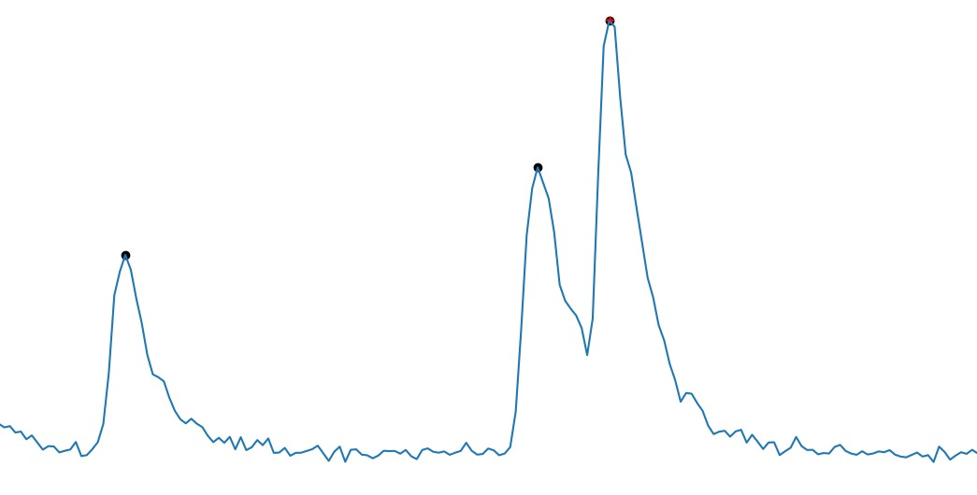
Pile up Filter
Pile up filter time = 50 nsec
Find all peaks
Pile-up
of Peaks
Find 20% of each peak height
Clean Peak
If this height has decay time < 50ns
Clean Peak

Slide 8
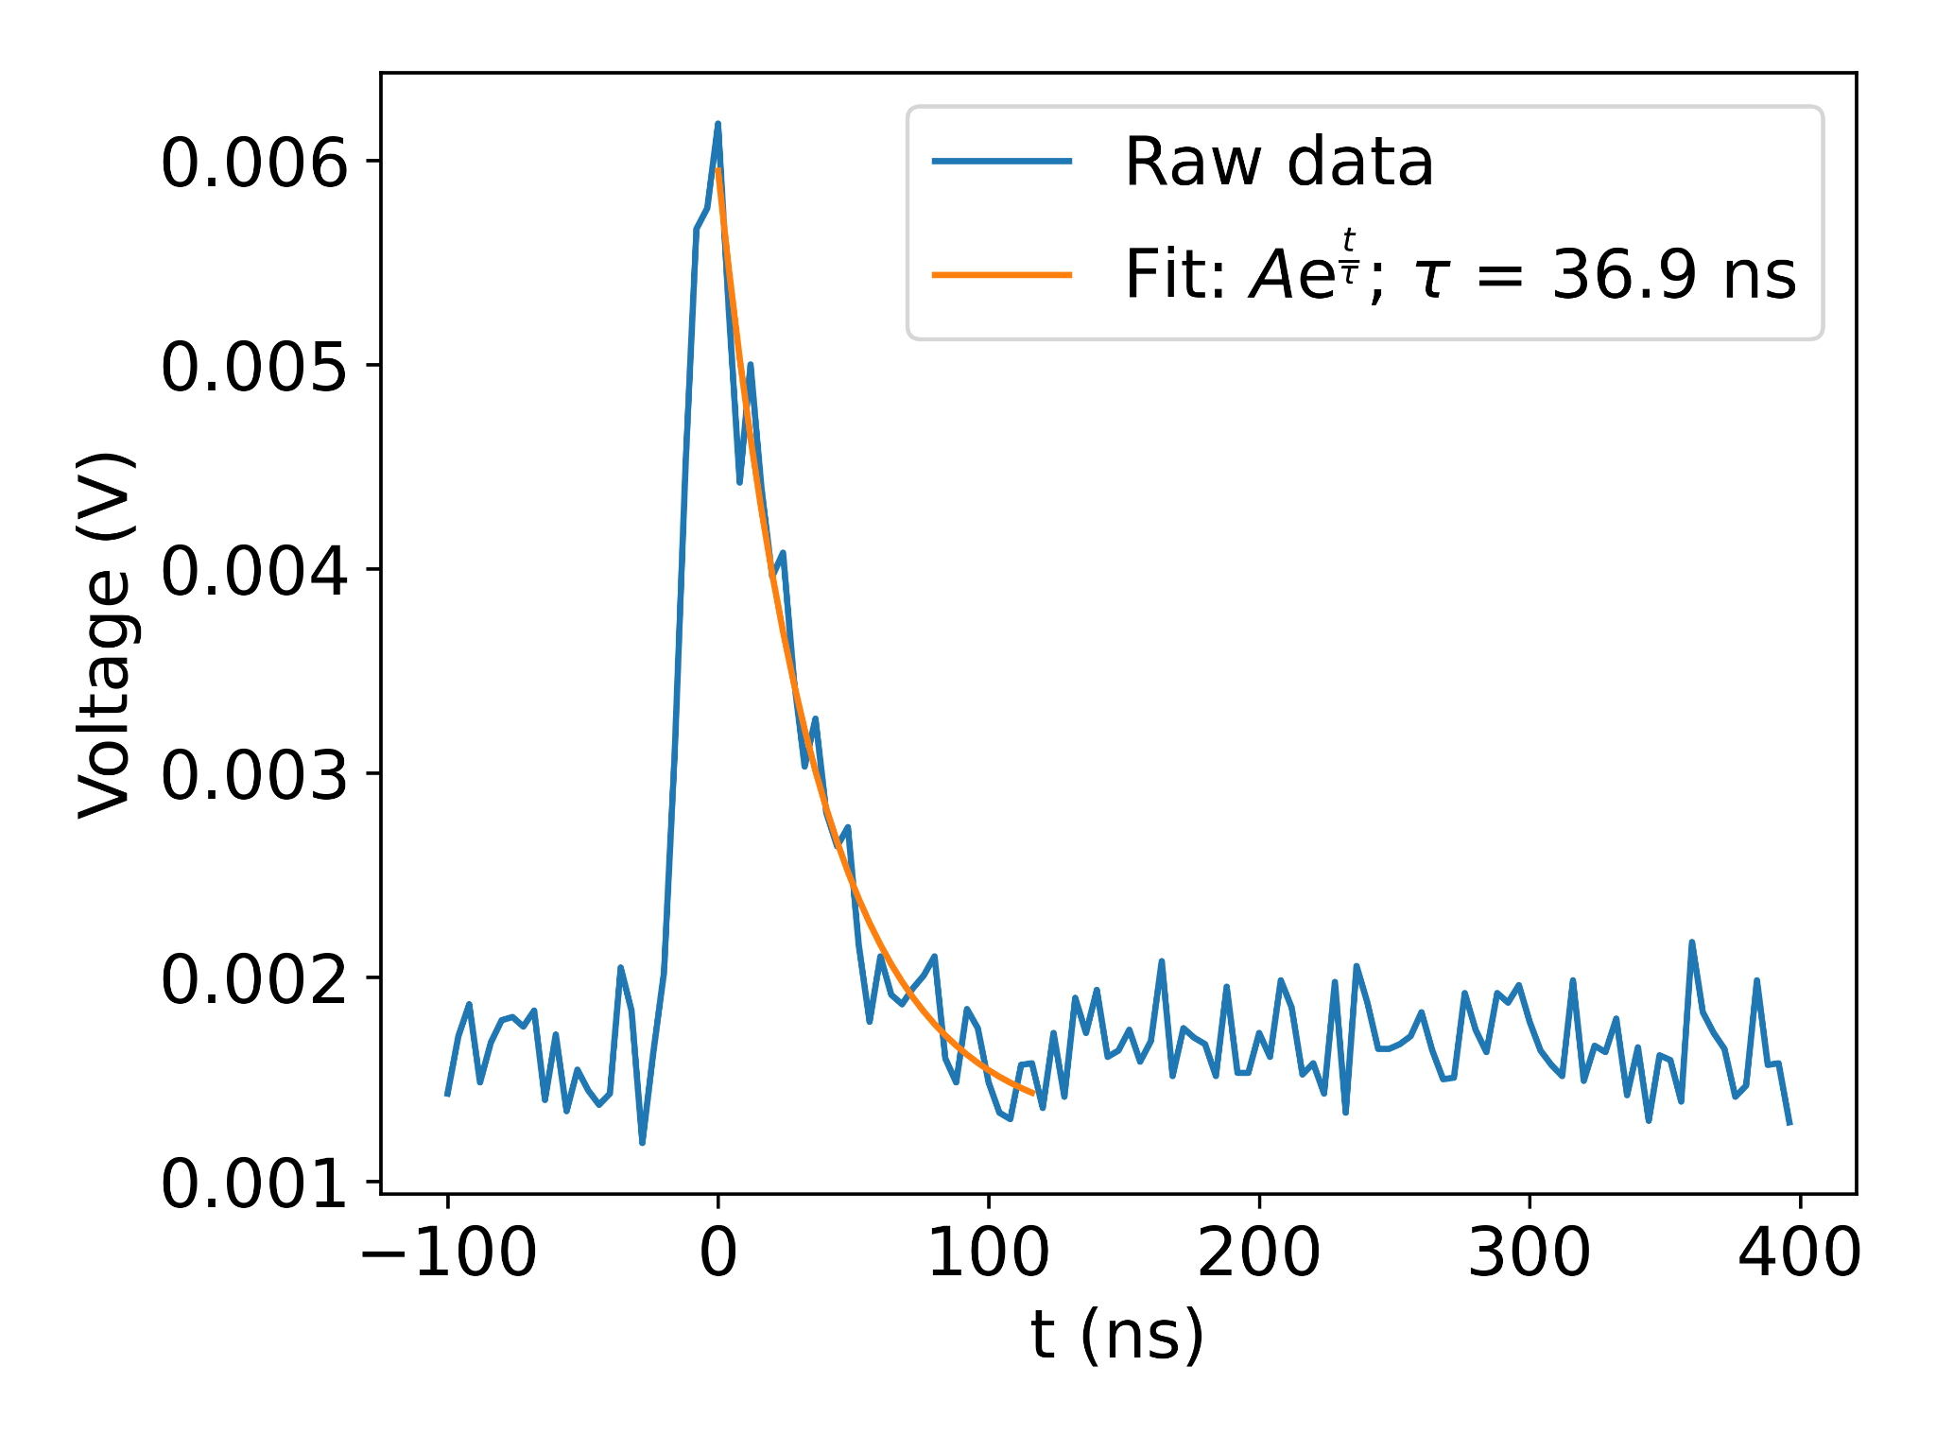
Pile up Filter

Slide 9
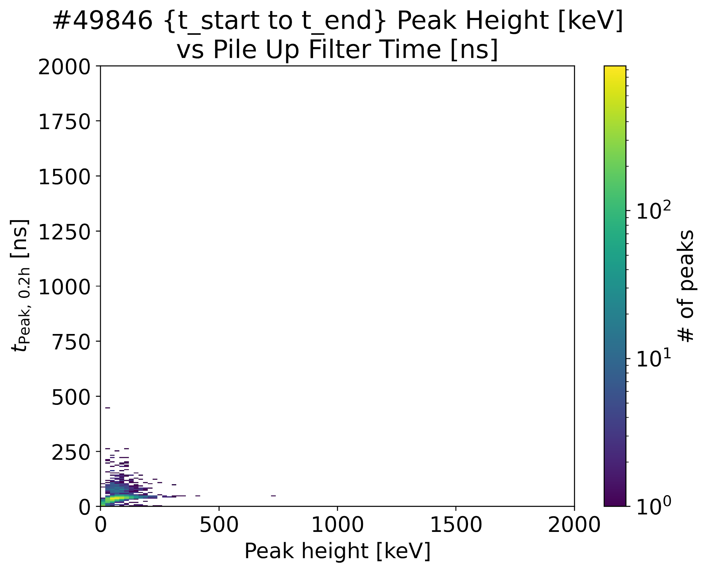
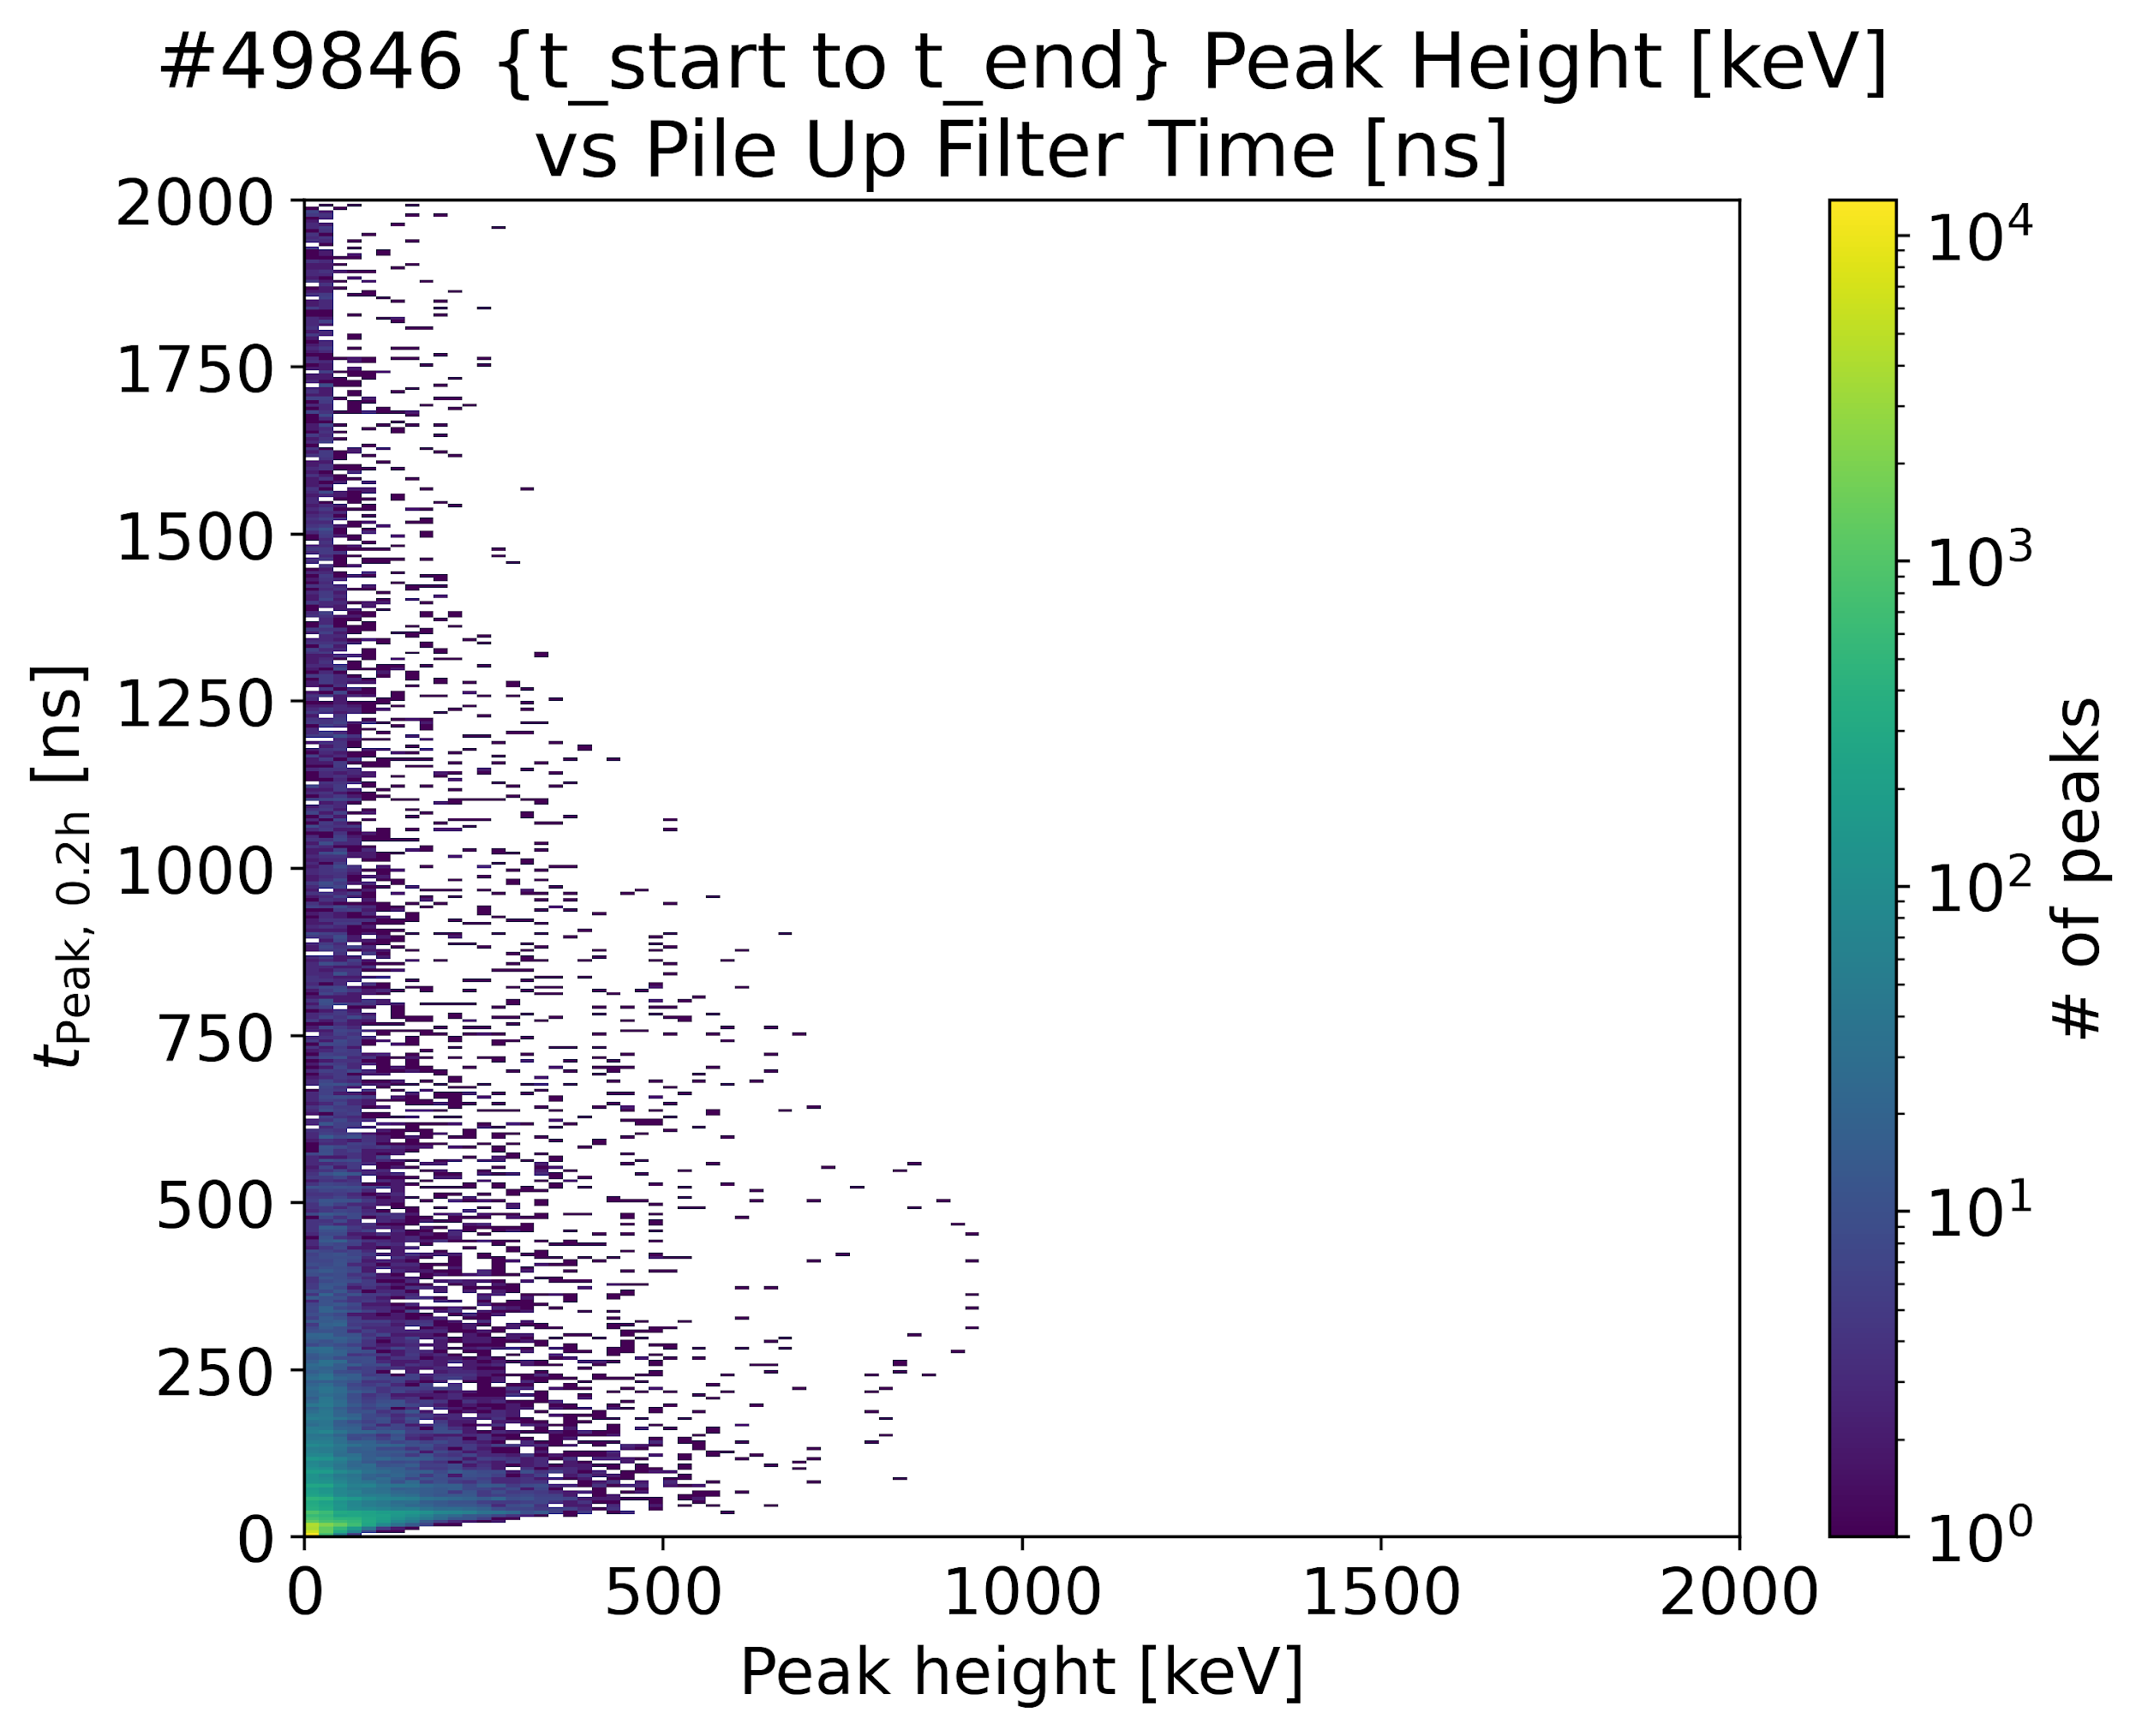
Pulse Shape Discrimination
CeBr-A (Shielded)
CeBr-A (Unshielded)

Slide 10
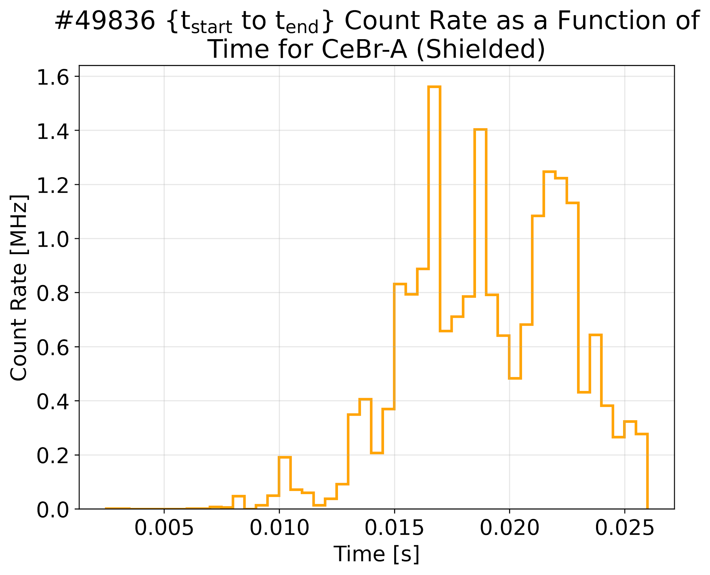
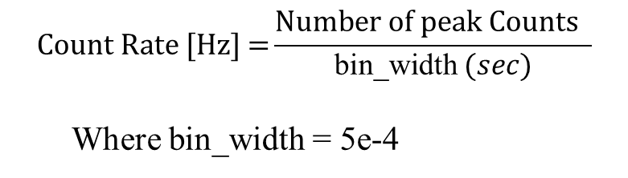
Count Rate
Count rate is how fast the detector is registering pulses (events per second).

Slide 11
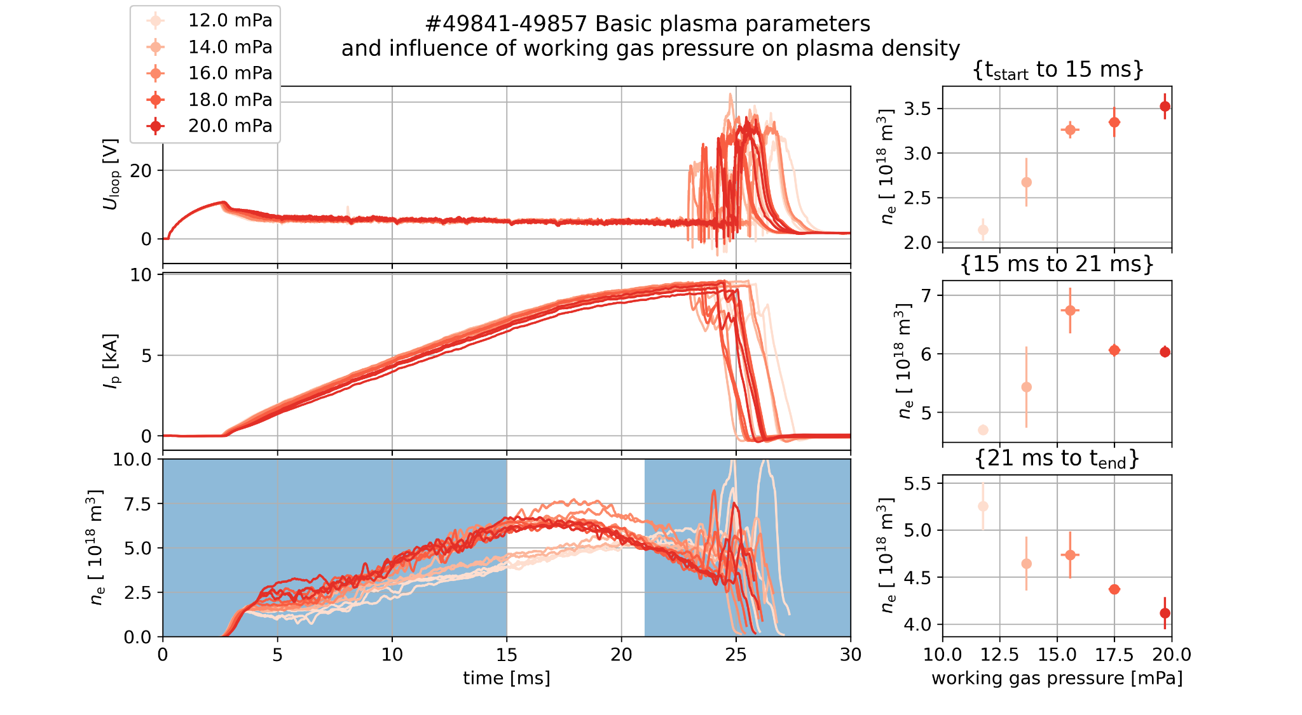
Same discharge parameters apart from gas pressure
  Repeatable
    U_loop
    I_p
Gas pressure dictates plasma density only on beginning of discharge
Notes:
show here probably Marek figure, where is nicely present that in the first 15 ms the request pressure quite nicely corresponds to rising density, but at the later part its more “random” (probably plasma movinga and touching the wall, thus releasing a lot of runaways as well)
-> so that should be your explanation why we divided our analysis into two parts - up to 15 ms vs the whole discharges with emphasis that up to 15 ms is should be easier explainable

Slide 12
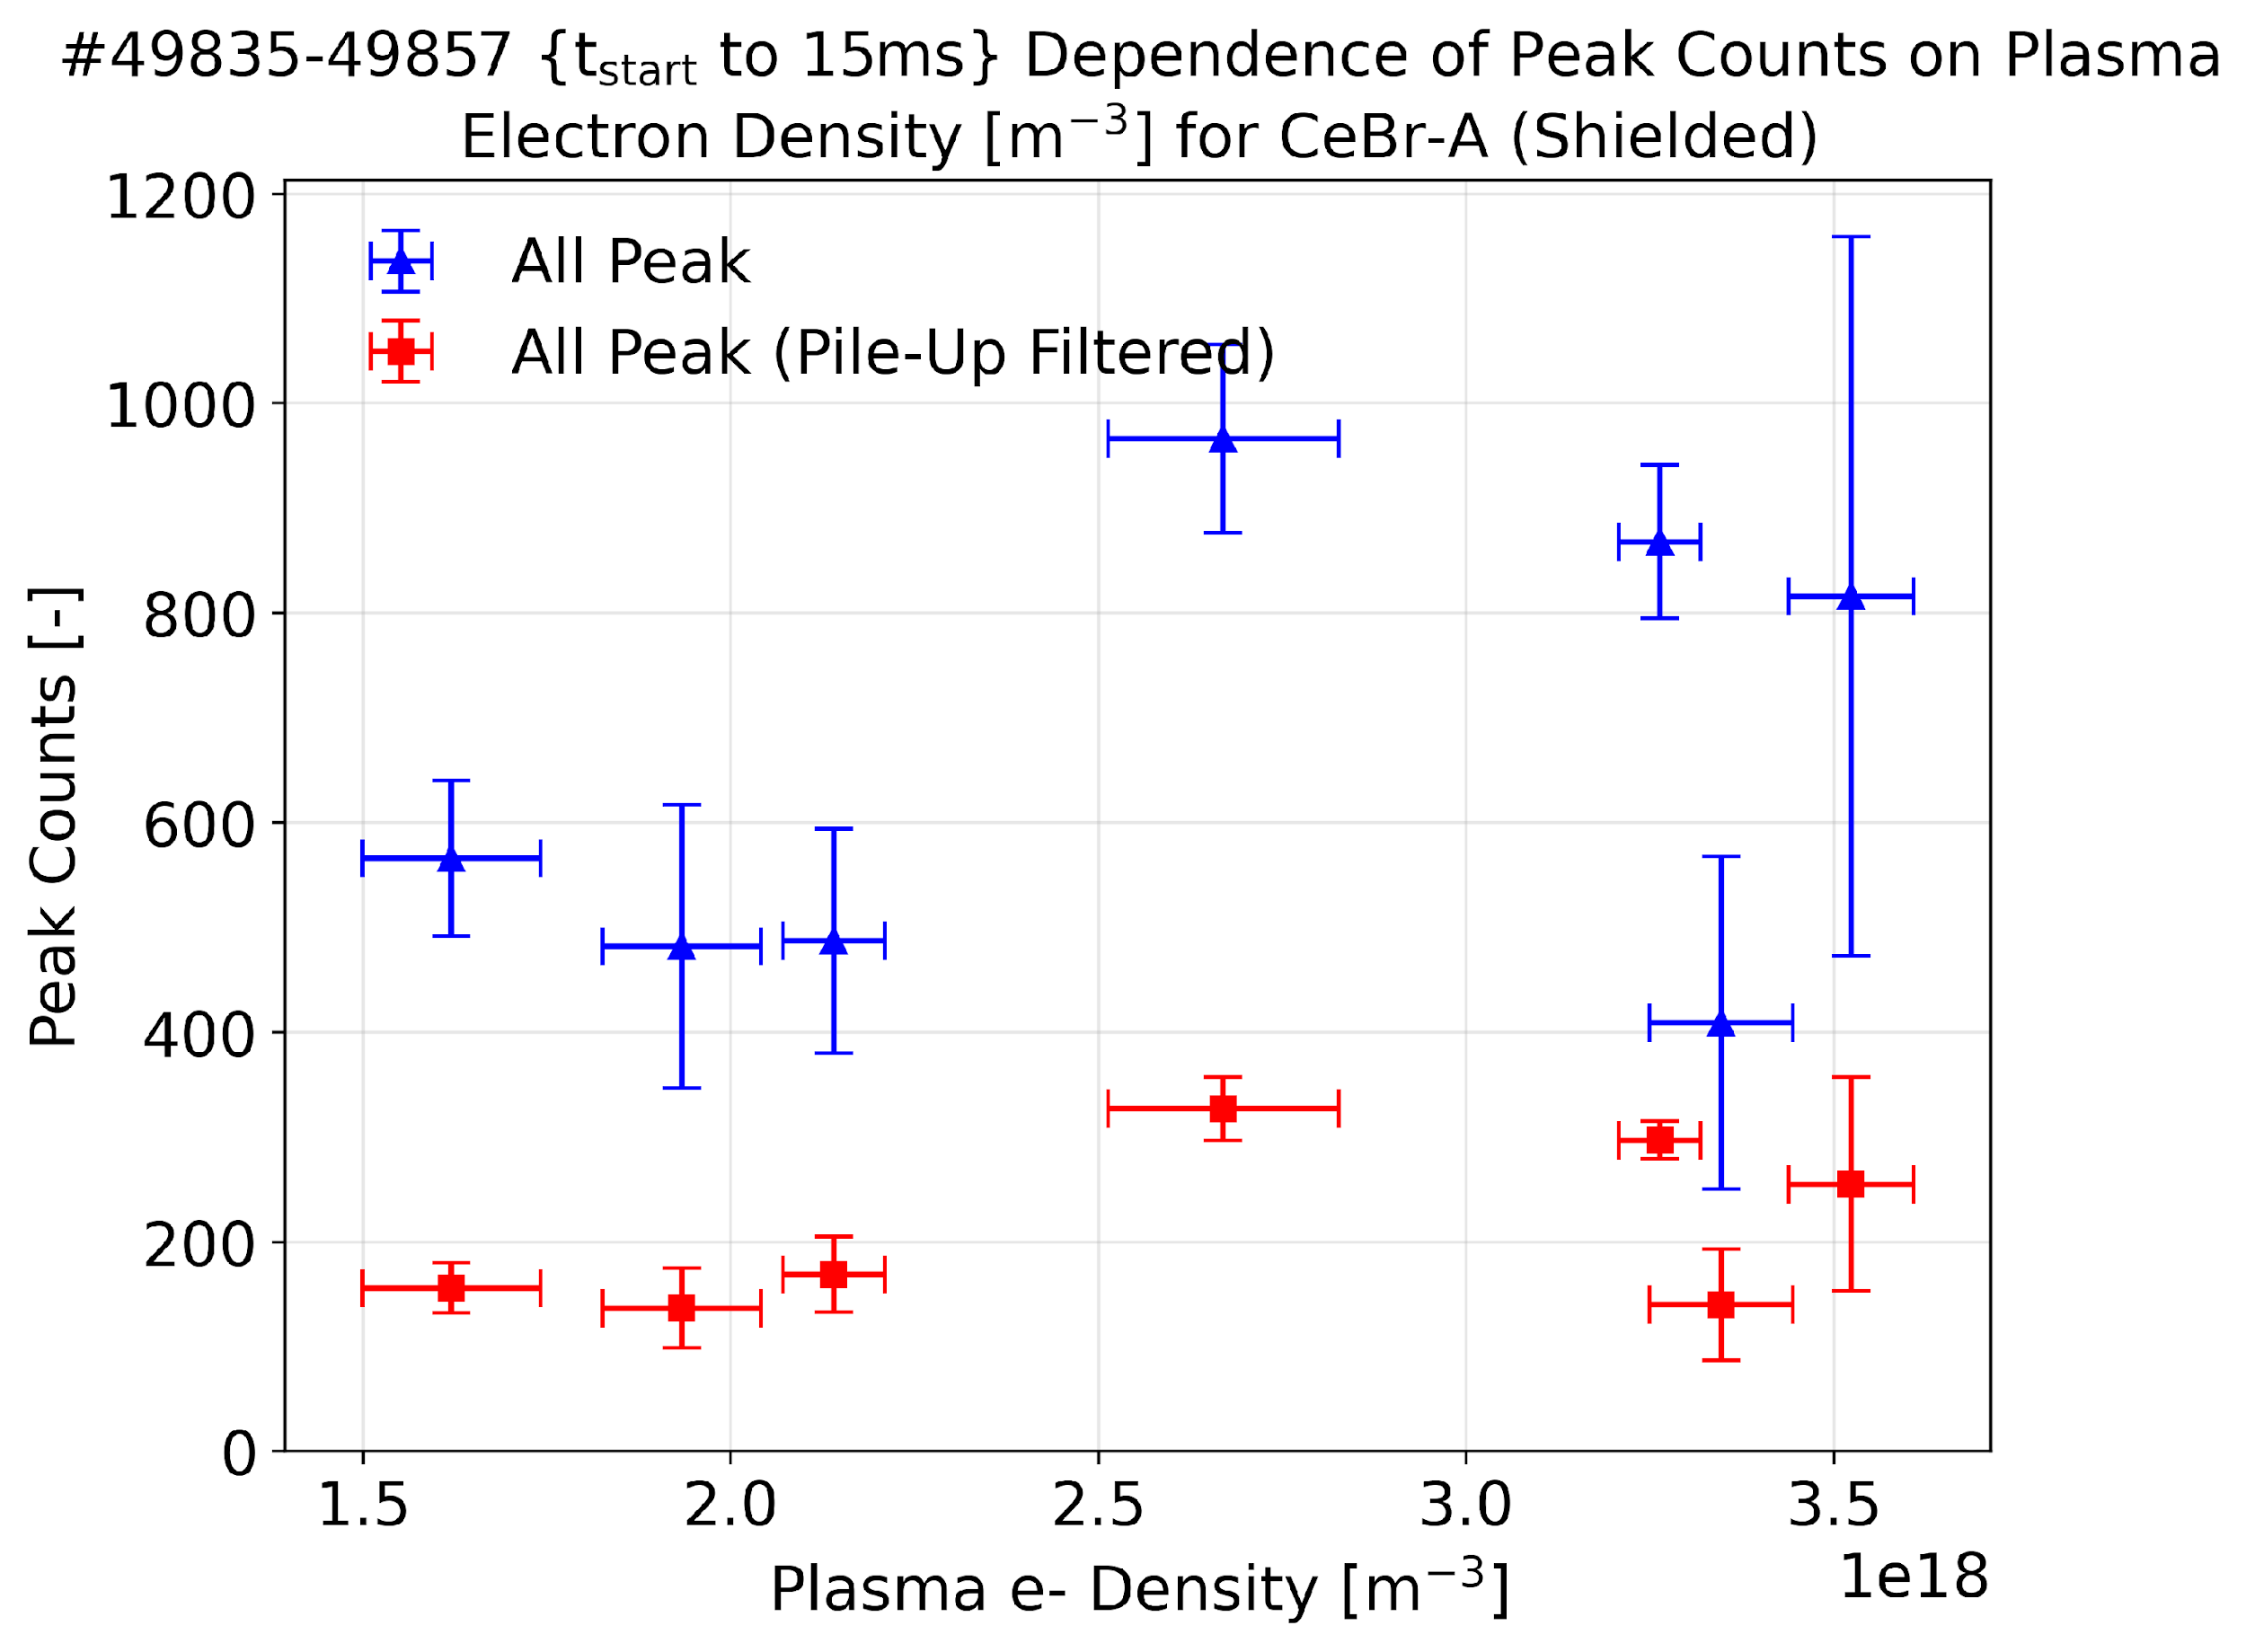
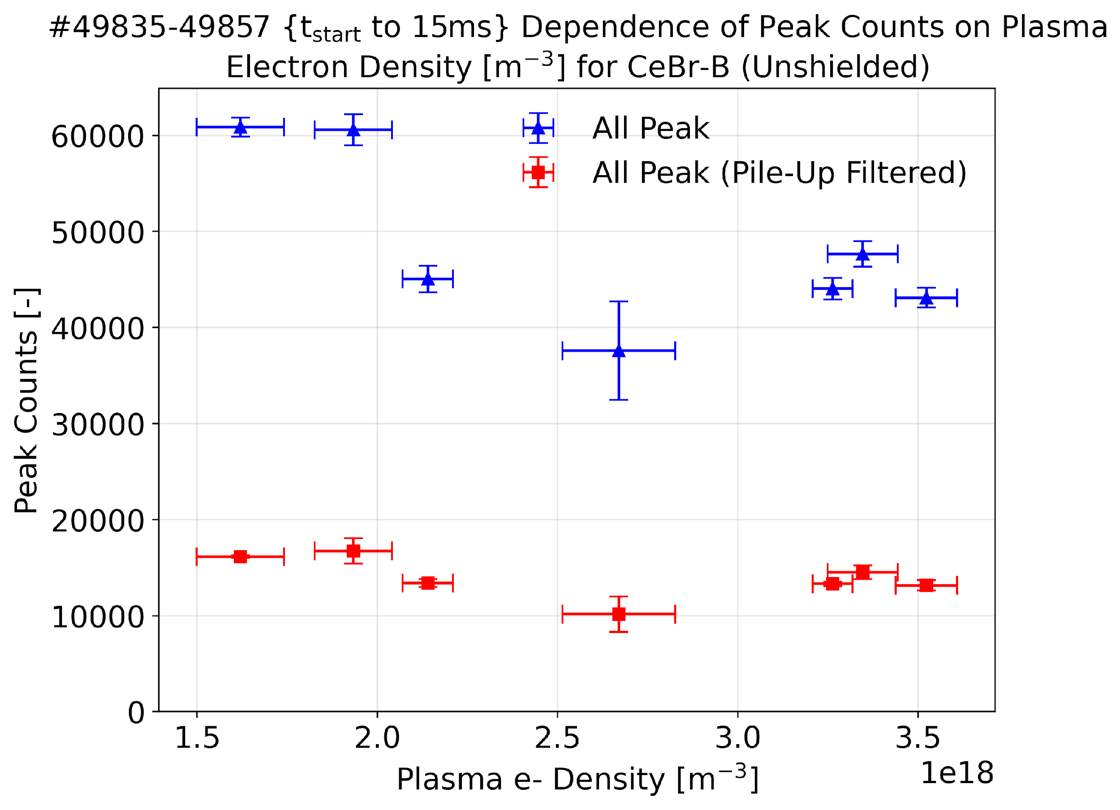
Peak Counts on Plasma Electron Density
Plotting
Calculating
mean & SDE
Removing offset from Energy vs time spectrum
Counting peaks
of every shot
Plasma e- Density
for every shot
t_{start} to 15 ms

Slide 13
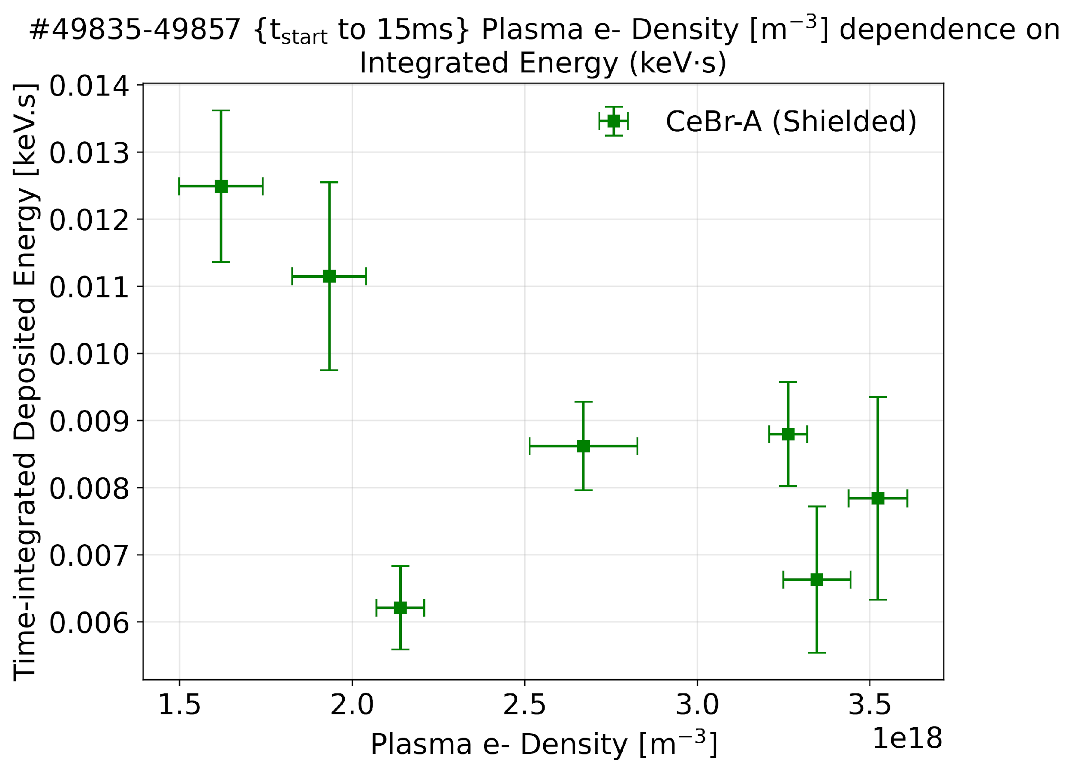
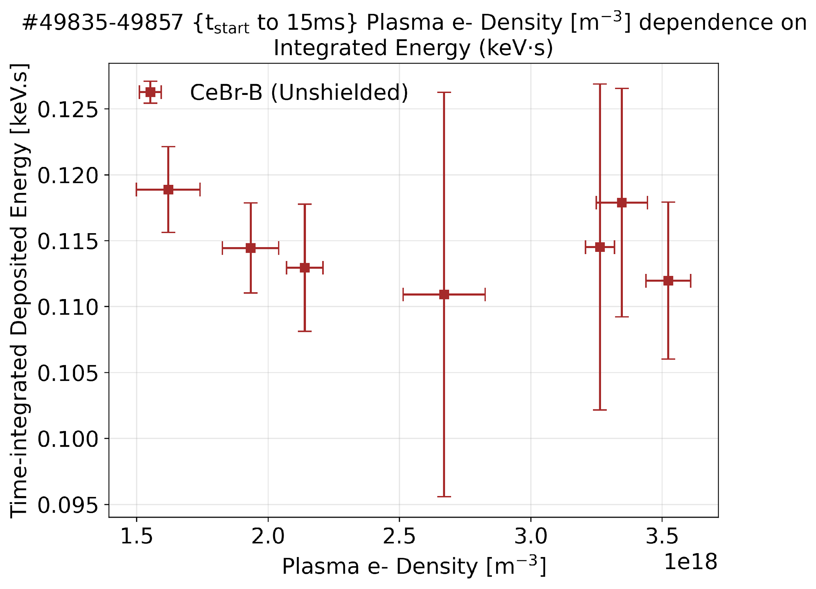
Total Energy on Plasma Electron Density
Plotting
Calculating
mean & SDE
Removing offset from Energy vs time spectrum
Integrating every shot with time
Plasma e- Density
for every shot
t_{start} to 15 ms

Slide 14
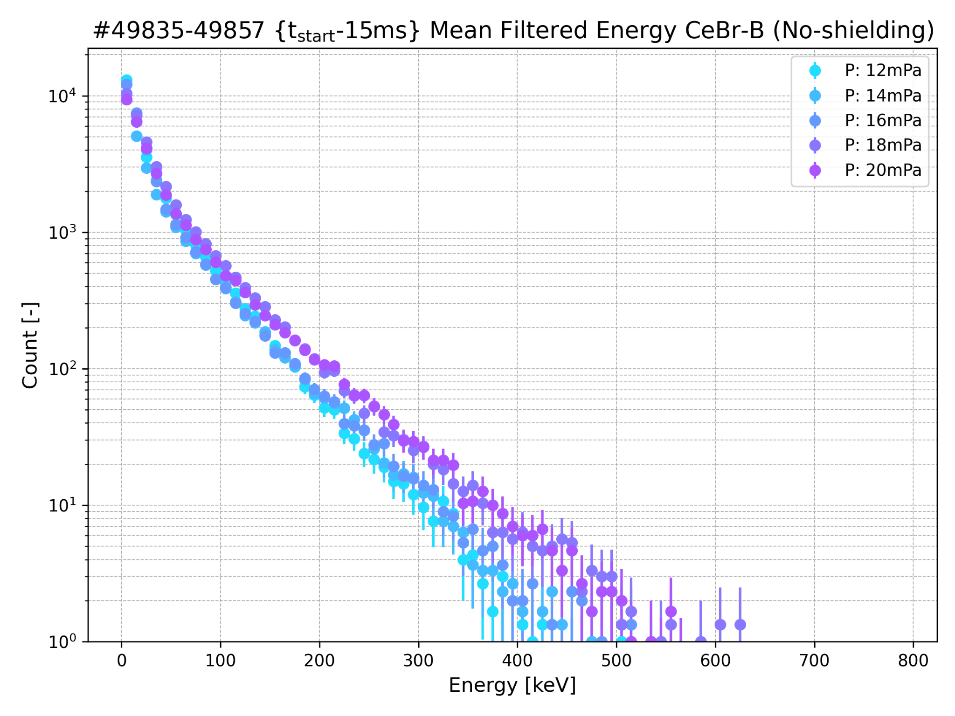
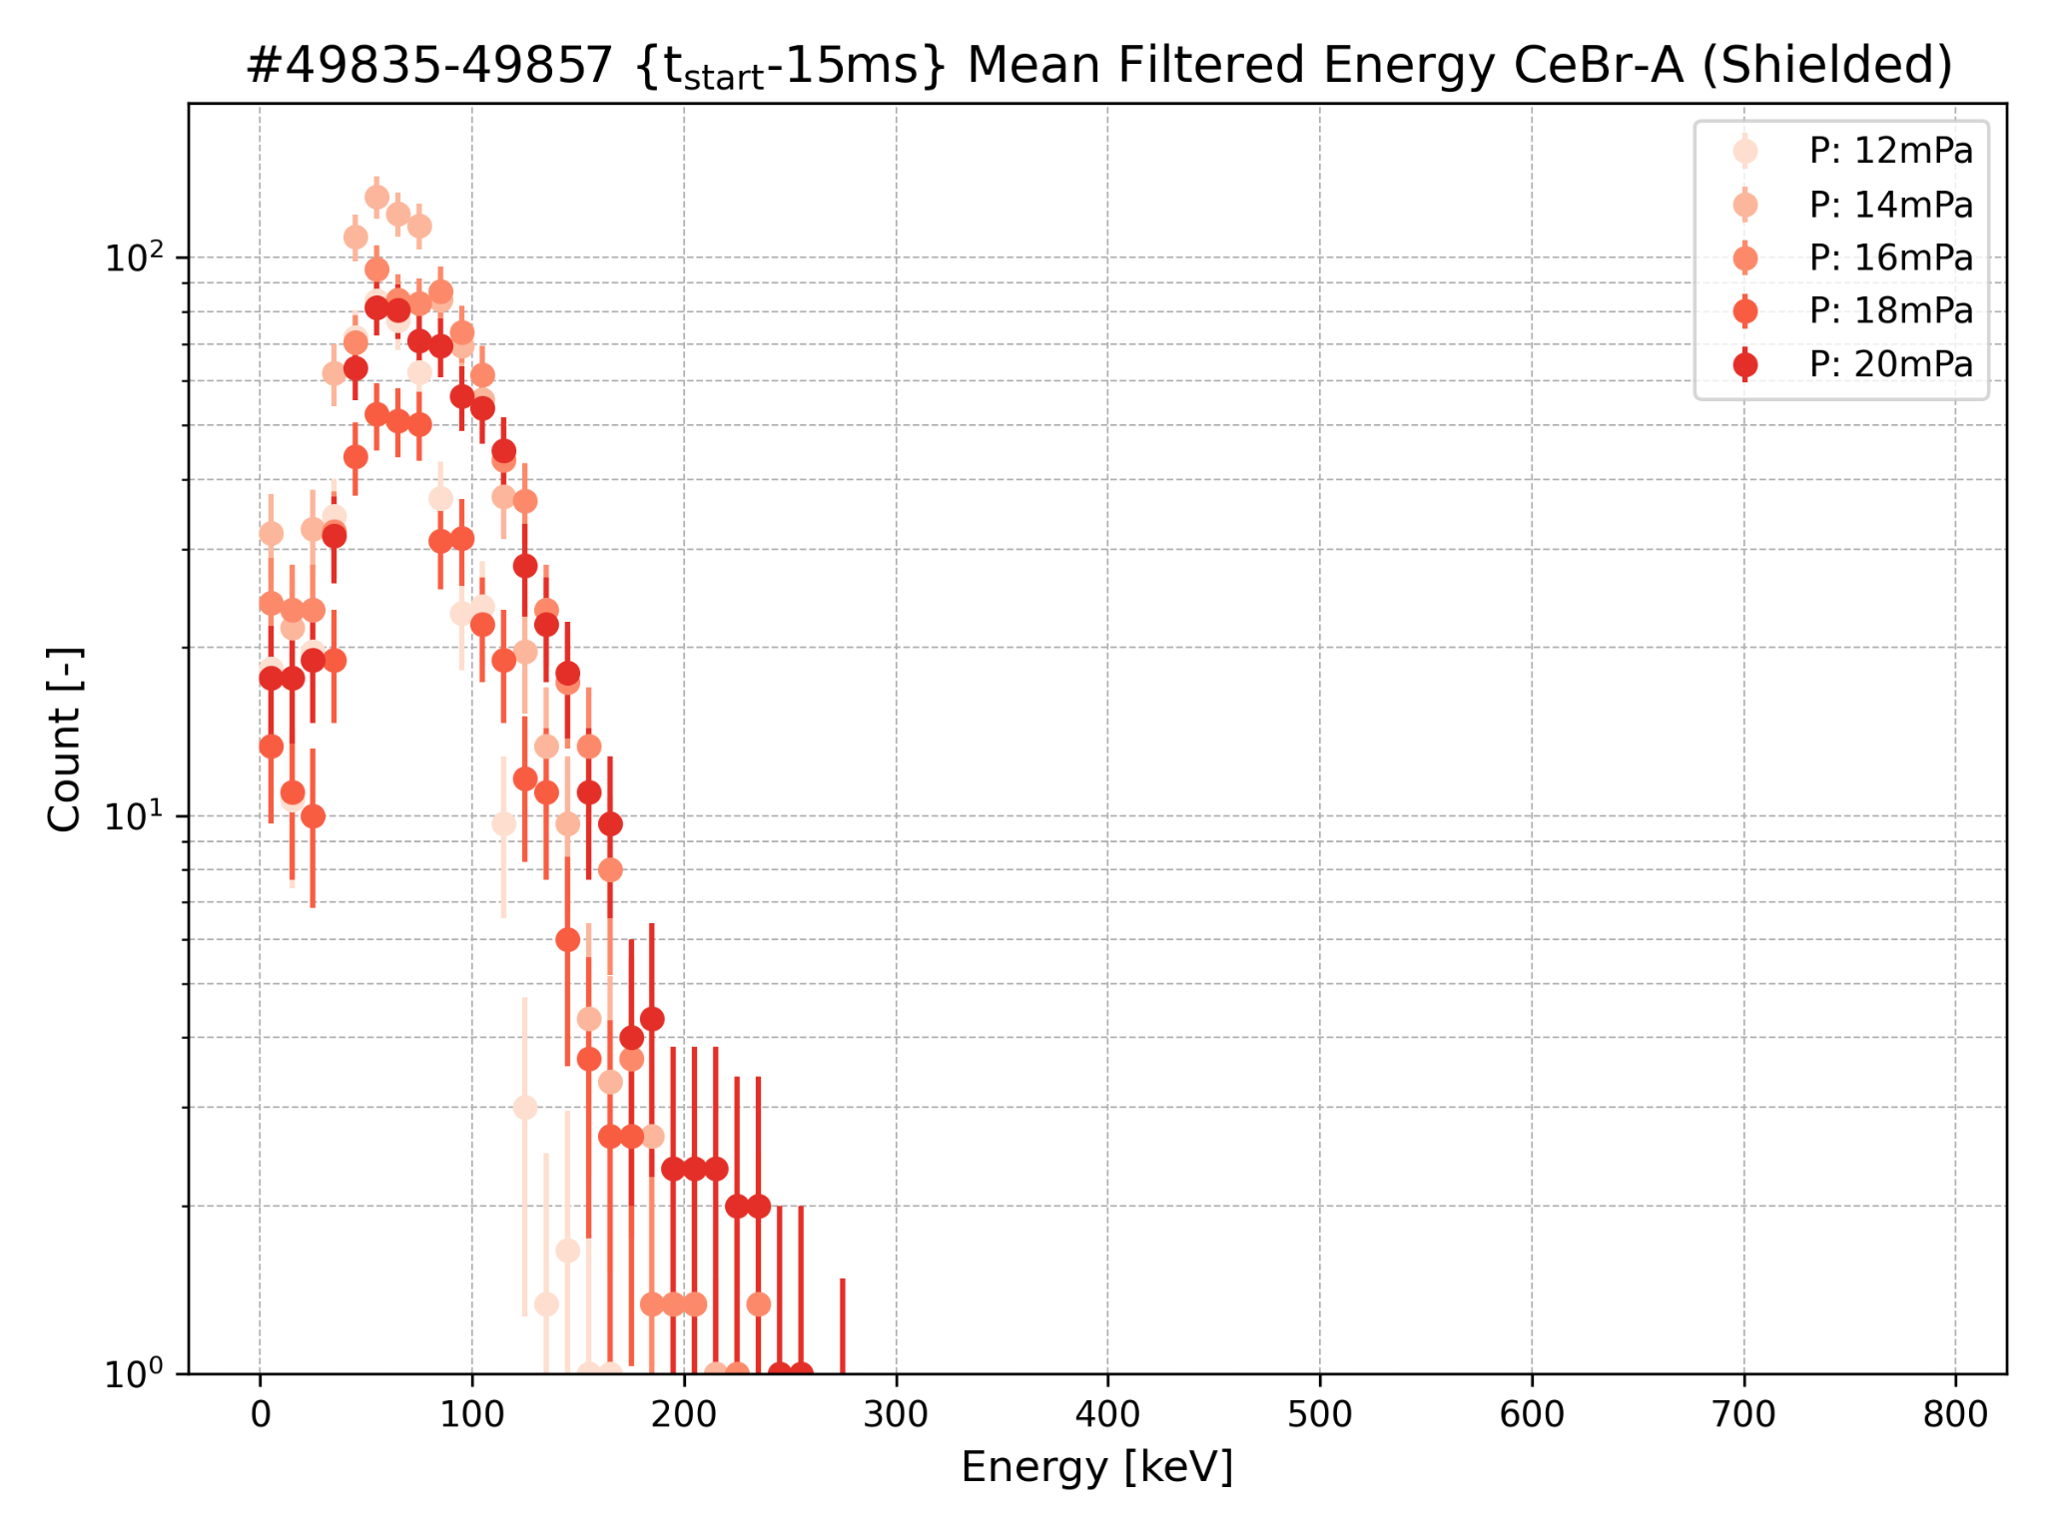

Slide 15
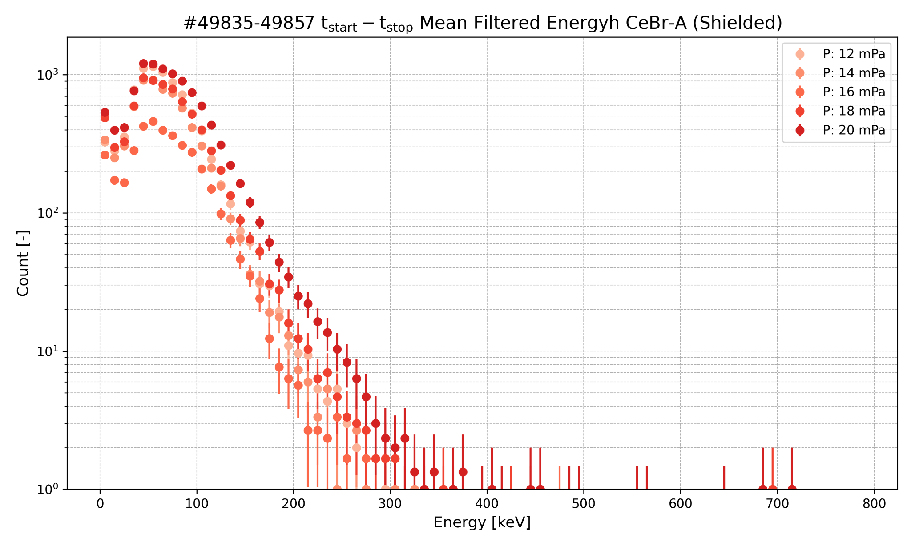

Slide 16
Detector successfully calibrated.
Pileup reduced through filtering to get reliable signals. PSD analysis demonstrated clear signal discrimination.
Time vs. count rate analysis confirmed detector stability and response.
Plasma density validation confirmed measurement accuracy.
Peak count showed consistent dependence on plasma density.
Integral vs density showed decreasing dependence. (as generally expected)
Interesting result: Energy spectra seems to shift into higher RE energies with increasing density. (less expected, needs more detailed analysis for validation)

Slide 17
Backup slides

Slide 18
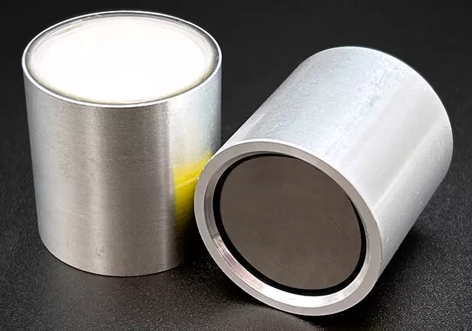
Very high light yield (~60,000 photons/MeV)
Resolution for scintillators (~3–4% at 662 keV)
Low intrinsic background compared to LaBr₃(Ce)
Decay Time = 18 - 25 ns
Lower limit: ~20–30 keV
Upper limit: up to 3–5 MeV
Covers HXR (~20–200 keV) and extends into γ-rays
https://www.epic-crystal.com/scintillation-crystals/cebr3-crystal.html
Notes:
demonstrate what is pile-up vs nice peak
describe verify briefly PSD you used for get rid of pile-ups
plot those nice figures for psd
compare the results for shielded/unshielded

Slide 19
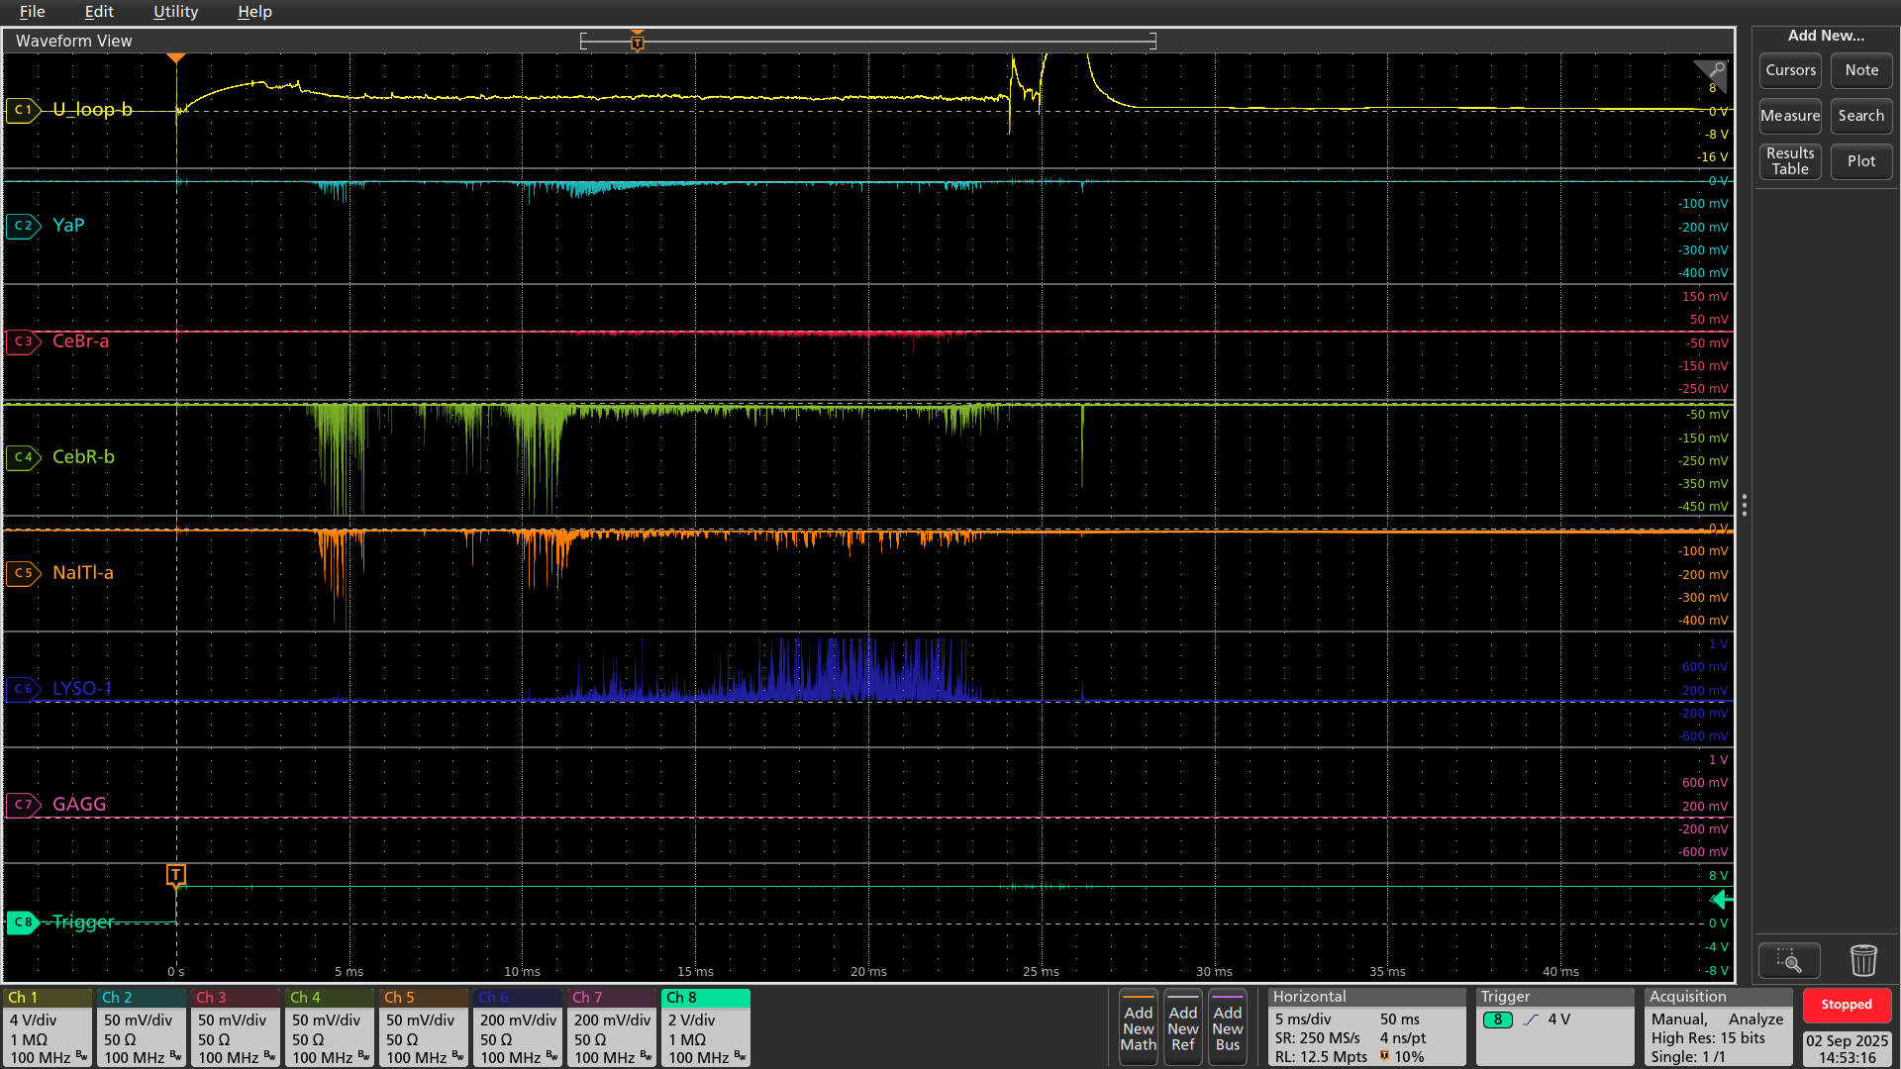
Shot no: #49836

Slide 20
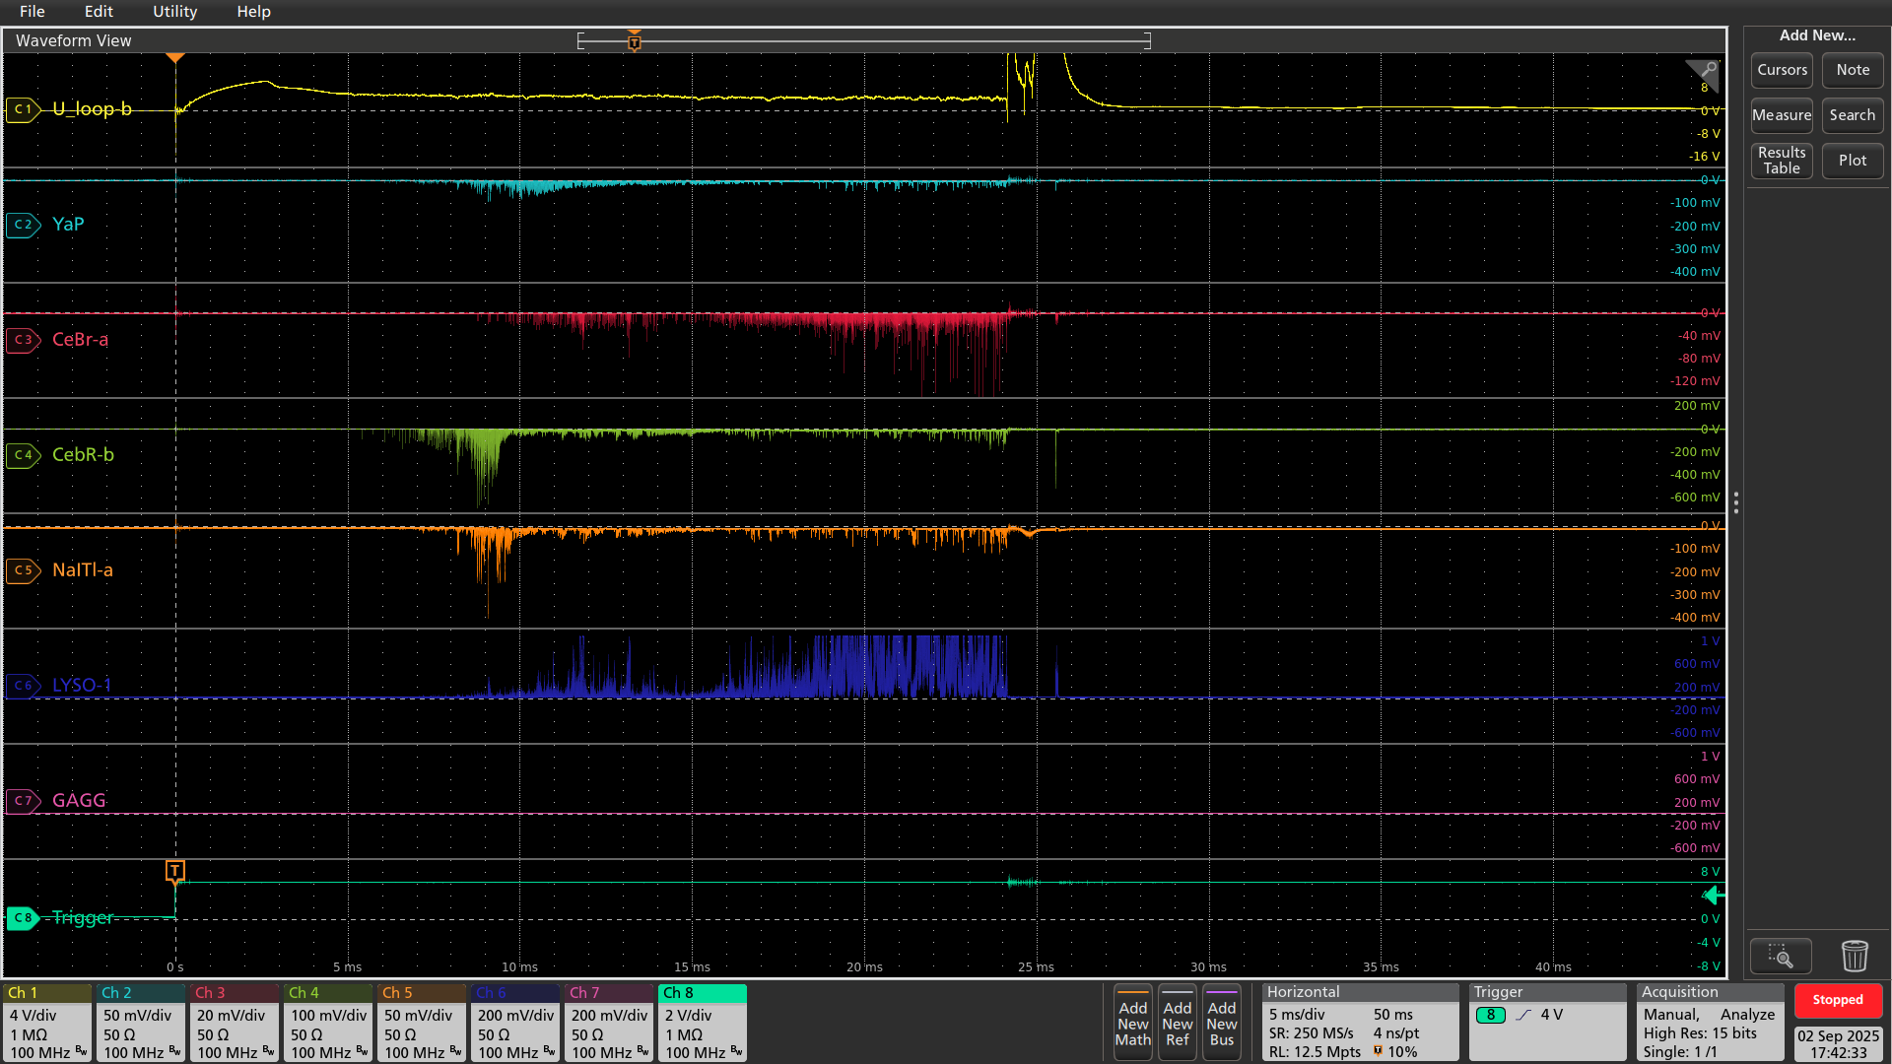
Shot no: #49856

