Slide 1
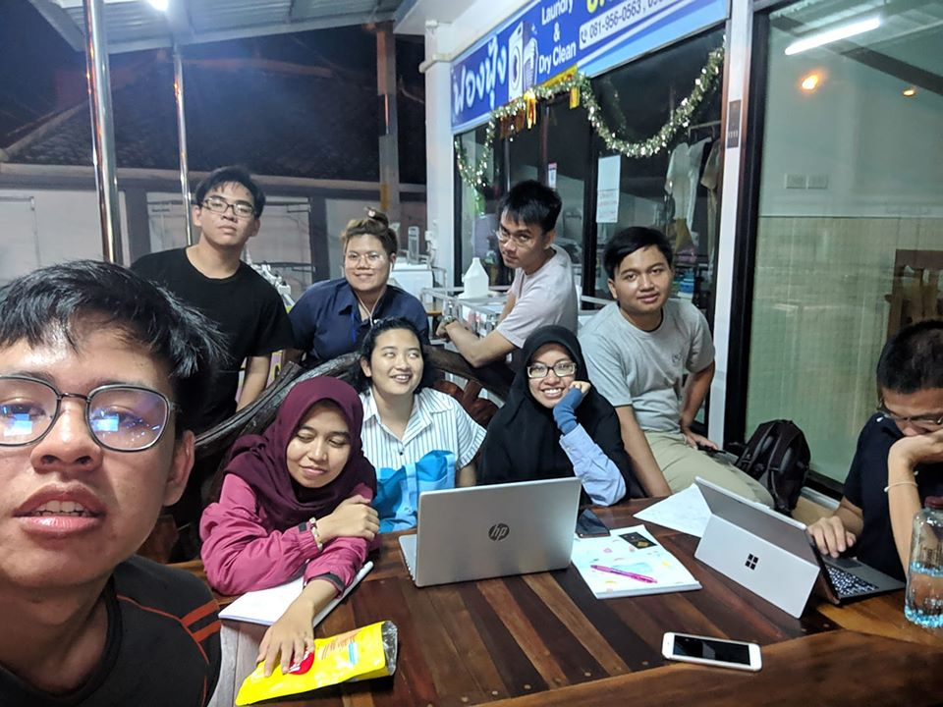
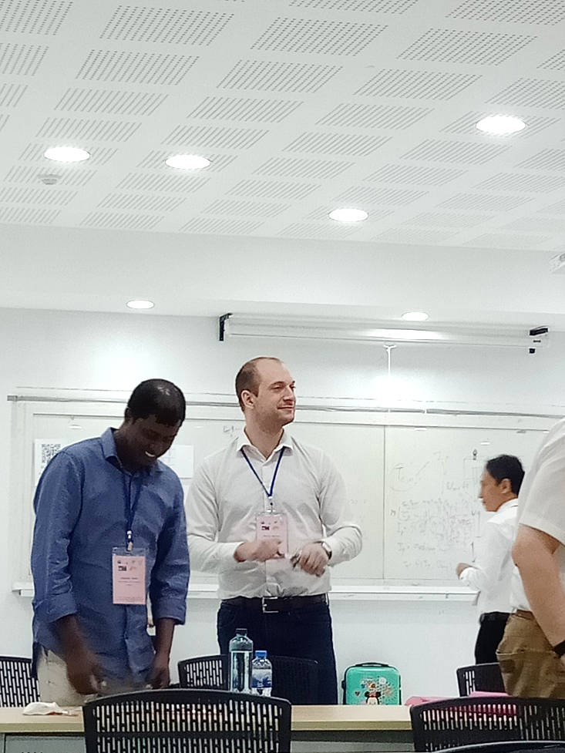
GROUP 5
Experiment on GOLEM - 2020
Member
CHANCAI JARASBOONSAREA
SURIN SERMSUKROONGSAKUL
KRIANGDET NAKPRASERT
TAWEEWAT HOMHUAN
NATTAKARN SOMJAIMAK
PEEMSINEE PHUANGMALA
APISIT DANG-IAD
HOANG TUAN DUC
MARTIN MATUSU
FIRLIYANI RAHMATIA NINGSIH
RAHMAT PUTRA PAMUNGKAS
RAISYA SALSABILA

Slide 2
GOALS
Try to find the relation between the UCD and the Confinement Time
Try to find the relation between UCD , UB and temperature of plasma

Slide 3

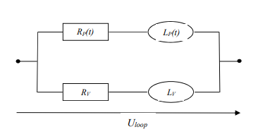







INTRODUCTION
Theoretical ideas
Faraday's law:
Integrated:
proportional:
$$I_{Total}$$
$ϕ$
$I_{Total}=I_{v}+I_{p}$
$$I_{p}$$
$U_{loop}=R_{v}I_{v}+L_{v}\frac{dφ}{dt}$

Slide 4
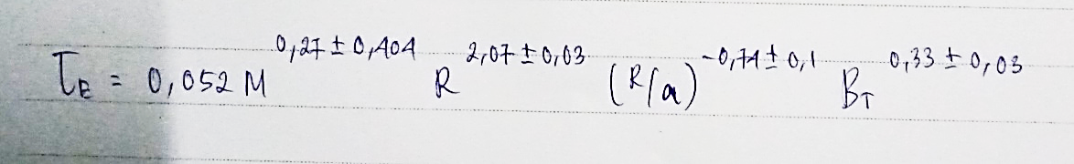
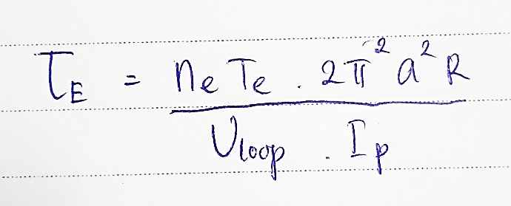
INTRODUCTION
Theoretical ideas
Time Scaling
Confinement Time

Slide 5

PULSE PLAN AND REALISATION
Temperature
Confinement Time
Maximize Temperature
UB = 600 V
UB = 750 V
UB = 850 V
UCD = 300 V
UCD = 400 V
UCD = 500 V
UB = 900 V
t = 5 ms
PH2 = 20 mPa
UCD = 400 V
UCD = 550 V
UCD = 700 V
PWG = 30 mPa
TCD = 1000 $μs$

Slide 6
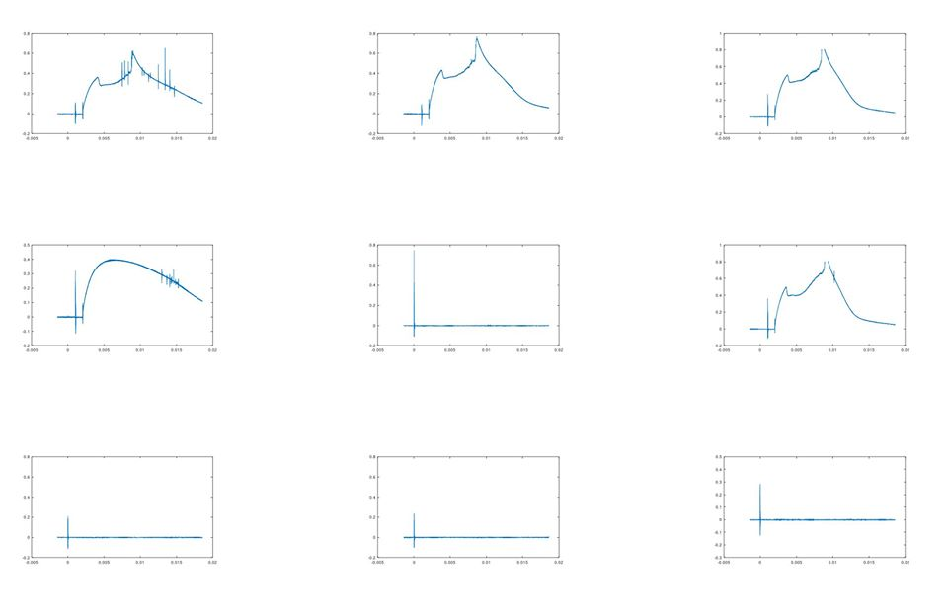
Result
U_{CD}
U_{B}

Slide 7
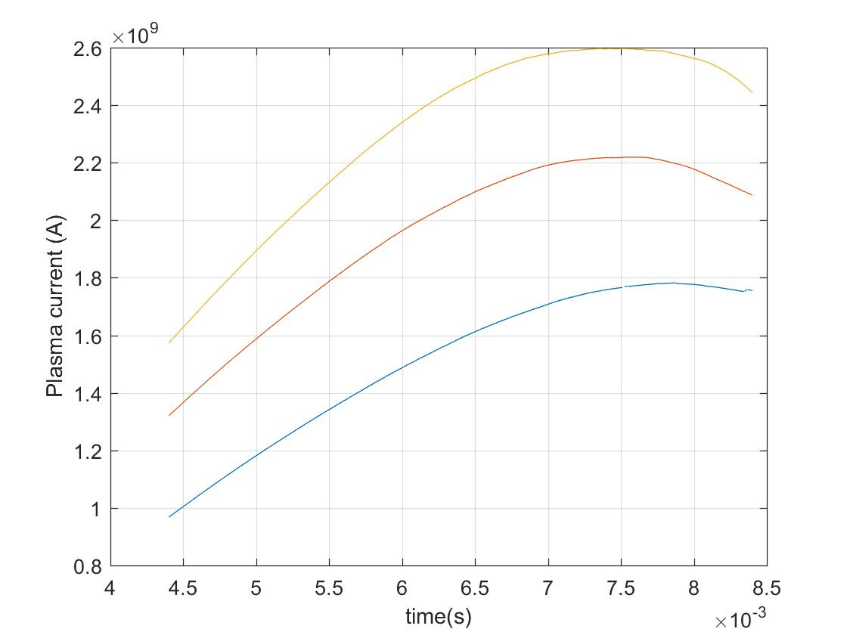
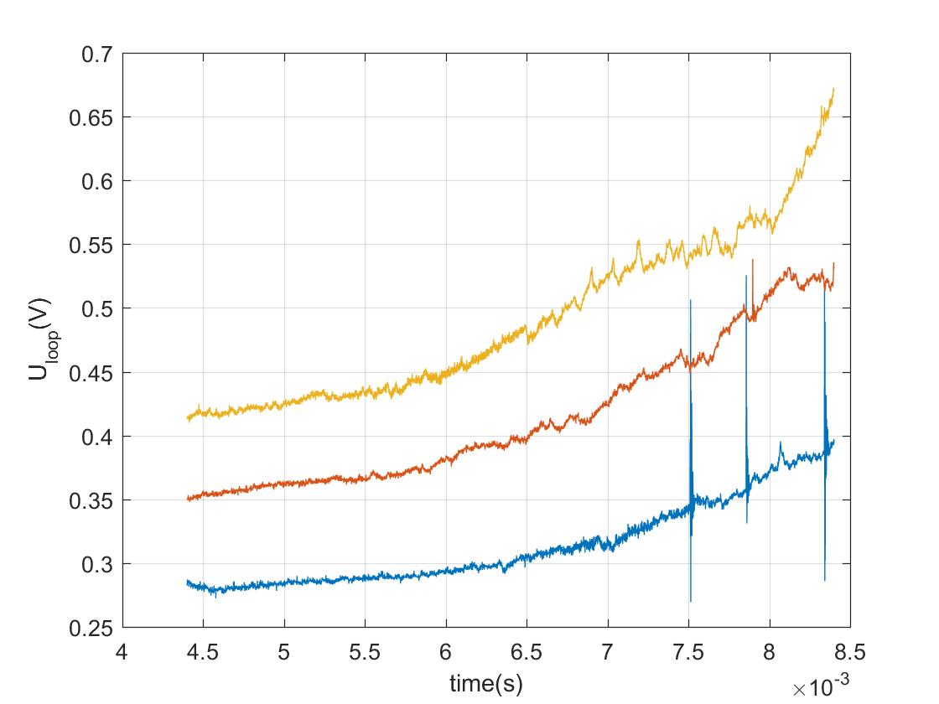
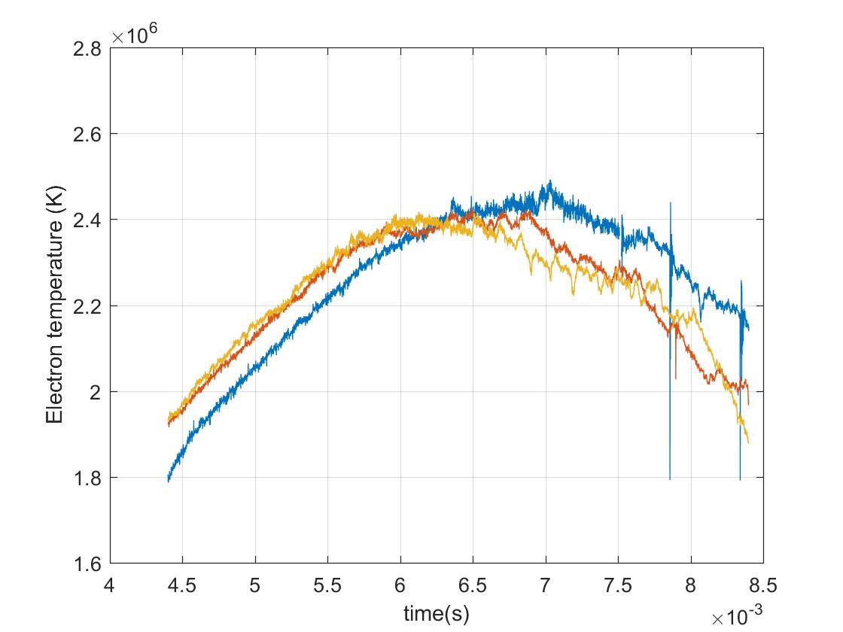
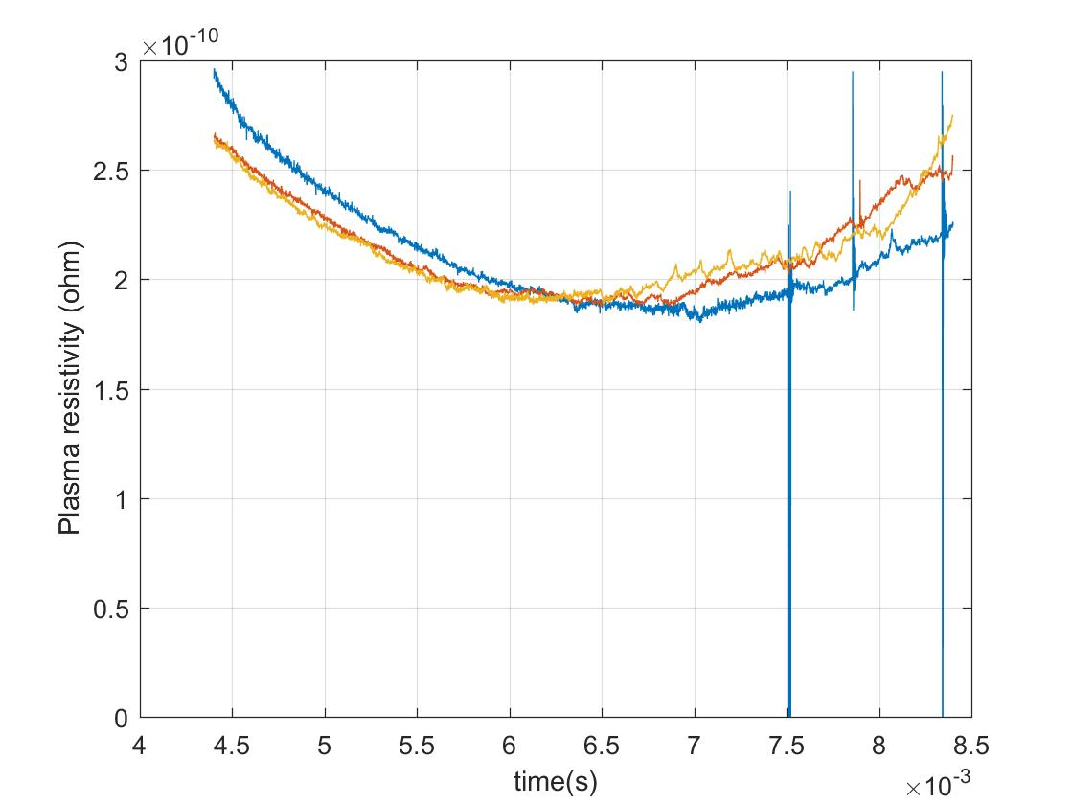
INTERPRETATION
Temperature
(Vary Ucd)
Blue = 400 V
Red = 550 V
Yellow = 700 V
1
2
3
4

Slide 8
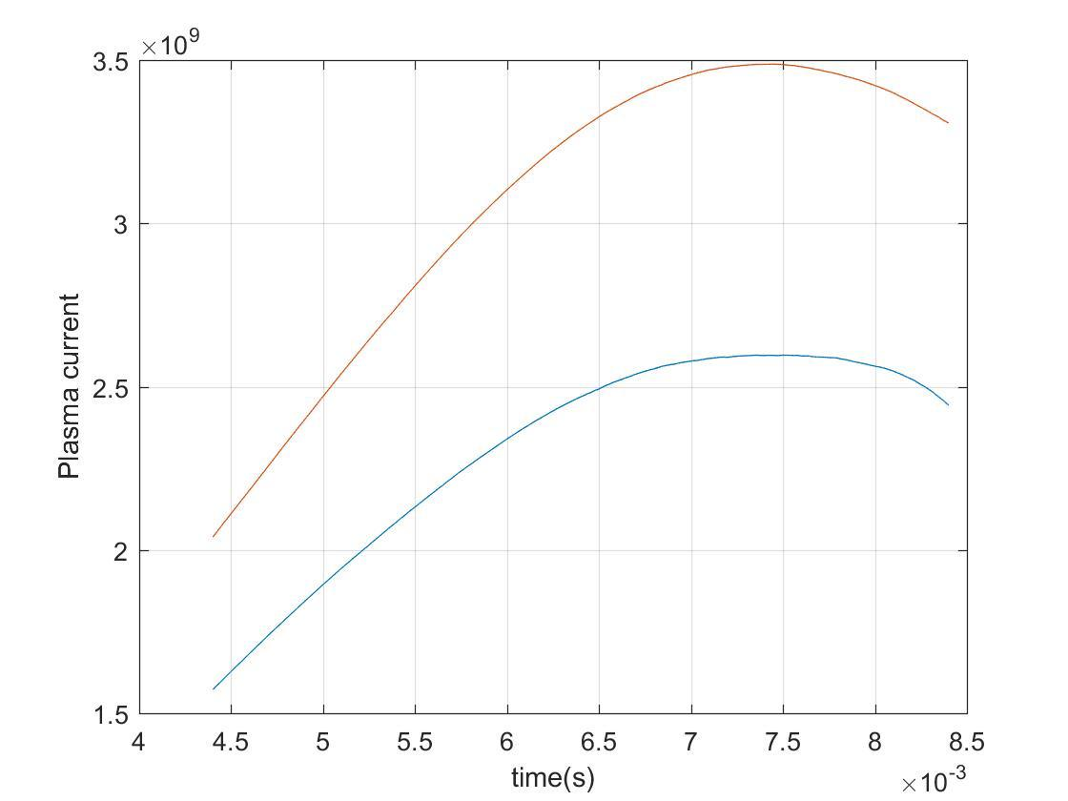
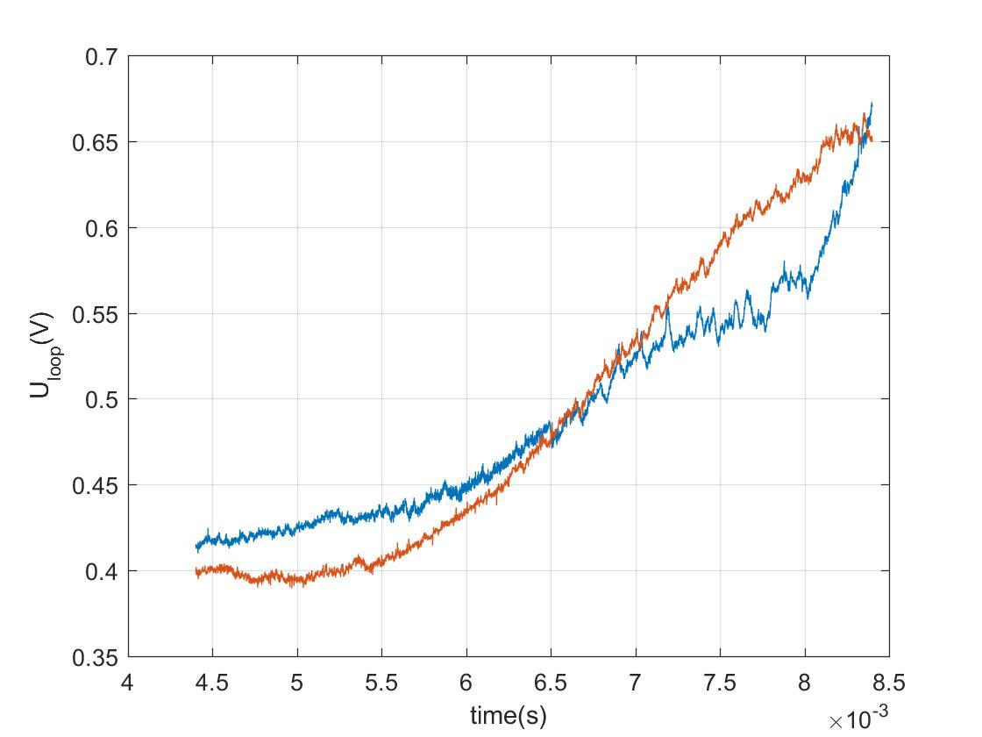
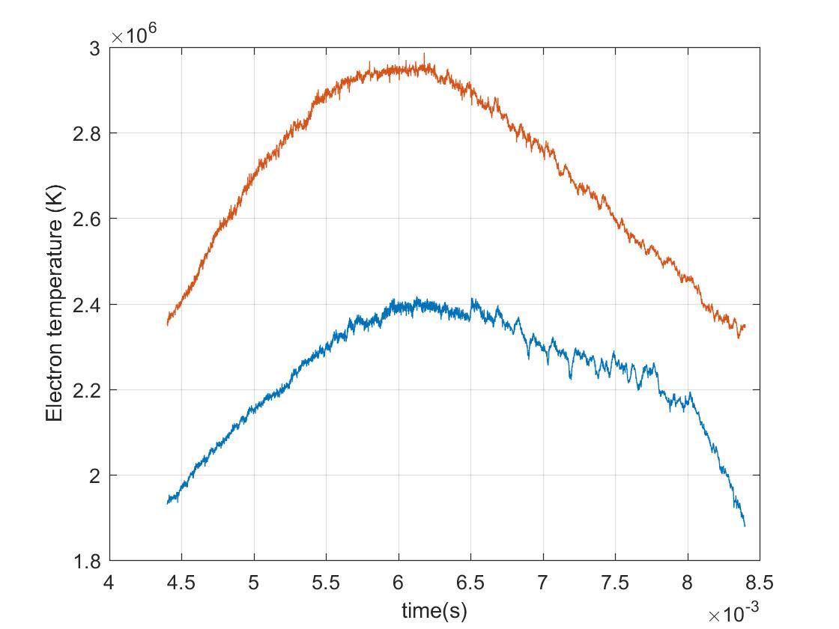
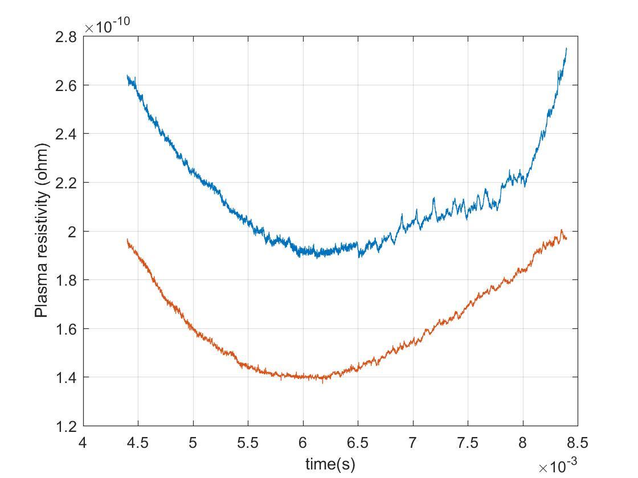
Vary UB
Blue = 600 V
Red = 750 V
1
2
3
4

Slide 9
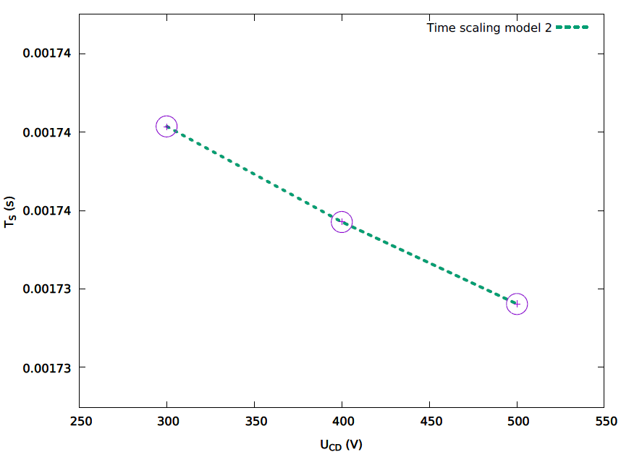
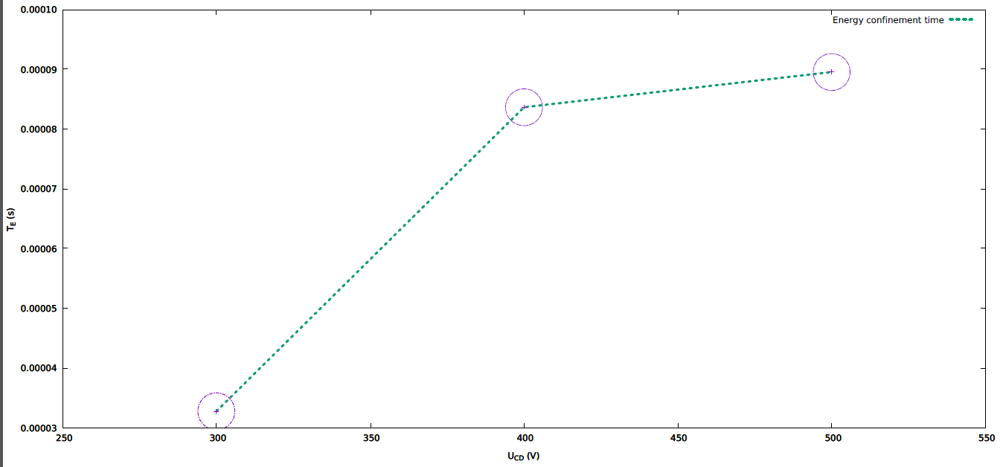
Confinement Time

Slide 10
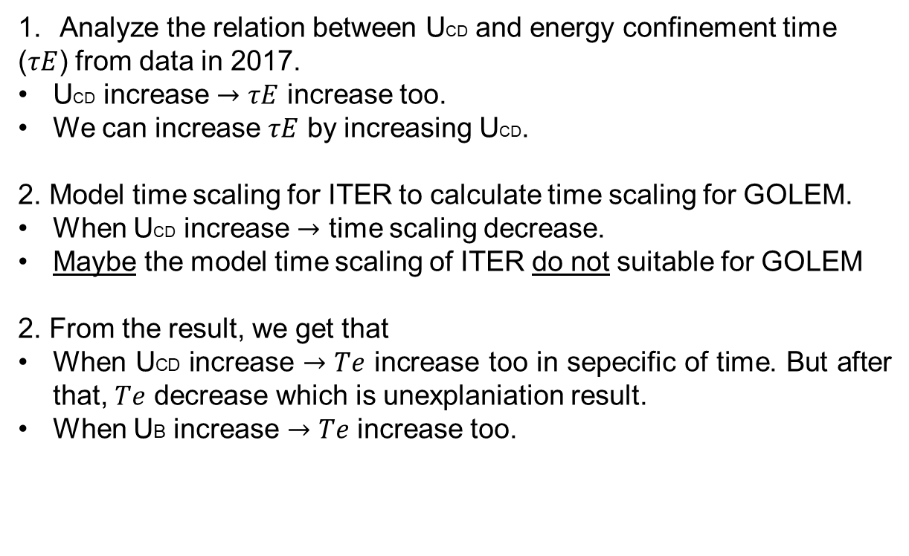
CONCLUSION
Analyze the relation between UCD and energy confinement time
($τE$) from data in 2017.
UCD increase $→τE$ increase too.
We can increase $τE$ by increasing UCD.
2. Model time scaling for ITER to calculate time scaling for GOLEM.
When UCD increase $→$ time scaling decrease.
Maybe the model time scaling of ITER do not suitable for GOLEM
2. From the result, we get that
When UCD increase $→Te$ increase too in sepecific of time. But after that, $Te$ decrease which is unexplaniation result.
When UB increase $→Te$ increase too.

Slide 11
Thank you
for your attention.

