Slide 1
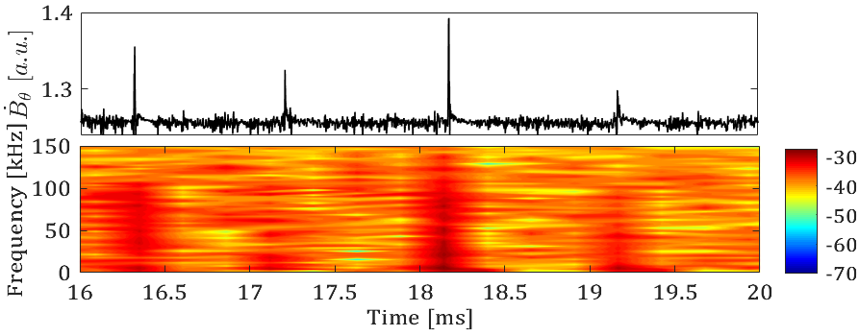
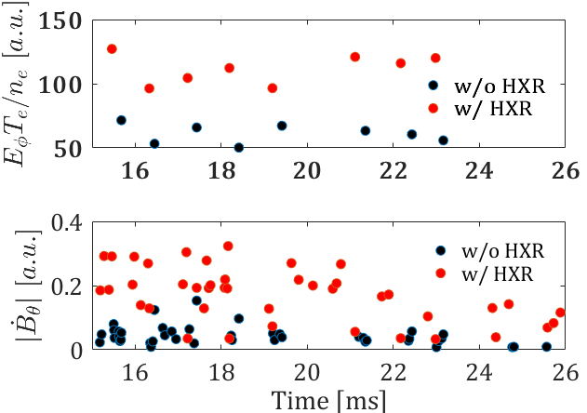
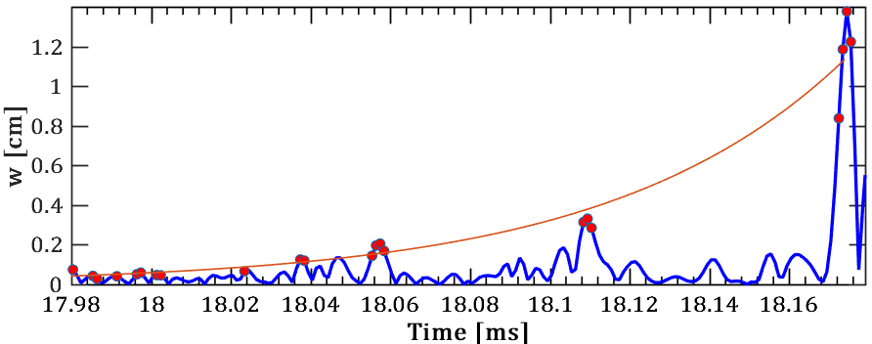
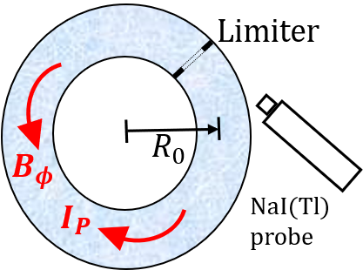
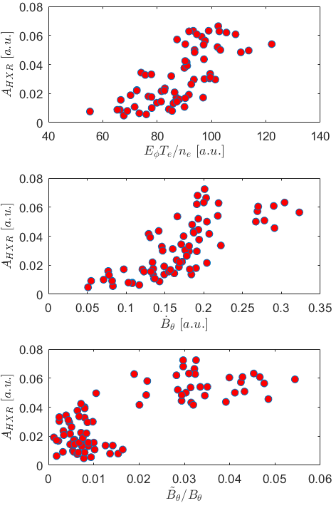
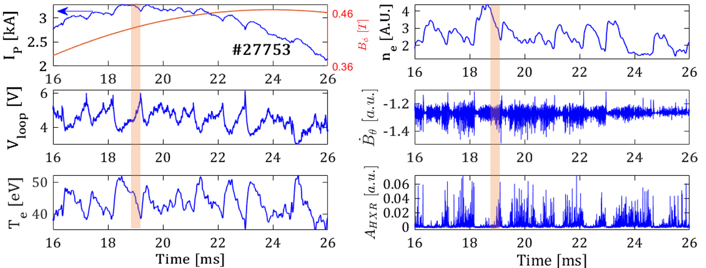
Study of Runaway Electrons in GOLEM Tokamak
Pravesh Dhyani¹, Vojtěch Svoboda¹, Jan Mlynář^{1,2}, Jaroslav Čeřovský^{1,2}, Ondřej Ficker², Vladim$\acute{i}$r Linhart³, Jan St$\ddot{o}$ckel^{1,2}
¹Department of Physics, Faculty of Nuclear Sciences and Physical Engineering, Czech Technical University, Prague, Czech Republic
²Institute of Plasma Physics, Czech Academy of Sciences, Prague, Czech Republic
³Department of Dosimetry and Application of Ionizing Radiation, Faculty of Nuclear Sciences and Physical Engineering, Czech Technical University, Prague, Czech Republic
Abstract: High loop voltage and low-density discharges at GOLEM tokamak present favorable conditions for the study of runaway electrons (RE). In this paper, we discuss the interplay between magnetic hydrodynamic (MHD) fluctuations and runaway electrons. In quasi-periodic events, HXR generated due to the RE during the destabilization of the tearing modes. Tearing modes become stable at the time when HXRs are suppressed. During the HXR emission, high amplitude poloidal magnetic fluctuations and toroidal electric field were measured outside the tokamak. Analysis suggests that parallel electric field induced by magnetic reconnections due to the tearing modes excitation triggers the RE generation.
Inner (SS) tube, 2. Oe, 3. Long bellow, 4. Short bellow,
5. Electrical feed through (insulated w
Temporal profile of toroidal electric field $\left(E_{φ}\right)$ normalized with Dreicer field $\left(n_{e}T_{e}^{−1}\right)$ and ${\dot{B}}_{θ}$ oscillations amplitude for the HXR and non-HXR cases (#27753).
Excitation of multiple harmonics of tearing modes up to $\sim 100kHz$ recorded in ${\dot{B}}_{θ} signals$at the time of HXR emission
[dB]
Experimental Setup and Conditions
GOLEM and Plasma Parameters (Shot No. #27753)
Major radius (R₀) =0.40m; Minor radius (a) =0.085m
Plasma current (I_{P})~ 3.3kA; clockwise as viewed from top
Toroidal magnetic field (B_{ϕ})~ (0.4-0.45)T; anticlockwise as viewed from top
Edge safety factor q_{a} ~10-11
Plasma density < 1.0×10¹⁹m⁻³
Electron temperature ~ (40-60)eV
Island growth and parallel electric field generation due to the magnetic reconnection of tearing modes
Schematic lay-out of the experiment at GOLEM tokamak (#27753)
GOLEM tokamak discharge #27753 showing quasi-periodic oscillations during the emission and suppression of HXRs
Magnetic fluctuations start growing soon after the rise of plasma current
HXR signal amplitude $(A_{HXR})$ shows linear dependence on normalized electric field $(E_{φ}T_{e}/n_{e})$, magnetic fluctuations${(\dot{B}}_{θ})$amplitude and ${\tilde{B}}_{θ}/B_{θ}$ (#27753)
Magnetic islands grow as $dw/dt\sim (80−90)m/s$ $\text{Island} \text{width} w=2\frac{r_{s}}{m}{\left(\frac{r_{c}}{r_{s}}\right)}^{m}{\left(\frac{{\tilde{B}}_{θ}}{B_{θ}}\right)}^{1/2}\sim (1.5−2.0)cm$
$Parallel electric field E_{||}=\left(\frac{sB_{φ}}{16r_{s}}\right)w\left(\frac{dw}{dt}\right)$ ~ (0.7-0.8)V/m
Summary and discussion
RE generation is triggered by the parallel electric field induced by magnetic reconnections due to the tearing modes excitation.
Reason of quasi-periodic excitation – suppression of tearing modes is not yet fully understood. Particularly, the key component causing fast suppression of the tearing modes.
3. Loss of current causes local peaking of magnetic shear and excites tearing modes. Excitation of the tearing modes due to peaking of magnetic shear can be explained by the linear tearing mode growth rate relation : $γ∝{\left(q^{′}/q\right)}^{2/5}$
Acknowledgements: The work has been supported by the Operational programs RDE CZ.02.1.01/0.0/0.0/16_019/0000778: Centre of Advanced Applied Sciences, and CZ.02.2.69/0.0/0.0/16_027/0008465: International Mobility of Researchers CTU.
Threshold for RE loss: ${\tilde{B}}_{θ}/B_{θ}\sim (1−3)×{10}^{−3}$
High HXR signals: ${\tilde{B}}_{θ}/B_{θ}\sim (2−5)×{10}^{−2}$
3rd European Conference on Plasma Diagnostics (ECPD) 6-9 May 2019 Lisbon, Portugal

