Slide 1
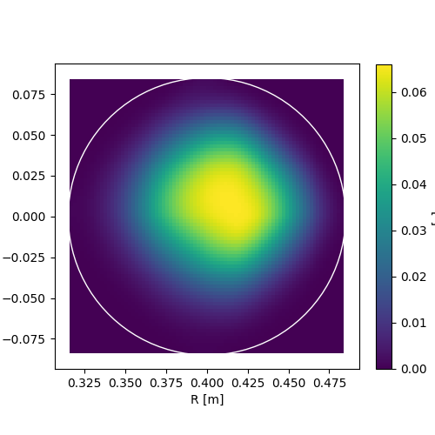
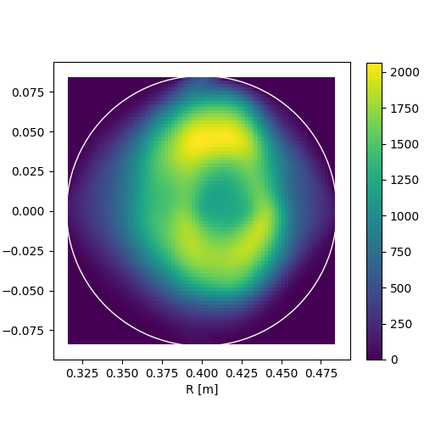
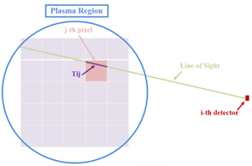
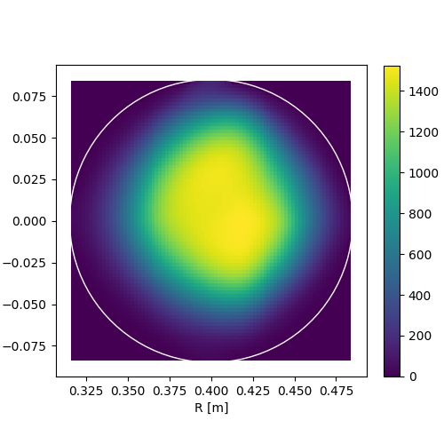
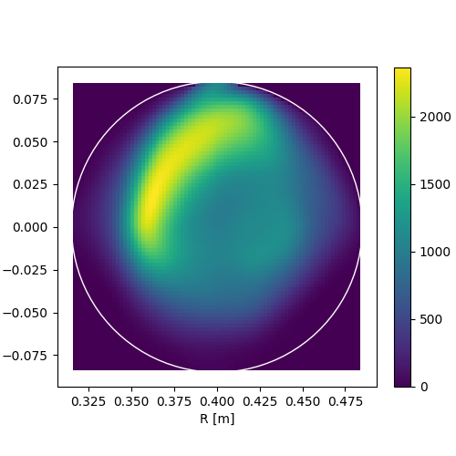
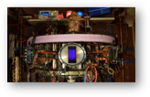
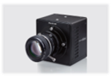
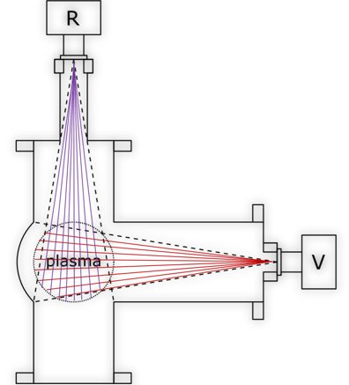
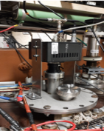
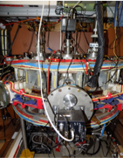
Novel Installation of Fast Cameras at Tokamak GOLEM
S. Abbasi¹, J. Brotankova¹, J. Chlum¹, J. Mlynar¹, J. Svoboda^{1,2}, and V. Svoboda¹ ¹ Faculty of Nuclear Physics and Physical Engineering, Czech Technical University in Prague, Czech Republic ² Institute of Plasma Physics of the Czech Academy of Sciences, Prague, Czech Republic
Abstract
Tomographic inversion of radiation [1] determines spatial distribution of tokamak plasma radiation sources using line integrated plasma projections data. For measurements of the projections, fast visible radiation matrix cameras became broadly applied on tokamaks in recent past [2]. The tokamak GOLEM of the Czech Technical University in Prague strives to implement up-to-date diagnostics with enhanced temporal and spatial resolution. Therefore, a novel diagnostic system of two crossed monochrome cameras (vertical and horizontal) was integrated into the GOLEM diagnostics. In this study the progress in solving specific challenges of the ill-conditioned tomographic inversion via the algorithm [3] optimisation and testing for tokamak GOLEM will be presented together with the first tomographic results.
Tokamak GOLEM & Visible Cameras
Tomographic Inversion
Results
The tokamak GOLEM is located at the Faculty of Nuclear Physics an Physical Engineering (Czech Technical University in Prague)
Minor & Major radius = 0.085 & 0.4 m
Discharge duration ~ 5 ms
Tomographic inversion of radiation determines spatial distribution of tokamak plasma radiation sources using line integrated plasma projections data. In this method the plasma region observed by the detector pinhole camera is discretized into N plasma pixels as shown in Fig. 2. The small pinhole consists of a fan of narrow cones that, cconsidering smooth variation of the emission function over the view cone, provides the Line Of Sight (LOS) approximation in which each pinhole cone approximated by a single LOS. The line integrated measurements f_{i} of the detector i relates to allg_{j}s corresponding emissivity in j-th plasma pixel along the respective LOS as follows:
f_{i} = Σ_{j}T_{ij} · g_{j} ,
T_{ij} = the length of the i-th LOS in the j-th plasma pixel. The equation will be inverted to reconstruct the two dimensional (2D) emissivity function g(x,y) of the plasma region observed by detectors. The reconstruction result is optimized by using Minimum Fisher Regularisation (MFR) [1,3].
Fig. 2
a)
b)
Monochrome cameras Photron FASTCAM Mini UX 50 with Maximum Frame Rate of 160,000 fps (1280 × 8 pixels) in 12-bit ADC dynamic range.
Pixel size = 10 µm × 10 µm
Frame Rate = 40,000 fps (1280 × 56 pixels) [4]
c)
d)
Fig. 4
The Radial camera image
Fig. 4: The figure shows the reconstructed plasma emissivity profiles at several times with frame numbers a) 158, b) 208, c) 308 and d) 408. Figure b) displays expected hollow profile.
References
Jan Mlynar et al. “Inversion techniques in the soft-X-ray tomography of fusion plasmas: toward real-time applications”. In: Fusion Science and Technology 58.3 (2010), pp. 733–741.
M Odstrčil et al. “Plasma tomographic reconstruction from tangentially viewing camera with background subtraction”. In: Review of scientific instruments 85.1 (2014), p. 013509.
Jakub Svoboda et al. “Tomotok: python package for tomography of tokamak plasma radiation”. In: Journal of Instrumentation 16.12 (2021), p. C12015.
Photron Europe Limited. "Product Datasheet Mini UX Fastcam series by Photron". [Online] Retrieved from: http://photron.com/wp-content/uploads/2015/11/Mini-UX-REV16.9.29.pdf [Accessed 9 September 2022]
Fig 3: Schematic figure of Poloidal GOLEM tokamak cross section (plasma vacuum vessel) with the geometry of the lines of sight of two Vertical (V) and Radial (R) fast visible cameras in respectively red and purple.
The vertical camera image
Fig. 1
Fig. 3

