Slide 1
Tokamak GOLEM
Anastasia Stovbchataya
Arseniy Kholod
MIPT, group 1

Slide 2
Introduction

Slide 3
Introduction
energy confinement time – vital characteristic of the tokamak, which shows plasma energy loss rate
$$W_{p}=\frac{1}{3}en_{e}T_{e}V_{p}$$
$$n_{e}=\frac{2p_{0}V_{chamber}}{k_{B}T_{0}V_{p}}$$
$$W_{p}=W_{p0}e^{−t/τ_{E}}$$
$$T_{e}=0.9∙{(R_{p}^{})}^{−\frac{2}{3}}=0.9∙{\left(\frac{U_{l}}{I_{p}}\right)}^{−\frac{2}{3}}$$
$$P_{heating}=P_{loss}=\frac{W_{p}}{τ_{E}}=U_{l}I_{p}$$
$$τ_{E}=\frac{en_{e}T_{e}V_{p}}{3U_{l}I_{p}}$$

Slide 4
Plan
a table of the discharges we made and their parameters
time traces of raw data collected by oscilloscope
time traces of processed $U_{loop}$, $B_{t}$ and $I_{p}$
the time period where we averaged $U_{loop}$, $B_{t}$ and $I_{p}$
a graph with the dependence of the energy confinement time $τ_{E}$ on the torodial magnetic field $B_{t}$

Slide 5
Discharge number | Initial gas pressure | U_{bt} | U_{cd} | Plasma existance
34394 | 16 mPa | 600 V | 450 V | Yes
34395 | 16 mPa | 700 V | 450 V | Yes
34396 | 16 mPa | 800 V | 450 V | Yes
34398 | 16 mPa | 900 V | 450 V | Yes
34399 | 16 mPa | 1000 V | 450 V | Yes
34400 | 16 mPa | 200 V | 450 V | No
34402 | 16 mPa | 300 V | 450 V | No
34404 | 16 mPa | 400 V | 450 V | Yes
34406 | 16 mPa | 600 V | 550 V | Yes
34407 | 16 mPa | 600 V | 350 V | Yes
34408 | 16 mPa | 600 V | 650 V | Yes
34410 | 16 mPa | 300 V | 400 V | No

Slide 6
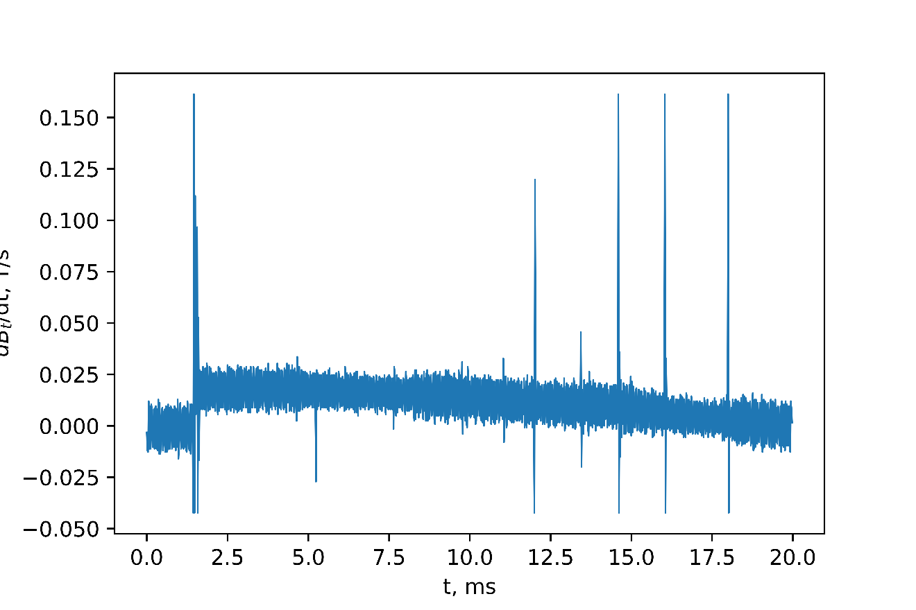
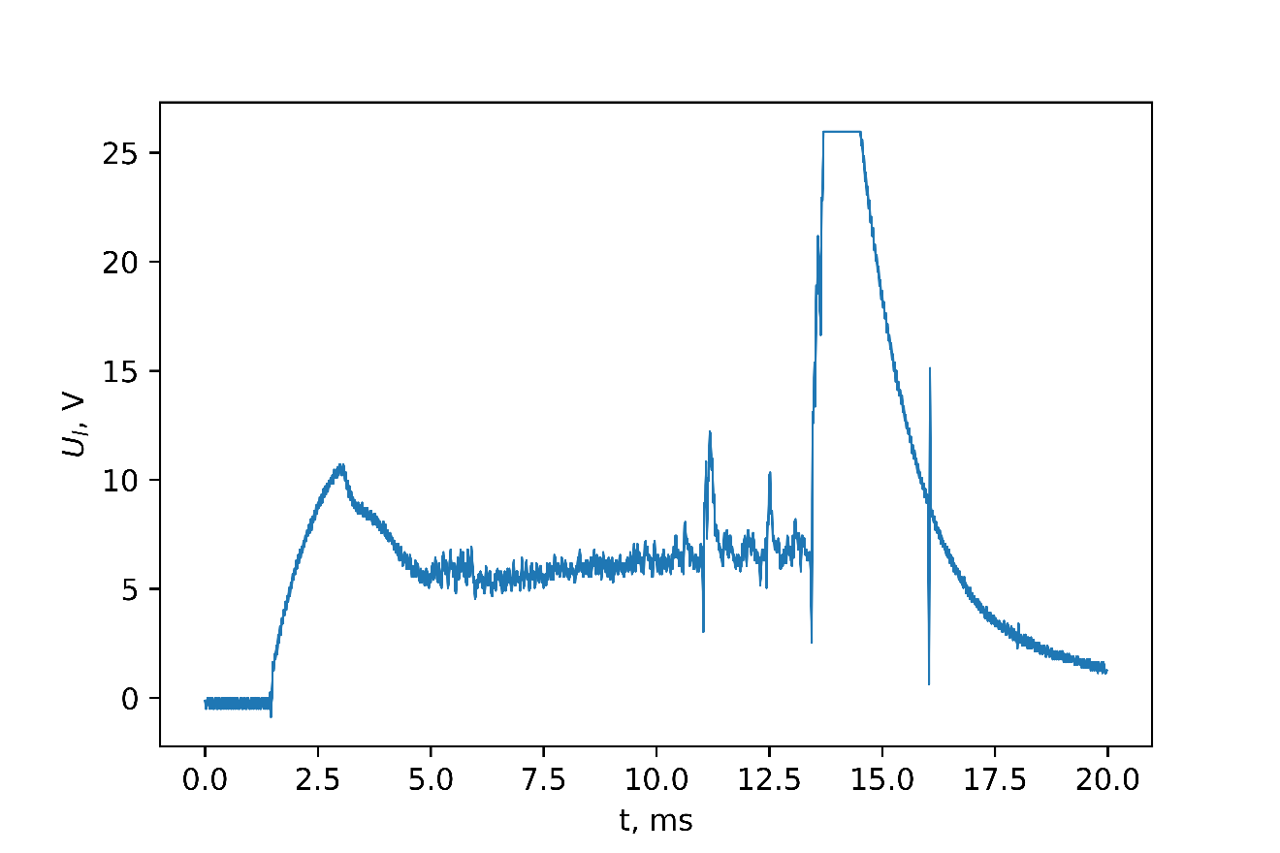
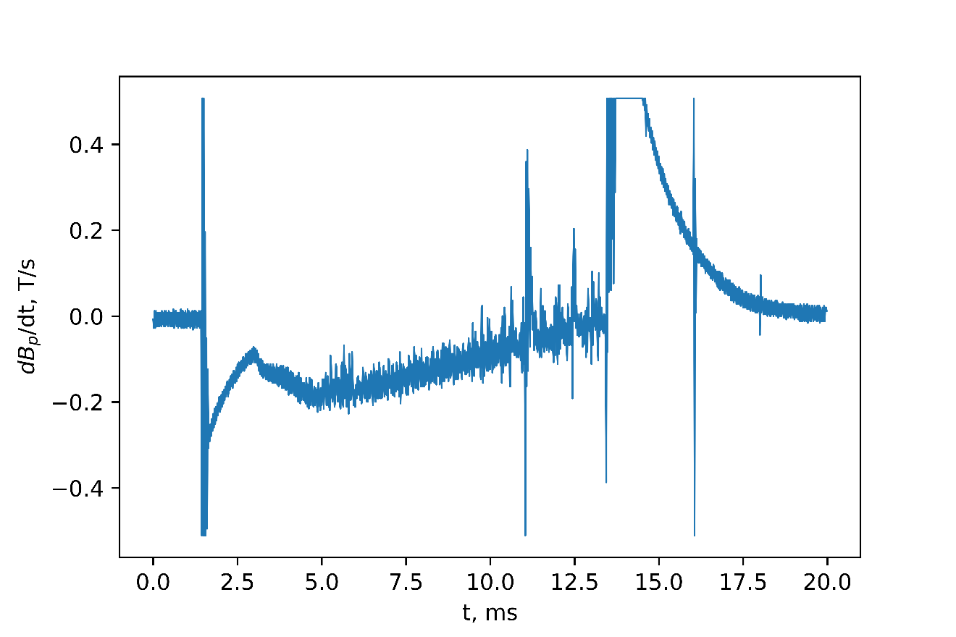
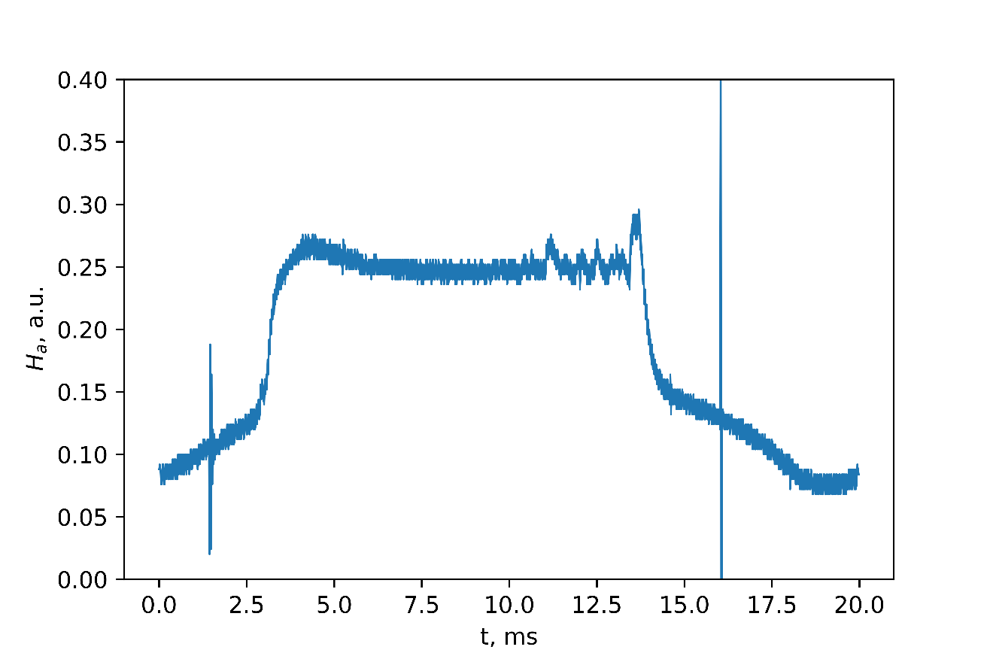
Results. Raw data

Slide 7
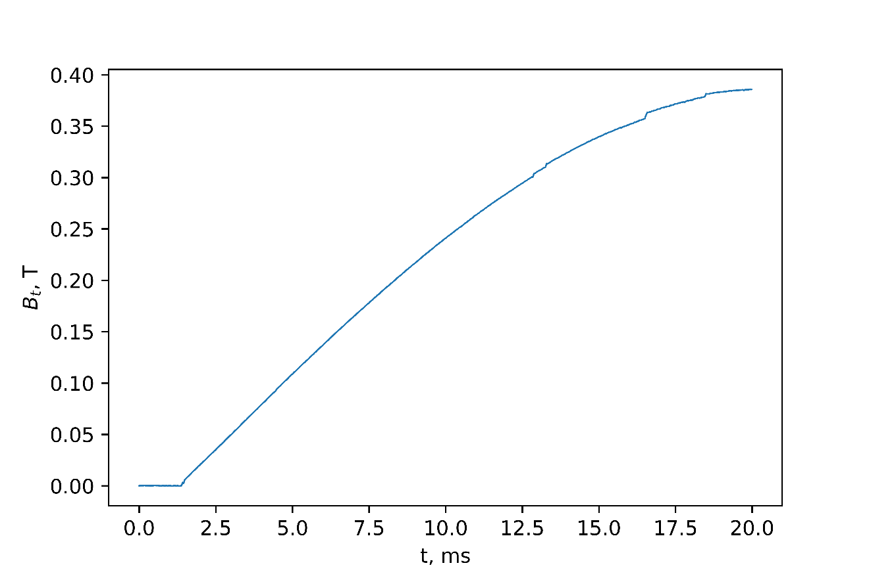
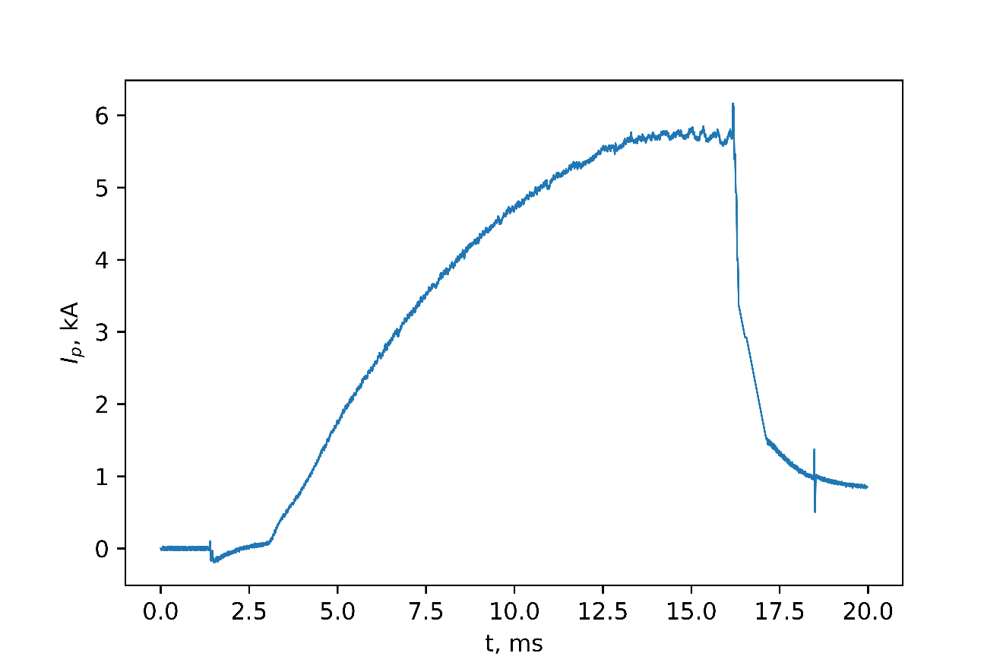
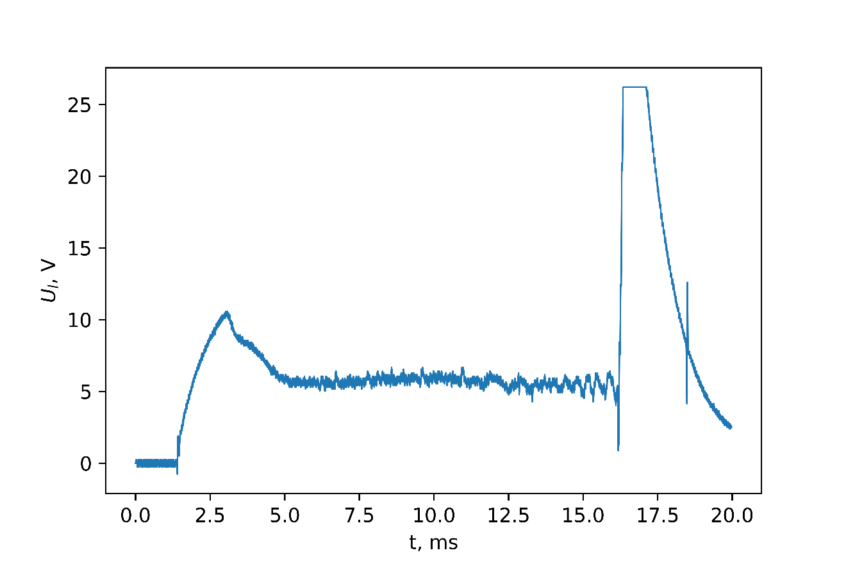
Results. Processed data
$$U_{B_{t}}=NS\frac{dB_{t}}{dt}$$
$$U_{RC}∝\frac{dB_{p}}{dt}$$
$$I_{p}\left(t\right)=C_{RC}\int_{0}^{t}{U_{RC}\left(τ\right)dτ−\frac{U_{l(t)}}{R_{ch}}}$$
$$B_{t}\left(t\right)=C_{B_{t}}\int_{0}^{t}{U_{B_{t}}\left(τ\right)dτ}$$

Slide 8
Results.
Quasistationary phase
Quasistationary phase

Slide 9
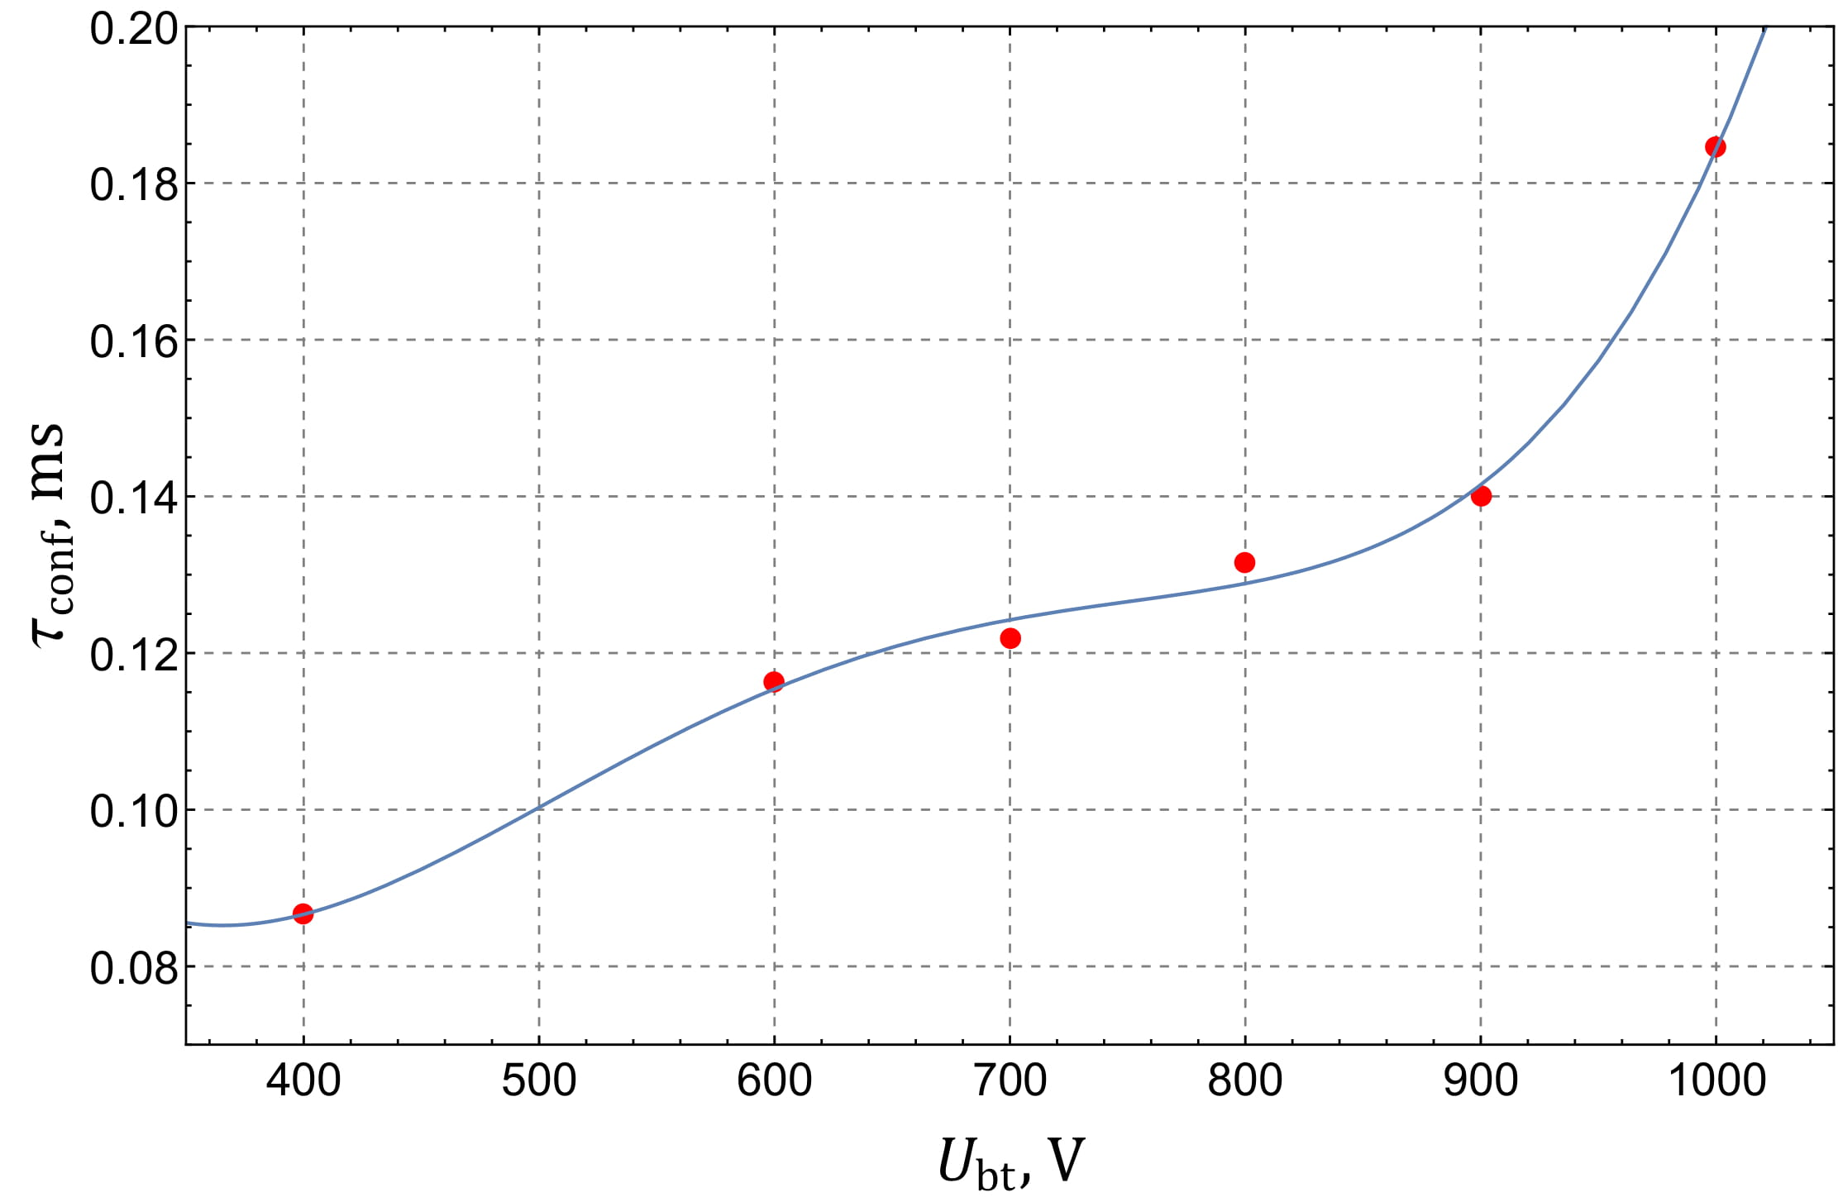
Results. Confinement time dependence on toroidal magnetic field

Slide 10
Conclusions
existance of quasistationary phase
energy confinement time increases with toroidal magnetic field
plasma exists in a certain range of values of $U_{bt}$ and $U_{l}$

Slide 11
Thank you for attention!

