Slide 1
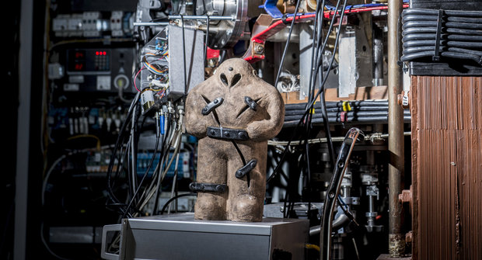
Hydrogen and Helium experiments on the GOLEM tokamak, May 2020
Martina Lauerová, 7.6.2020
Scaling of macroscopic plasma parameters
Analysis of Probe data

Slide 2
Introduction
Series of all shots both in hydrogen and helium were performed on 20. 5. and 27. 5. 2020
The charging voltage of the capacitor bank for powering the toroidal field coils is fixed at U_{BT} = 1000V
The time delay between triggers of U_{BT} and U_{CD} is fixed at T_CD = 0 ms
The charging voltage of the capacitor bank for powering of the primary winding of the GOLEM transformer was changed within the range of U_{CD} = 400-750 V
The pressure of working gas was changed on a shot to shot bases
The total number of discharges is 162
A combined probe head was kept at the position with r = 85mm from the center of the tokamak vessel

Slide 3
Data processing
We constructed summary graphs for the whole shot series - dependencies of the maximum plasma current I_{plasma}, the breakdown voltage U_{BD}, the central electron temperature T_{e}(0) and Ohmic heating P_OH on the pressure of working gas
For each U_{cd} (for both gases separately) three shots are chosen – the one with the highest pressure, with the lowest pressure and the middle pressure
For these shots we plot the floating potential (LP), the plasma potential (BPP), and we derived the electron temperature from all probes

Slide 4
Footnotes for discharge table
I_{plasma max}. – the maximum value of plasma current
T_Ip max. – time when the plasma current reaches its maximum
Uloop_t_Ip max. – the loop voltage when plasma current reaches its maximum
U_{bd} – voltage when plasma was first formed
T_U_{bd} – time when plasma was first formed
T max. – duration of the discharge
Central Te – estimated value of the central electron temperature
Ohmic heating – ohmic heating when plasma current was maximal

Slide 5
Discharges in Hydrogen (20. 5.2020)

Slide 6
Discharges in Hydrogen (20. 5.2020) – contd.

Slide 7
Discharges in Helium (27. 5. 2020)

Slide 8
Discharges in Helium (27. 5. 2020) – contd.

Slide 9
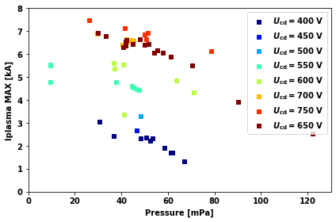
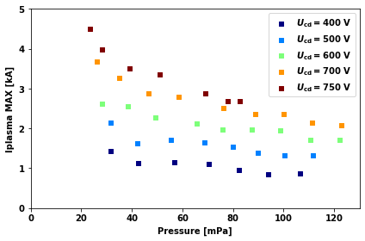
Dependency of maximum plasma current on the pressure of working gas for selected U_CD
Hydrogen plasma (#32880 - #32946)
Helium plasma (#33011 - #33063)
Highest plasma currents are achieved at high U_CD and low filing pressures in H as well as in He plasmas

Slide 10
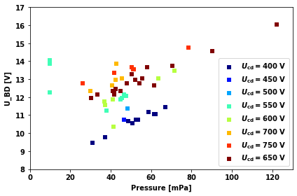
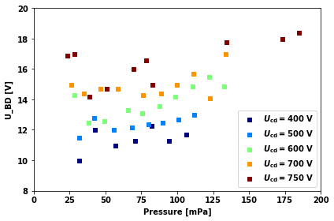
Dependency of the breakdown voltage U_BD on the pressure of the working gas
Hydrogen plasma (#32880 - #32946)
Helium plasma (#33011 - #33063)
The breakdown voltage U_BD increases with the pressure of the working gas
In hydrogen plasmas, U_BD is almost independent on U_CD for U_CD > 450 V

Slide 11
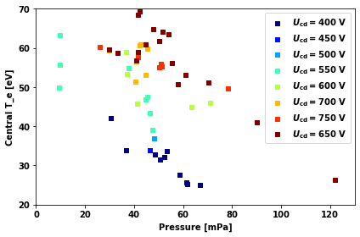
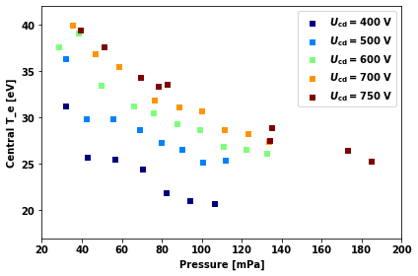
Dependency of the central electron temperature on the pressure of the working gas
Hydrogen plasma (#32880 - #32946)
Helium plasma (#33011 - #33063)
The central electron temperature is calculated from plasma conductivity at the time of the maximum plasma current according Spitzer formula, assuming the plasma radius a = 0.085 m.
$T_{e}\left(0\right)=43.495{\left(\frac{Z_{eff}I_{pl}}{U_{loop}}\right)}^{2/3}$ [eV, kA, V]
The effective ion charge is taken in hydrogen discharges as Z_{eff} = 2,5 and for Helium plasmas as Z_{eff} = 4

Slide 12
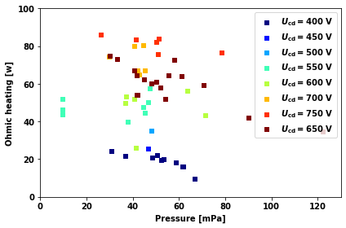
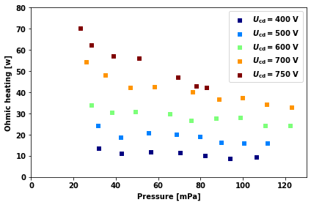
Comparison of ohmic heating
Hydrogen plasma (#32880 - #32946)
Helium plasma (#33011 - #33063)
P_OH = Ip max * Uloop at Ip max.
Ohmic heating increases with Ucd and mildly decreases with increasing pressure

Slide 13
Results
Hydrogen data are rather scattered but still some useful information can be extracted from experimental data
Maximum plasma current clearly increases with U_{CD}
Maximum plasma current is decreasing with increasing pressure
The breakdown voltage increases with filling pressure
The breakdown voltage increases with UCD, but the correlation isn‘t too clear
With higher, UBD tends to be bigger, the same thing applies to the central electron temperature
Central electron temperature tends to decrease with increasing pressure

Slide 14
Results
Helium correlation is much more clear
With increasing UCD, I plasma max. is also increasing
With increasing pressure, I plasma max. is decreasing
UBD is also increasing with increasing UCD
It is also increasing with increasing pressure
Central electron tempeature is decreasing both with decreasing UCD and increasing pressure

Slide 15
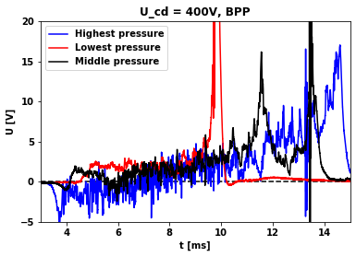
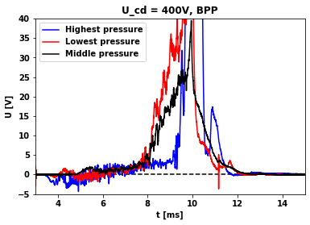
Comparison of the plasma potentials, Ucd = 400V
Hydrogen plasma (#32880, #32887, #32882)
Helium plasma (#33014, #33012, #33018)
However, this comparison isn‘t completely accurate because the pressures are bit different
Note that the level of fluctuations in Hydrogen is higher than in Helium, in particular, at the highest pressures

Slide 16
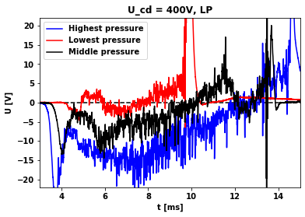
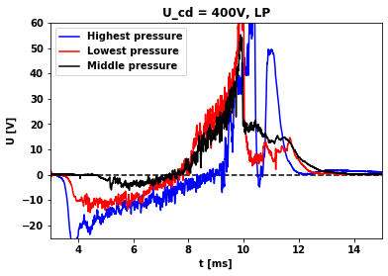
Comparison of floating potentials (LP), U_{cd} = 400V
Hydrogen plasma (#32880, #32887, #32882)
Helium plasma (#33014, #33012, #33018)
Again, this comparison isn‘t completely accurate because the pressures are bit different.
Note again higher level of fluctuations in Hydrogen plasma.

Slide 17
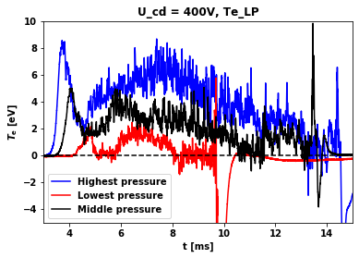
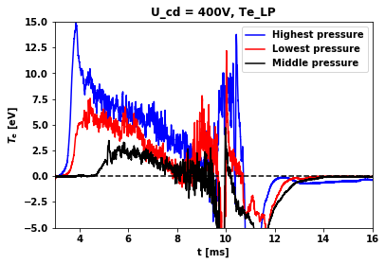
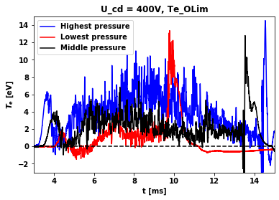
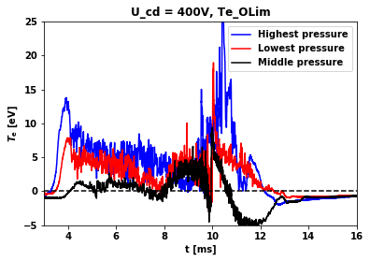
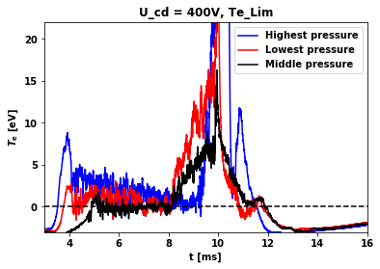
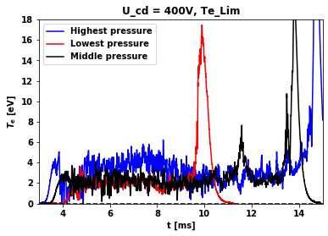
Comparison of electron temperatures, Ucd = 400V

Slide 18
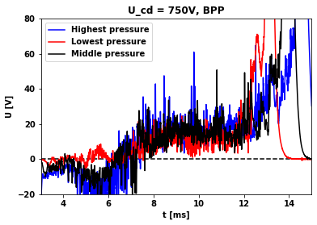
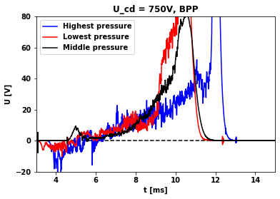
Comparison of plasma potentials, Ucd = 750V
Hydrogen plasma (#32925, #32928, #32926)
Helium plasma (#33063, #33051, #33062)
However, this comparison isn‘t completely accurate because the pressures are bit different
Note again higher level of fluctuations in Hydrogen plasmas

Slide 19
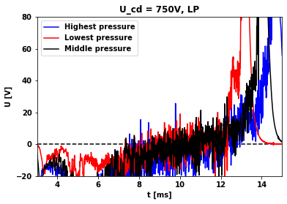
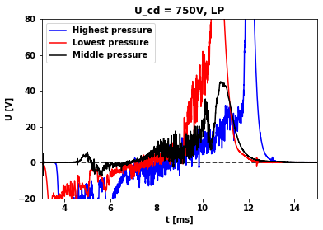
Comparison of floating potentials (LP), Ucd = 750V
Hydrogen plasma (#32925, #32928, #32926)
Helium plasma (#33063, #33051, #33062)
However, this comparison isn‘t completely accurate because the pressures are bit different

Slide 20
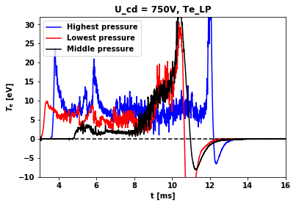
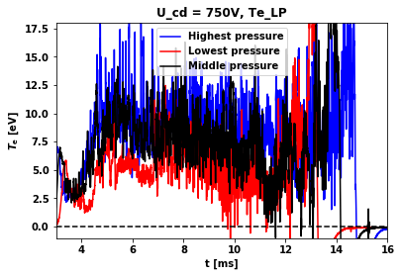
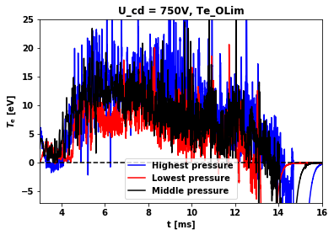
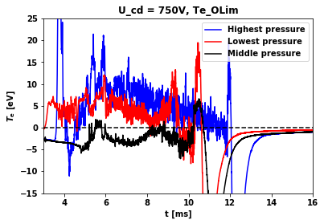
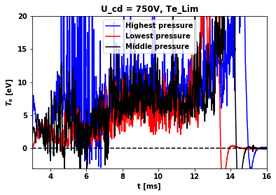
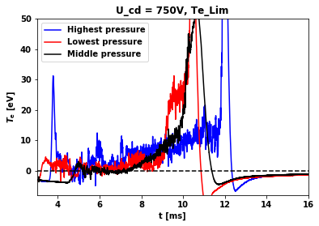
Comparison of electron temperatures at the plasma edge, Ucd = 750V

Slide 21
BPP and LP values at Ip max. (hydrogen)

Slide 22
BPP and LP values at Ip max. (helium)

Slide 23
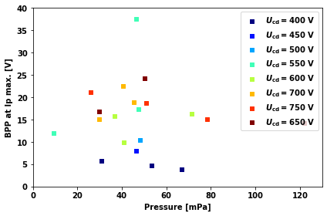
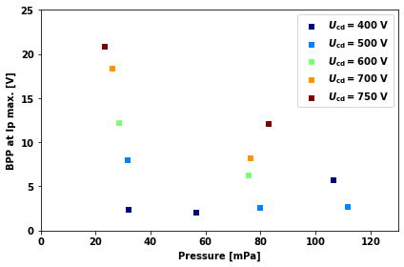
BPP values at Ip max.
Image on the left – chosen hydrogen shots, on the right – chosen helium shots
These correlations are very unclear, especially in the case of the hydrogen shots

Slide 24
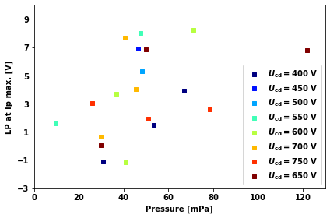
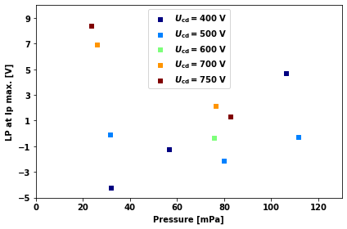
LP values at Ip max.
On the left – chosen hydrogen shots, on the right – chosen helium shots
These correlations are very unclear

Slide 25
ConclusionS
Helium shots are about 1 – 2 ms shorter than the hydrogen ones.
The shape of the functions is different and helium signals are bigger (which may be caused by the imperfekt pressure comparison)
Same thing applies for electron temperatures
As expected, by raising U_{cd}, the signals increased as well
Another interesting thing is the helium data are much cleaner even though I didn’t use any kind of smoothing.

