Slide 1
GOMTRAIC 2013
Plasma MHD Activity Observations via Magnetics Diagnostics:
Magnetic island Analysis
Frederik Ostyn (UGent)
Daniel Hernández (CICATA-IPN)
Mauricio Rodríguez (US)

Slide 2
Overview
INTRODUCTION
SAFETY FACTOR
MAGNETIC ISLANDS
DETECTION METHOD
FLUCTUATION OF RAW DATA
SPECTROGRAM
SUMMARY

Slide 3
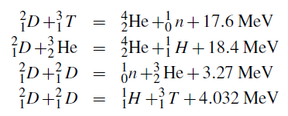
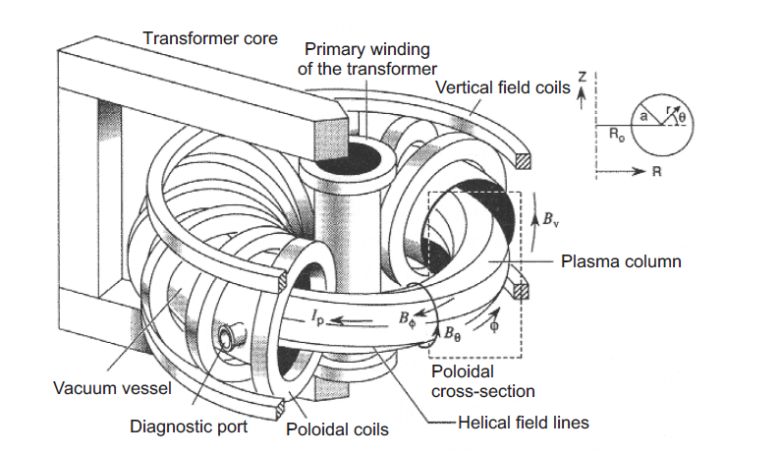
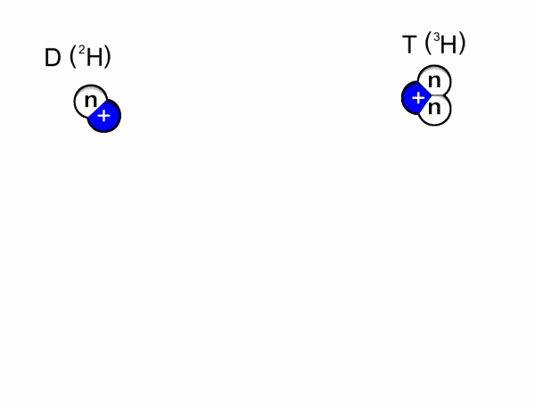
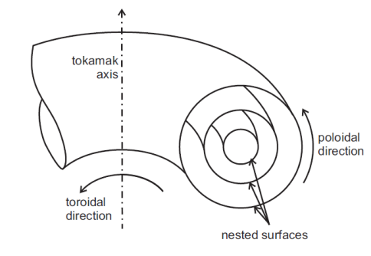
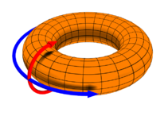
Introduction
Fusion in Earth
Gas confined by magnetics fields
Tokamak (GOLEM)
Plasma in equilibrium*:
Ψ = const
p = const
T = const
j_{plasma}=const
gas
Low density and long connement time.
Helical Shape
Major Radius: 0.4 m Minor Radius: 0.1 m
Toroidal Magnetic Field < 0.8 T
Plasma Current: < 8 kA
Discharge Duration: 13 ms
Background Pressure of Vacuum: 10 - 200 mPa
Work Gas: H₂
* circular cross-section and zero Shafranov shift

Slide 4

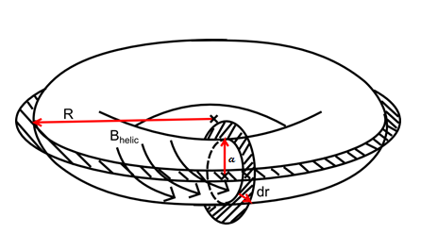
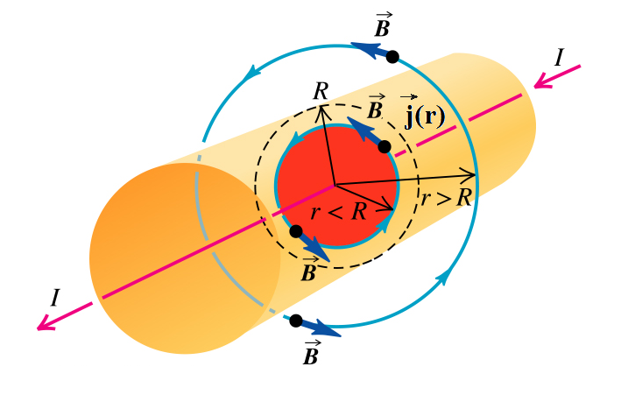

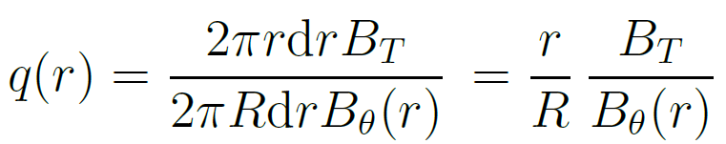
Safety factor
“How many toroidal rotations are neccesary for a single rotation of a magnetic field line in the poloidal direction (2π)”
At the plasma Edge (r=a)
Depends on the geometry of the machine Major Radius: R=0.4 m Minor Radius: r=0.1 m

Slide 5
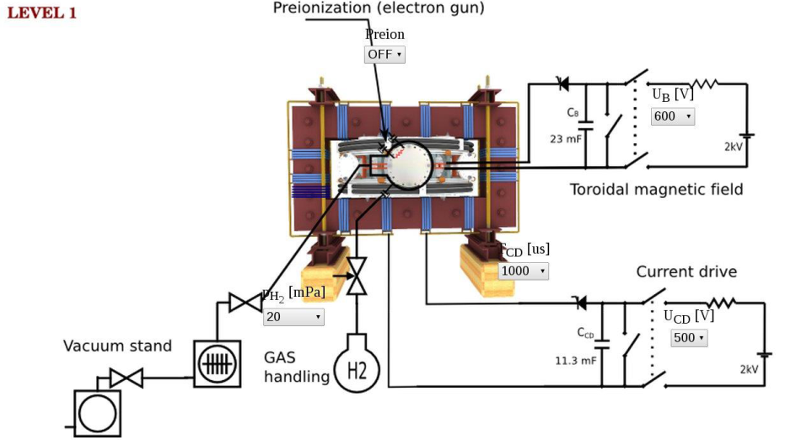
Control Room system

Slide 6
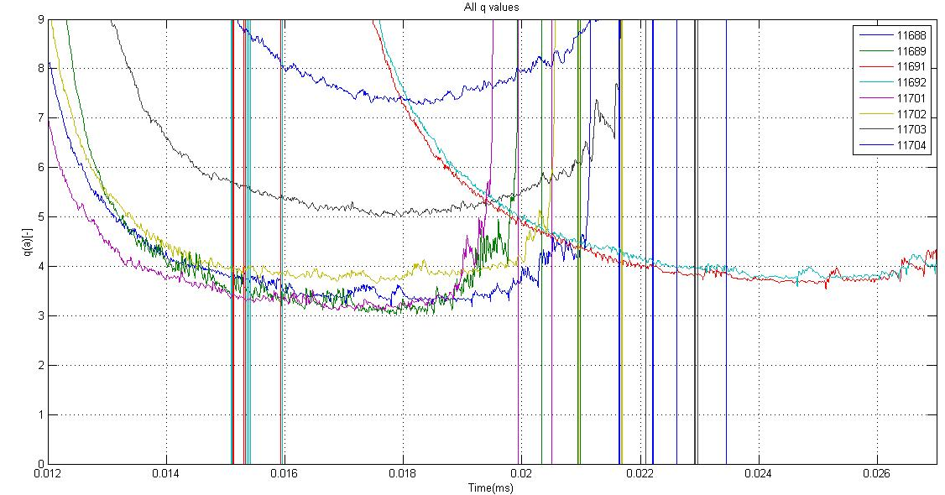
Safety factor: Experimental
Shot # [-] | U_{B} [V] | U_{CD} [-] | T_{CD}[ms] | PH2[mPa] | Preion[-]
11688 | 500 | 600 | 5000 | 2.07->16.92 (12) | 1
11689 | 400 | 600 | 5500 | 1.69->11.80 (12) | 1
11691 | 500 | 600 | 10000 | 1.71->10.02 (10) | 1
11692 | 500 | 600 | 10000 | 1.72->9.96 (10) | 1
11701 | 400 | 600 | 5000 | 1.63->11.40 (12) | 1
11702 | 400 | 500 | 5000 | 1.60->11.53 (10) | 1
11703 | 400 | 400 | 5000 | 1.60->9.89 (10) | 1
11704 | 400 | 300 | 5000 | 1.61->10.00 (10) | 1
Stability of plasma requires the safety factor at the edge (r=a):
2 < q_{min}(a) < 3
Time(s)

Slide 7
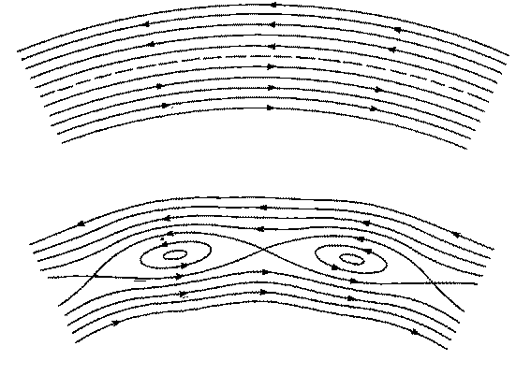
Magnetics Islands (I)
A magnetic island is a closed magnetic flux tube , bounded by a separatrix , isolating it from the rest of space
The rupture of the assumed initial topology of toroidally nested flux surfaces needed to produce the island which requires the reconnection of magnetic field lines in plasma.

Slide 8
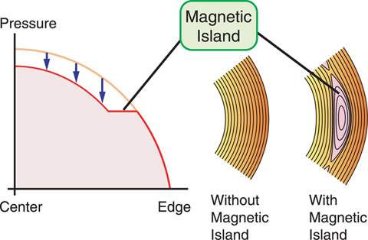
Magnetics Islands (II)
If a magnetic island appears, heat and particles transport is enhanced due to shorted field lines, and as a result there is a deterioration of pressure, temperature and plasma current profile.
Irrational: Any fluctuation can spread quickly and
homogeneously
Small rational numbers: due to geometrical properties and periodic boundary conditions a plasma wave can live for long time (MHD mode).

Slide 9
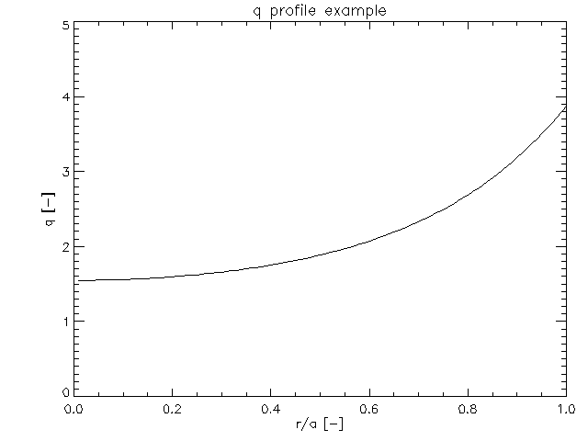
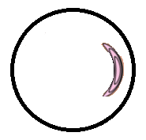
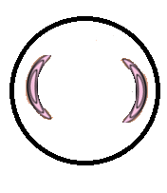

Magnetics Islands (III)
q = m/n=1
q = m/n=2
q = m/n=3
M = 3 mode is closer to the edge and detector. So the signal would be stronger.

Slide 10
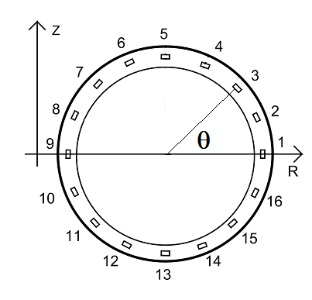
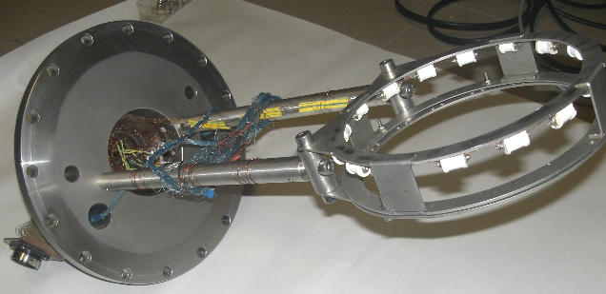
Detection of magnetic island
Magnetic islands are rotating with the plasma in the toroidal direction
Islands deteriorates p, T and j
On GOLEM, p and T measurements are not optimized but can measure j
Measurement of time evolution of poloidal magnetic field
Set of sensors of local magnetic field (for GOLEM 16)

Slide 11
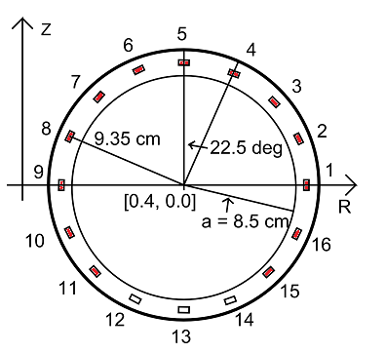
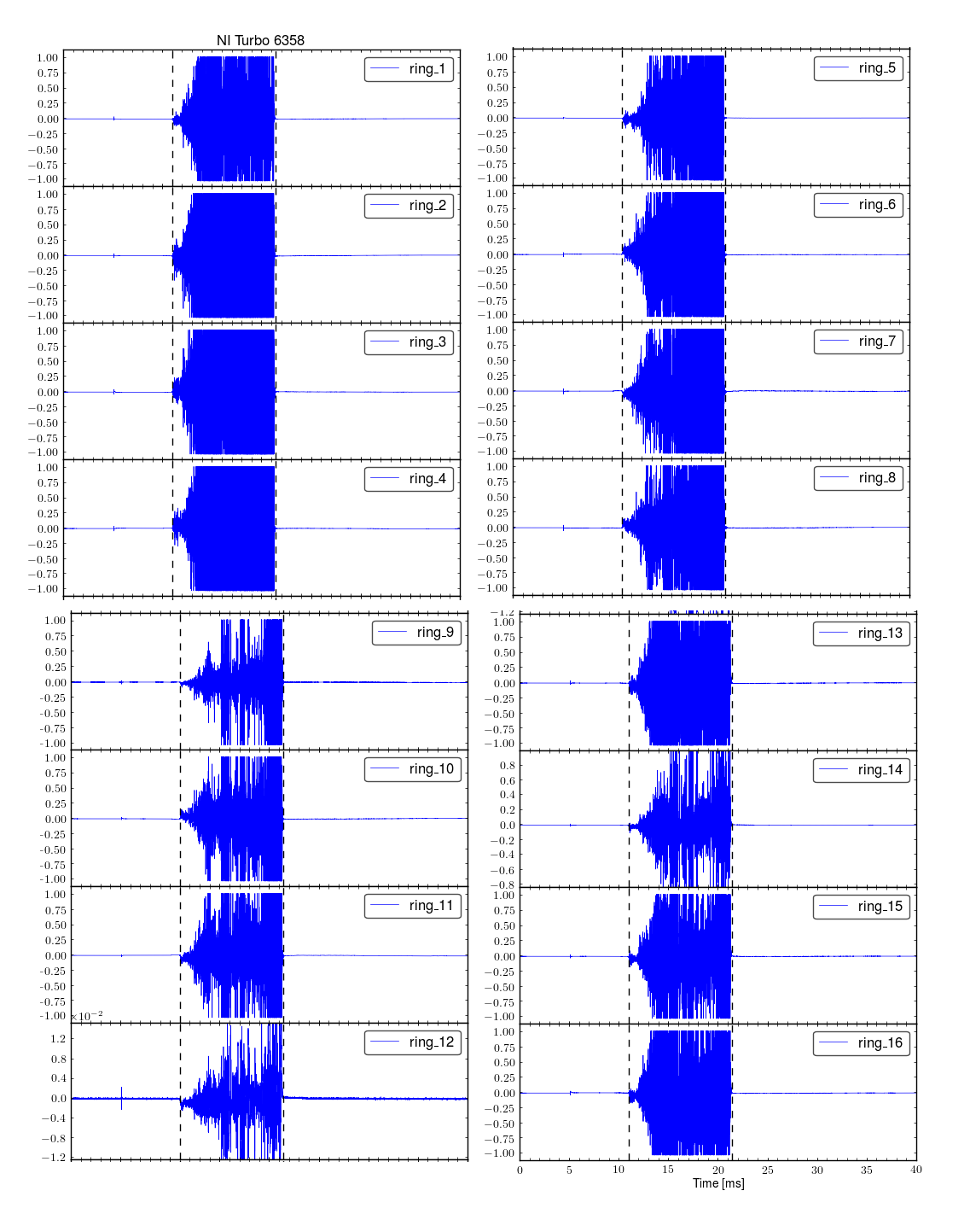
B_{θ} measurement coils
Coil # [-] | Polarity [-] | A_{eff} [cm^2]
1 | - | 68.93
2 | - | 140.68
3 | + | 138.83
4 | + | 140.43
5 | - | 68.59
6 | + | 134.47
7 | - | 134.28
8 | + | 142.46
9 | - | 67.62
10 | + | 142.80
11 | - | 140.43
12 | x | x
13 | x | x
14 | x | x
15 | - | 139.82
16 | - | 139.33
Signal is measured on distribution of local magnetic field sensors

Slide 12
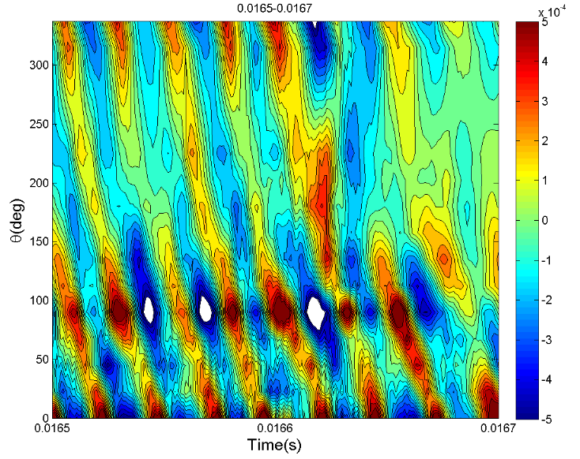
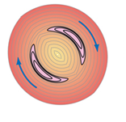
Fluctuation of Raw Data (I)
T
T
Window of signal from all the sensors
Number of oscillation maxima for one period time given time of the mode is equal to m mode number
m=2

Slide 13
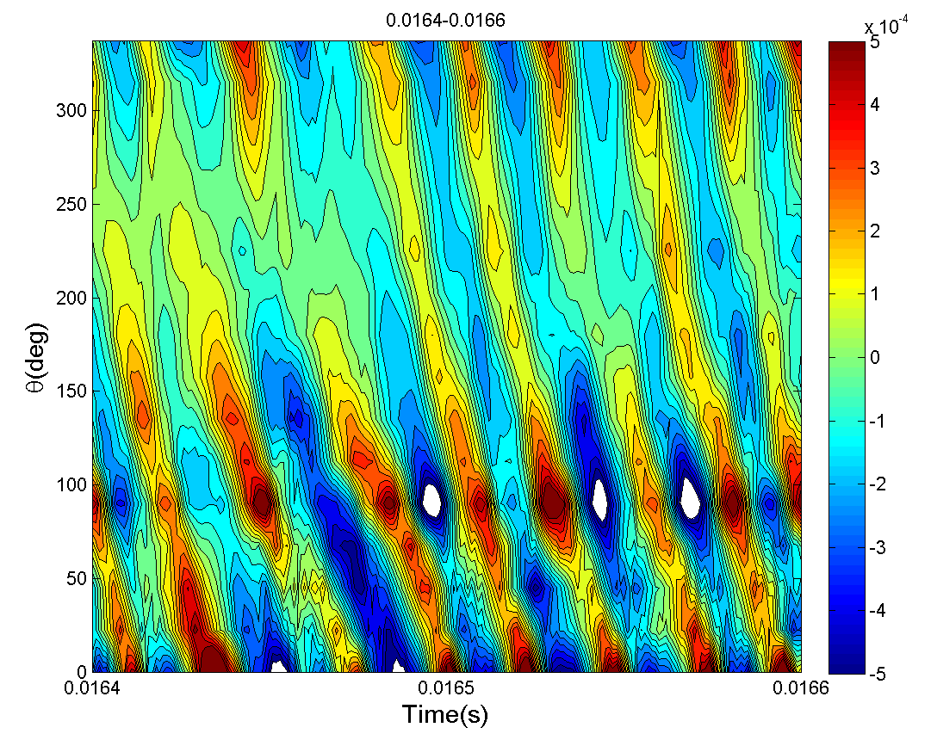
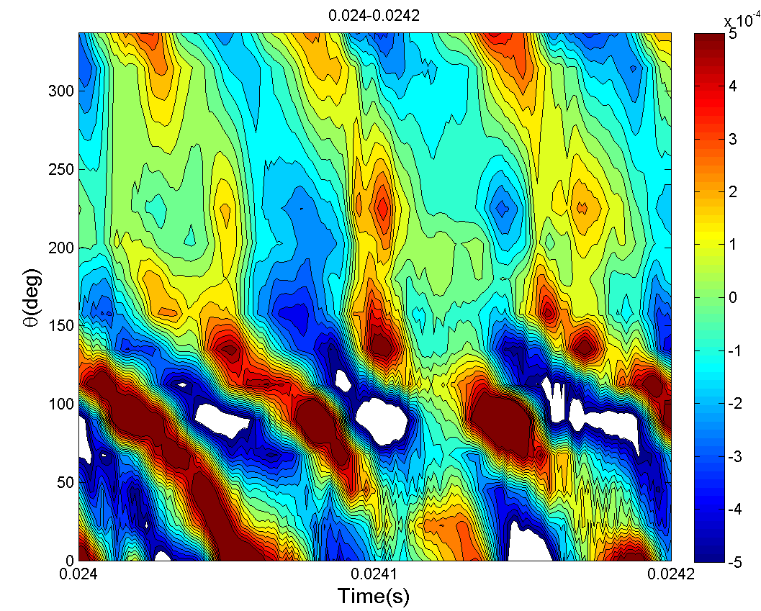
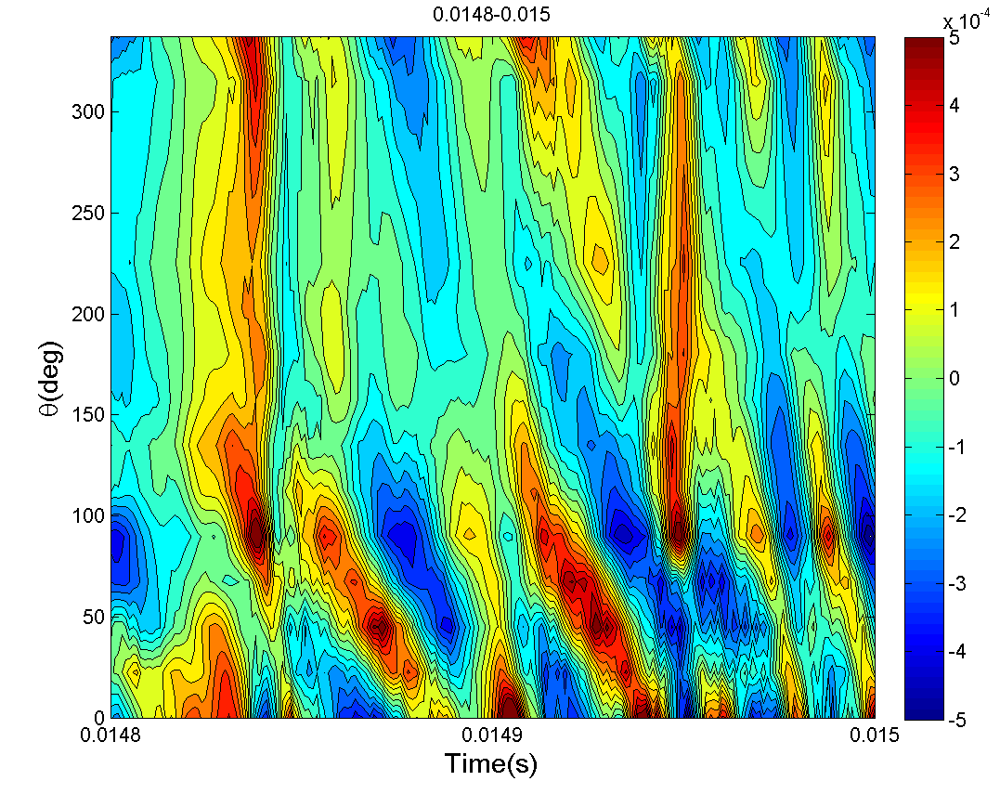
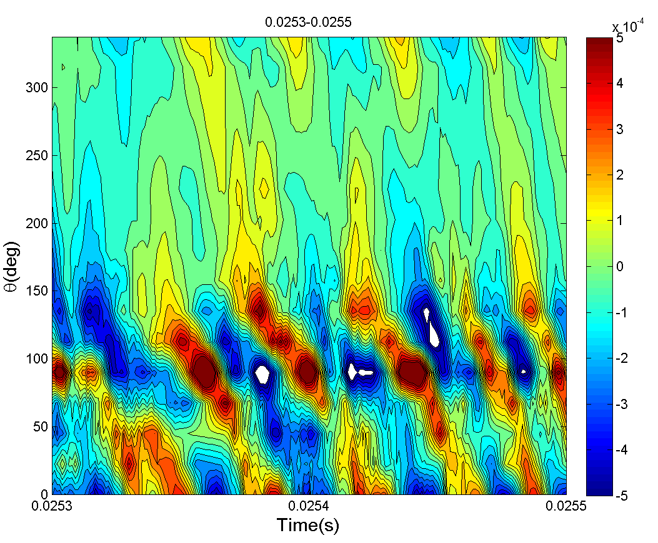
Fluctuation of Raw Data (II)
# 11688
# 11691
Oscilations are best visible when island is on radius close to plasma edge
# 11689
# 11692

Slide 14
Fluctuation of Raw Data (III)
Shot # [-] | Island Index | Time_d[ms] | Time_u[ms] | m[-] | Comments
11688 | 1 | 16.4 | 16,6 | 2 | Good Signal
11689 | 1 | 14,8 | 15,0 | 2 | Nice
11691 | 1 | 24,0 | 24,2 | 2 | Nice
11691 | 2 | 25,8 | 26 | 3 | Not Very Nice
11692 | 1 | 25,3 | 25,5 | 2
11701 | 1 | 14 | 14,2 | 2
11702 | 1 | 15 | 15,2 | 2
11703 | 1 | 19,2 | 19,4 | 2
11704 | 1 | 21,7 | 21,9 | 1

Slide 15
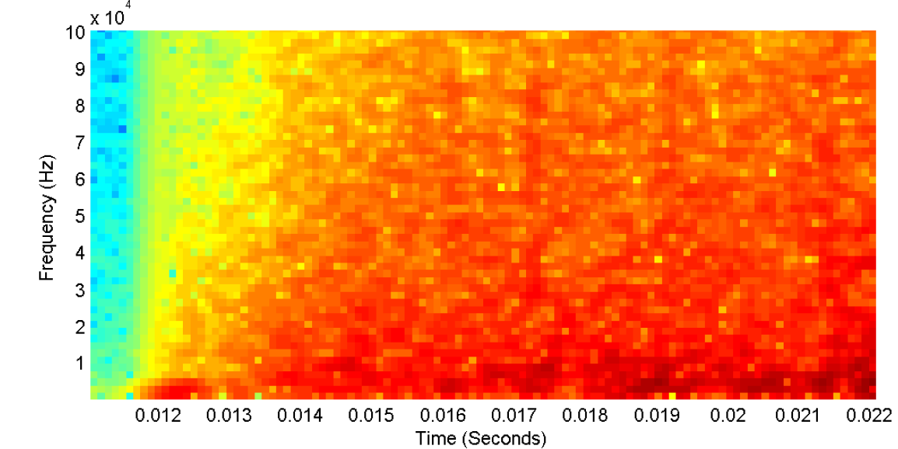
Spectrogram
To know the time of MHD mode appears
Look for high peaks in spectrogram (dark red)
The time window where the peaks appear is where to look (black circles)
# 11704, coil 4
15

Slide 16
Summary
In a Tokamak the magnetic configuration produces a field in toroidal and poloidal axis, in GOLEM Tokamak this can be controlled remotely
The safety factor in Tokamak GOLEM is determined by
Low values for safety factor are ideal to observe magnetic island
In Tokamak GOLEM MHD studies is by 16 Mirnov coils mounted in a poloidal ring
Number of oscillation maxima for one period time given time of the mode is equal to m mode number
Mode number 2 was observed a lot of times
The spectrograms show the magnitude of the signal in frequency state for each coil of poloidal arrangement
Future work is to process the signal with statistical methods (cross correlation, to get a better analysis)

Slide 17



Thank you for your attention
Contact: frederik.ostyn@ugent.be
Contact: Mauricio.Rodriguez-Ramos@ipp.mpg.deg
Contact: ingdha@hotmail.com

