Slide 1
Timepix3 detector at the Golem Tokamak
Štěpán Malec
malecste@cvut.cz
Mariánská 2026
1
1

Slide 2

Outline
Timepix3 detector
Experimental setup
Measurements and data processig
Continuous wavelet transform
Minimum wavelet coherence
Ridges extraction
Phase shift
Š. Malec
2

Slide 3
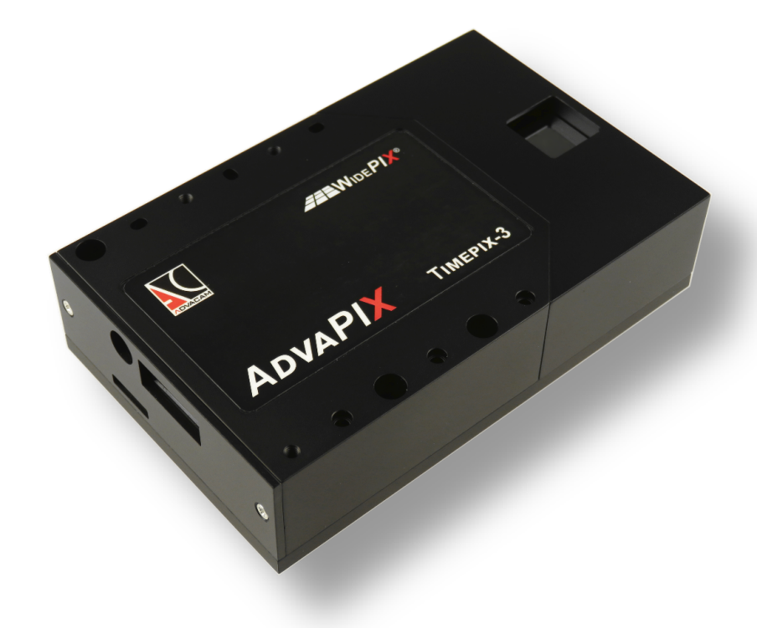
Timepix3 detector
256 x 256 pixels
1 pixel 55 μm x 55 μm
130 nm technology
Maximum hit rate 40 Mhits·cm⁻²·s⁻¹
Time stamping with precision of 1,56 ns
Š. Malec
3

Slide 4
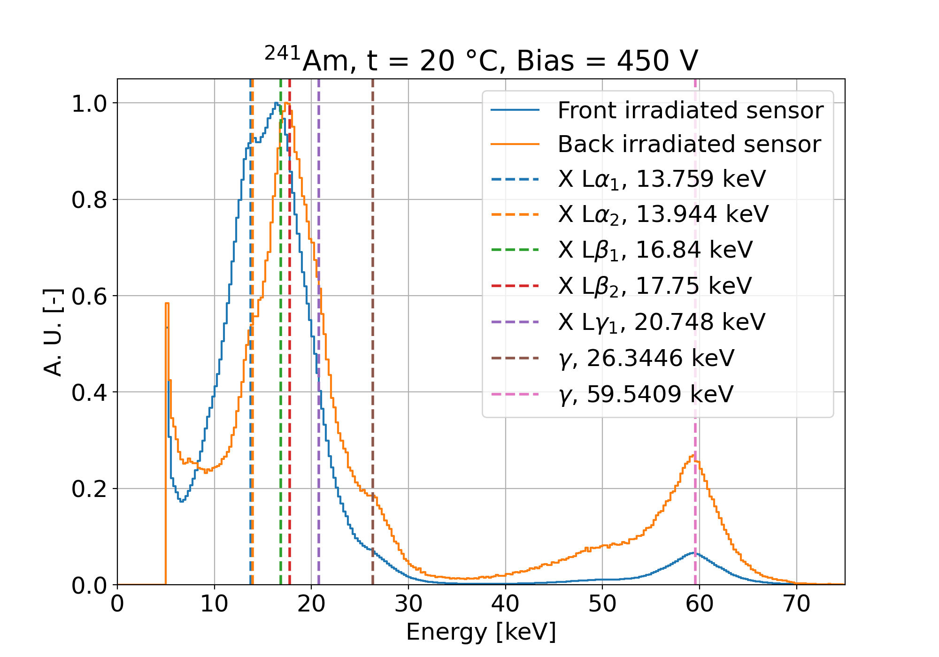
Timepix3 detector
Š. Malec
4

Slide 5
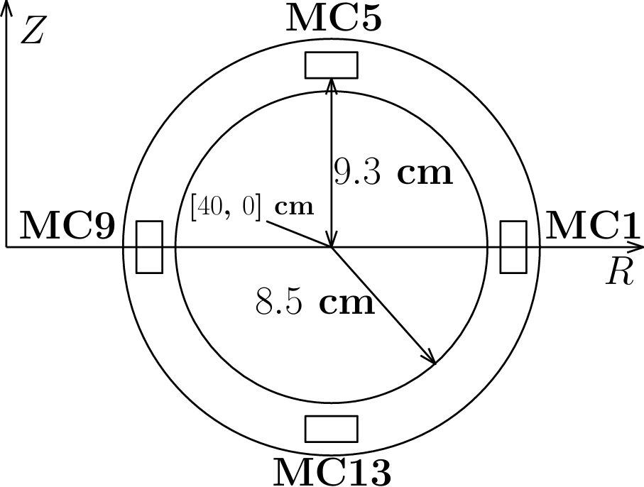
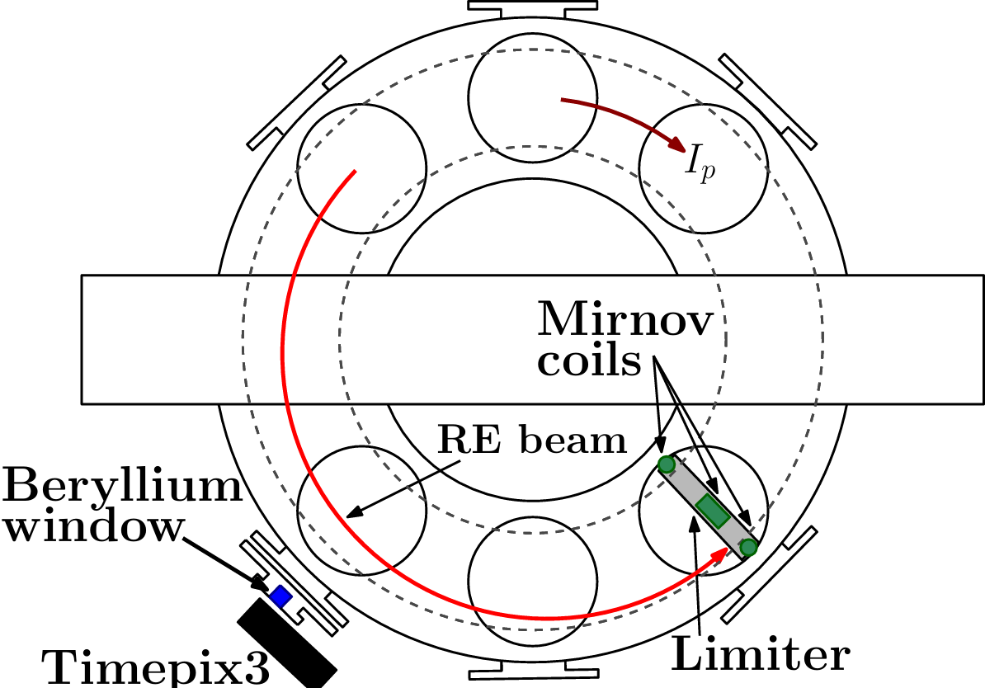
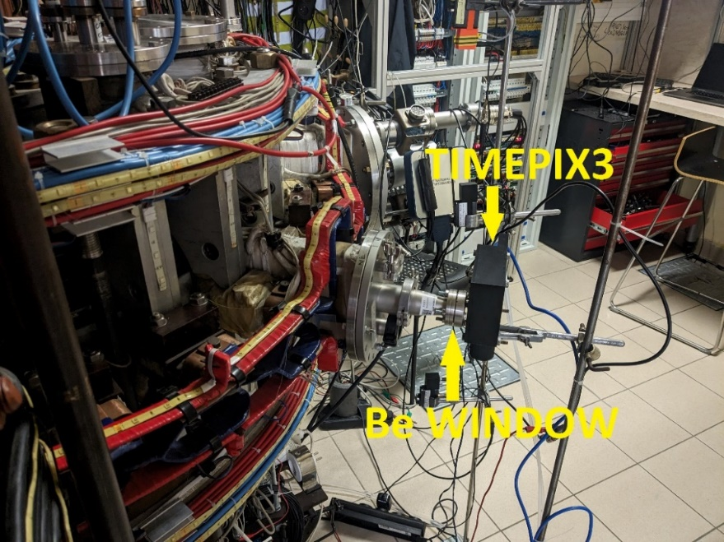
Experimental setup
Timepix3 in the equatorial plane
Sight into the plasma through a beryllium window
Limiter Mirnov coils
Š. Malec
5

Slide 6
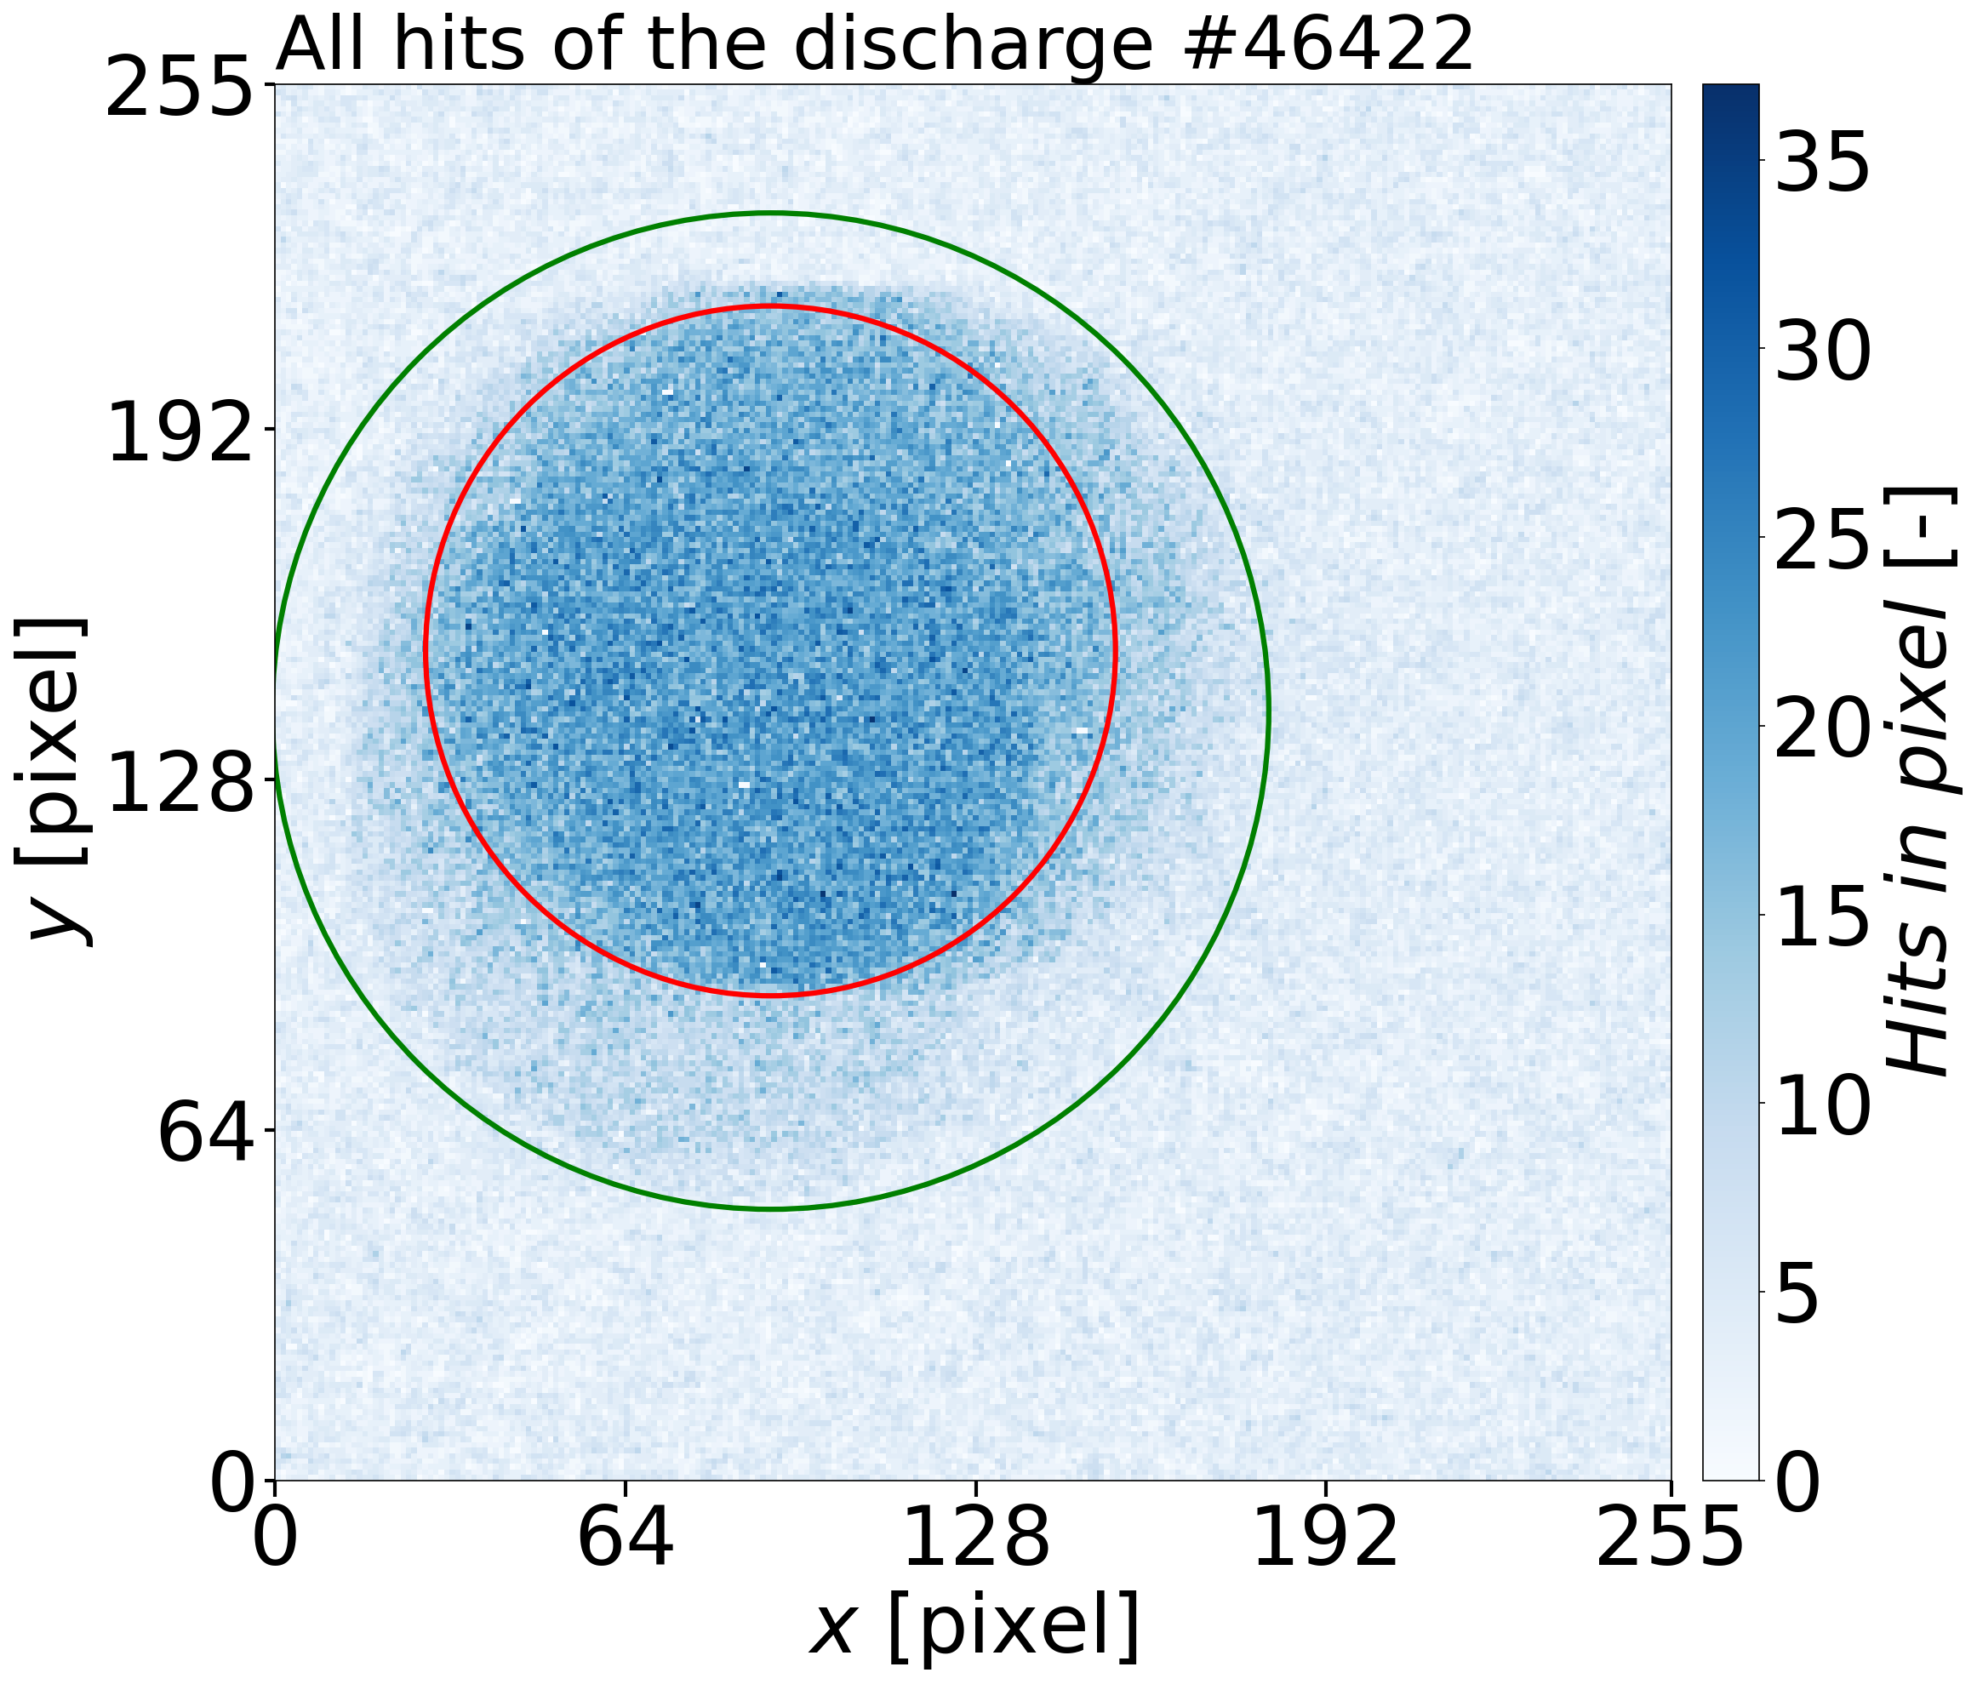
Measurements and data processing
overall hit map of detector pixels of the Timepix3
hit map shows how many times a given detector sensor pixel was above the energy threshold during the discharge
Two areas for dataprocessing
Red circle - direct line of sight through the beryllium window
Š. Malec
6

Slide 7
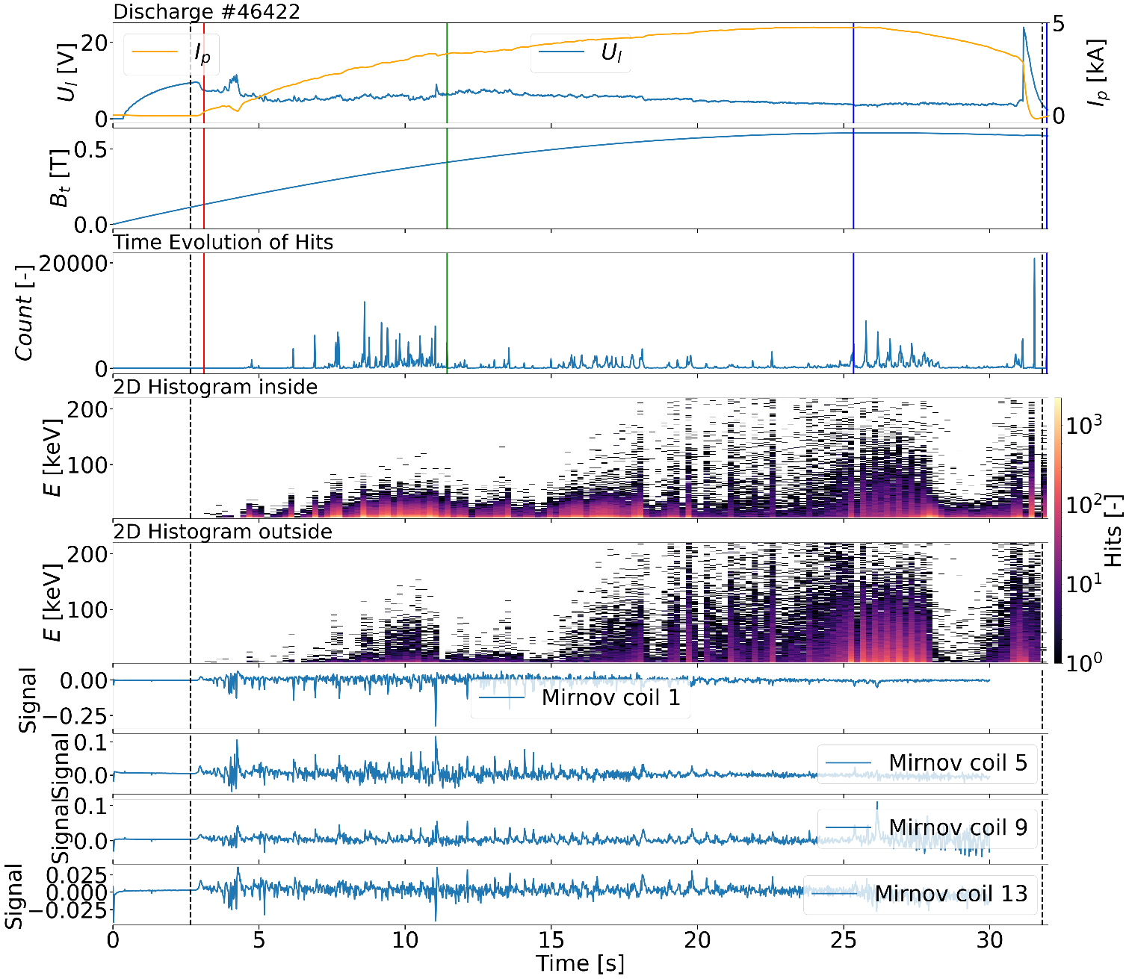
Measurements and data processing
main GOLEM tokamak parameters
time evolution of the interactions detected by the Timepix3
Mirnov coils raw signals
Š. Malec
7

Slide 8
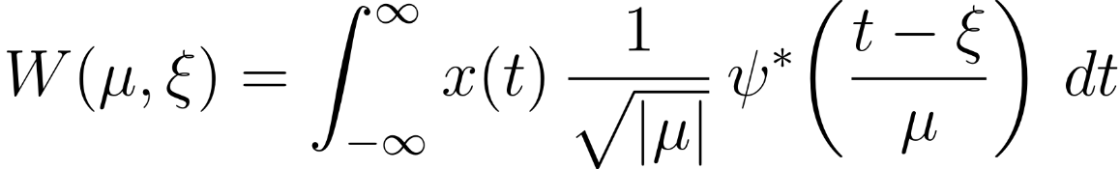
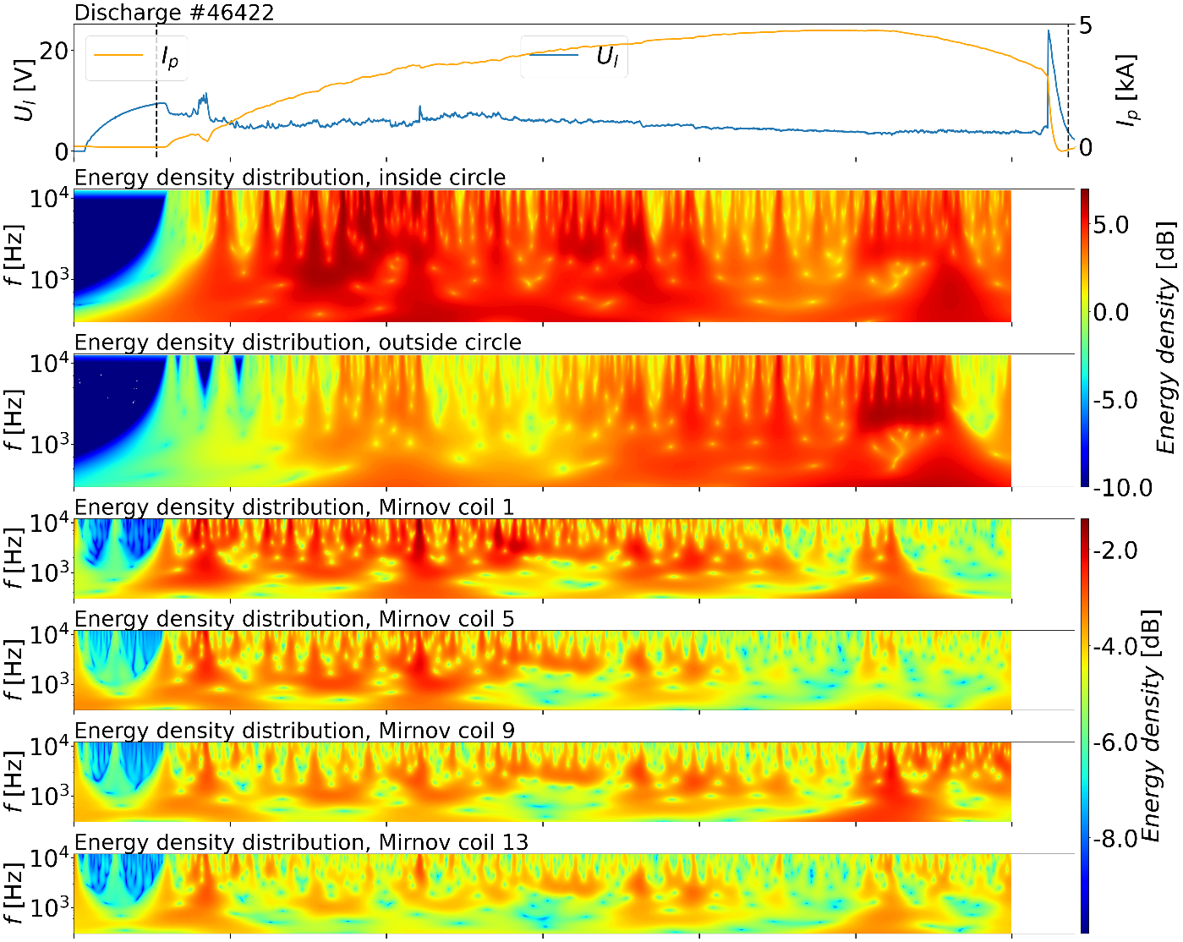
Continuous wavelet transform
Wavelet transformation was applied to each signal
  ξ - Time shift
  μ - Scale
  ∗ - Complex conjugation
  ψ - Analytic Morlet wavelet of order 3
Š. Malec
8

Slide 9
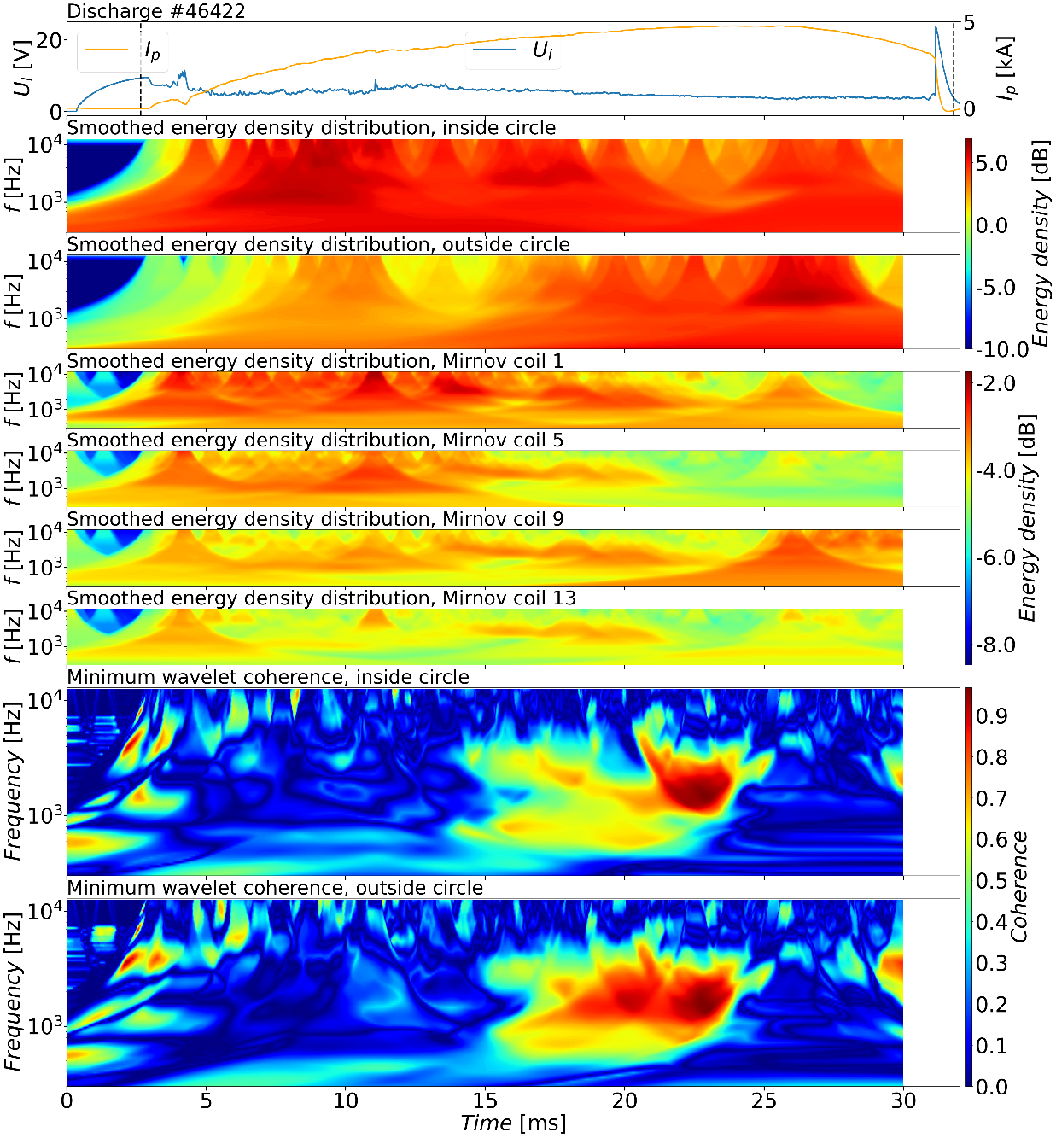
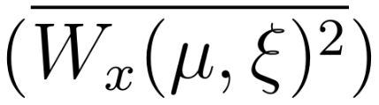
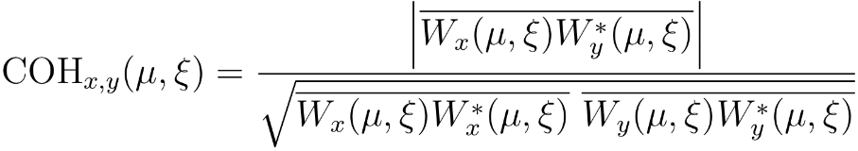
Minimum wavelet coherence
Smoothed energy density
Minimum wavelet coherence
Š. Malec
9

Slide 10
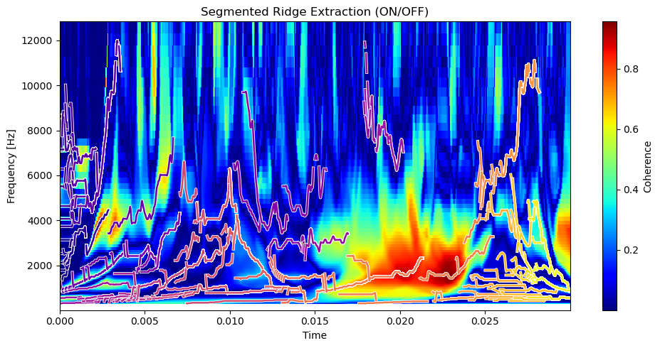
Ridges extraction
Continuous curves of local amplitude maxima, are determined in minimum wavelet coherence images (ridges)
Ridge analysis tracks these continuous trajectories of maxima in a time sequence
Š. Malec
10

Slide 11
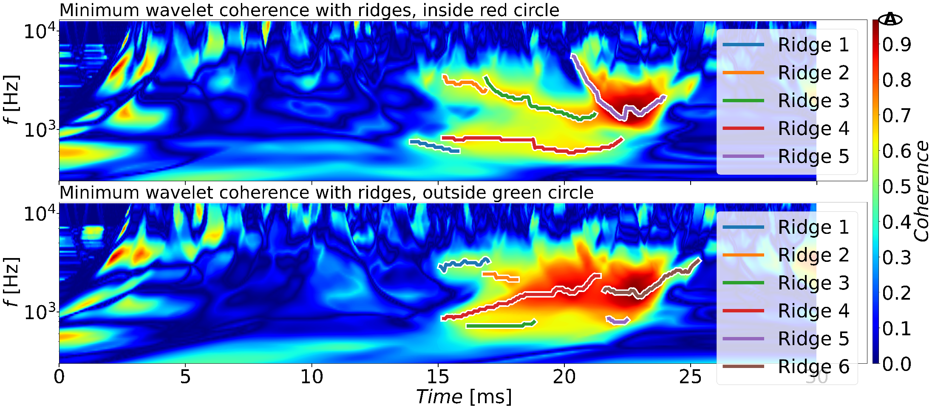
Ridges extraction
Ridges after adjusting the conditions for their separation (amplitude, length, etc.)
The phase shift is calculated along each ridge between each Mirnov coil and the signals from Timepix3
Š. Malec
11

Slide 12
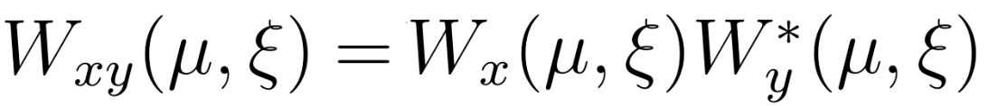
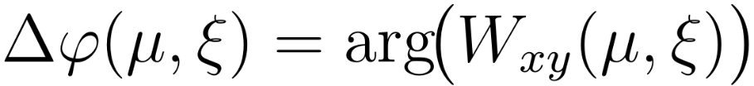
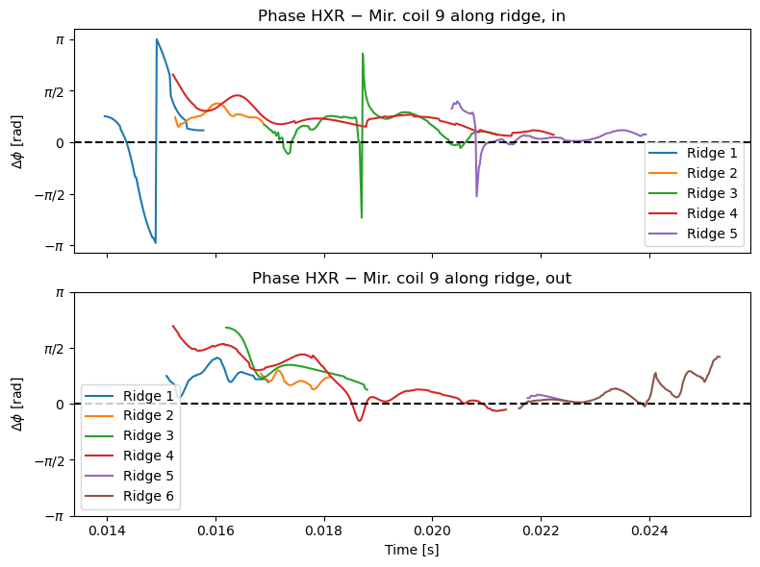
Phase shift
Roughly constant phase shift with only minor variations among the ridges
Trend in the phases across the different Mirnov coils might indicate a mode structure
Š. Malec
12

Slide 13
Conclusion
Runaway electron losses in these intervals may be modulated by MHD modes
Future work could focus on determining the toroidal and poloidal mode numbers
The calculation of phase shift along ridges depends on the quality of separation of individual ridges -> Better algorithm for ridges separation
Š. Malec
13

Slide 14
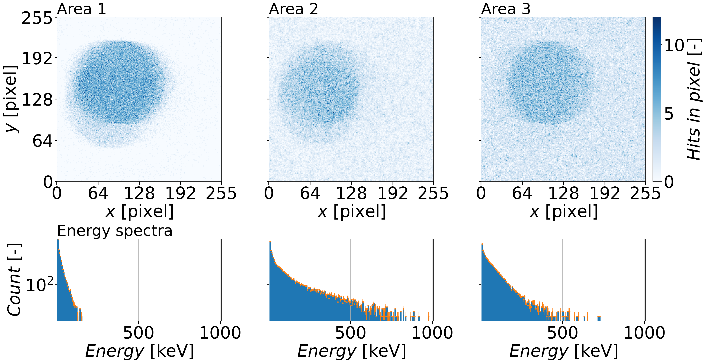
Backup
Š. Malec
14

Slide 15
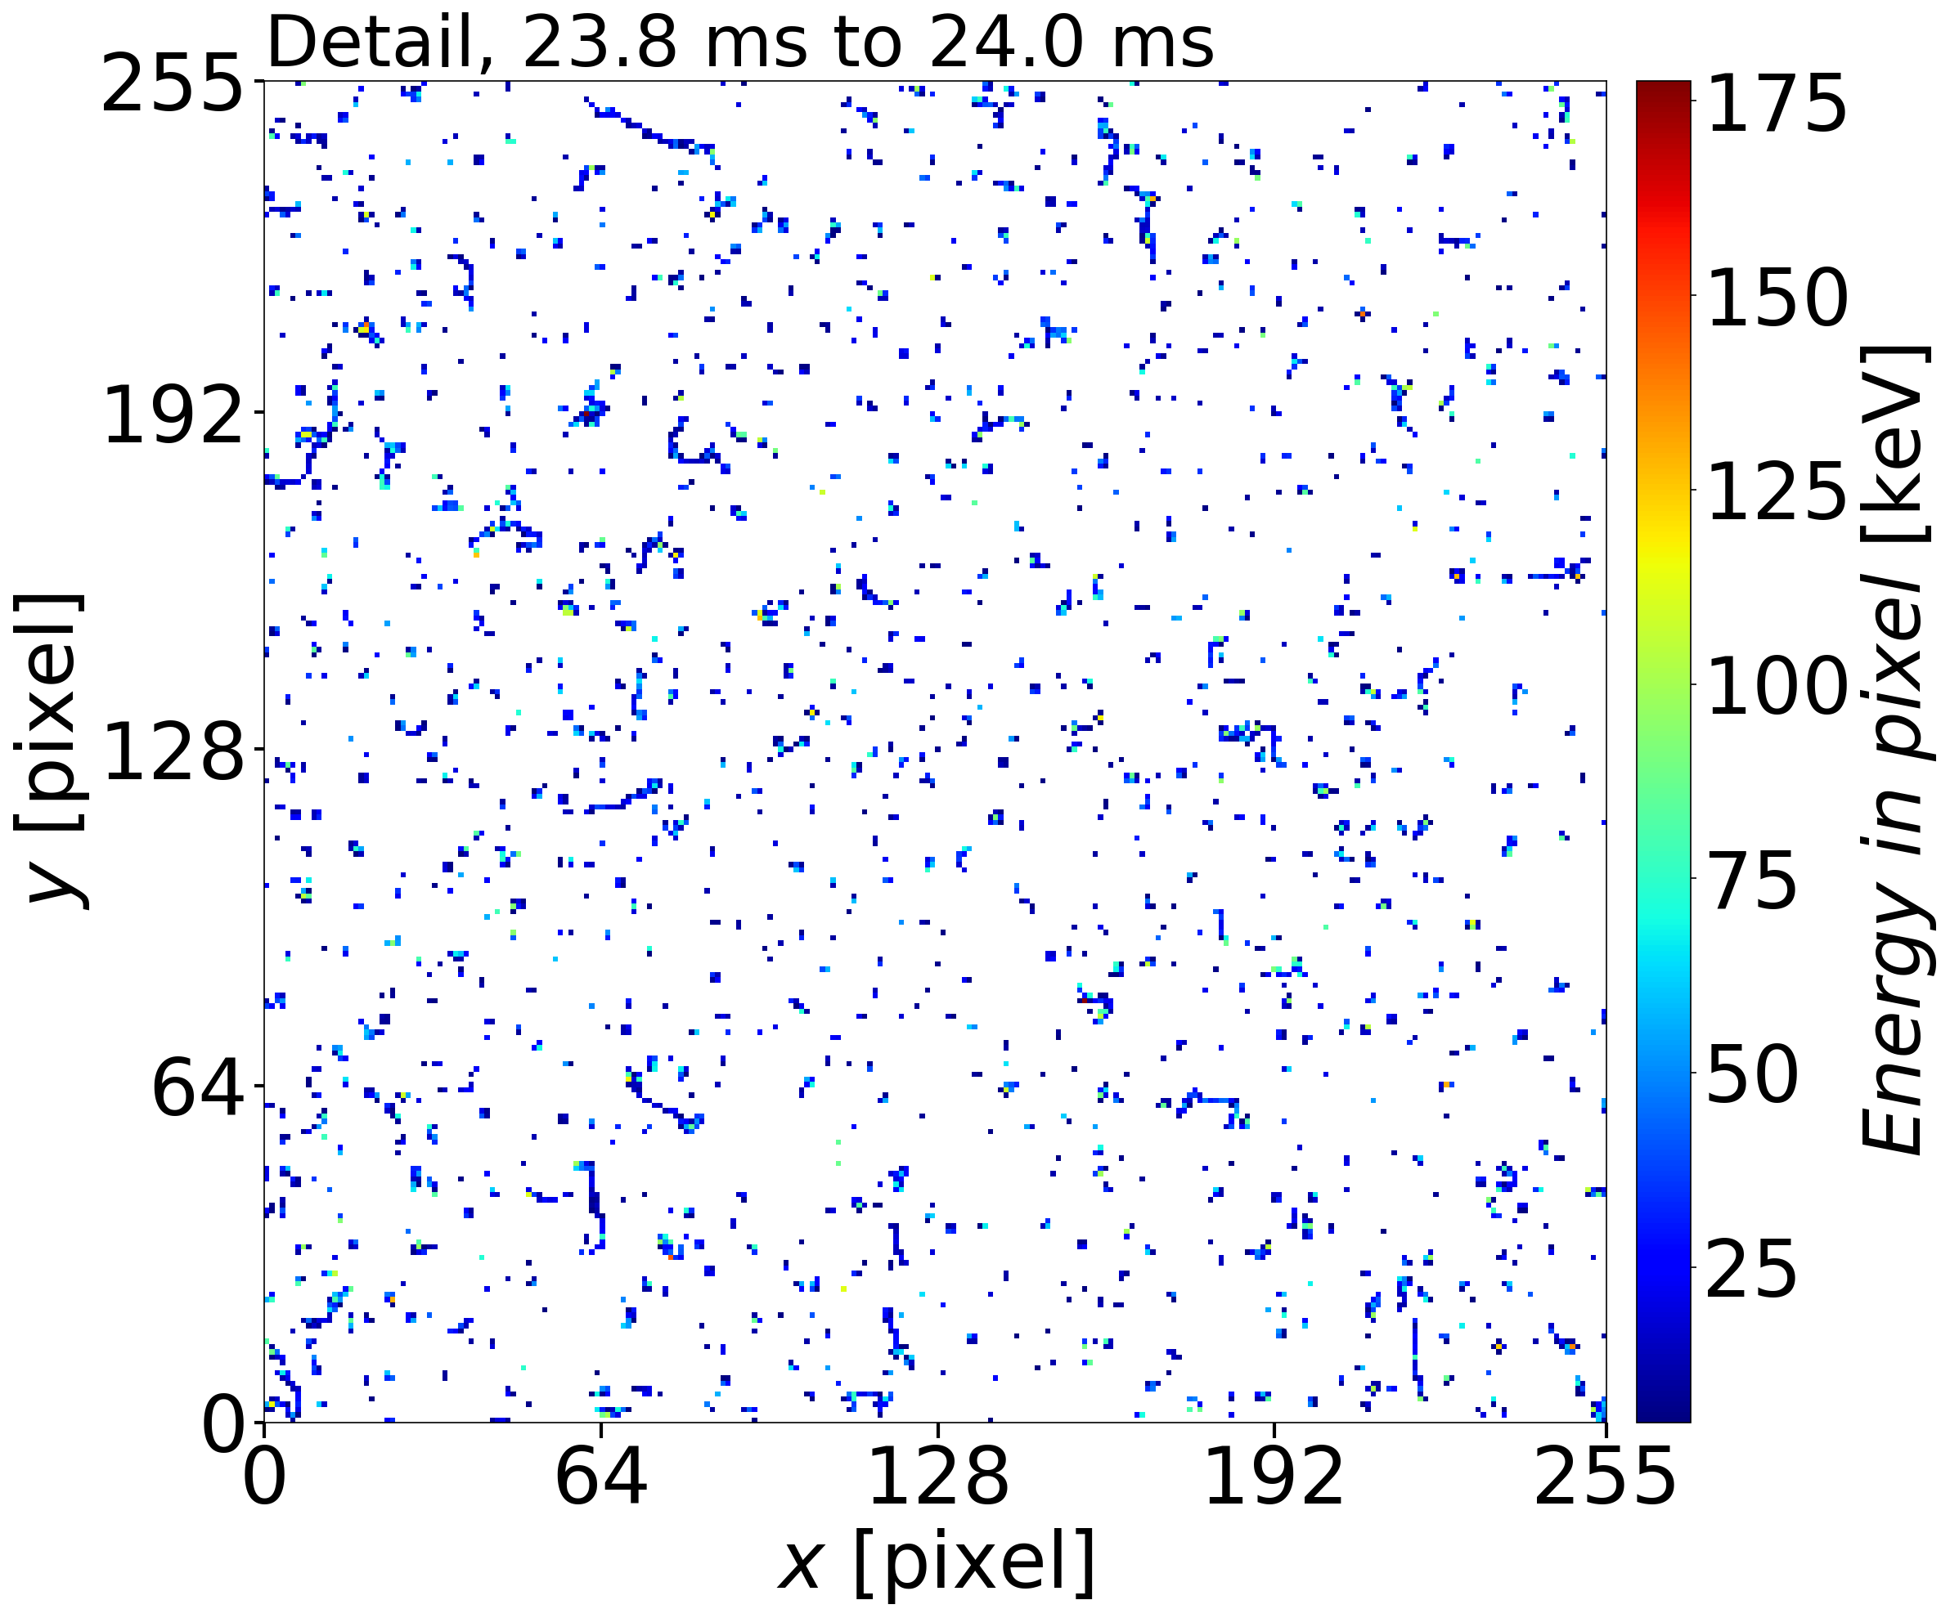
Backup
Š. Malec
15

Slide 16
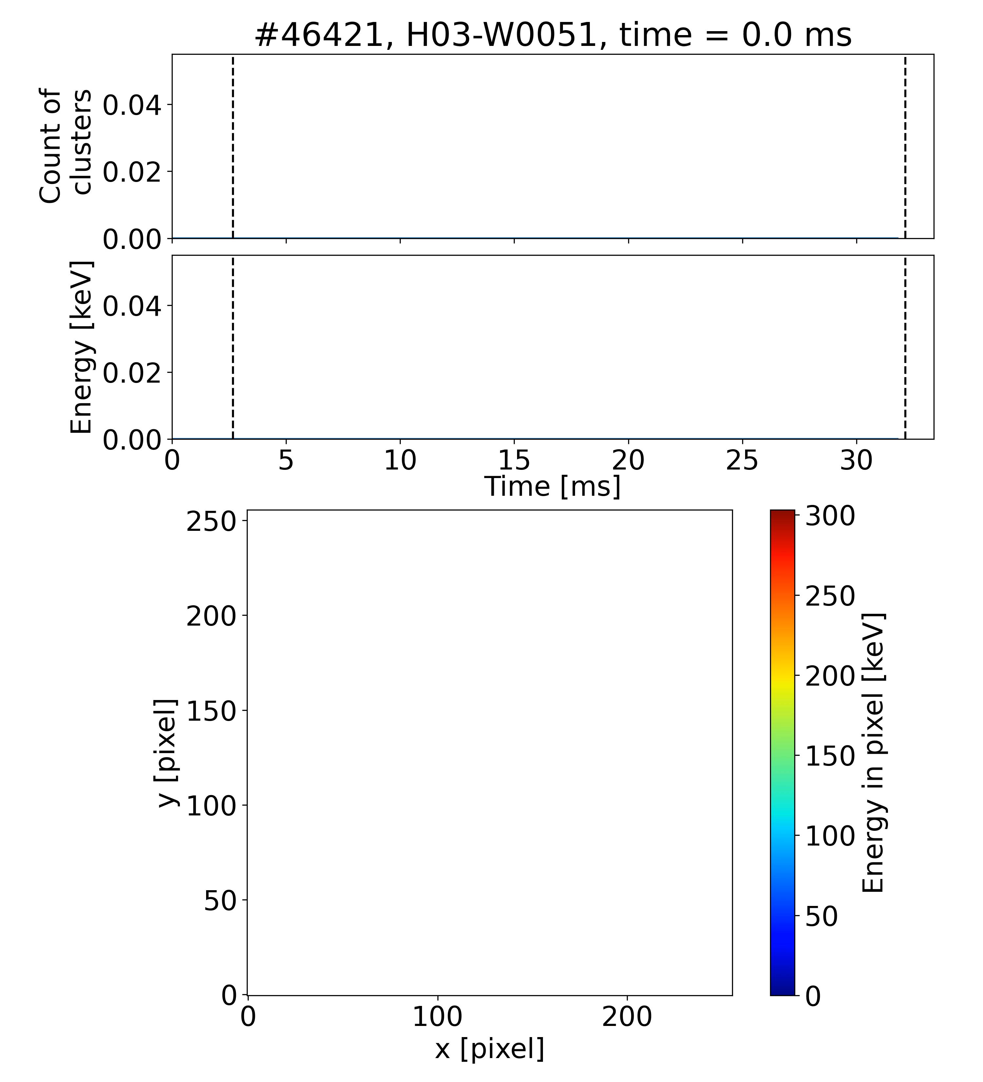
Measurement at the Be window
Š. Malec
16

Slide 17
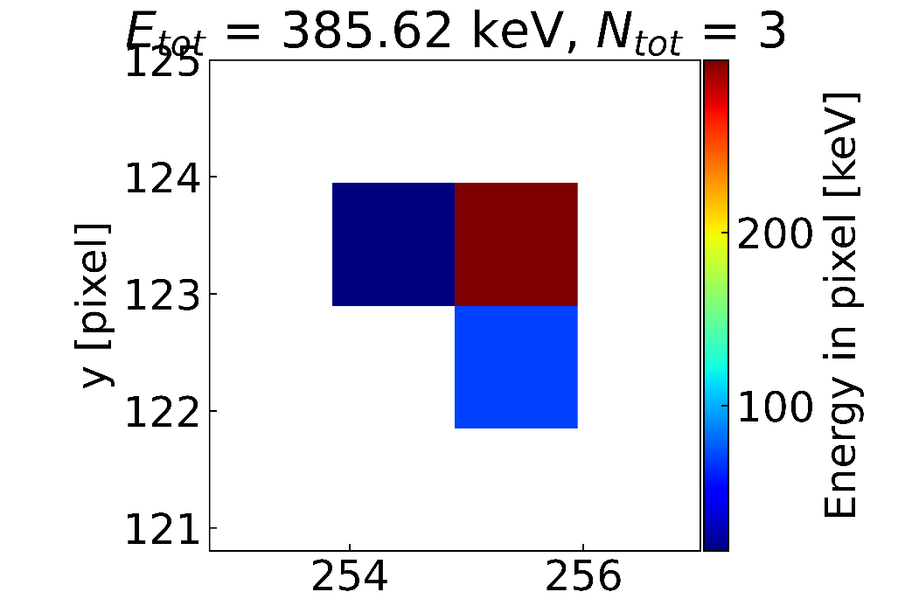
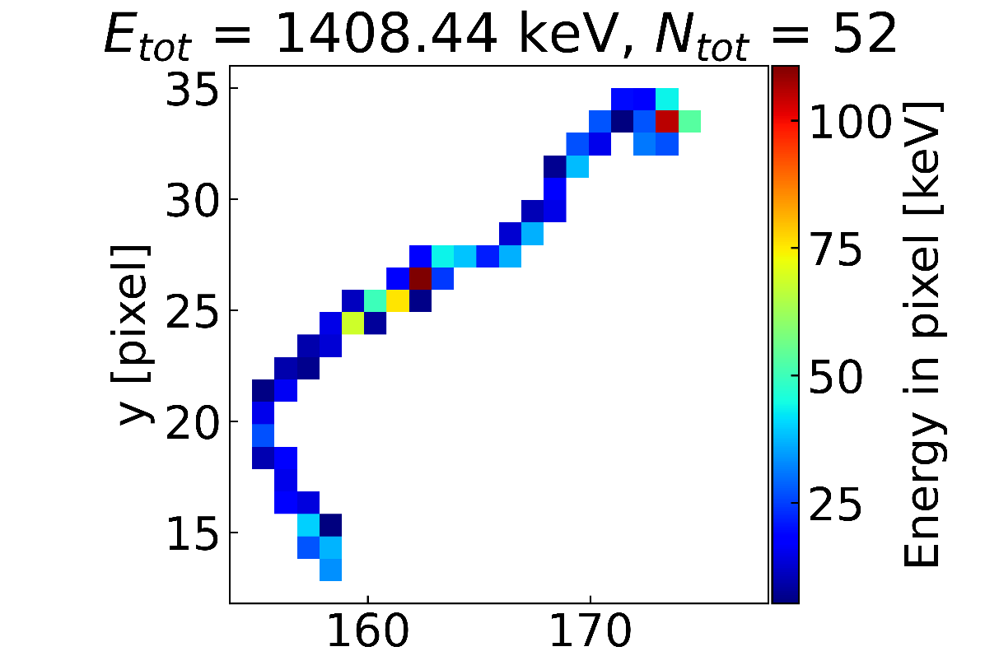
Measurement at the Be window
At the Be window measurement, interactions with higher energy are more frequent
Photon
Electron
Š. Malec
17

