Slide 1

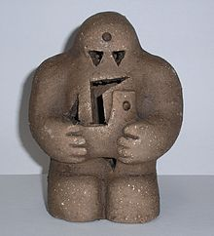
The Golem Tokamak
Experiment
Group 5

Slide 2
Mentor
Professor Rémi Dumont
Assistance
Arlee Tamman
members
Damasus Riko Prijono - Indonesia
Jutha Chaitrakrankit - Thailand
Nattharinee Charoenrat - Thailand
Anthika Lakhonchai - Thailand
Naira Hamid - Pakistan
Shaikh Zubin Abdulfarid - India
Arnatee Umudi - Thailand
Sabahat Hassan Doger - Pakistan
Atita Tapoh - Thailand
Mahnoor Fatima - Pakistan
Bagaskala Eka Nugraha - Indonesia
Amila Amatullah - Indonesia
Le Ngoc Uyen - Vietnam
Wajiha Zafar - Pakistan

Slide 3
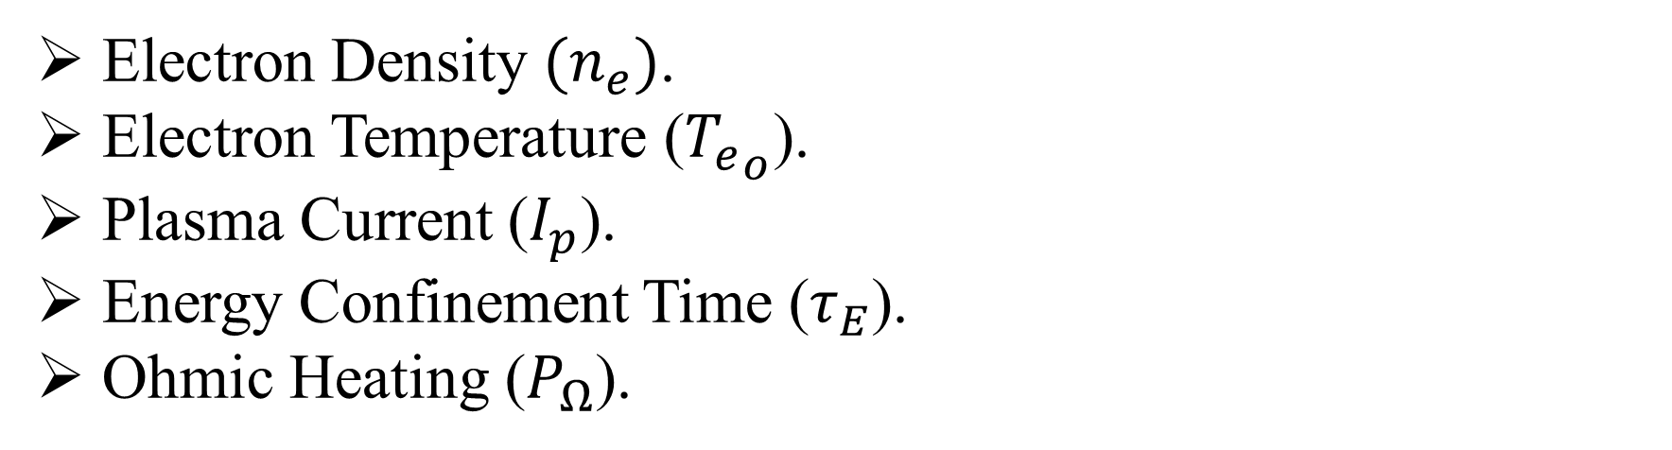
Objectives
Effect of varying pressure on following parameters
Electron Density .
Electron Temperature ().
Plasma Current ().
Energy Confinement Time ().
Ohmic Heating ().

Slide 4
Adjustable Parameters
Suggested Pressure(mPa) | Discharge Pressure(mpa)
20 | 12.2
20 | 11.18
40 | 18.14
40 | -
60 | 13.44
60 | -
10 | 6.41
10 | 5.69
30 | 13.55
30 | 14.80
U_{CD} = 500 V
U_{B} = 700 V
τ_{cd} = 5 ms

Slide 5
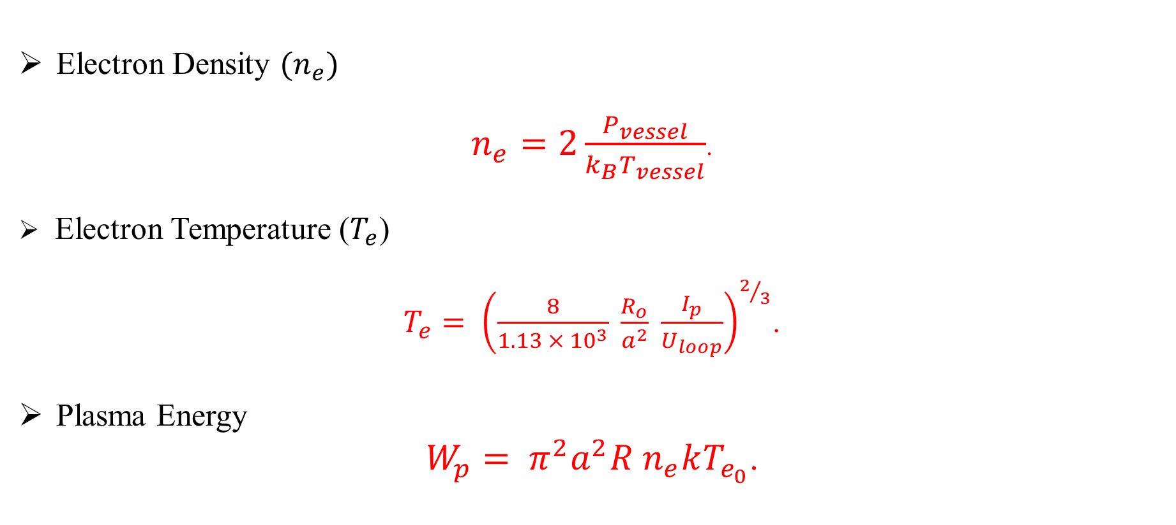
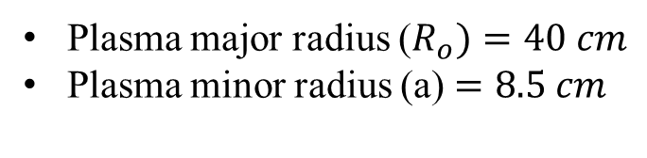
Measurement of Physical Quantities
Electron Density
.
Electron Temperature ()
.
Plasma Energy
.
Plasma major radius (
Plasma minor radius (a)

Slide 6
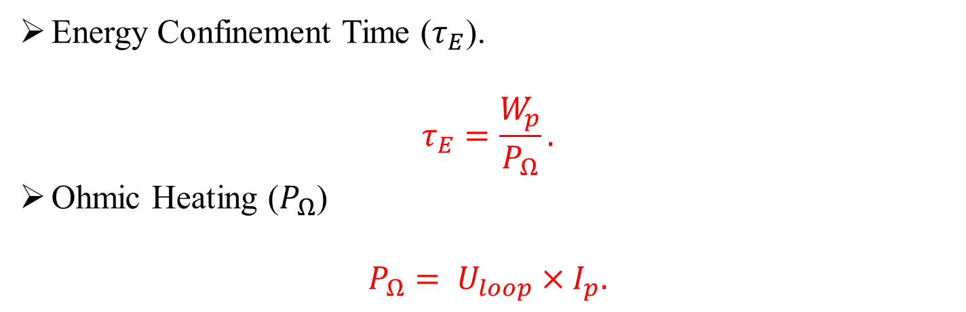
Measurement of Physical Quantities
Energy Confinement Time ().
Ohmic Heating ()

Slide 7
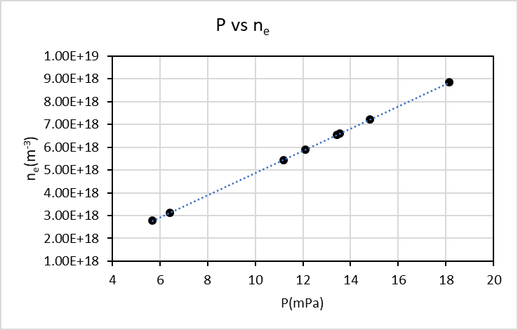
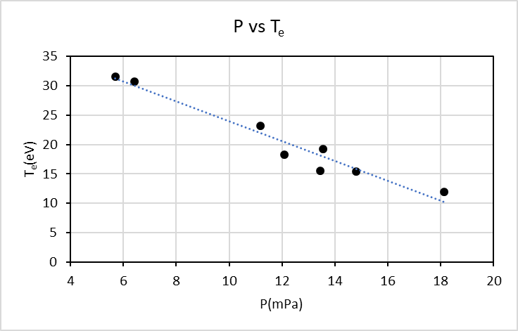
Results & Discussion

Slide 8
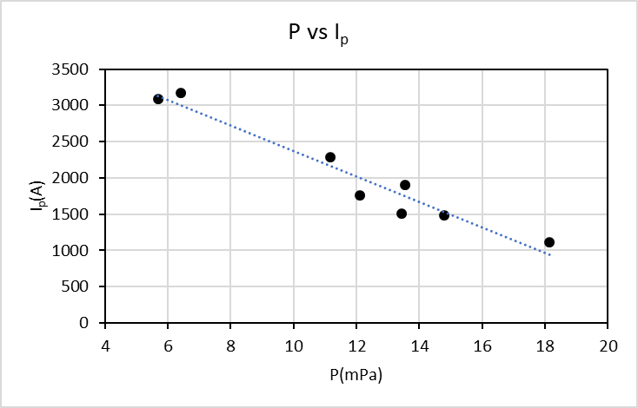
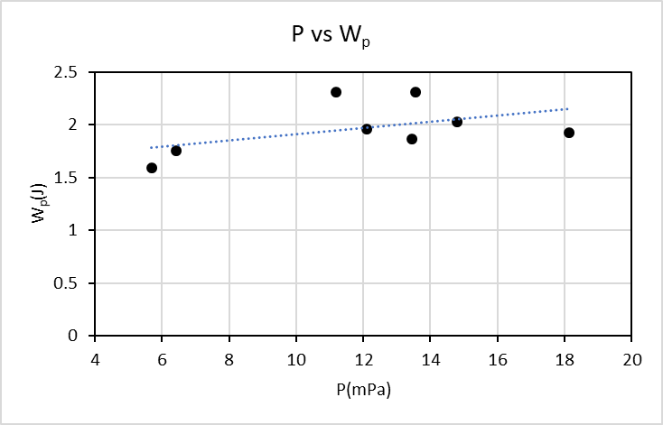
Results & Discussion

Slide 9
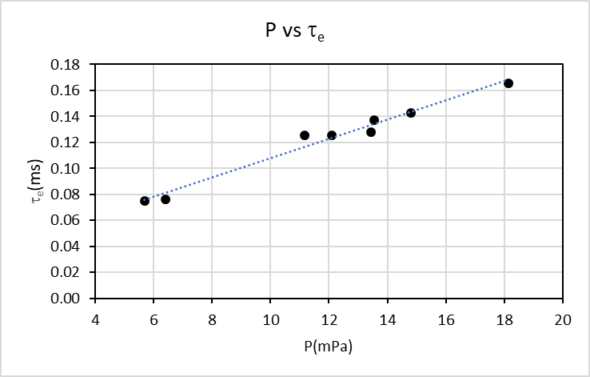
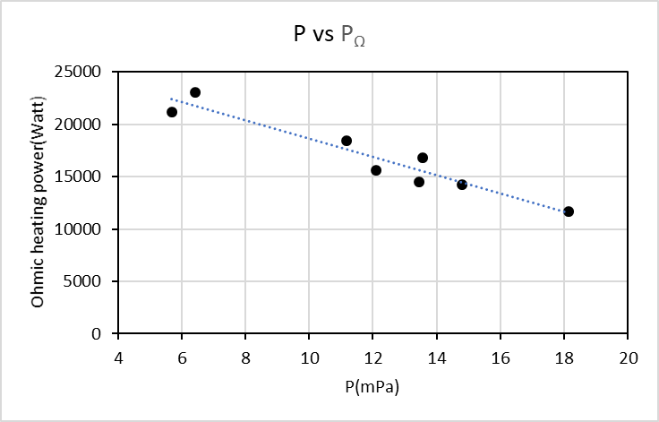
Results & Discussion

Slide 10
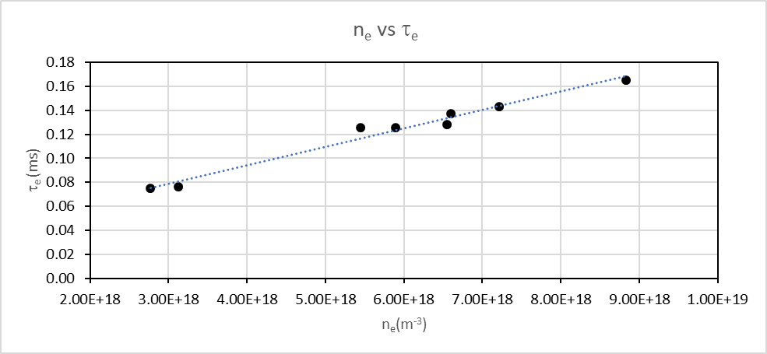
Results & Discussion

Slide 11
Comparison of Electron Temperature Calculated and Experimental
Experiment (Te) | Calculate (Te) | % Error
19.5 | 18.23 | 6.94
24.8 | 23.20 | 6.88
12.8 | 11.97 | 6.96
16.6 | 15.58 | 6.52
32.9 | 30.77 | 6.93
33.6 | 31.50 | 6.66
20.5 | 19.19 | 6.84
16.5 | 15.41 | 7.08
 | Average | 6.85

Slide 12
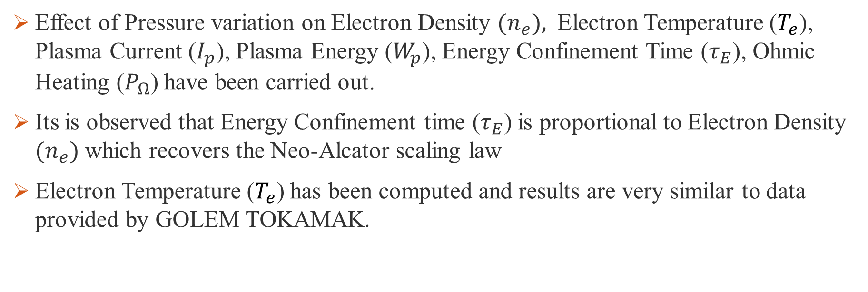
Conclusion
Effect of Pressure variation on Electron Density Electron Temperature (), Plasma Current (), Plasma Energy (), Energy Confinement Time (), Ohmic Heating () have been carried out.
Its is observed that Energy Confinement time () is proportional to Electron Density which recovers the Neo-Alcator scaling law
Electron Temperature () has been computed and results are very similar to data provided by GOLEM TOKAMAK.

Slide 13
THANK YOU

Slide 14
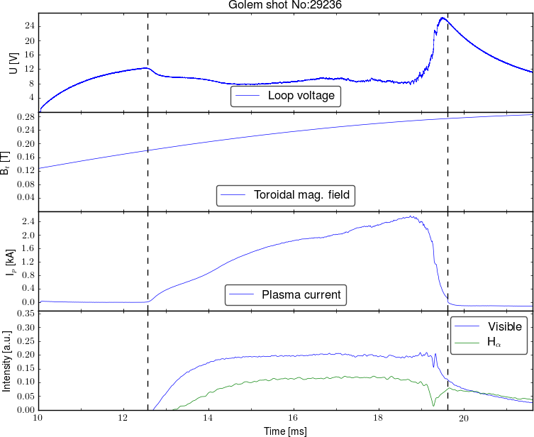

Slide 15
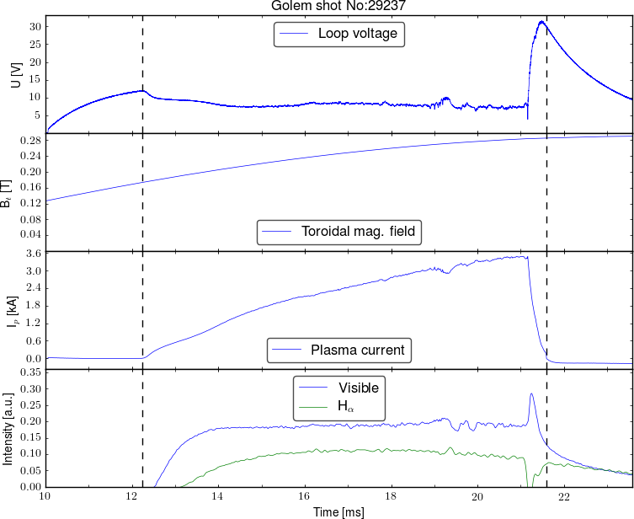

Slide 16
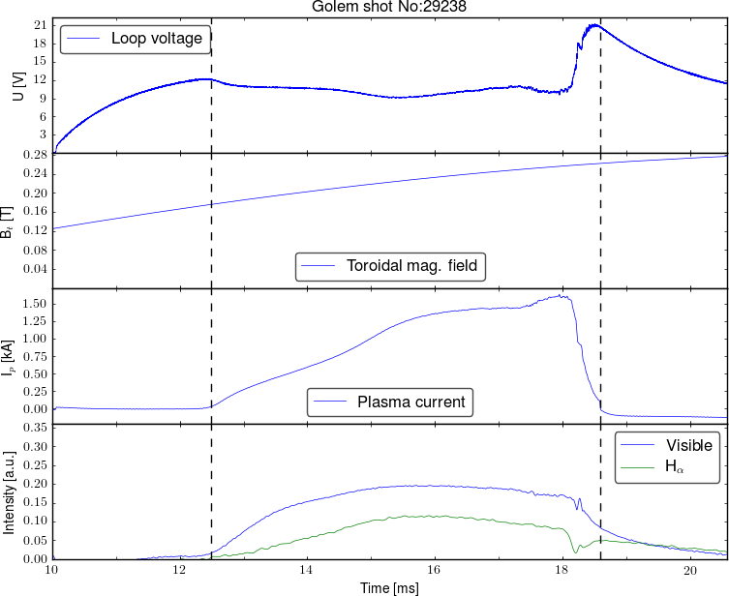

Slide 17
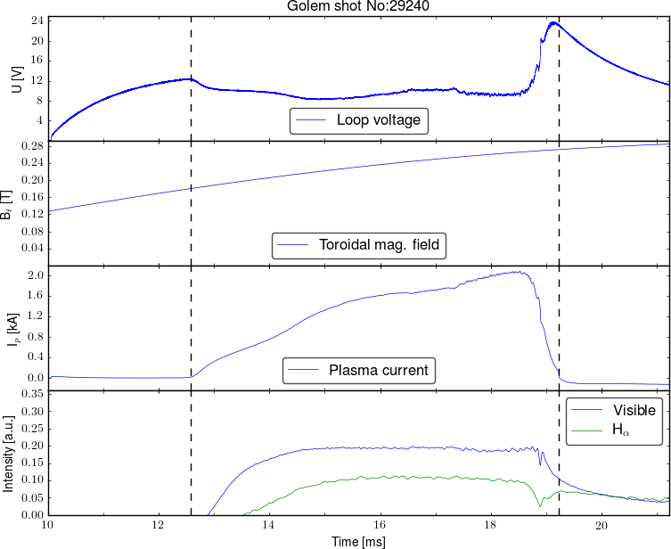

Slide 18
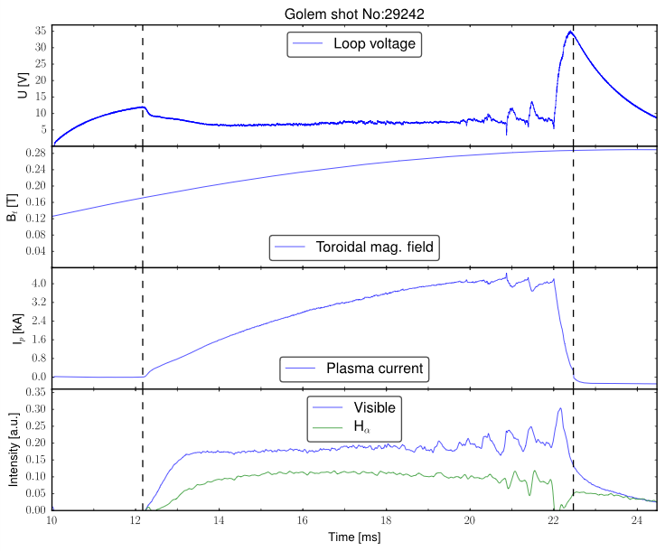

Slide 19
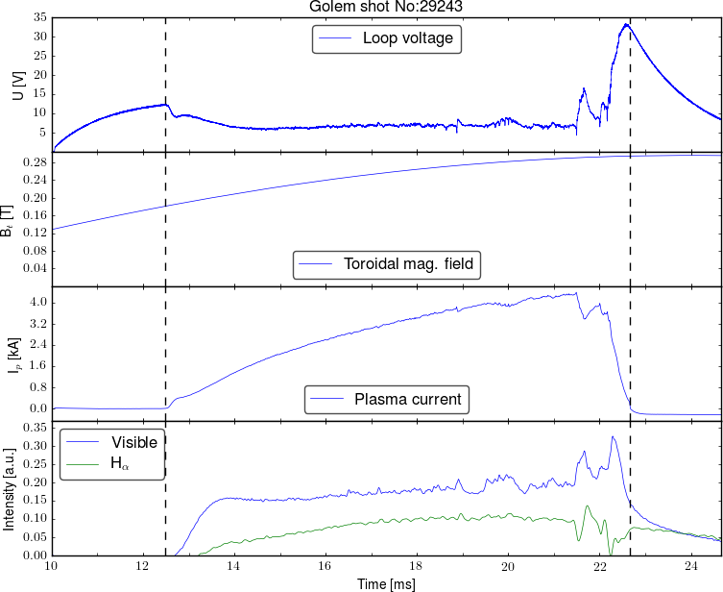

Slide 20
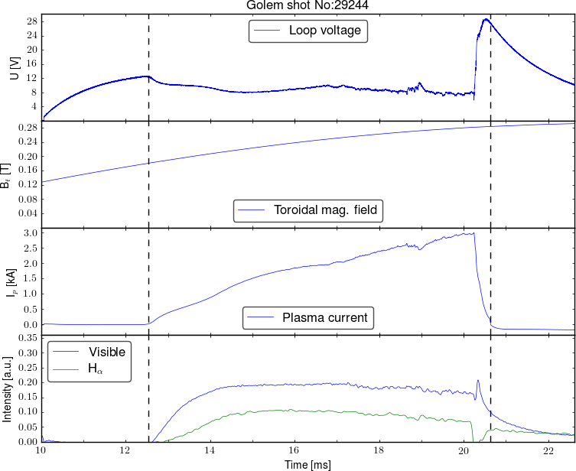

Slide 21
