Slide 1


Density measurements by microwave interferometry
Daniel Costa, Nadiia Lisovska, Johan Buermans, Siusko Yevhen
07.05.2019, Prague

Slide 2
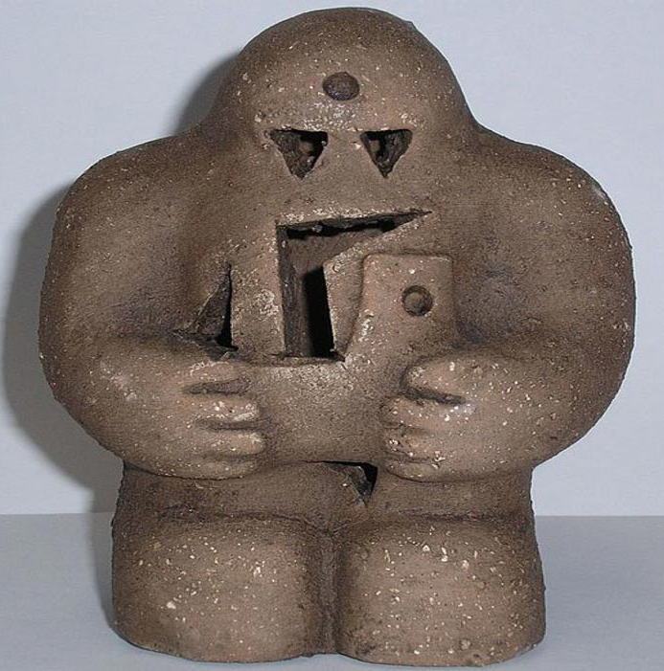
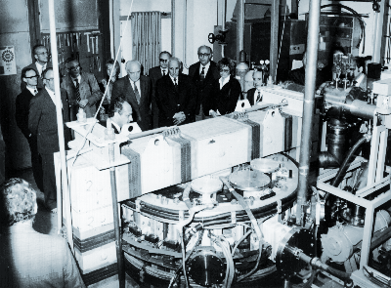
Introduction
Toroidal magnetic field | <0.8 T
Plasma current | <8 kA
Central electron Temperature | 80 eV
Safety factor of plasma edge | 15
Working gas pressure | 0-100 mPa
Work gas | H2 (He)

Slide 3
Main features of the Interferometry on GOLEM tokamak
The real-time line-average electron density measurement
The precise frequency filtering
Tunable bandwidth of the digital filters
Multi-chord measurement
Tasks
Dependency of the plasma density on toroidal magnetic field and electric field.
Reconstruction of the plasma density profile evolution from LFS (low field side) to HFS (high field side) by multi-chord measurement.

Slide 4
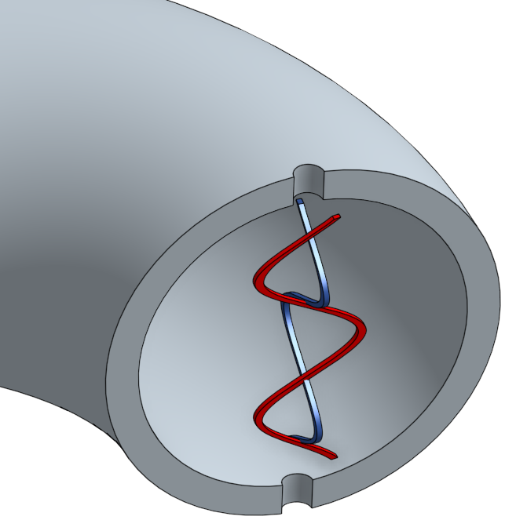

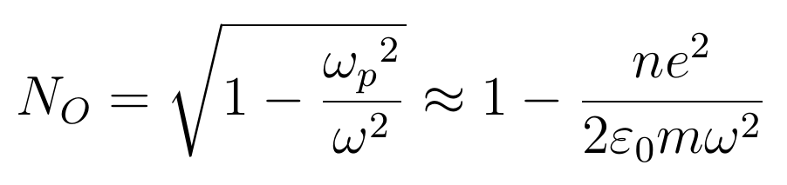
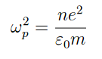

Basic Concepts
Ordinary waves (O waves)
One wave goes through the plasma
Another goes through air
We can deduce the density from the phase difference between the two!
refr. index density phase shift density :)

Slide 5
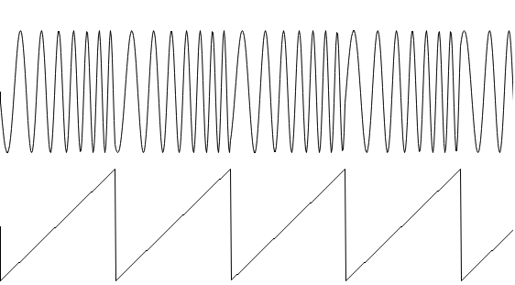


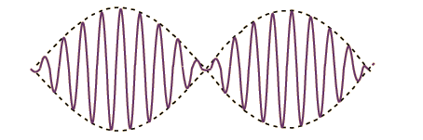
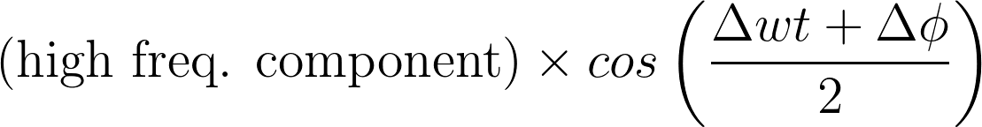
Basic Concepts
Waves need to have a high frequency
(71 GHz) to overcome the cut-off
We modulate the wave in frequency with a sawtooth signal
Reference wave:
Probing wave:

Slide 6
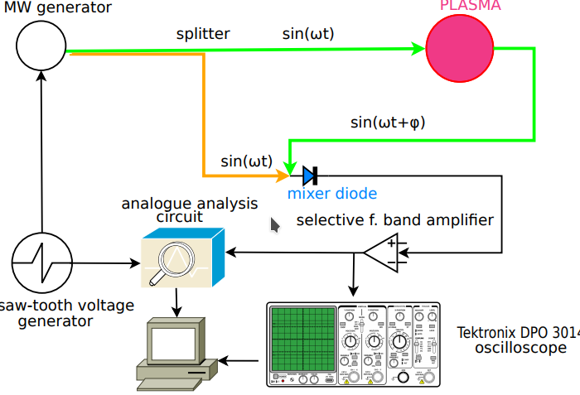
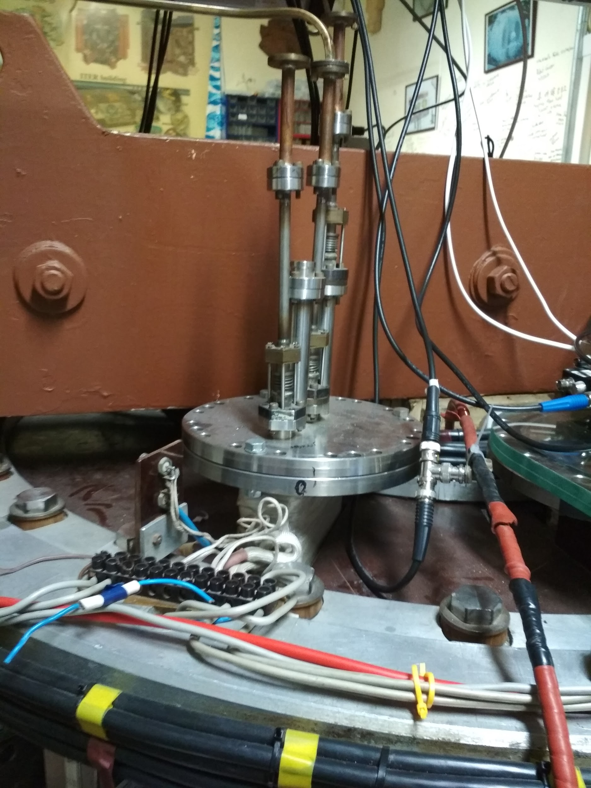
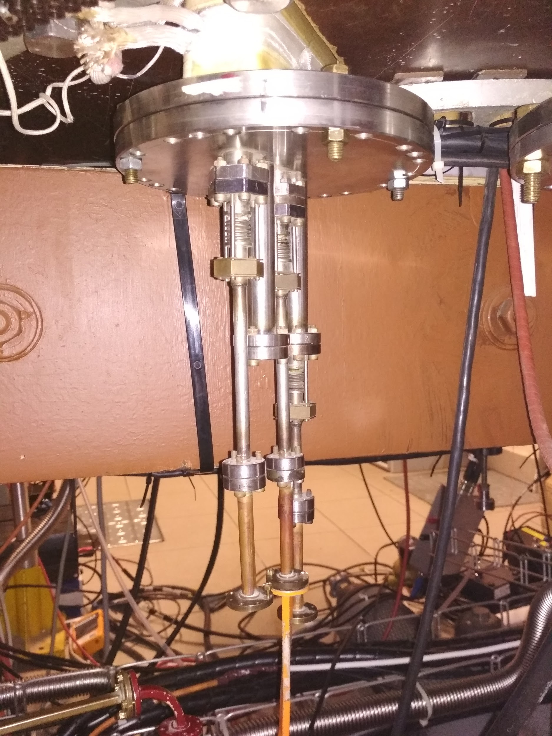
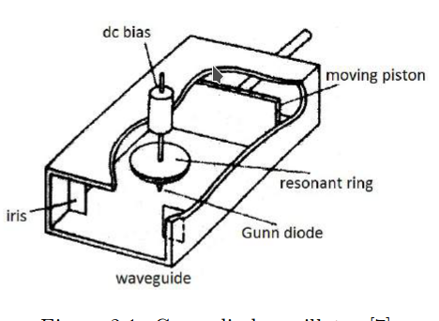
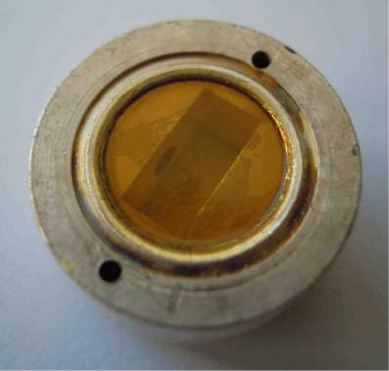
Gunn oscillator frequency: 71 GHz
Sawtooth frequency: 500 kHz
Frequency sweep: 30 MHz
Waveguide path difference: 10 m

Slide 7
Goals
Dependency of the plasma density on the electric field.
Dependency of the plasma density on toroidal magnetic field.
Reconstruction of the plasma density profile evolution from LFS (low field side) to HFS (high field side) by multi-chord measurement.

Slide 8
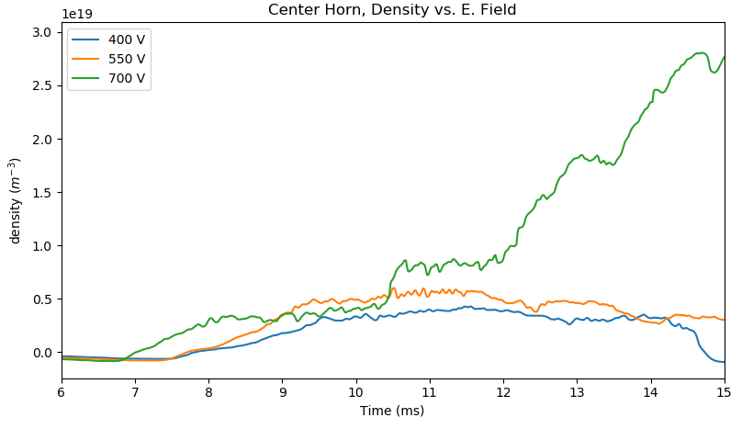

Slide 9
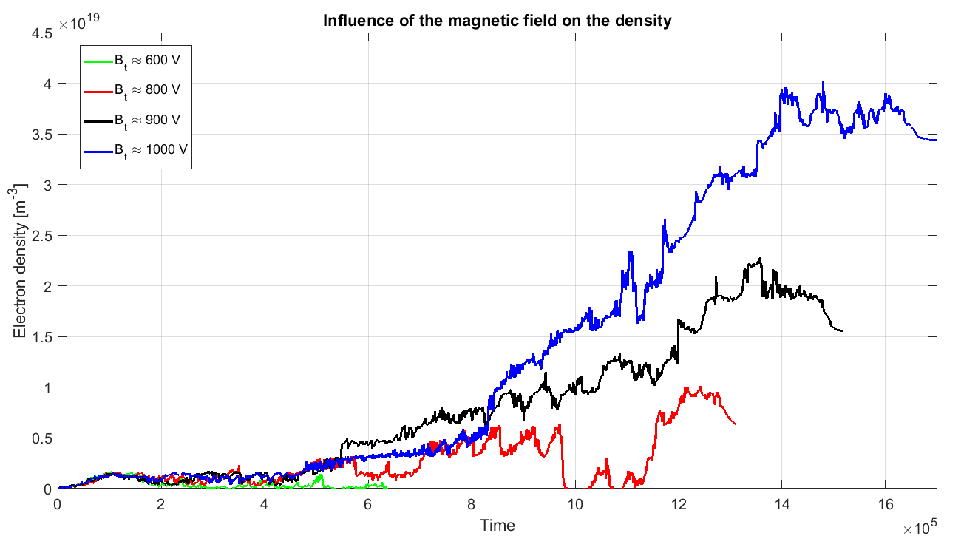

Slide 10
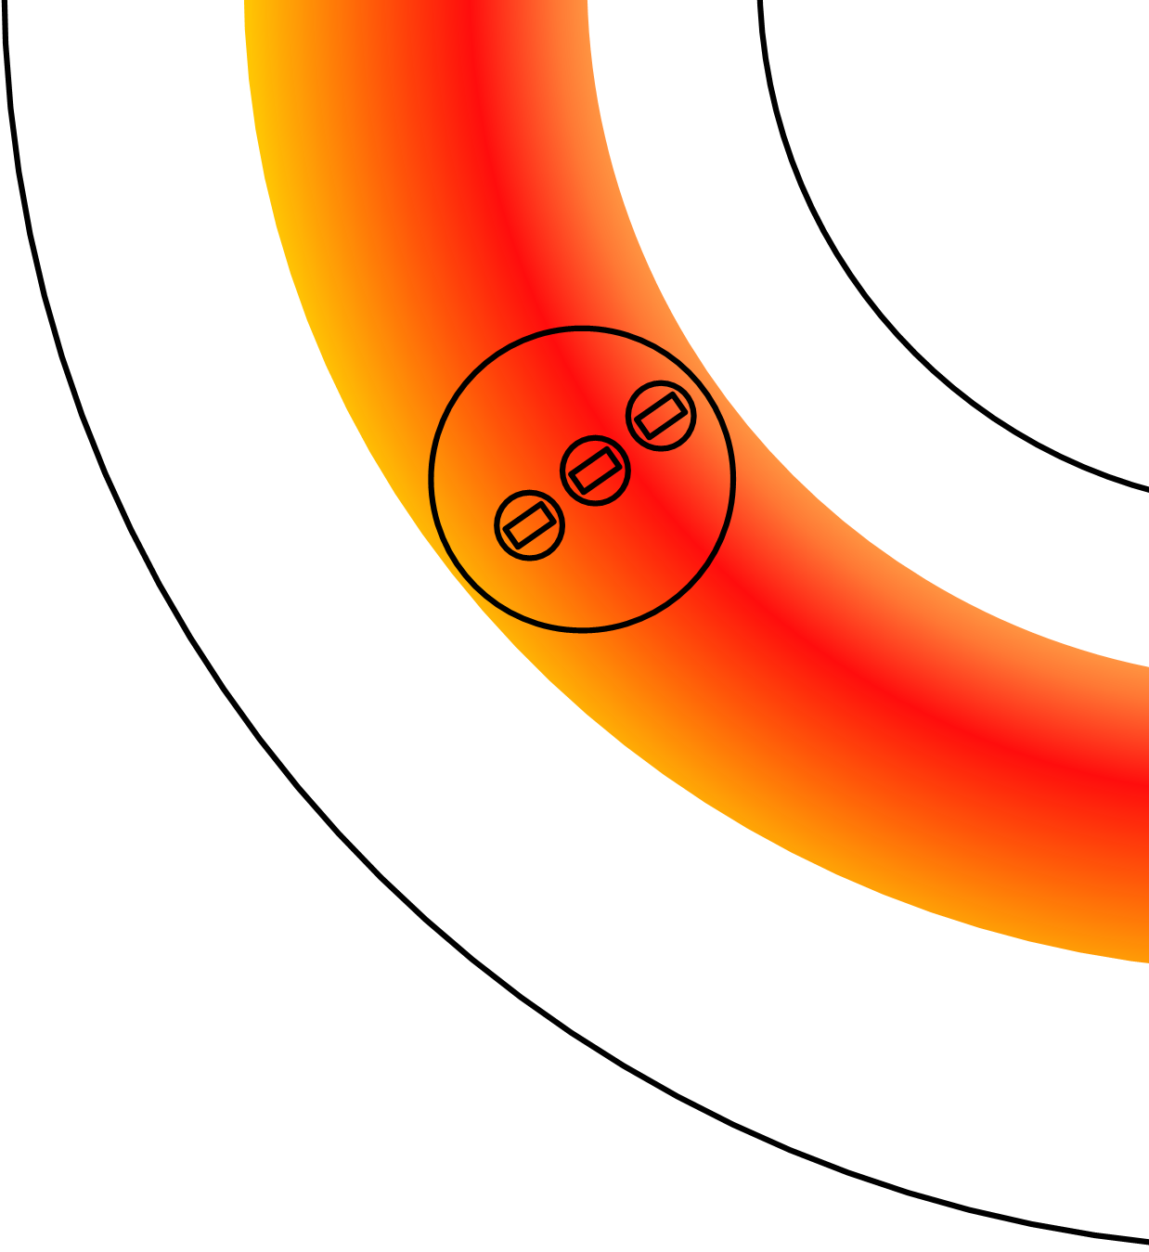
Density profile measurements
Three chords for the line-average electron density measurement:
LFS
Center
HFS
Only one interferometer
HFS
LFS

Slide 11
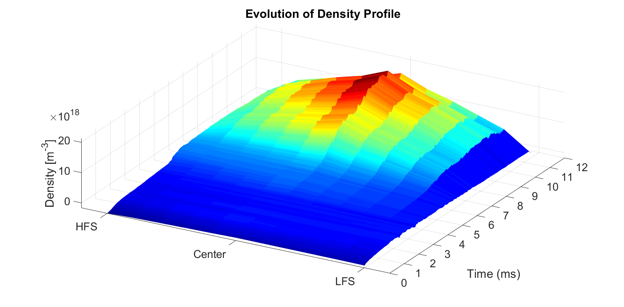

Slide 12
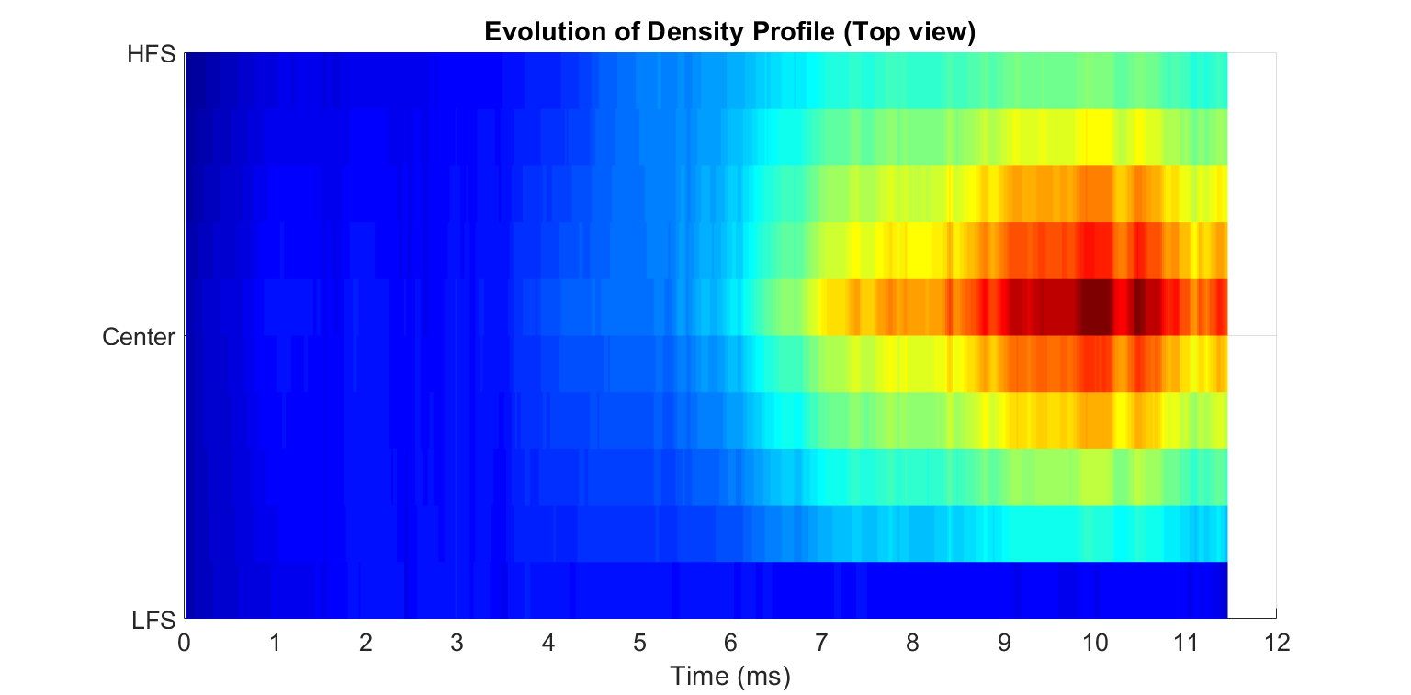
A glimpse of the future...

Slide 13
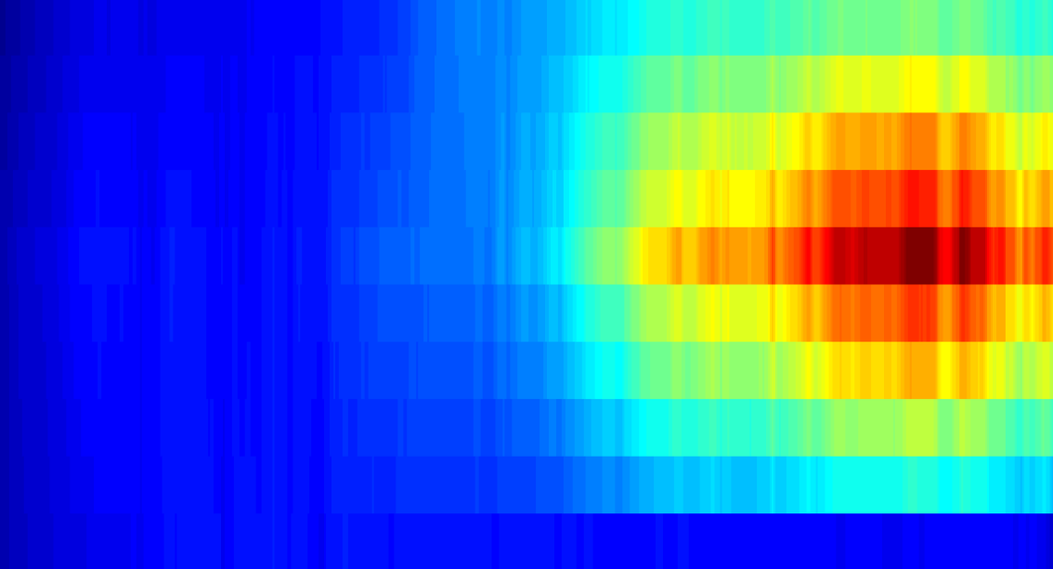
Conclusion
Density versus Electrical Field
Density versus Magnetic Field
Density profile evolution
Horizontal position of plasma

Slide 14

Basic equations
[1]
[2]
[3]

Slide 15



Basic algorithms for data processing
Phase shift
Complex representation
1. Fourier transformation via FFT.
2. Finding the carrier frequency.
3. The complex exponential signale creation.
4. The analytic representation is created
5. This filter). representation This smoothing is smoothed averages out in time the oscillating by a convolution component with a of Gaussian s a (t) constructed window (essentially in the previous a low-pass
step.
6. The phase and amplitude are obtained from the polar representation of s a (t).
Polar representation

