Slide 1

NAIJAFUSION 2025
The Tokamak as a Transformer:
An Experimental Study of Ohmic Heating on GOLEM
Jatto Daniel Onimisi[1], Chinomnso Daniel Umejiaku[2], Adanna Deborah Onwuasoanya[2]
Affiliations:
`1. University of Ilorin, Ilorin, Nigeria,
2. University of Nigeria, Nsukka, Nigeria
Supervisors:
Yashpreet Sembhi, The GOLEM Tokamak Team, Czech Technical University
Abuchi Chukwurah, The University of Texas, Austin
1st Nigerian School on Plasma Physics and Fusion Energy 19/09/2025

Slide 2

What to Expect
1. Introduction to Tokamaks and GOLEM
2. The Transformer Principle
3. The Physics of Ohmic Heating
4. Our Experimental Campaign on GOLEM
5. Results & Discussion
6. Conclusion
NAIJA FUSION 2025 19/09/2025

Slide 3
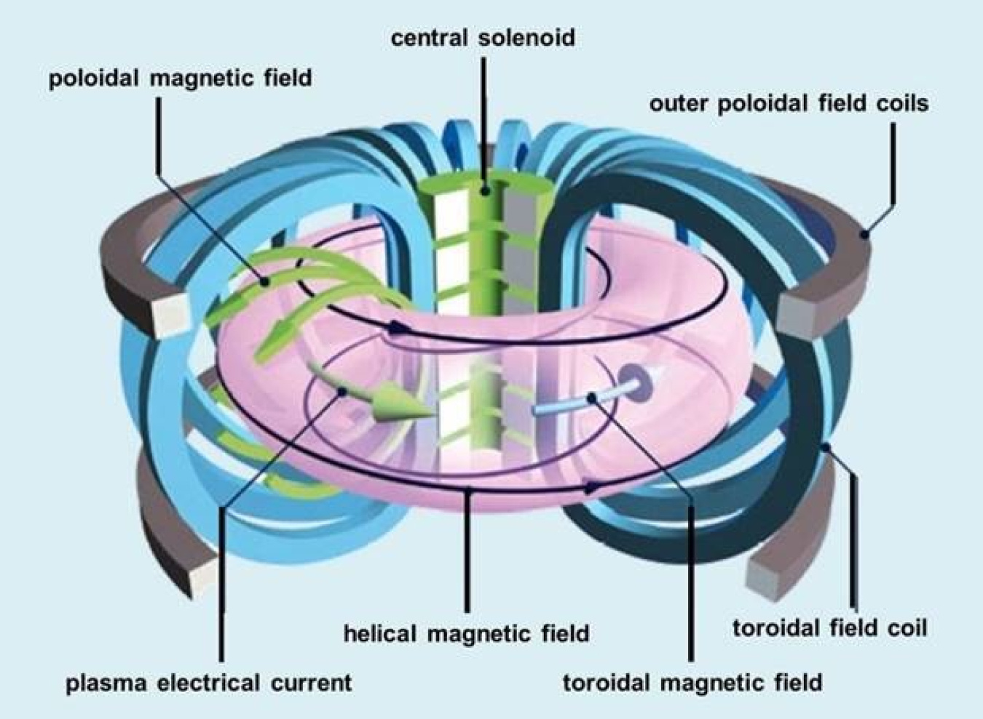
What is a Tokamak?
An experimental device that uses powerful magnetic fields to confine and heat plasma in a doughnut-shaped (toroidal) container to achieve controlled nuclear fusion, the same process that powers the sun.
Our Testbed: GOLEM
A small, educational tokamak perfect for research and training.
Our Mission:
We used GOLEM remotely to investigate two of its most fundamental principles.
NAIJA FUSION 2025 19/09/2025

Slide 4
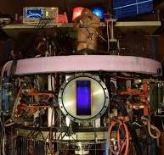
The GOLEM Tokamak
“Oldest operational Tokamak in the world”
Key Specs
R ≈ 0.4 m, a ≈ 0.085 m
Bt < 0.8 T, Ip < 8 kA
Short pulse ≈ 13-15 ms
NAIJA FUSION 2025 19/09/2025

Slide 5
The Transformer Concept
Core Idea
A tokamak is a giant electrical transformer.
Primary Winding: The Central Solenoid.
Secondary "Winding": The plasma itself.
The Physics (Faraday's Law)
A changing current in the solenoid induces a strong electric field (Loop Voltage, U_loop) in the chamber. This voltage is what drives the Plasma Current (I_p).
This is why conventional tokamaks are pulsed. A transformer only works with a changing flux.
NAIJA FUSION 2025 19/09/2025

Slide 6
Ohmic Heating
The Basics
Definition: Heating by driving a current through resistive conductors’s converting some of its electrical energy into heat.
Role: Heats already-ionized plasma, not neutral gas.
Formula: P = I²R(Ohmic power dissipation)
Analogy: like heating a wire with current, but plasma is the “wire.”
NAIJA FUSION 2025 19/09/2025

Slide 7
Ohmic Heating in Plasma
A few Things to Note
Seed plasma creation (via pre-ionization, RF, etc.) → Ohmic heating takes over.
Solenoid (primary coil) → Plasma (secondary)
Changing flux induces toroidal E-field
Drives plasma current (RLC-like circuit
NAIJA FUSION 2025 19/09/2025

Slide 8
Ohmic Heating in Plasma
How does Ohmic Heating work?
Transformer induces current in plasma
Plasma has resistance → converts current into heat
Ohmic heating power: P = I²R
Link: Transformer action drives the current; Ohmic effect generates the heat
NAIJA FUSION 2025 19/09/2025

Slide 9
Ohmic Heating
The Basics
Definition: Heating by driving a current through resistive conductors’s converting some of its electrical energy into heat.
Role: Heats already-ionized plasma, not neutral gas.
Formula: P = I²R(Ohmic power dissipation)
Analogy: like heating a wire with current, but plasma is the “wire.”
NAIJA FUSION 2025 19/09/2025

Slide 10
Ohmic Heating in Plasma
A few Things to Note
Seed plasma creation (via pre-ionization, RF, etc.) → Ohmic heating takes over.
Solenoid (primary coil) → Plasma (secondary)
Changing flux induces toroidal E-field
Drives plasma current (RLC-like circuit
NAIJA FUSION 2025 19/09/2025

Slide 11
Ohmic Heating in Plasma
How does Ohmic Heating work?
Transformer induces current in plasma
Plasma has resistance → converts current into heat
Ohmic heating power: P = I²R
Link: Transformer action drives the current; Ohmic effect generates the heat
NAIJA FUSION 2025 19/09/2025

Slide 12
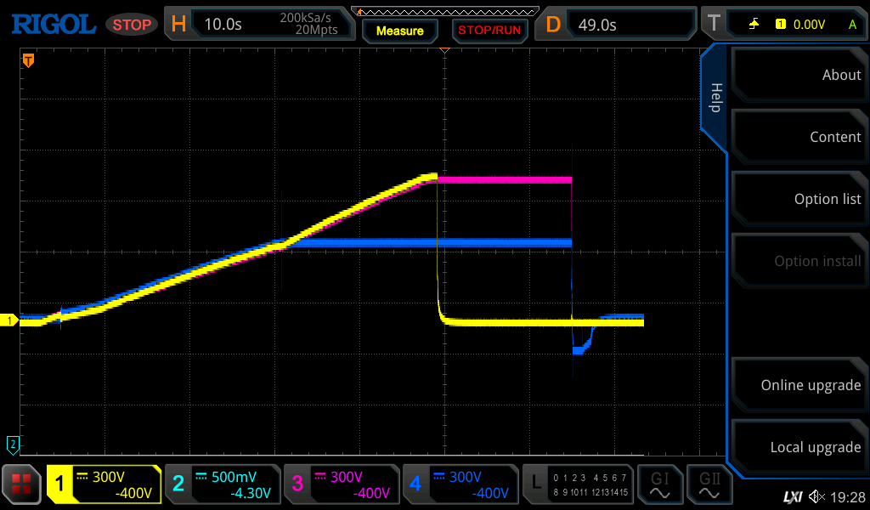
Ohmic Heating in Plasma
Oscilloscope
Oscilloscope: negative dip shows inductive effects
Energy can flow back into capacitor
Plasma heating = Transformer-driven current + Ohmic dissipation
12
3
NAIJA FUSION 2025 19/09/2025
NAIJA FUSION 2025 19/09/2025

Slide 13
Before and After Wall Conditioning:
Efficiency improves across both plasma and vacuum shots after wall conditioning. This indicates that conditioning positively affects energy deposition
S/N | Shot # | Description | Gas Pressure | V_initial (V) | V_discharge (V) | U_loop (V) | R_ch_avg (mΩ) | I_ch (kA) | I_p (kA) | Plasma Status | E_initial (J) | E_discharge (J) | W_vac (J) | W_vac % | W_ohm (J) | W_ohm % | Total Used (J) | Total %
2 | 49896 | Plasma pre-wall | 10 | 400 | 160 | 4.12 | 9.84 | 0.42 | 0.59 | Plasma Available | 11880 | 1900.8 | 219.5 | 11.50% | 262.6 | 13.80% | 482.1 | 25.40%
3 | 49905 | Plasma post-wall | 10 | 400 | 160 | 4.09 | 9.84 | 0.42 | 2.21 | Plasma Available | 11880 | 1900.8 | 263.9 | 13.90% | 745.8 | 39.20% | 1009.7 | 53.10%
1 | 49895 | Second day vacuum (pre-wall) | 0 | 400 | 160 | 4.11 | 9.84 | 0.42 | N/A | Vacuum Shot/No Plasma | 11880 | 1900.8 | 177 | 9.30% | N/A | N/A | 177 | 9.30%
4 | 49910 | Vacuum post-wall | 0 | 400 | 160 | 4.18 | 9.84 | 0.43 | N/A | Vacuum Shot/No Plasma | 11880 | 1900.8 | 180.2 | 9.50% | N/A | N/A | 180.2 | 9.50%
NAIJA FUSION 2025 14/09/2025

Slide 14
Effect of Voltage and Gas Pressure
Increasing the capacitor voltage and gas pressure net-wise does not always improve plasma energy efficiency.
S/N | Shot # | Description |  | V_initial (V) | V_discharge (V) | U_loop (V) | R_ch_avg (mΩ) | I_ch (kA) | I_p (kA) | Plasma Status | E_initial (J) | E_discharge (J) | W_vac (J) | W_vac % | W_ohm (J) | W_ohm % | Total Used (J) | Total %
3 | 49905 | Plasma post-wall | 10 | 400 | 160 | 4.09 | 9.84 | 0.42 | 2.21 | Plasma Available | 11880 | 1900.8 | 263.9 | 13.90% | 745.8 | 39.20% | 1009.7 | 53.10%
5 | 49913 | Plasma 2 post-wall | 12 | 450 | 210 | 4.19 | 9.84 | 0.43 | 1.71 | Plasma Available | 15035.6 | 3274.4 | 253.1 | 7.70% | 695.9 | 21.30% | 948.9 | 29.00%
NAIJA FUSION 2025 14/09/2025

Slide 15
Optimized Parameter Adjustments
Conversely, reducing the initial voltage while increasing the gas pressure resulted in higher plasma energy efficiency and better overall energy utilization.
S/N | Shot # | Description |  | V_initial (V) | V_discharge (V) | U_loop (V) | R_ch_avg (mΩ) | I_ch (kA) | I_p (kA) | Plasma Status | E_initial (J) | E_discharge (J) | W_vac (J) | W_vac % | W_ohm (J) | W_ohm % | Total Used (J) | Total %
5 | 49913 | Plasma 2 post-wall | 12 | 450 | 210 | 4.19 | 9.84 | 0.43 | 1.71 | Plasma Available | 15035.6 | 3274.4 | 253.1 | 7.70% | 695.9 | 21.30% | 948.9 | 29.00%
7 | 49921 | Record shot | 15 | 350 | 170 | 3.66 | 9.84 | 0.38 | 7.12 | Plasma Available | 9095.6 | 2145.8 | 100.3 | 4.70% | 1248.6 | 58.20% | 1348.9 | 62.90%
NAIJA FUSION 2025 14/09/2025

Slide 16
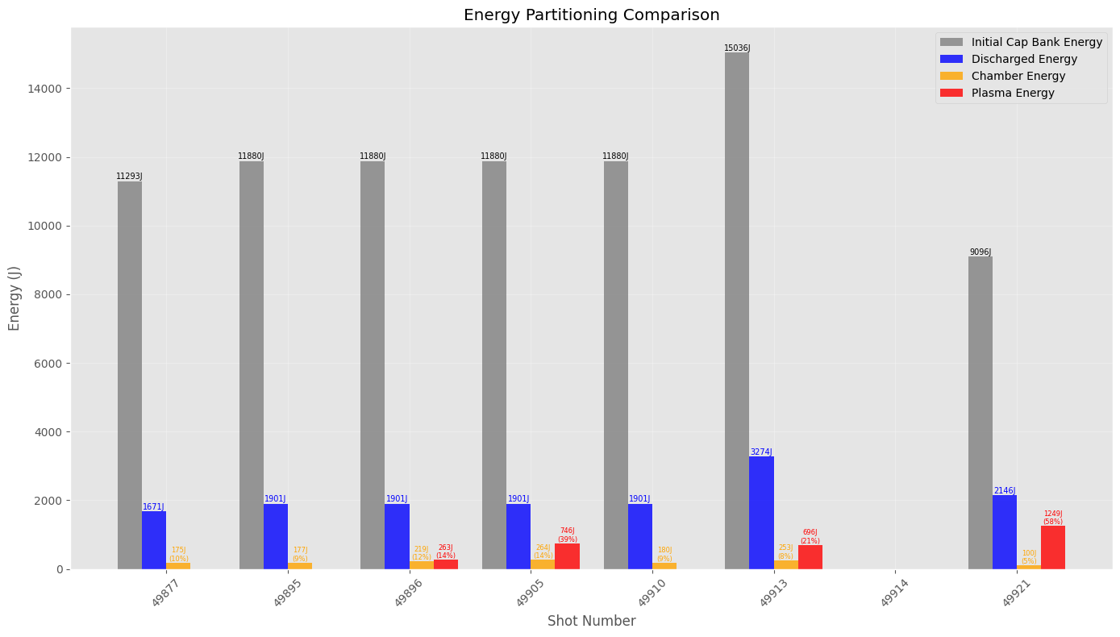
Ohmic Heating: Energy Utilization and Efficiency
Graph: Energy Depositions
NAIJA FUSION 2025 14/09/2025

Slide 17
Conclusion/Insights
Careful tuning of initial voltage and gas pressure, combined with wall conditioning, is essential to maximize plasma energy deposition and ohmic heating efficiency. We suggest conducting multiple tests and applying simple machine learning techniques, such as linear regression, to identify or confirm the optimal initial parameter set (initial voltage, gas pressure, etc.). This approach can help maximize plasma energy deposition and ohmic heating efficiency.
NAIJA FUSION 2025 14/09/2025

