Slide 1

NAIJAFUSION 2025
Plasma Analysis Using Electrostatic Probes:
Modelling Electron Temperature Profile
Under Different Operation Conditions
Supervisors: Federico Coto-Vilchez & Rajbir Kaur
Abubakar Sadiq Aliyu¹
Opara Adaugo Goodness²
Amanekwe, Uchechukwu Godbless³
1. Centre for Renewable Energy & Sustainabilty Transitions (CREST) at Bayero university, Kano
2. Department of Food Science And Technology, UNIZIK
3. Department of Mechanical Engineering, University of Nigeria, Nsukka
19.09.2025

Slide 2

Introduction
Electron temperature profiles are key in studying plasma behavior and confinement.
Understanding electron temperature distribution is critical for analyzing energy confinement, stability, and transport phenomena in tokamaks.
NAIJA FUSION 2025 16/09/2025

Slide 3
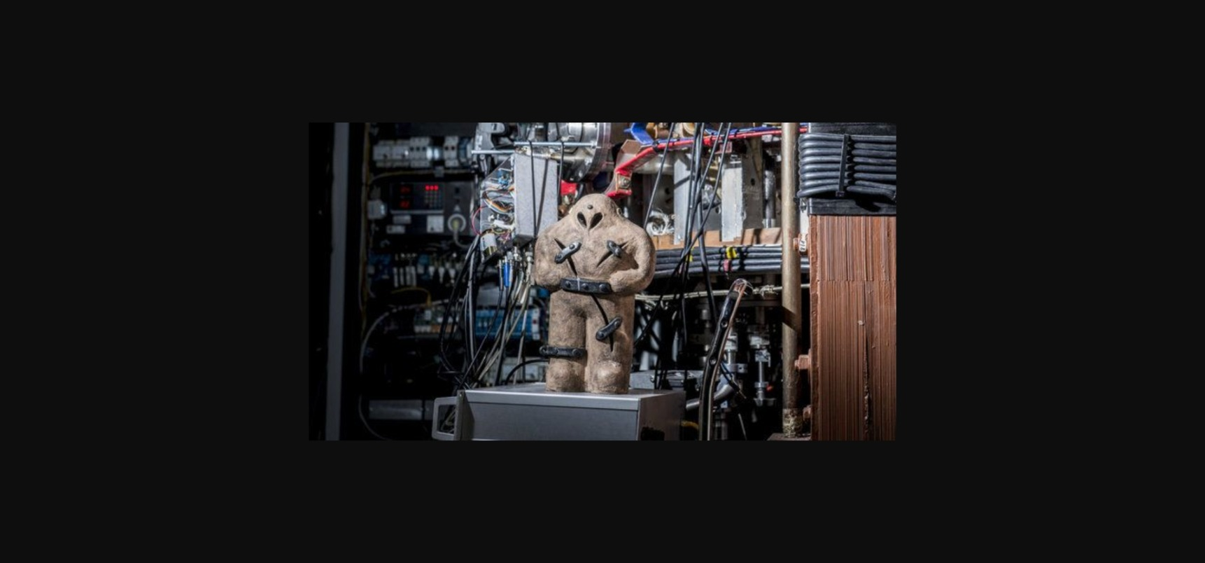
THE GOLEM TOKAMAK
The GOLEM tokamak is a compact, educational and research device operated at the Czech Technical University in Prague.
It provides a unique platform for hands-on plasma physics experiments accessible remotely via the internet.
NAIJA FUSION 2025 19/09/2025

Slide 4
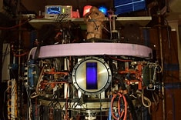
THE GOLEM TOKAMAK
Major Radius: 0.4m
Minor Radius: 0.085m
Pulse Duration: 15-25 ms
Plasma Current: 8kA
Electron Temperature: 40eV
Electron Density: 3 ×10¹⁸ m⁻³
Magnetic Field: 0.5T
Energy confinement Time: 0.4 ms
Thermal Heat Content: 20J
#GOLEM
#czechuni
#UNN
NAIJA FUSION 2025 19/09/2025

Slide 5
Aim
This work focuses on analytical modeling of the radial electron temperature profile in GOLEM tokomak using plasma current and loop voltage parameters derived from remotely obtained shots data, helping to interpret plasma behavior
NAIJA FUSION 2025 19/09/2025

Slide 6
Objectives
Execute plasma experiments remotely on the GOLEM tokamak.
Learn how to analyze data related to electron temperature.
Model the electron temperature profile for multiple discharges at various positions
Compare electron temperature profiles under similar discharge settings, before and after wall conditioning.
NAIJA FUSION 2025 19/09/2025

Slide 7
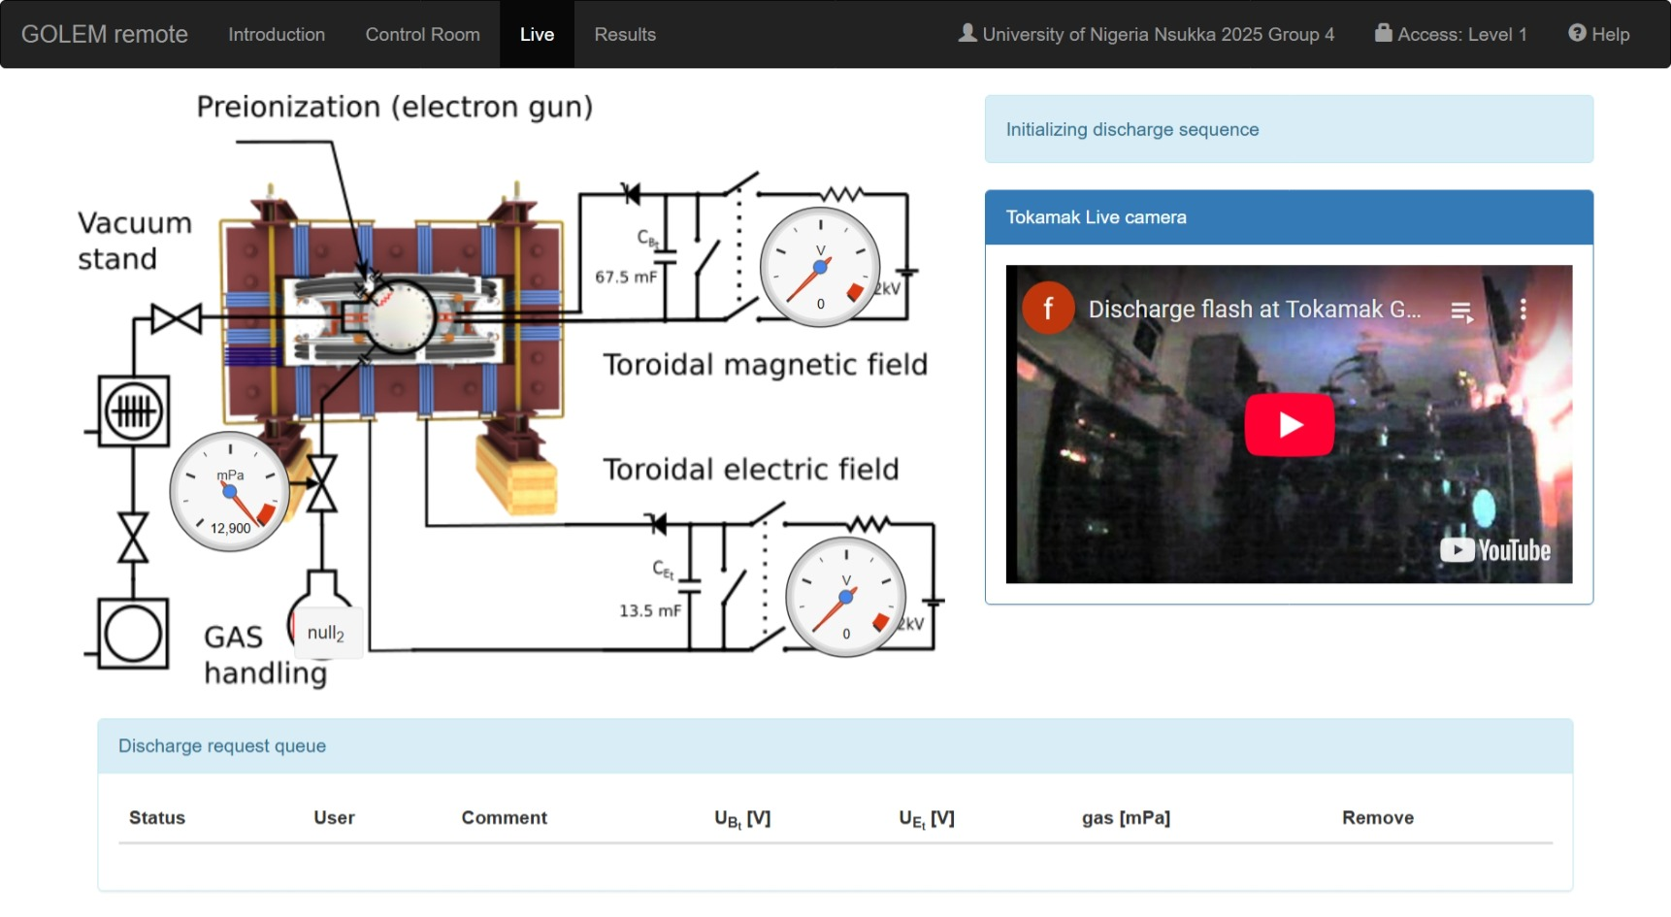
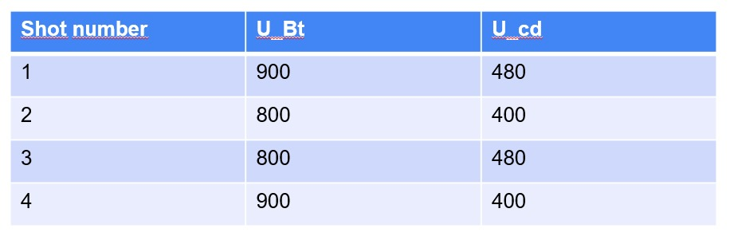
Methodology
Plasma discharges (“shots”) were conducted remotely via GOLEM’s web interface.
Multiple discharges under varying magnetic fields and plasma currents were analyzed to study temperature profile variations.
Electron temperature data were derived from diagnostic outputs and modeled parameters
NAIJA FUSION 2025 19/09/2025

Slide 8
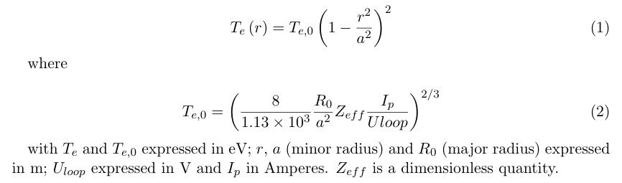
Methodology
The electron temperature profile was modeled using the function below:
NAIJA FUSION 2025 19/09/2025

Slide 9
Methodology
Te,0​: Central electron temperature (estimated from shot data)
Analysis and plotting done with Python.
NAIJA FUSION 2025 19/09/2025

Slide 10
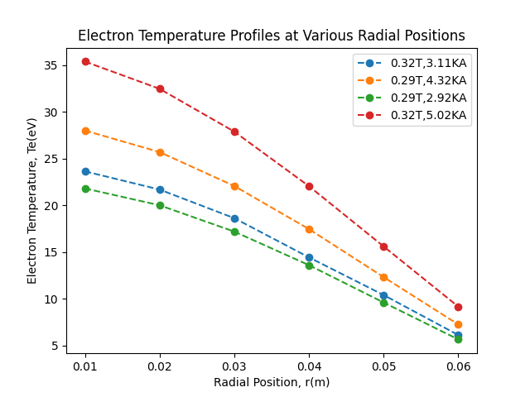
Results
Temperature profiles were created for plasma discharges conducted under varying magnetic fields and plasma currents.
The highest temperatures range from 22 to 35 eV, while decreased towards t edge values between 6 and 7 eV.
Increased magnetic field strength and plasma current resulted in elevated electron temperatures.
NAIJA FUSION 2025 19/09/2025

Slide 11
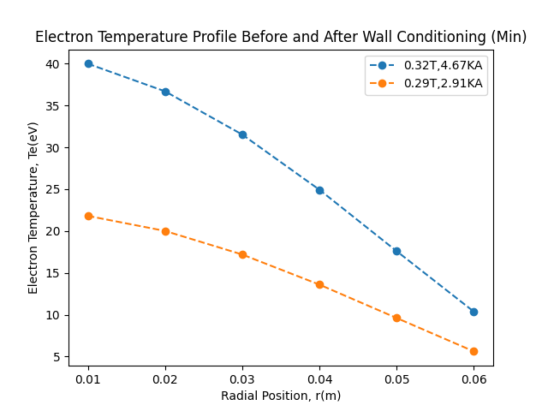
Results
These plots compare electron temperature profiles under minimum discharge settings, with toroidal magnetic field UBt = 800V and current derive field of UEcd = 400V before and after conditioning.
NAIJA FUSION 2025 19/09/2025

Slide 12
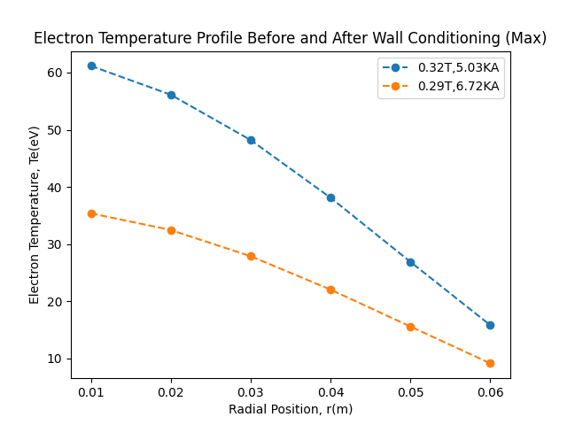
Results
These plots compare electron temperature profiles under maximum discharge settings, with toroidal magnetic field UBt = 900V and current derive field of UEcd = 480V before and after conditioning.
NAIJA FUSION 2025 19/09/2025

Slide 13
Discussion
The temperature models show that the plasma is hottest in the middle and gets cooler toward the edges, as expected in tokamaks.
Higher magnetic field and plasma current generally result in higher core electron temperatures, as expected.
NAIJA FUSION 2025 19/09/2025

Slide 14
Discussion
The effect of wall conditioning is clearly observed:
At minimum, the post-conditioning shot shows significantly higher electron temperatures than the pre-conditioning one.
At maximum, the difference in electron temperature profiles before and after wall conditioning becomes even more pronounced.
NAIJA FUSION 2025 19/09/2025

Slide 15
Discussion
This suggests improved plasma confinement and reduced impurity levels after wall conditioning
NAIJA FUSION 2025 19/09/2025

Slide 16
Conclusion
The electron temperature profile in the GOLEM tokamak was successfully modeled using data obtained from remotely executed plasma shots.
It was observed that the electron temperature decreases from the center of the plasma to the edge, which is the usual behavior in tokamaks.
NAIJA FUSION 2025 19/09/2025

Slide 17
Conclusion
Wall conditioning improved plasma performance by increasing electron temperatures at both minimum and maximum working conditions, likely due to reduced impurities
This study highlights the value of GOLEM for remote learning, basic diagnostics, and plasma modeling.
NAIJA FUSION 2025 19/09/2025

Slide 18
Acknowledgment
Sincere thanks to our supervisors and resource persons for their guidance and support throughout this project.
Gratitude to the GOLEM tokamak team for providing access and assistance with remote experiments.
Appreciation to the LOC of the NSPPFE for facilitating this valuable learning opportunity.
NAIJA FUSION 2025 19/09/2025

Slide 19
Thank you!
NAIJA FUSION 2025 19/09/2025

Slide 20
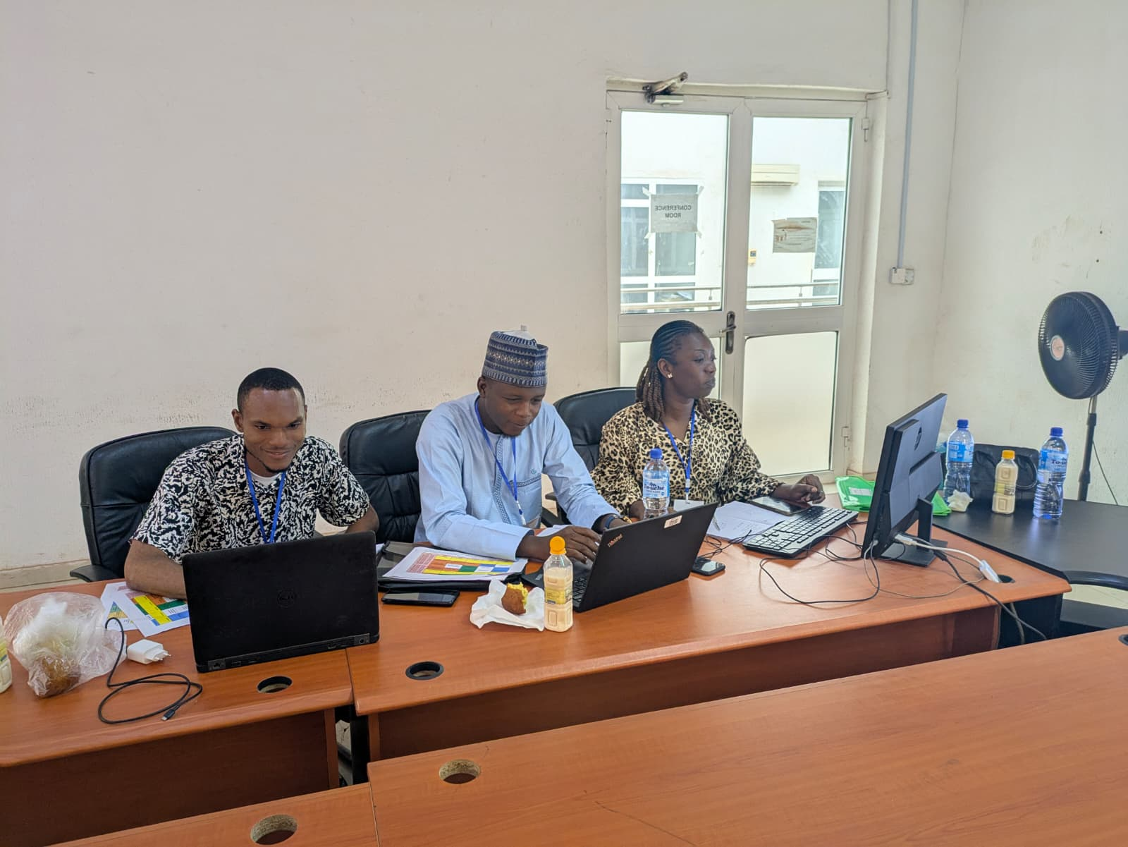
NAIJA FUSION 2025 19/09/2025

