Slide 1

NAIJAFUSION 2025
PLASMA STABILIZATION
MBAH HARRISON, OGBUABOR EMMANUEL, ATTAH OKWUDILI JOSEPH, AKPA JEREMIAH
Affiliations:
UNIVERSITY OF NIGERIA NSUKKA
Supervisors:Maria Reji, Hina Ali
DATE19-Sept-2025

Slide 2

PLASMA STABILIZATION
Outlook
Introduction to plasma positioning
Plasma positioning in GOLEM
Experimental setup
Experimental analysis
Explanation of the experimental results
Conclusion and future perspective
NAIJA FUSION 2025 14/09/2025

Slide 3
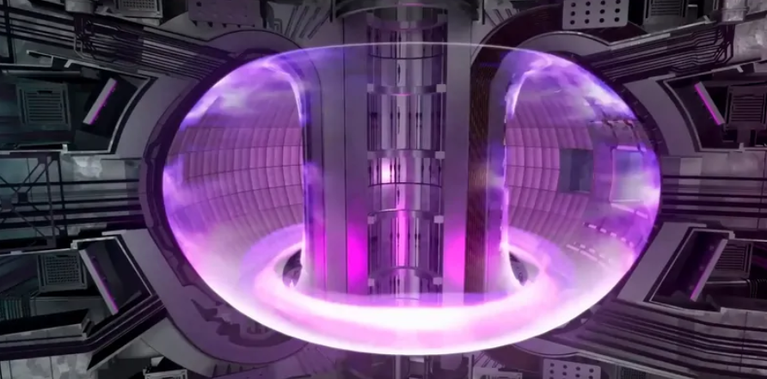
PLASMA STABILIZATION
Plasma position stabilization in Tokamak
Why plasma positioning is important for fusion?
Loss of confinement and plasma contact with walls is destructive
Why plasma moves?
Toroidal force balance (hoop force + tyre tube force + 1/R force = outward force on plasma
Vertical displacement event
NAIJA FUSION 2025 14/09/2025

Slide 4
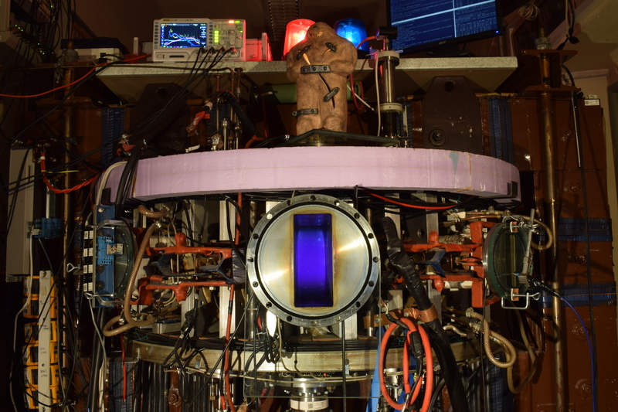
PLASMA STABILIZATION
GOLEM Tokamak
major radius R=0.4m
minor radius a=0.085m
toroidal magnetic field Bt <0.8 T
plasma current Ip <8 kA
discharge duration ≈ 13 ms
NAIJA FUSION 2025 14/09/2025

Slide 5
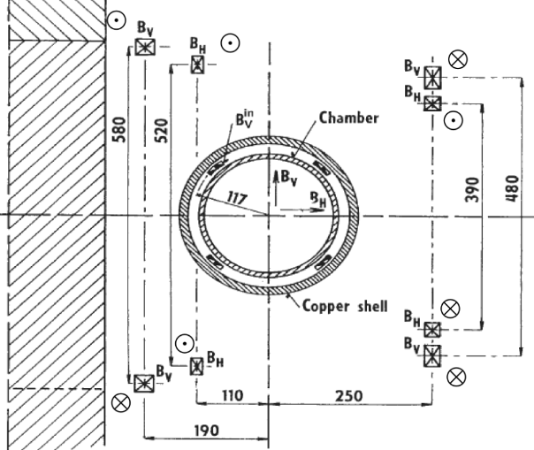
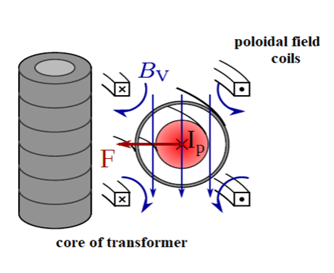
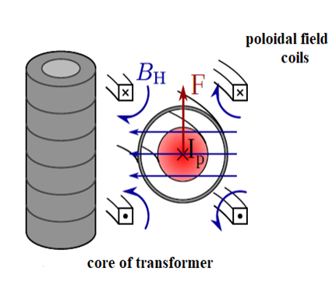
PLASMA STABILIZATION
Plasma position stabilization in GOLEM Tokamak
Poloidal field coils producing horizontal and vertical magnetic fields to position the plasma
NAIJA FUSION 2025 14/09/2025

Slide 6
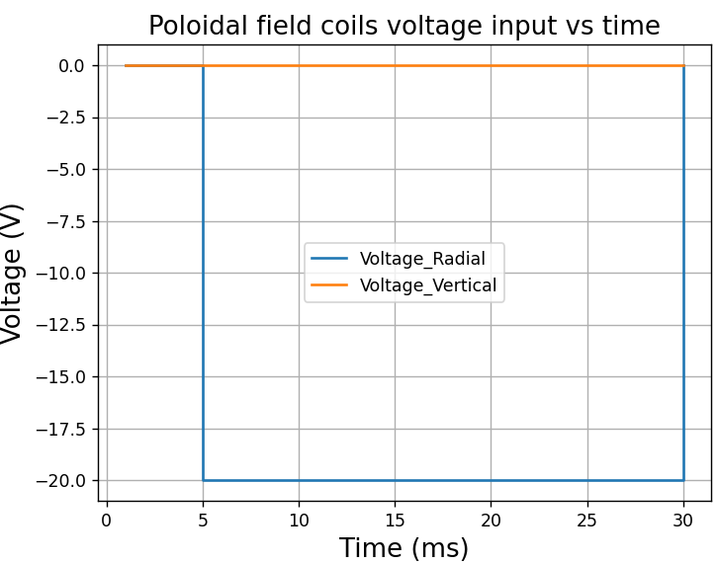
PLASMA STABILIZATION
Experimental setup
not working
NAIJA FUSION 2025 14/09/2025

Slide 7

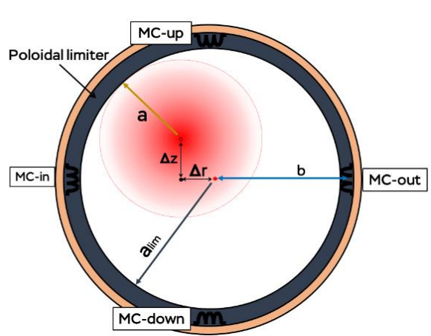
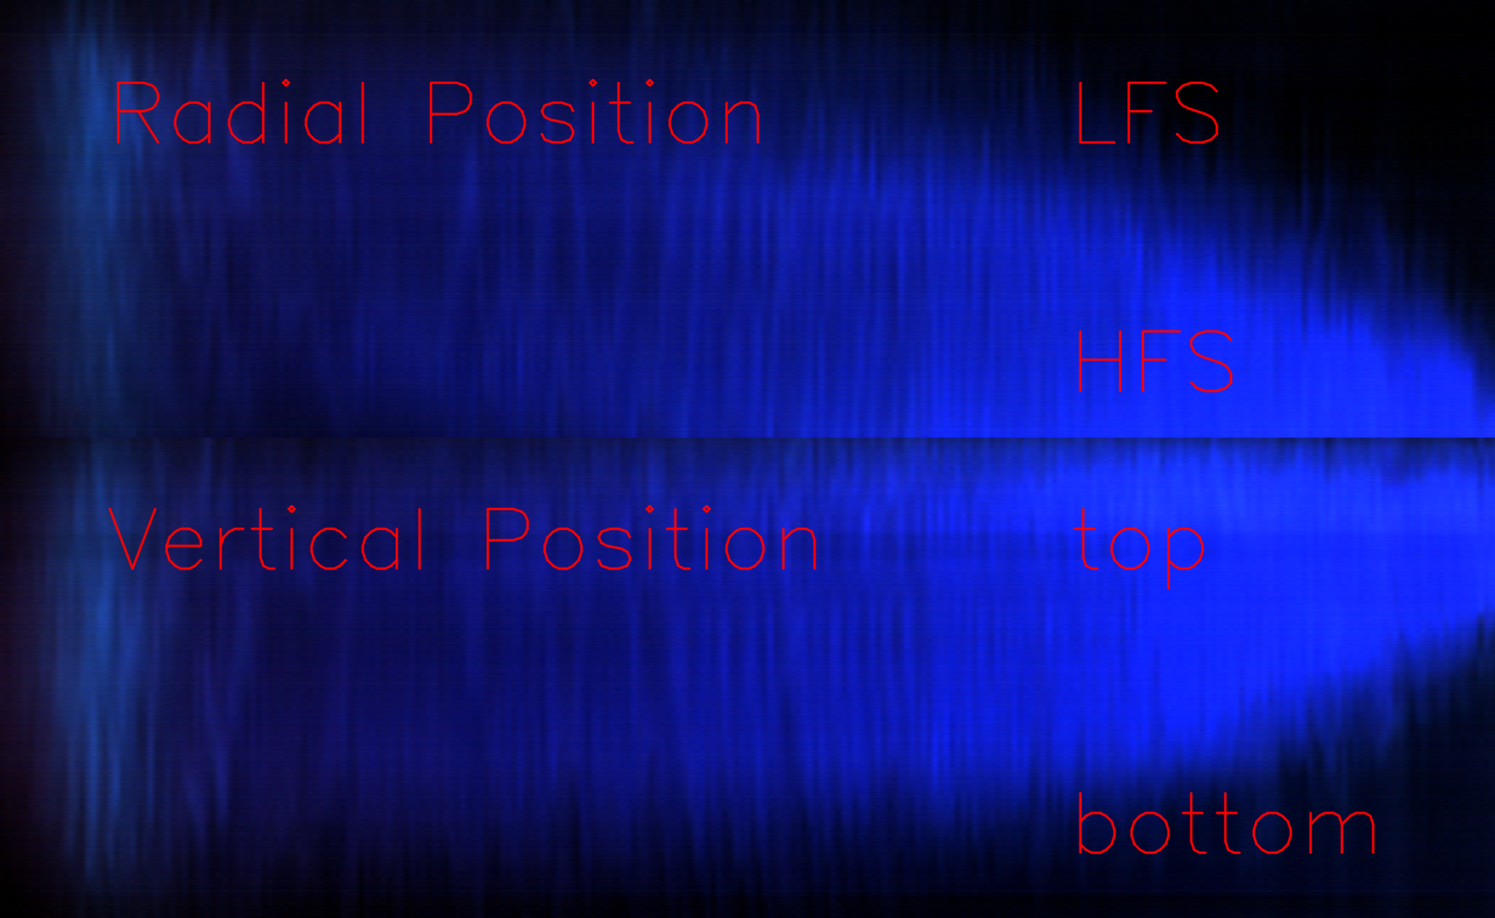
title of the slide
Experimental setup
Two fast cameras at (top & LFS) are being used to determine plasma position
NAIJA FUSION 2025 14/09/2025

Slide 8
title of the slide
EXPERIMENTAL SHOTS BEFORE WALL CONDITIONING
SHOTS IDs | r | z | r + z
49898 | 55.0 | 95.7 | 150.7
49899 | 60.0 | 96.2 | 156.2
49891 | 76.9 | 117.0 | 196.9
49882 | 22.1 | 33.9 | 56.0
NAIJA FUSION 2025 14/09/2025

Slide 9
title of the slide
EXPERIMENTAL SHOTS AFTER WALL CONDITIONING
SHOTS IDs | r | z | r + z
49916 | 45.6 | 30.5 | 76.1
49912 | 22.2 | 76.0 | 98.2
49917 | 74.6 | 91.6 | 166.2
49915 | 60.9 | 96.4 | 157.3
NAIJA FUSION 2025 14/09/2025

Slide 10
title of the slide
EXPERIMENTAL BEST SHOTS 49882
RADIAL DISPLACEMENT = 22.1mm
VERTICAL DISPLACEMENT = 33.9mm.
From the analysis, it is observed that the best shot was taken before wall conditioning.
NAIJA FUSION 2025 14/09/2025

Slide 11
title of the slide
EXPERIMENTAL WORST SHOTS 49891
RADIAL DISPLACEMENT = 76.9mm
VERTICAL DISPLACEMENT = 117.0mm.
From the analysis, it is observed that the worst shot was taken before wall conditioning.
NAIJA FUSION 2025 14/09/2025

Slide 12
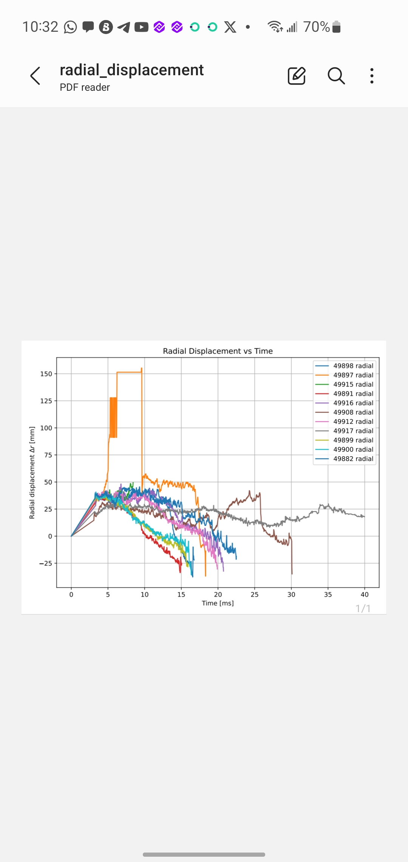
title of the slide
RADIAL DISPLACEMENT VS TIME
NAIJA FUSION 2025 14/09/2025

Slide 13
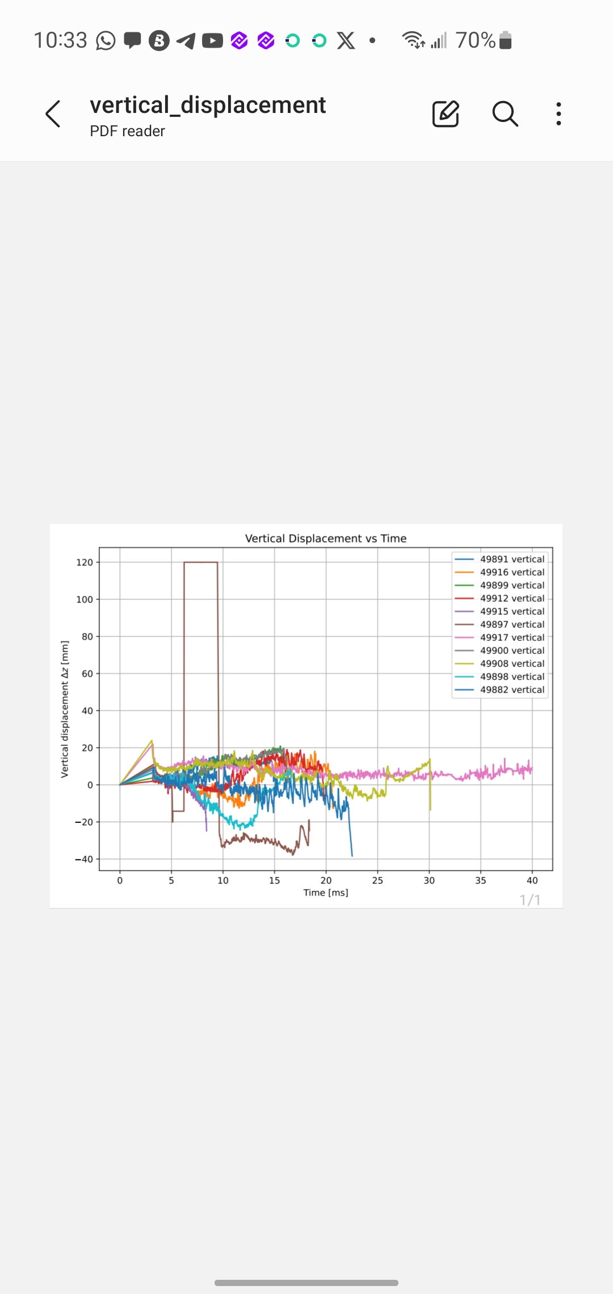
title of the slide
VERTICAL DISPLACEMENT VS TIME
NAIJA FUSION 2025 14/09/2025

Slide 14
title of the slide
VOLTAGES FOR THE WORST SHOT
RADIAL
-1
-2
-7
-8
-20
VERTICAL
-1
-5
-12
-20
NAIJA FUSION 2025 14/09/2025

Slide 15
title of the slide
VOLTAGES FOR THE BEST SHOT
RADIAL
0
-1
-2
-3
-24
-5
-20
VERTICAL
0
-1
-5
-12
-20
NAIJA FUSION 2025 14/09/2025

