Slide 1
Overview of the current state of runaway electron measurements at the GOLEM tokamak
L. Lobko, Š. Malec, M. Tunkl, O. Ficker,
G. I. Pokol, V. Svoboda, J. Cerovsky

Slide 2
GOLEM introduction
GOLEM RE team: three doctoral students (Lukáš Lobko, Štěpán Malec, Marek Tunkl) + supervisors
We all have inclined to HXR or neutron diagnostics during our pregradute studies -> naturally wanted to continue in that -> doctorate at GOLEM, because currently GOLEM only operating machine
→>> then next slide, GOLEM introduction…

Slide 3
Outline
GOLEM tokamak
Runaway electron diagnostics
  Scintillation detectors
  Timepix3
  In-vessel RE probe
Modelling / data analysis
  Scintillators response functions
  Energy spectra reconstruction
  RE strike point determination
  MHD-RE cross-correlation

Slide 4
1. GOLEM tokamak

Slide 5

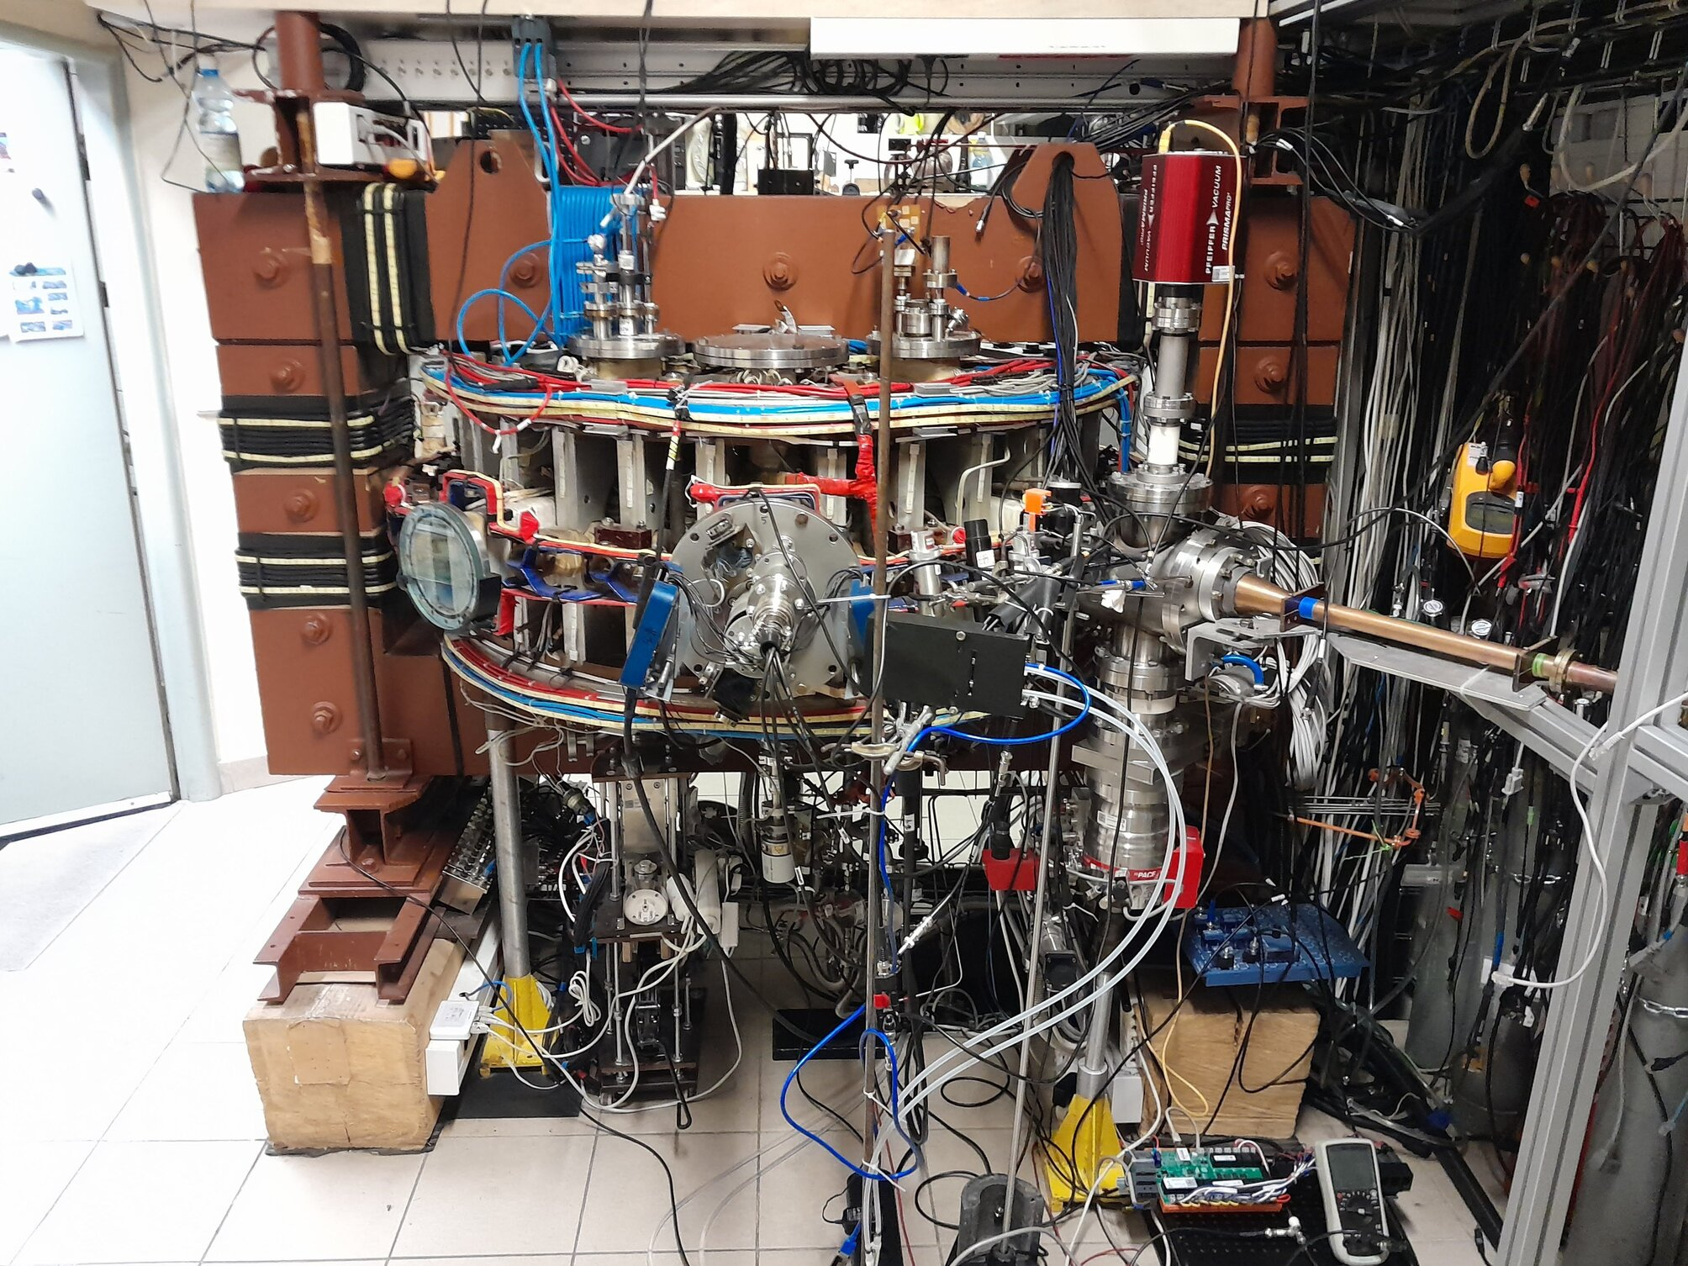
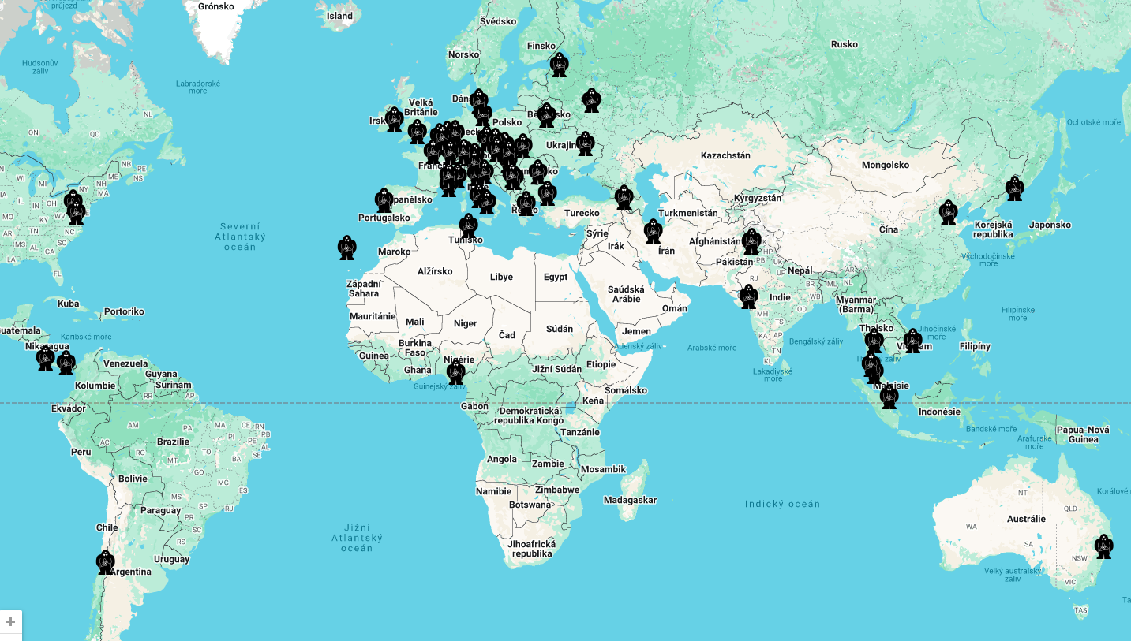
GOLEM tokamak introduction
small size machine from 60s, rebuild in 1984,
from 2009 operated at CTU in Prague
basic parameters
  R = 0.4 m
  a = 0.085 m (circular limiter)
  T_{e} ≅ 100 eV
  n_{e} ≅ 10¹⁸ - 10¹⁹ m⁻³
education on-site and remote
  high school projects, university training courses, BSc, MSc theses, …
  2025 so far ~ 800 discharges, ~ 350 remote

Slide 6
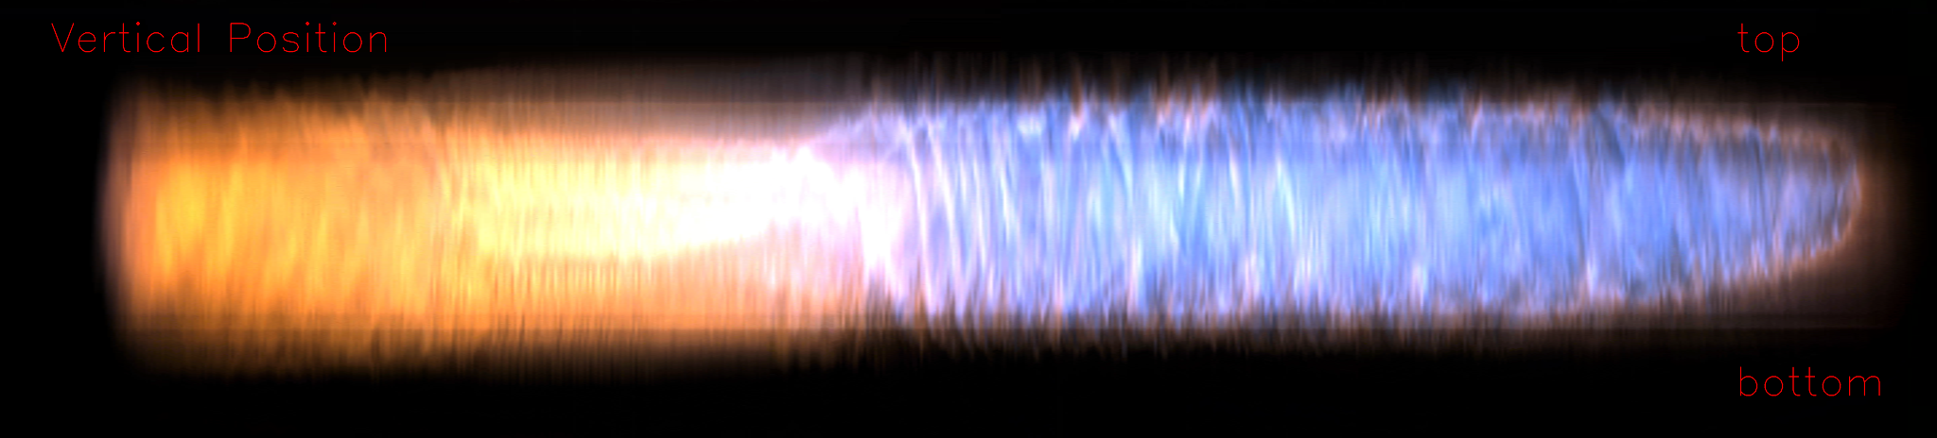
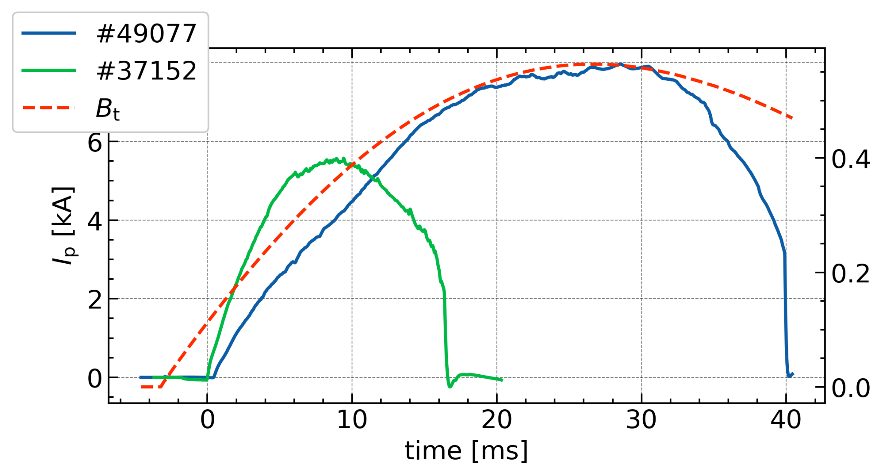
GOLEM scientific missions
high and cheap discharge repetition rate (3mins) and not so harsh environment
good diagnostics testing bed
probe measurements
  fast ion-temperature
  transport barrier in He
recently: significant technological improvements:
B_{t} ≈ 0.4 T B_{t} ≤ 0.8 T
I_{p} ≈ 4 kA I_{p} ≤ 14 kA
t_{p} ≈ 15 ms t_{p} ≤ 41 ms
High U_{loop} + low n_{e}
easy RE generation
RE diagnostics testing/development
Notes:
potential for Soft X-ray camera test for Compass-U

Slide 7
2. Runaway electron diagnostics

Slide 8
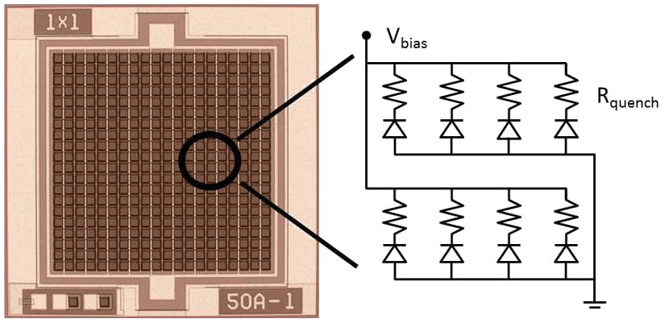
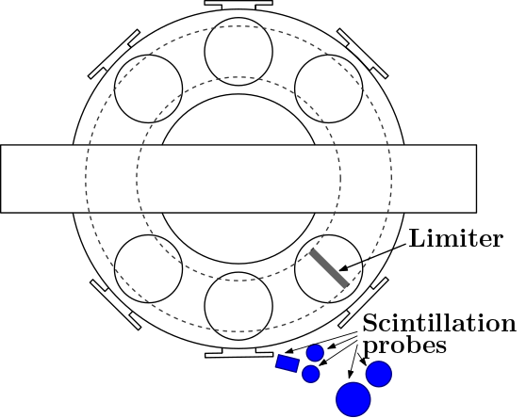
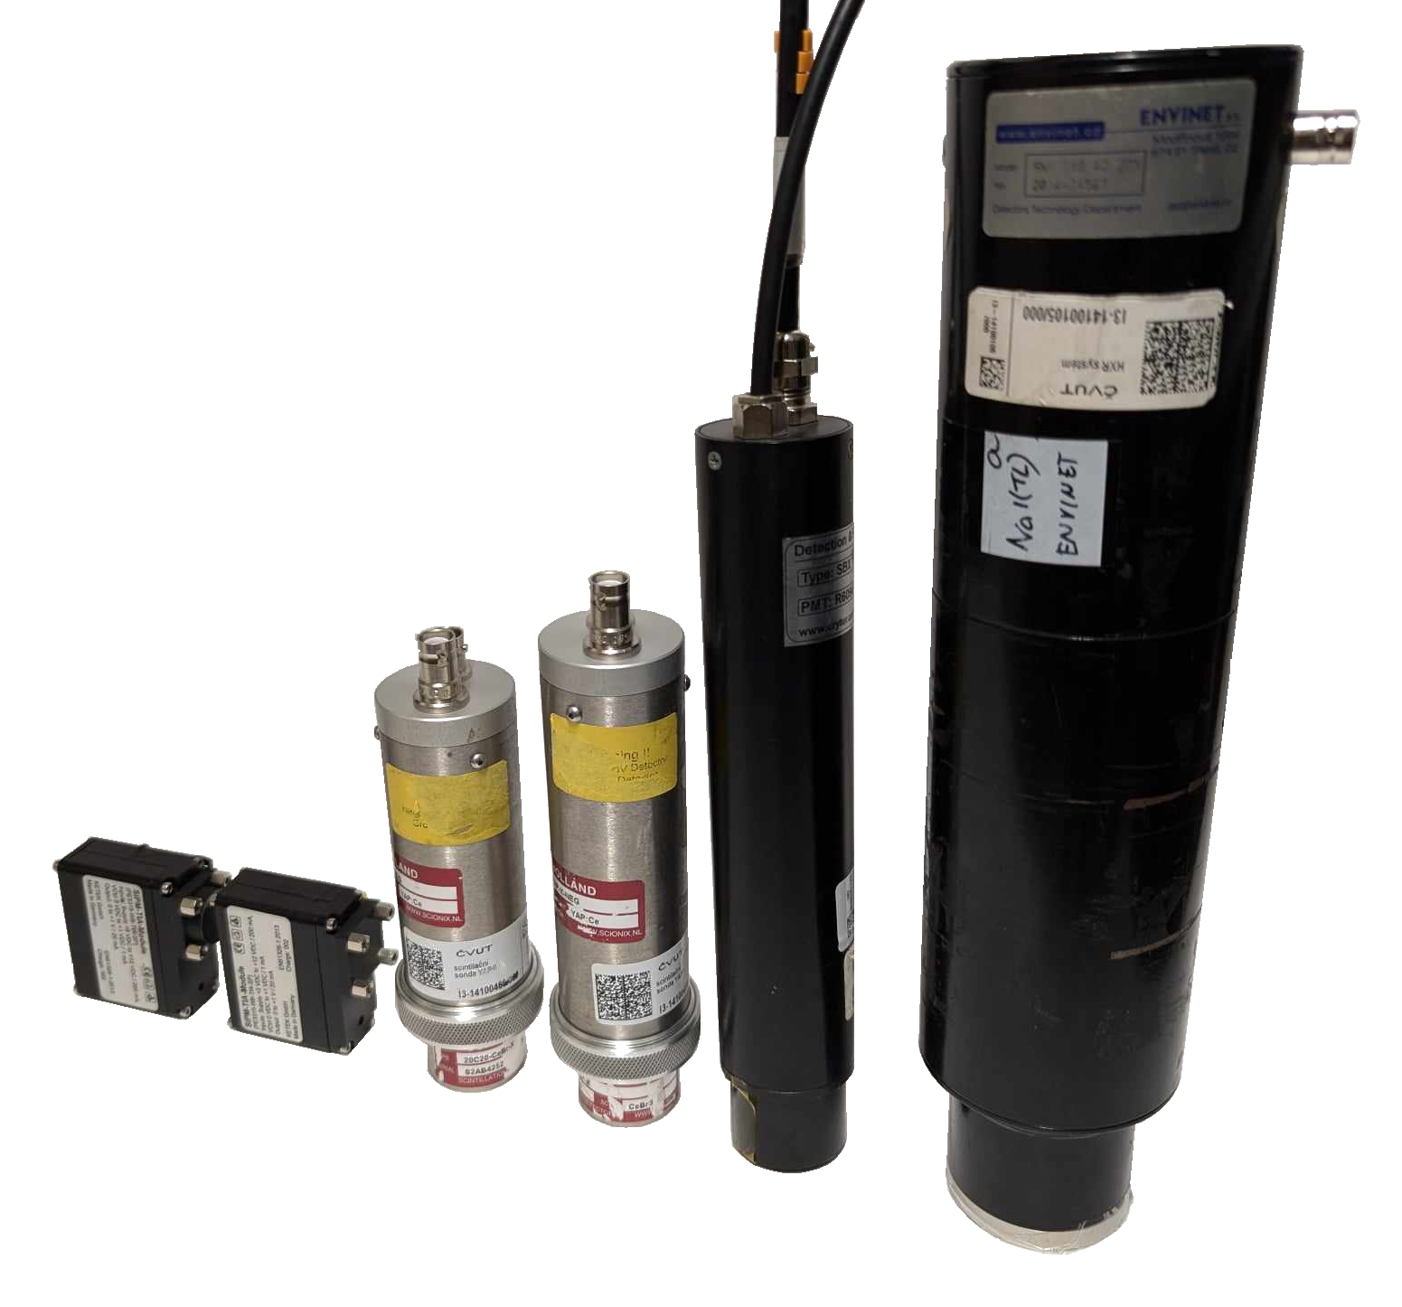
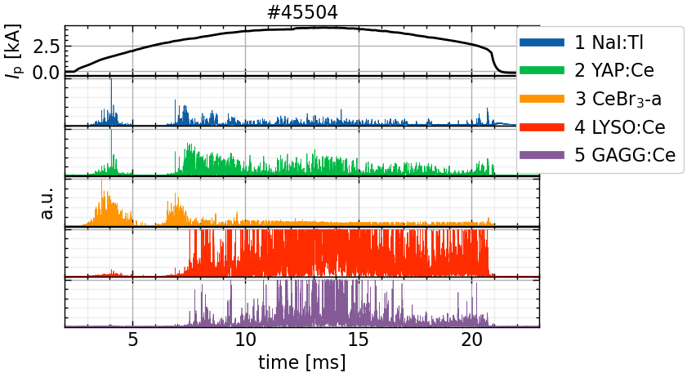
Scintillation detectors
use of various scintillation crystals
  NaI:Tl
  YAP:Ce
  CeBr₃
  LYSO:Ce:
  GAGG:Ce
traditional PMTs or SiPM
powerful DAS (250 MS/s, 15bit)
peak energy discrimination
5
4
3a
2
1
Notes:
mention use on TCV

Slide 9
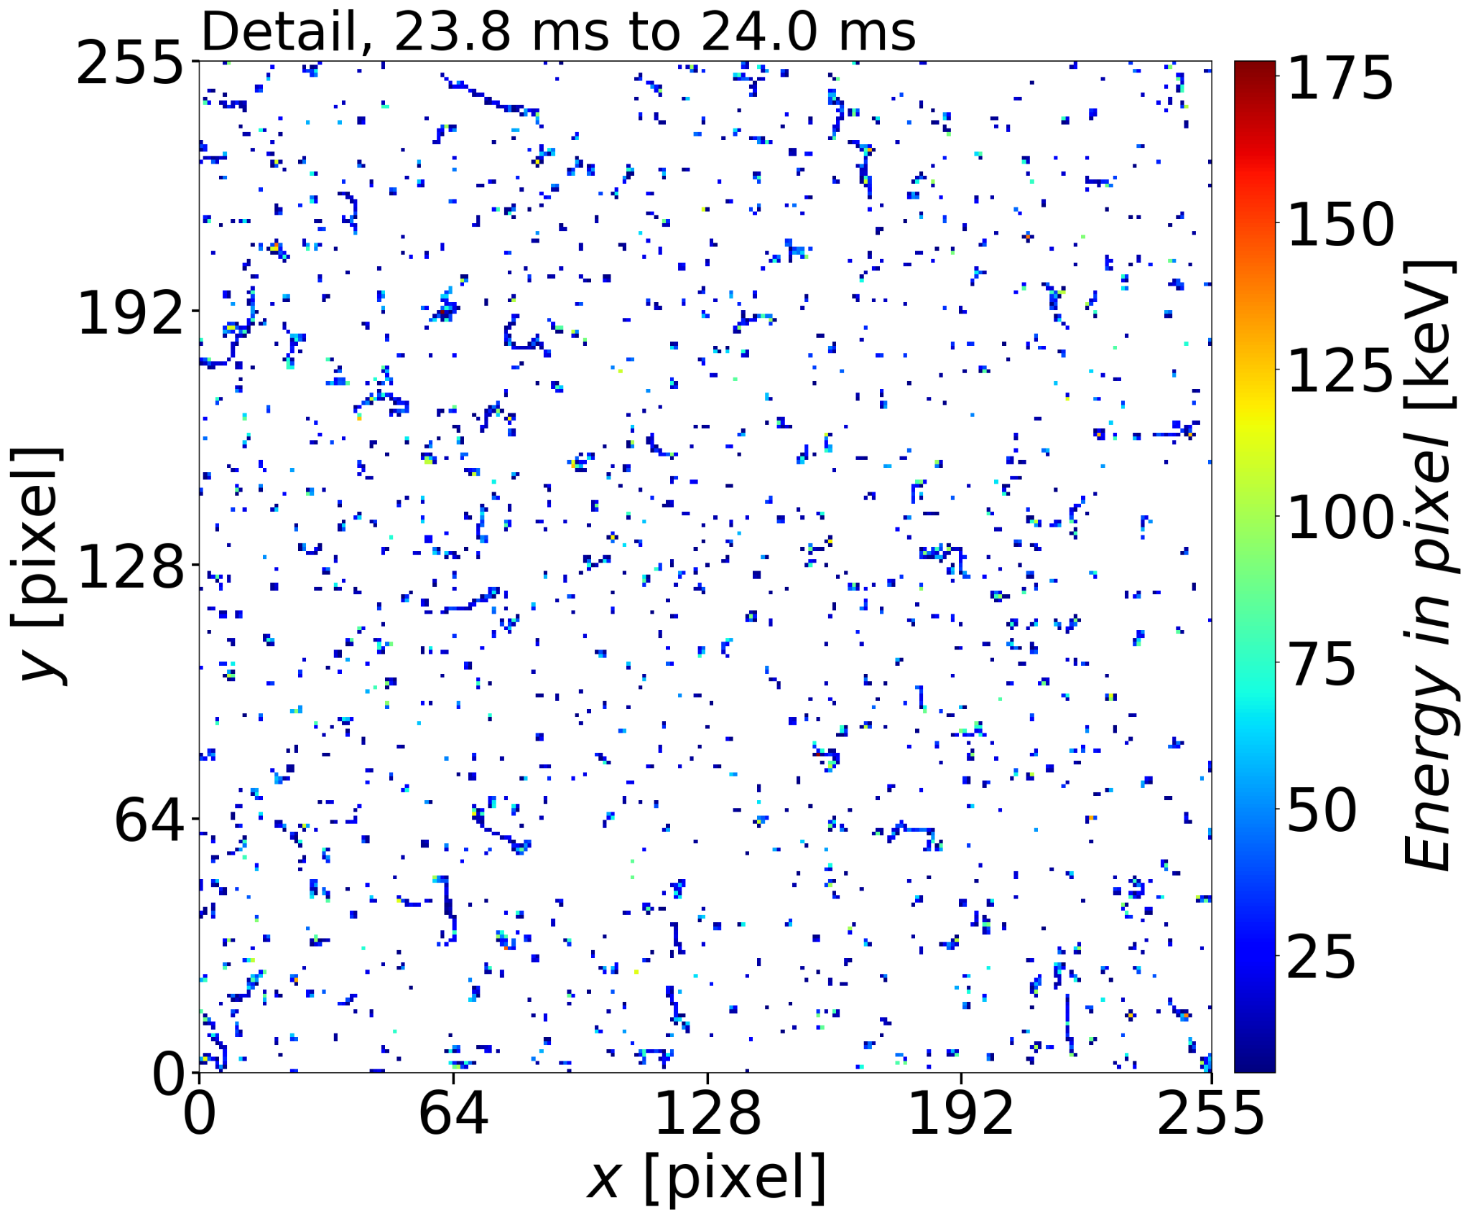
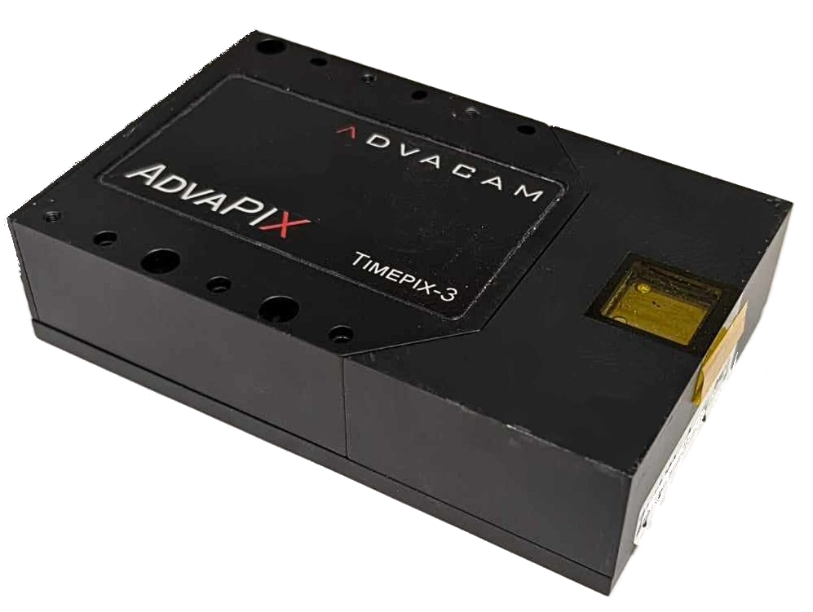
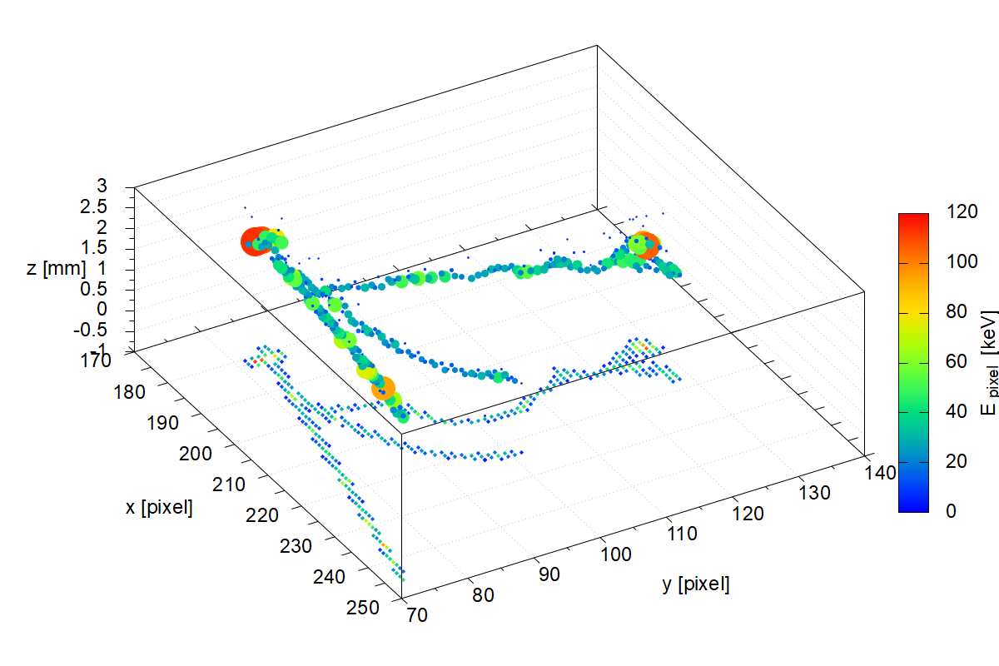
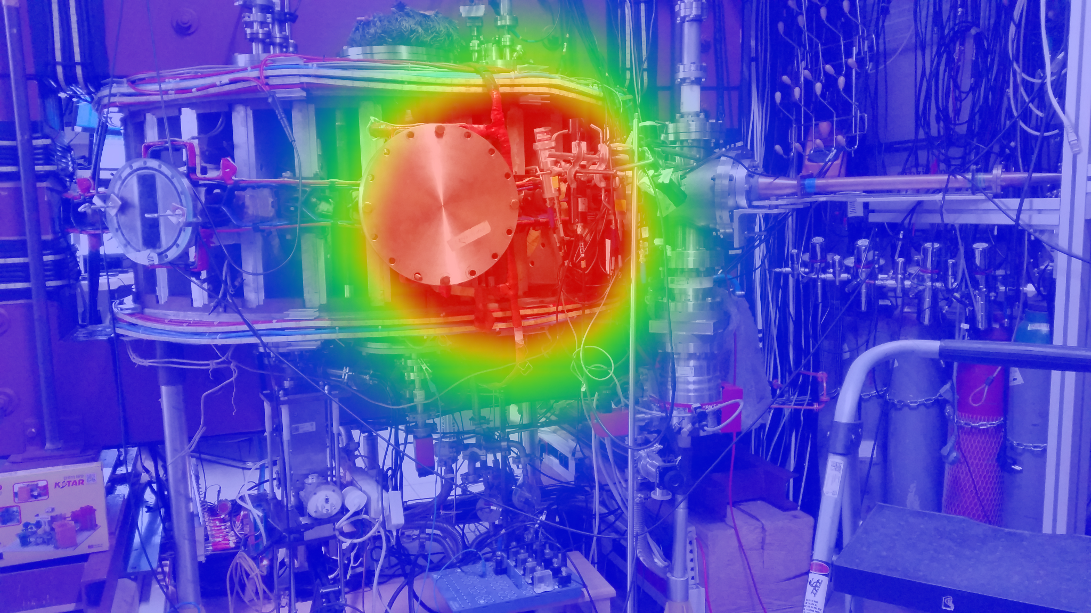
Timepix3 semiconductor pixel detector
compact high energetic particle detector (developed by CERN)
pixel array (256 x 256 pixels)
CdTe and Si sensors various energy detection efficiency
thermal stabilization is usually needed
easier avoidance from pileups than typical scintillators
various applications:
  spatial measurements
  Compton camera
  3D interaction reconstructions

Slide 10
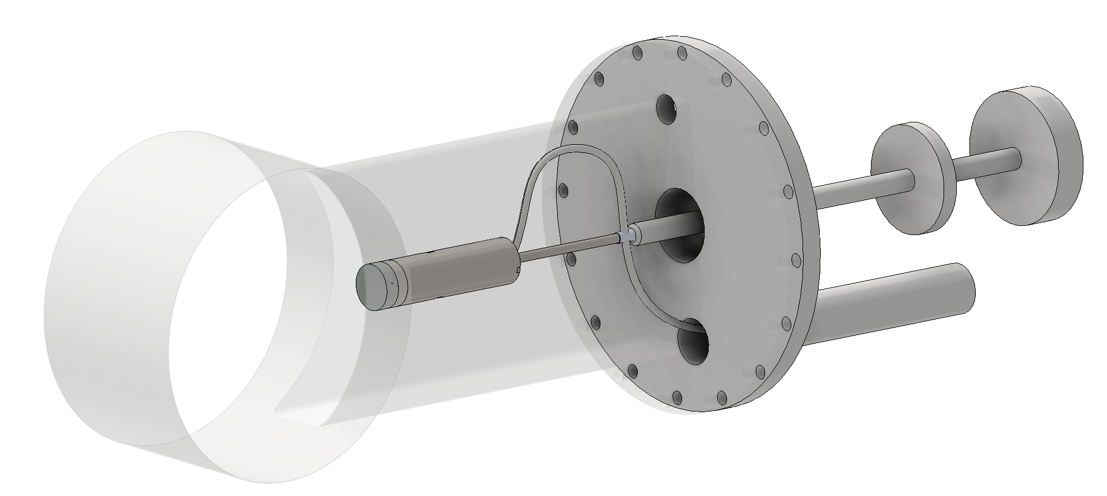

New in-vessel scintillation probe
Goal: direct measurement of REs
scintillation probe placed inside the tokamak chamber
REs → direct hit of scintillation pins → optical fibers → SiPM (outside the chamber) → oscilloscope
manipulator → easy to change radial position and the observed angle
collaboration with crytur company

Slide 11
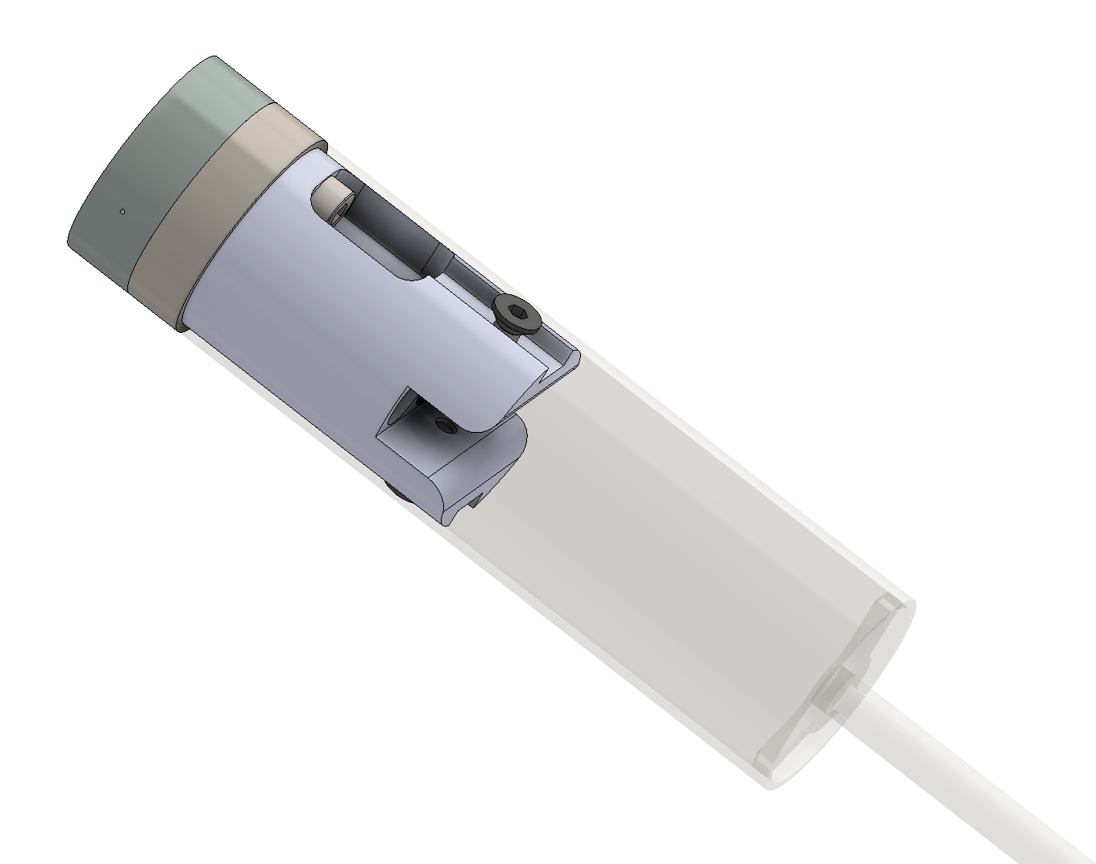
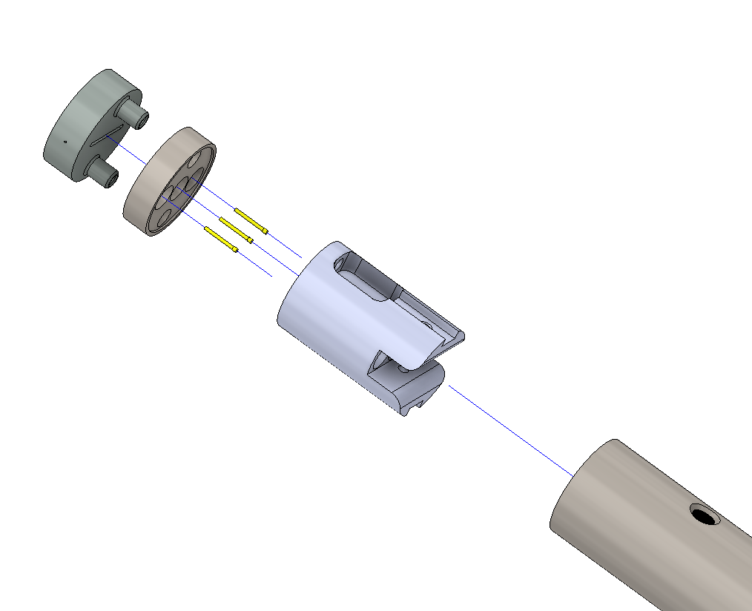
Current Probe design
Compact size of the whole probe - 93 x 25 mm
Very flexible design (no glued parts)
testing of various types of collimators, pins/coating thickness, etc.
collimator
pins holder
scint pins
optical fibers holder
manipulator

Slide 12
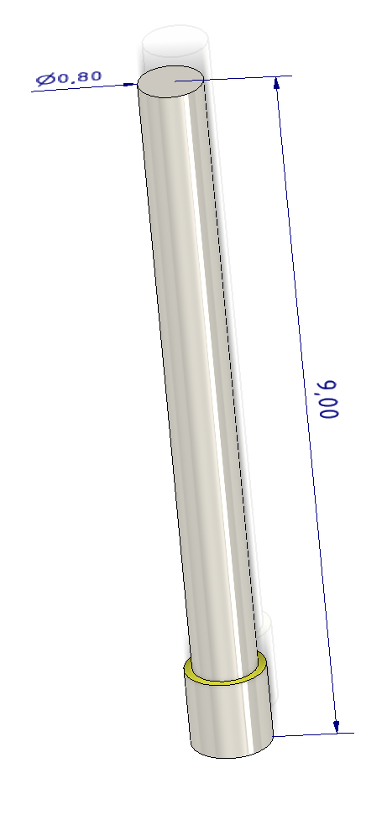
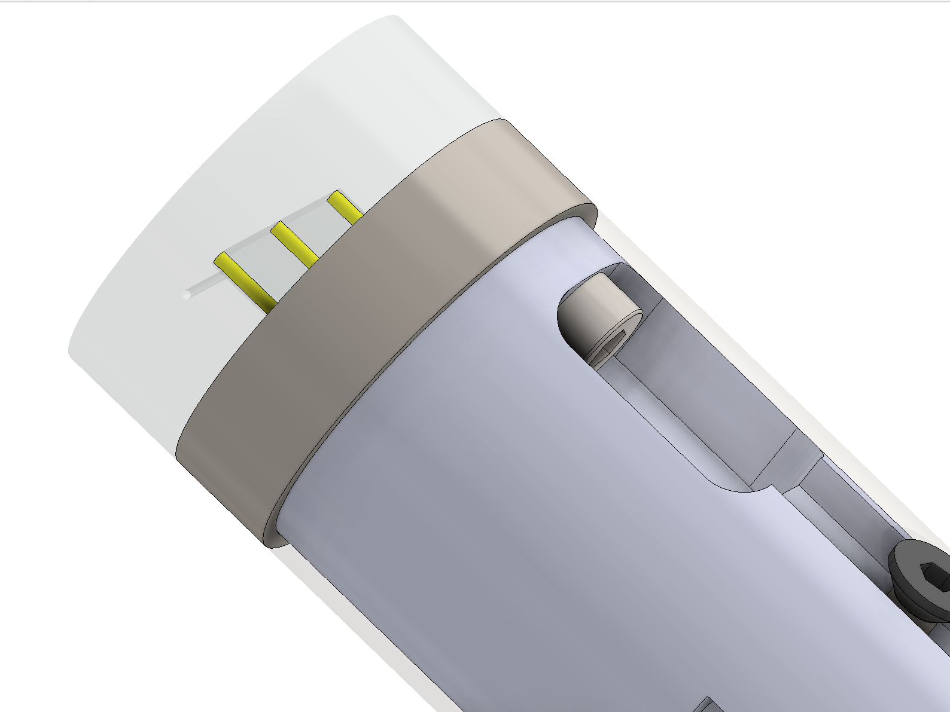
Detailed design of in-vessel probe
Very small scintillation pins are used - 0.8 mm diameter with 1 μm Ti cover
YAP:Ce scintillator (CRYTUR crystals) - fast decay time (approx. 25 ns) → possible peak energy resolution
First approach - line of three scintillation pins
→ possible additional energy discrimination
Mo collimator with 5 x 0.5 mm pinhole
→ possible pitch angle measurement

Slide 13
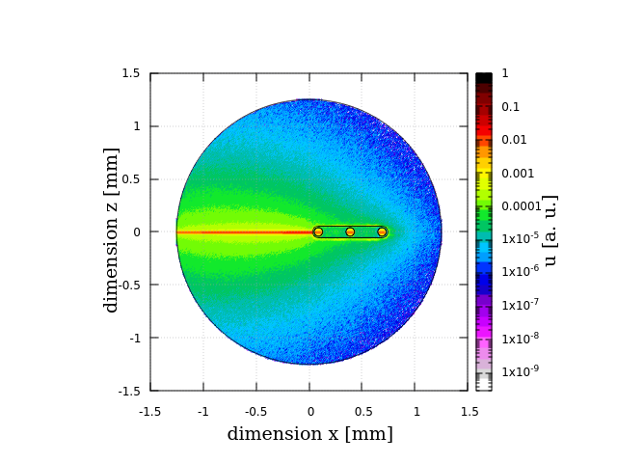
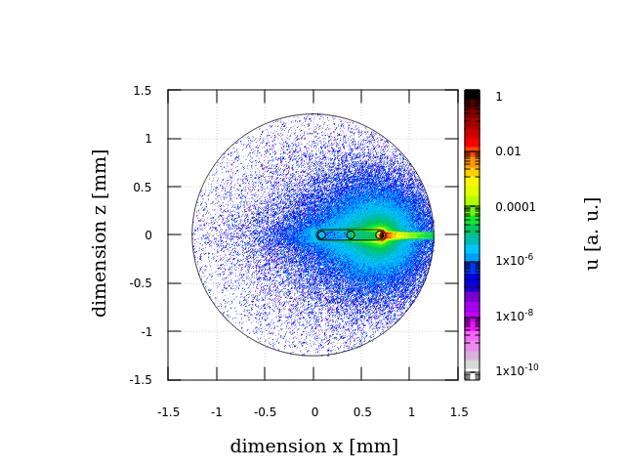
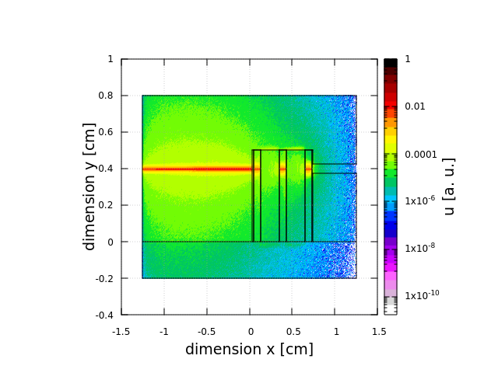
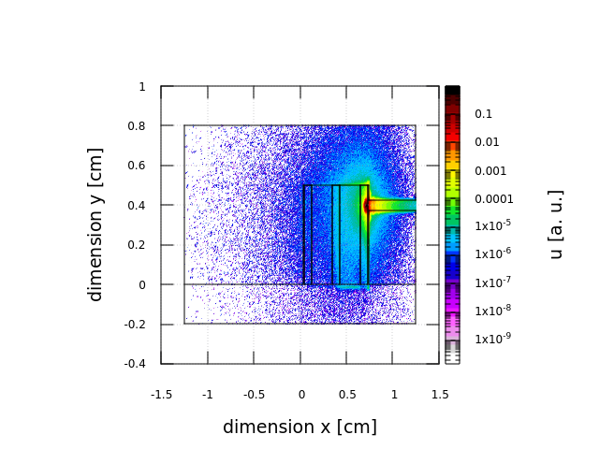
HXR vs electron absorption
FLUKA modelling
testing of various material and thicknesses of scintillation pins, coating and collimator
1 MeV HXR (left fig.) vs electron (right fig.) beam penetration comparison
low sensitivity to HXR background
mostly direct RE detection

Slide 14
3. Modelling / data analysis

Slide 15
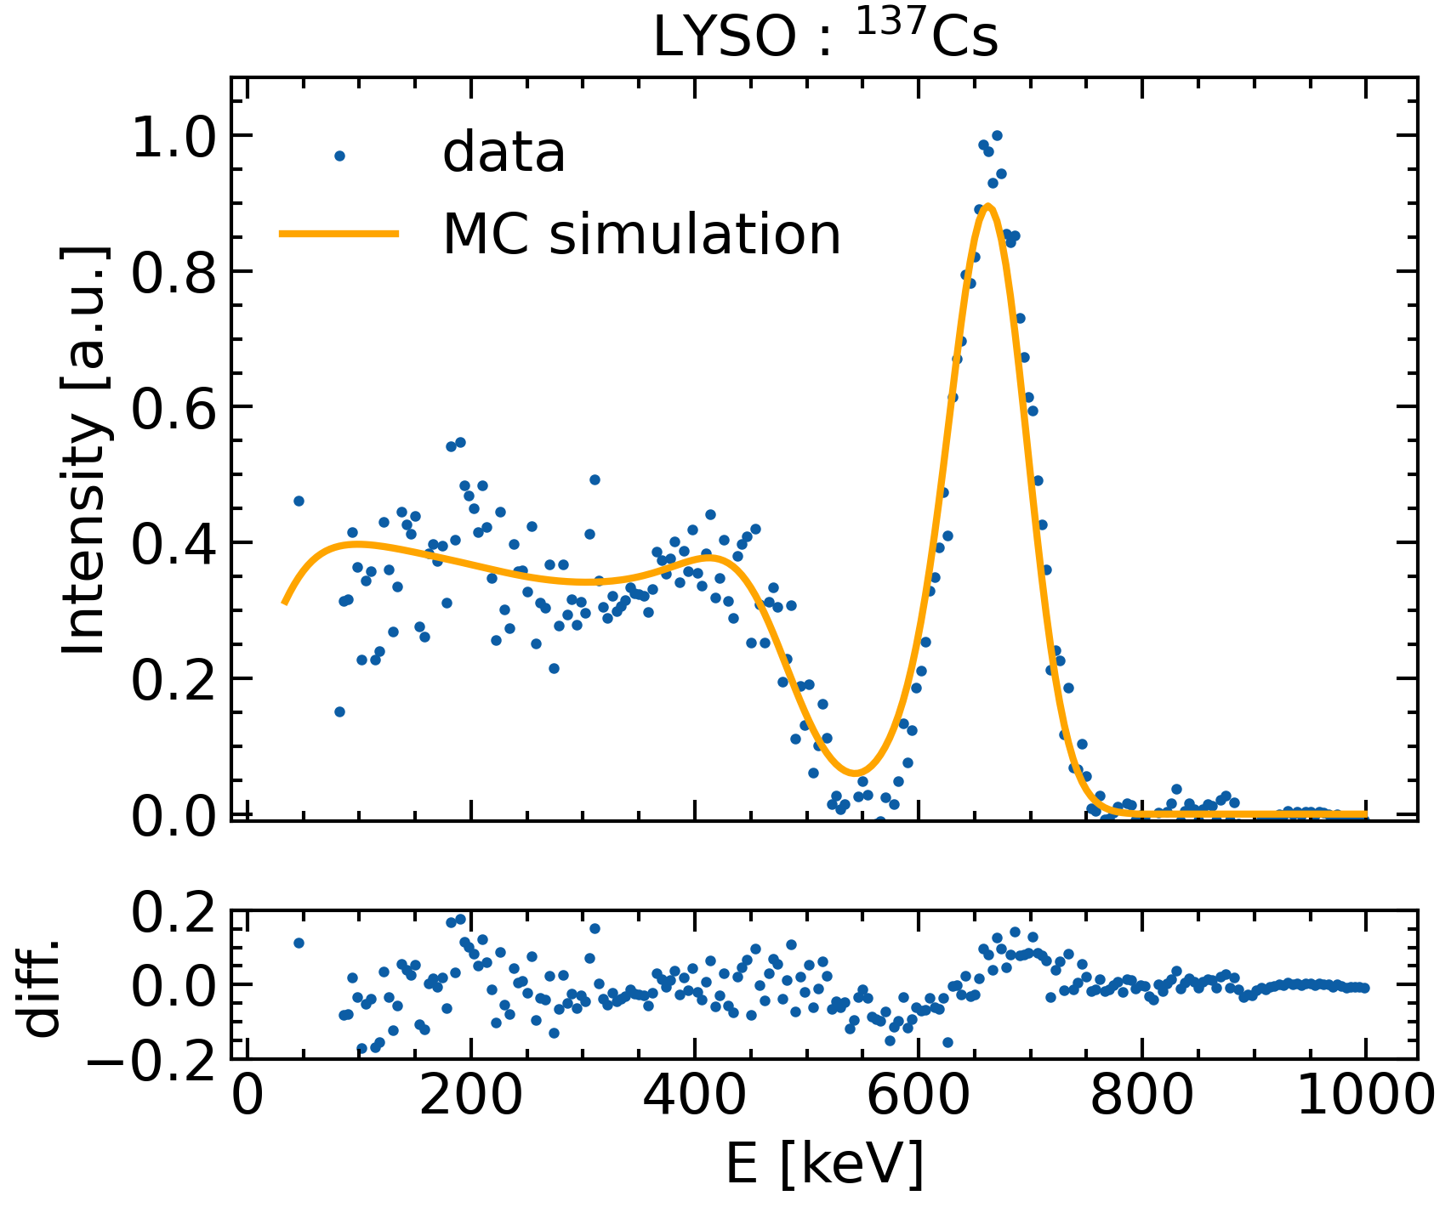
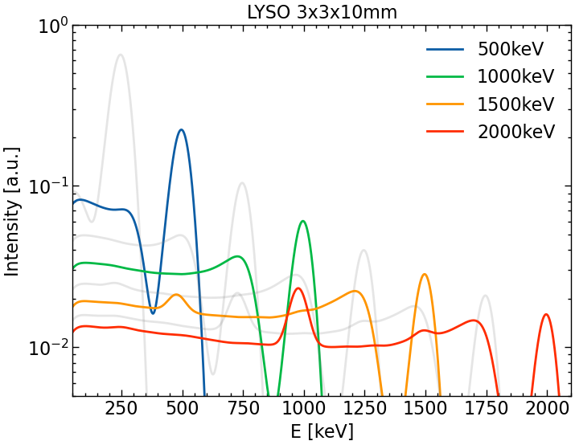
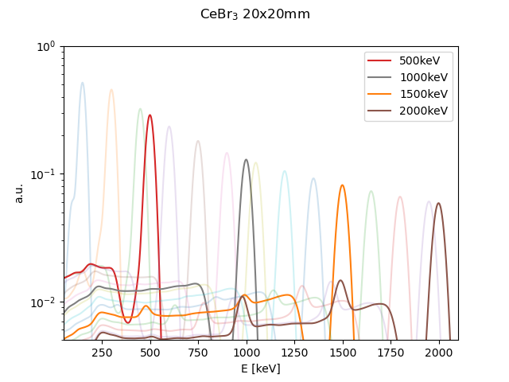
Modeling of scintillators response functions
Geant4 modelling of detector response functions
Results compared to real data (¹³⁷Cs - 661 keV)
too small scintillation crystal
rapid response decrease to higher energies
bigger CeBr3 for comparison
Notes:
To Do unify LYSO CeBr3 fig style, titles

Slide 16
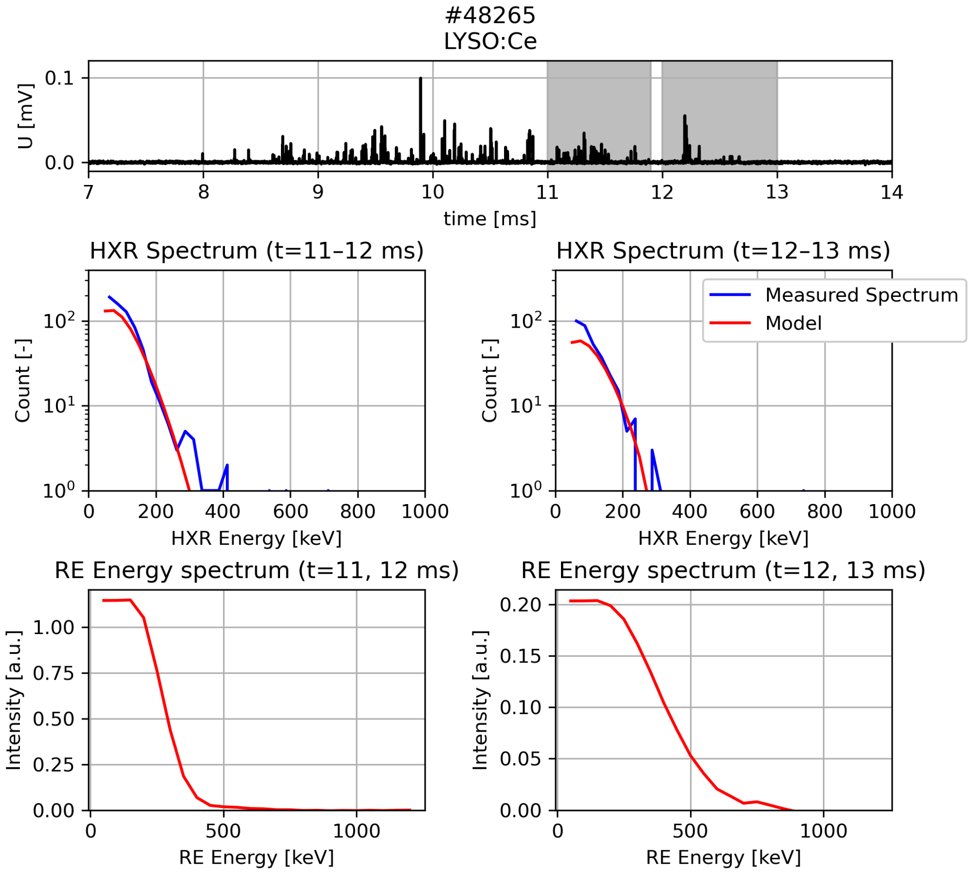




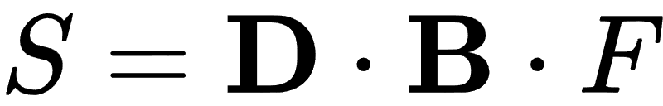
RE Energy spectra reconstruction
detector response functions ( )
+ bremsstrahlung ( ) modeled in Geant4
measured signal ( ), runaway distribution ( )
inversion problem – solved by Tikhonov Regularization using Tomotok code
sensitive to data quality
now only possible for
moderate RE discharges
(= no pileups, no PMT gain loss)

Slide 17
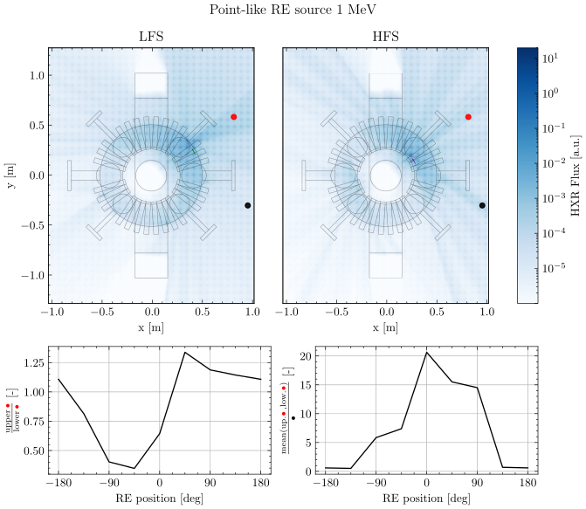
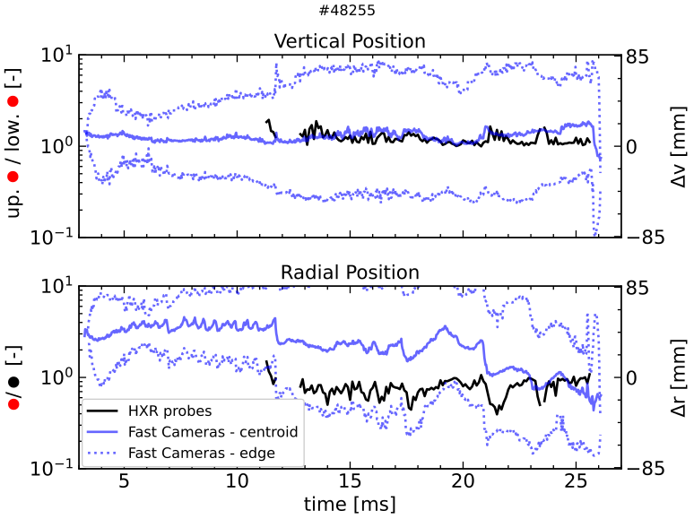
RE strike point determination
Goal: recover strike point position and RE pitch angle (not yet)
3 LYSO detectors placed at different positions (2 red and 1 black dots)
seems enough for RE strike point determination
Comparison of plasma position by fast visible cameras
Notes:
ToDo remove camera edge (should be centroid enough)

Slide 18
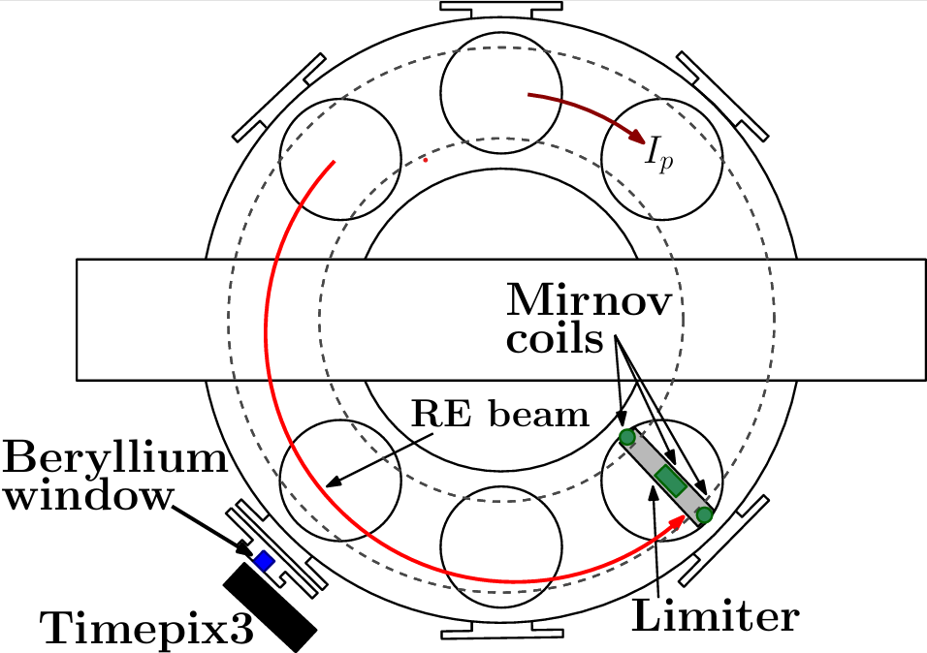
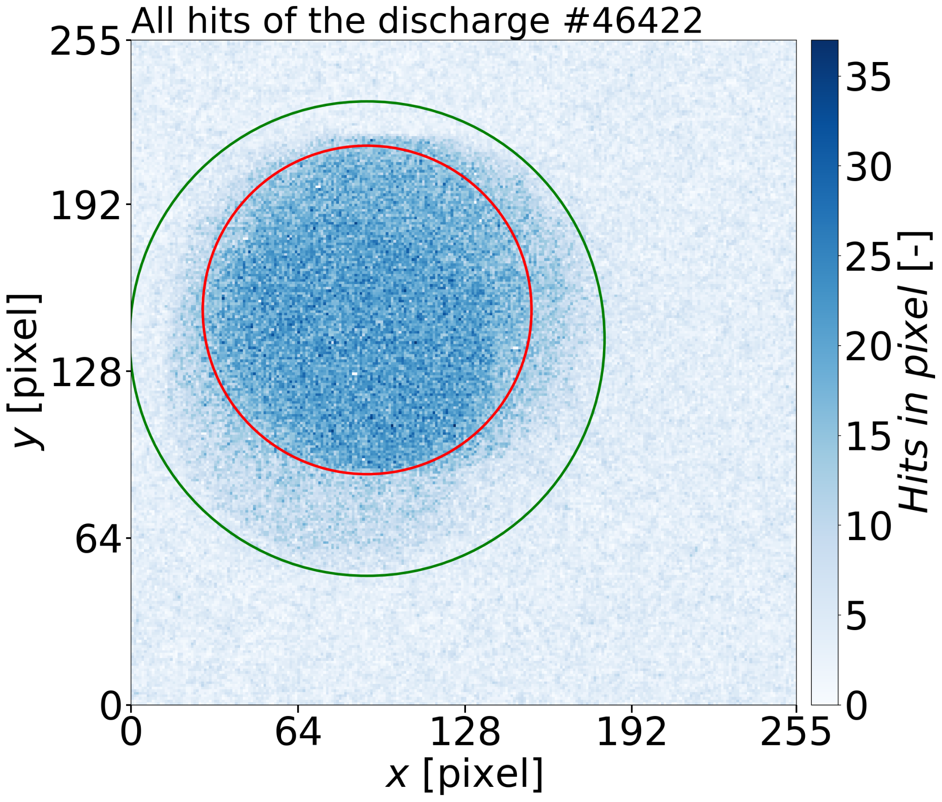
MHD-RE cross-correlation analysis experimental setup
First attempt to find MHD correlations with Timepix3 signal
4 mirnov coils poloidally placed near Mo limiter
Timepix3 placed behind Be window (to access lower X-ray energies)

Slide 19
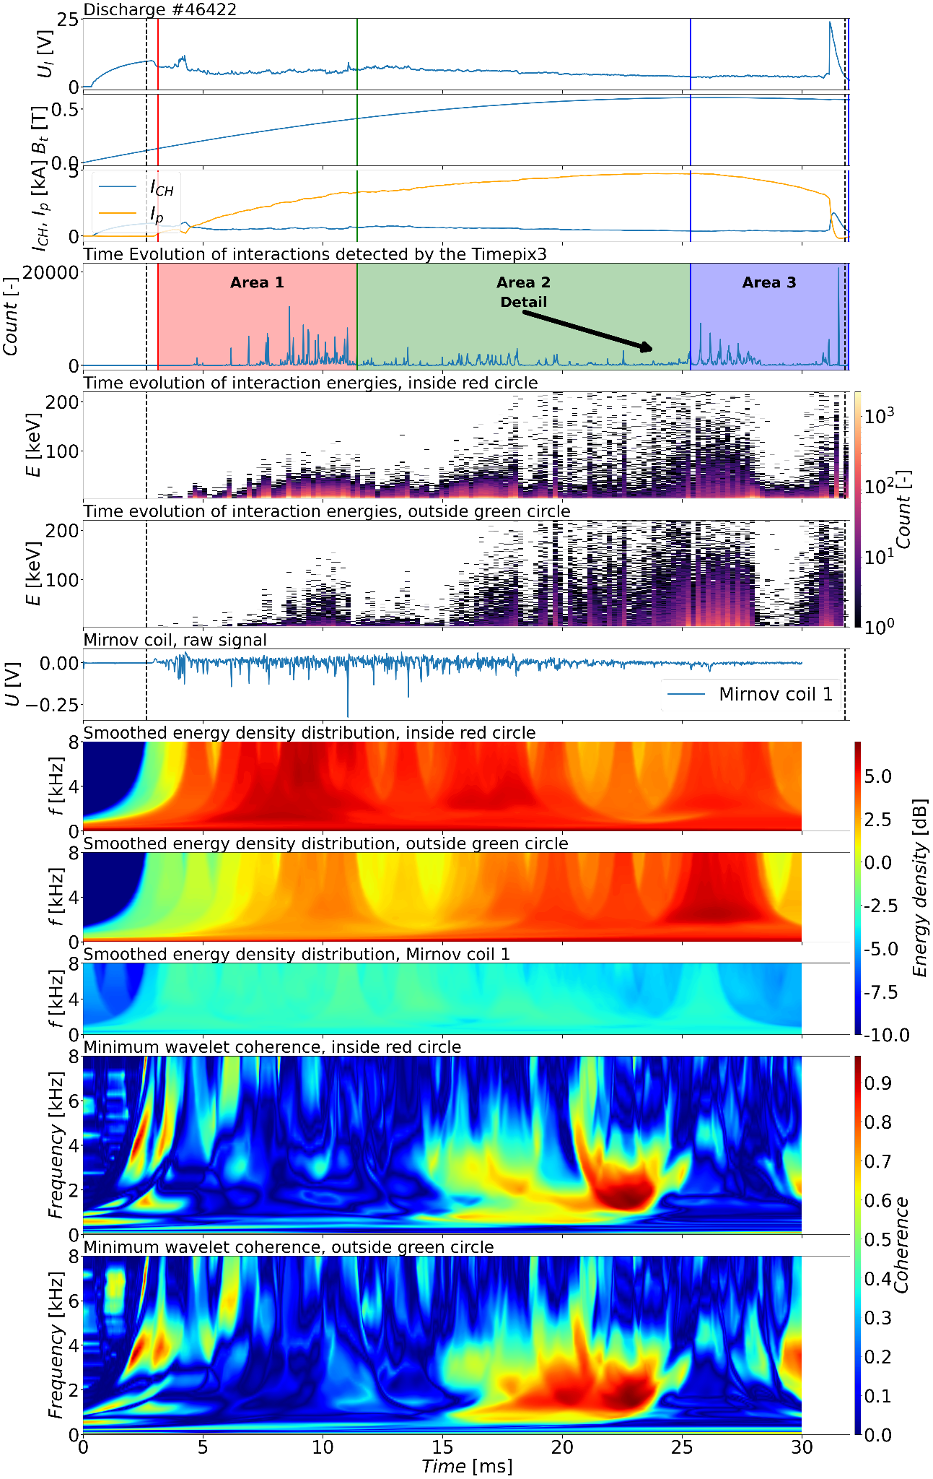
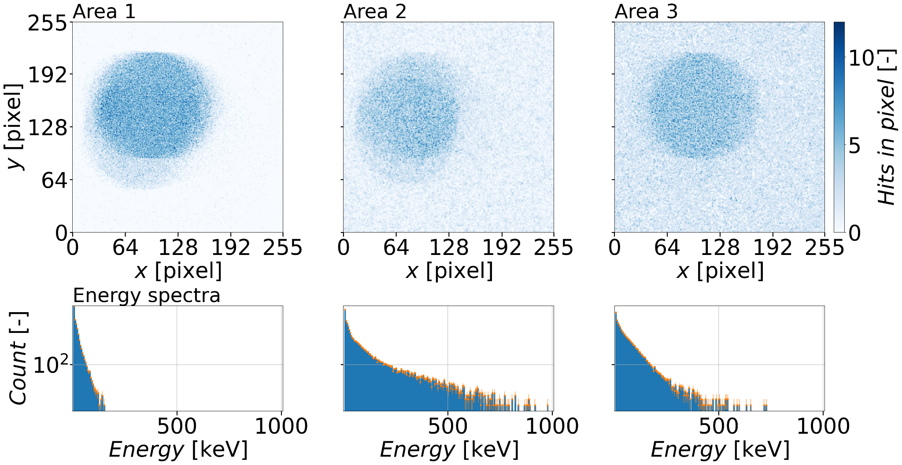
MHD-RE cross-correlation analysis
Three intervals evenly split by total count
Energy spectra from each interval is shown
Middle interval with highest MHD-correlations corresponds to highest energies in Timepix3 spectra

Slide 20
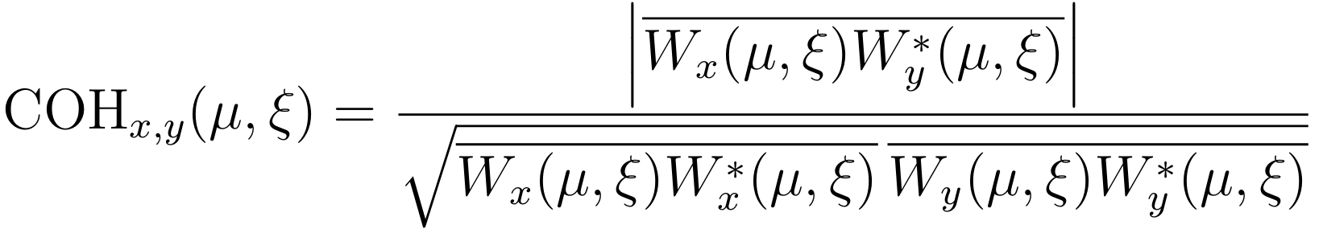




MHD-RE cross-correlation analysis
The discharge is divided into three intervals with equal interaction counts.
Visible difference in low energies (Be window)
Each signal is analysed via continuous wavelet transform (order-3 analytic Morlet wavelets)
Wavelet coherence is calculated by the formula:
Minimum wavelet coherences highlight the HXR–MHD correlation.
Notes:
The top three lines of the Figure show the main GOLEM tokamak parameters
ToDo make figure in png, check readability and remove raw mirr. coil line
N discharges analyzed – not one time phenomena
ToDo check with Gergo

Slide 21
Conclusion
GOLEM tokamak is used as RE diagnostics testing bed.
Various RE detectors were presented:
  Scintillation detectors - combination of different crystals with signal readout
  Timepix3 - excellent spatial, energy and time resolution, enabling the study of individual interactions.
  In-vessel probe - designed for direct RE measurement (energy, pitch angle)
Progress in data analysis:
  Successfully modelled scintillators response functions
  Promising energy spectra reconstruction
  Demonstration of simple inference of RE target position
  Wavelet analysis points to MHD driven runaway losses

Slide 22

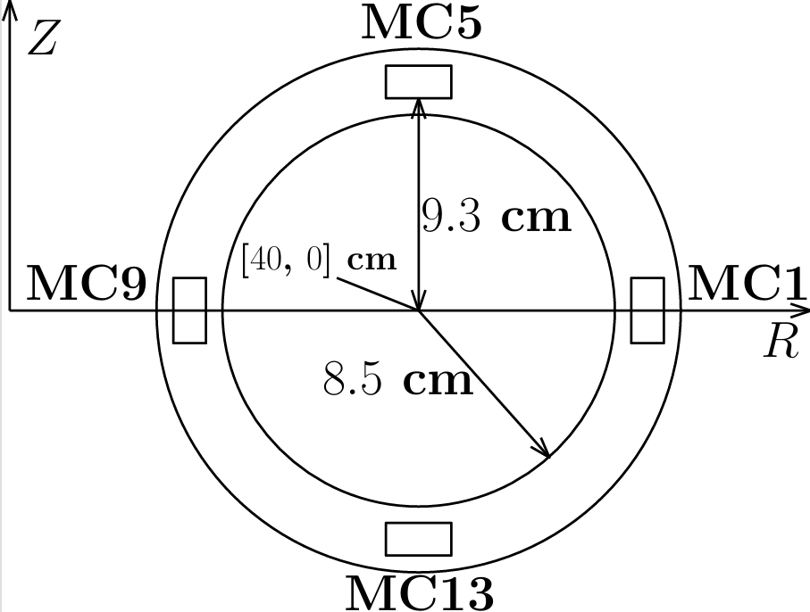
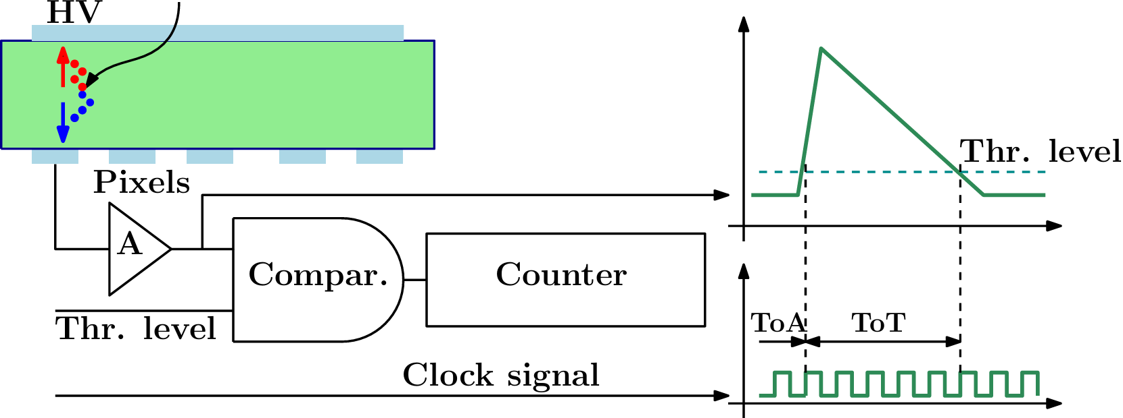
Backup

