Slide 1


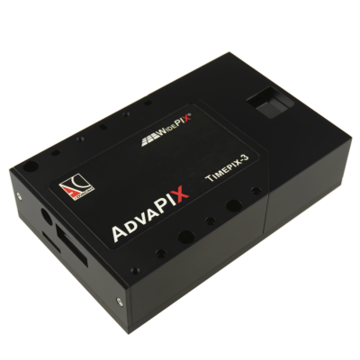
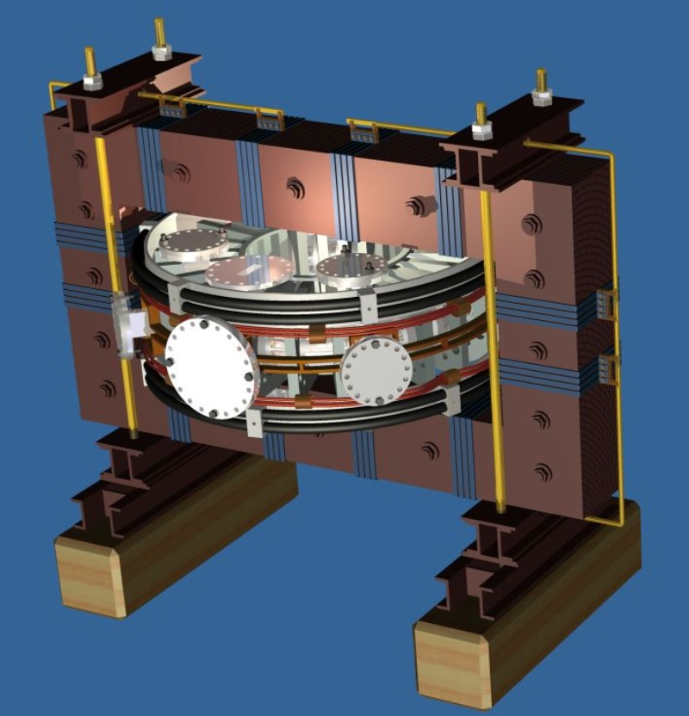
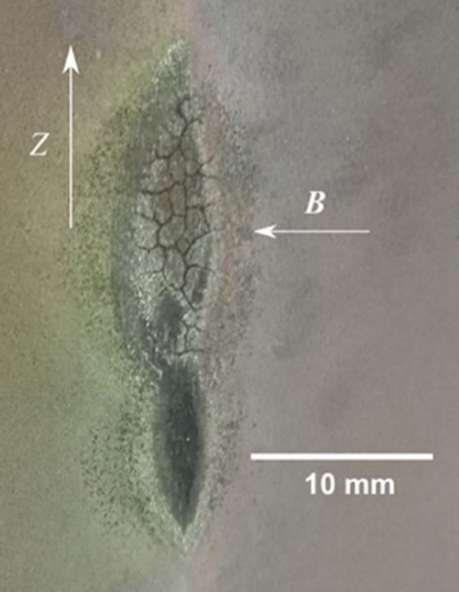
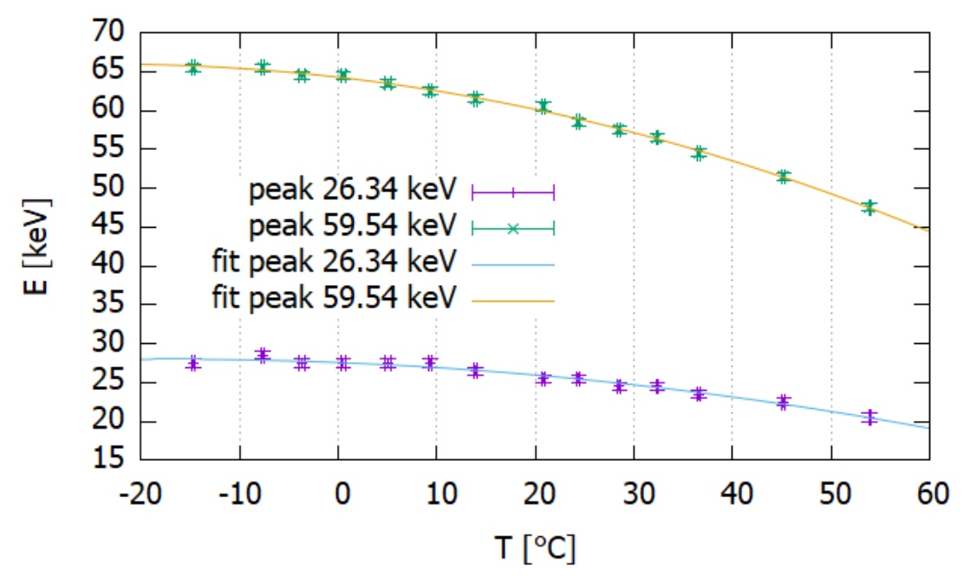
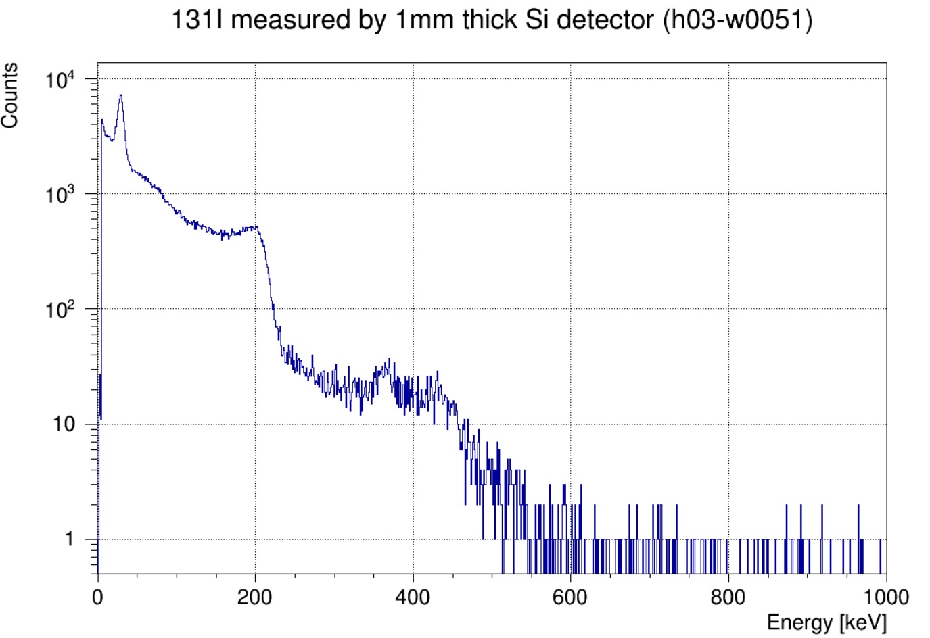
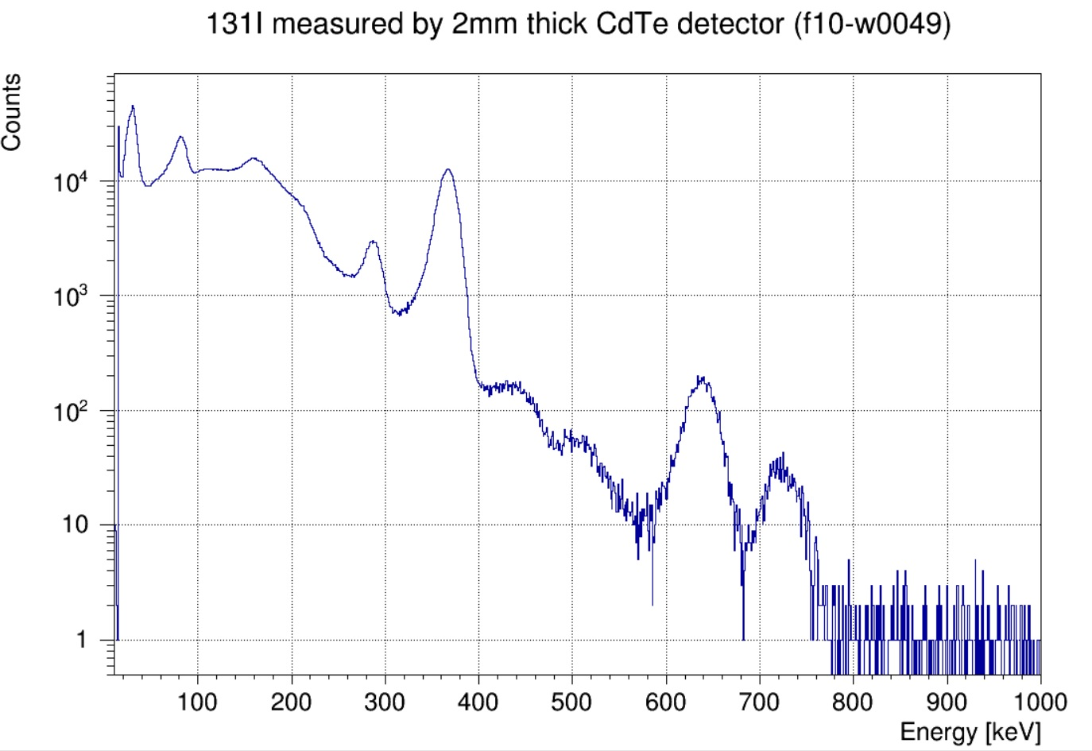
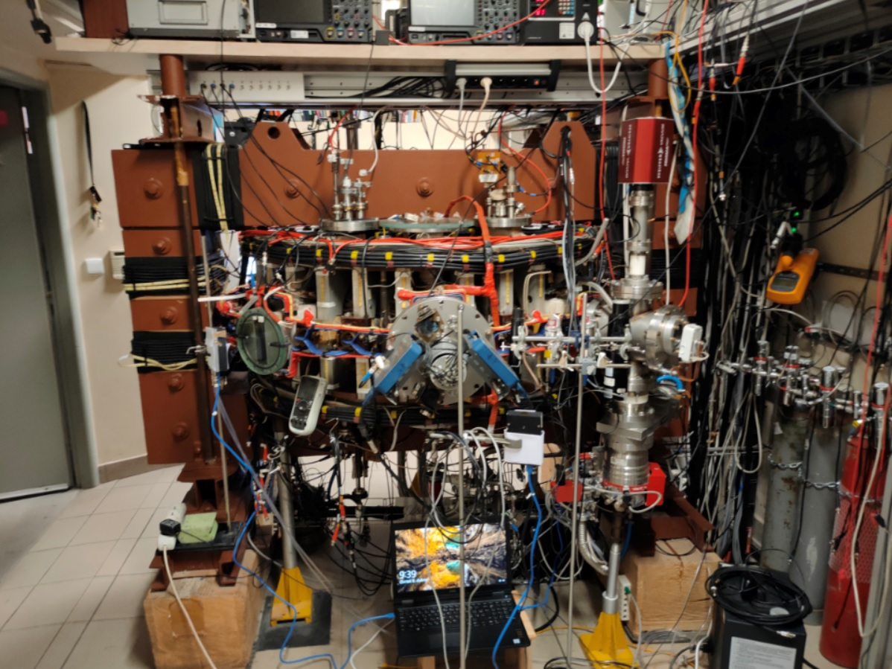
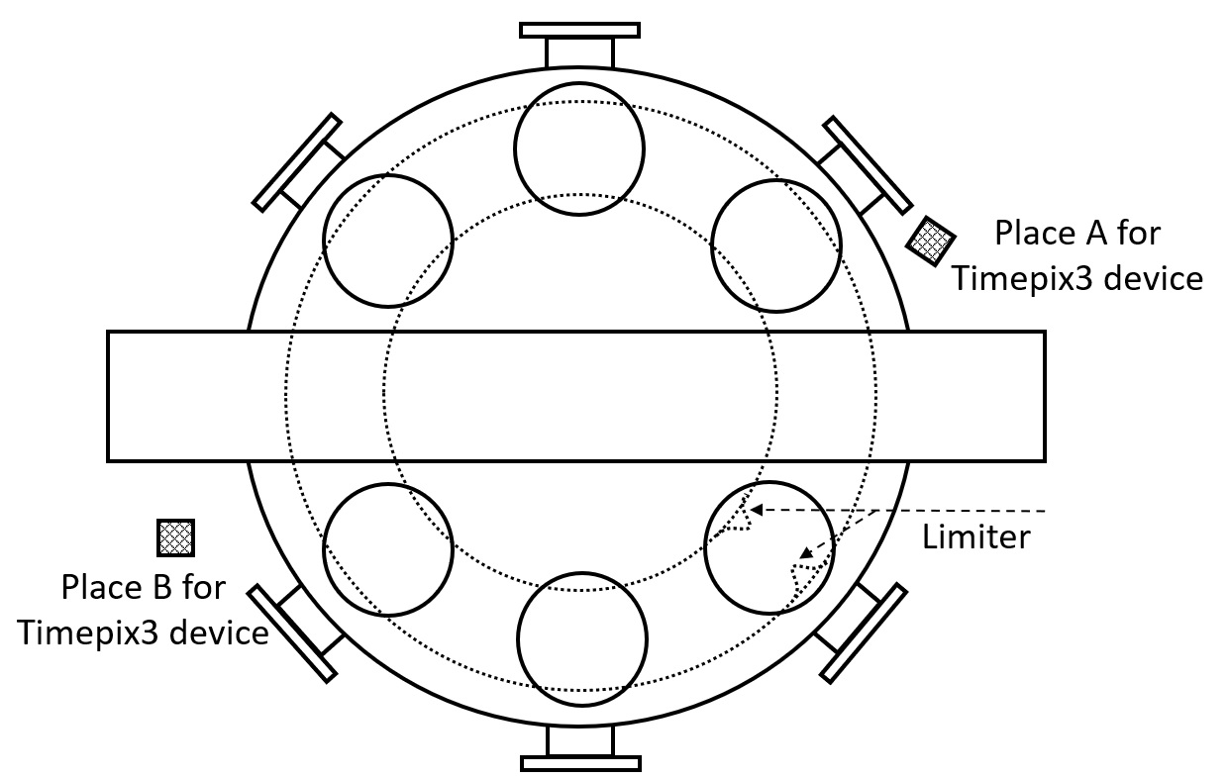
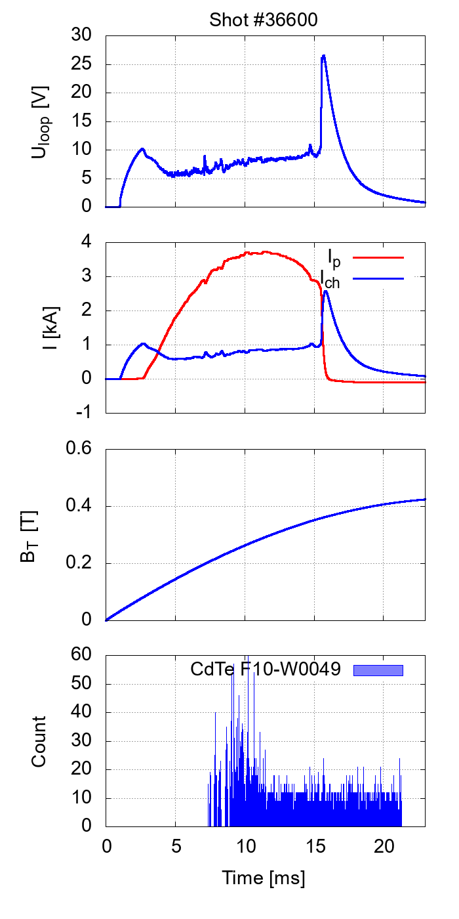
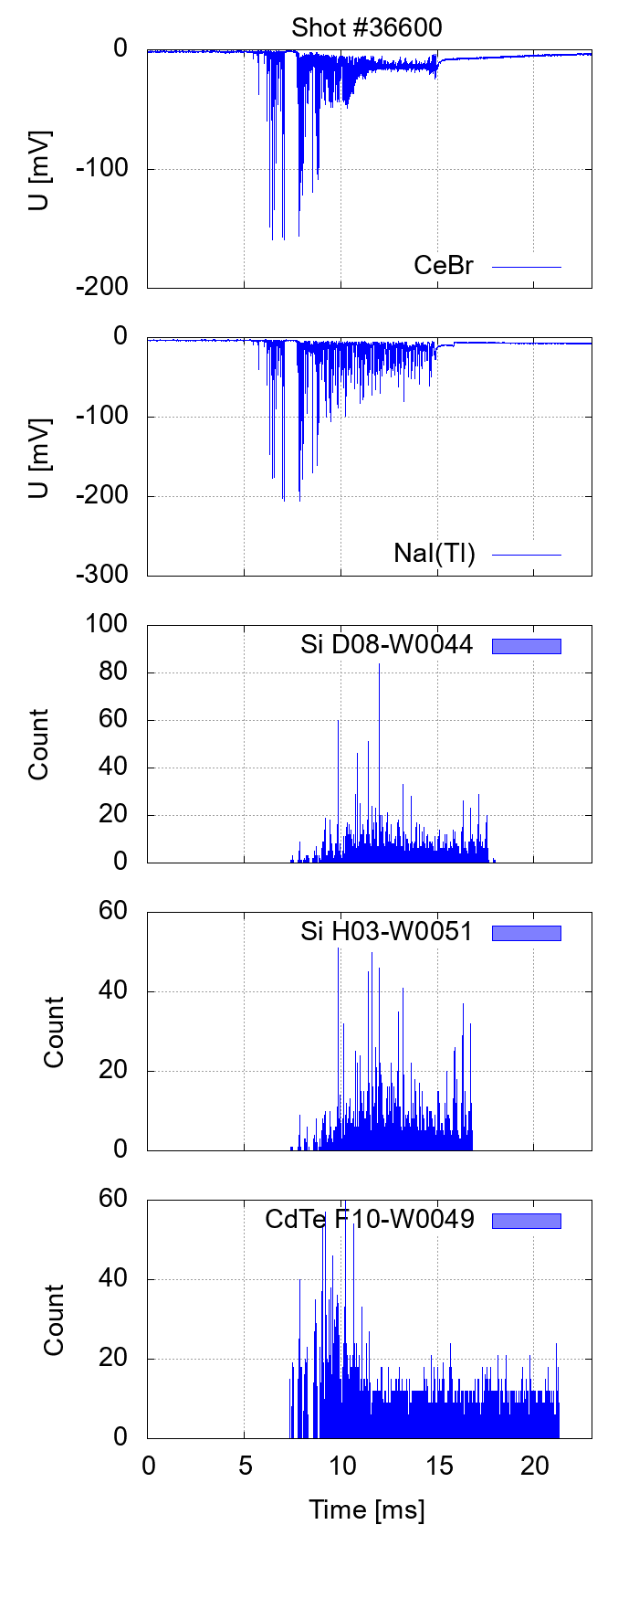
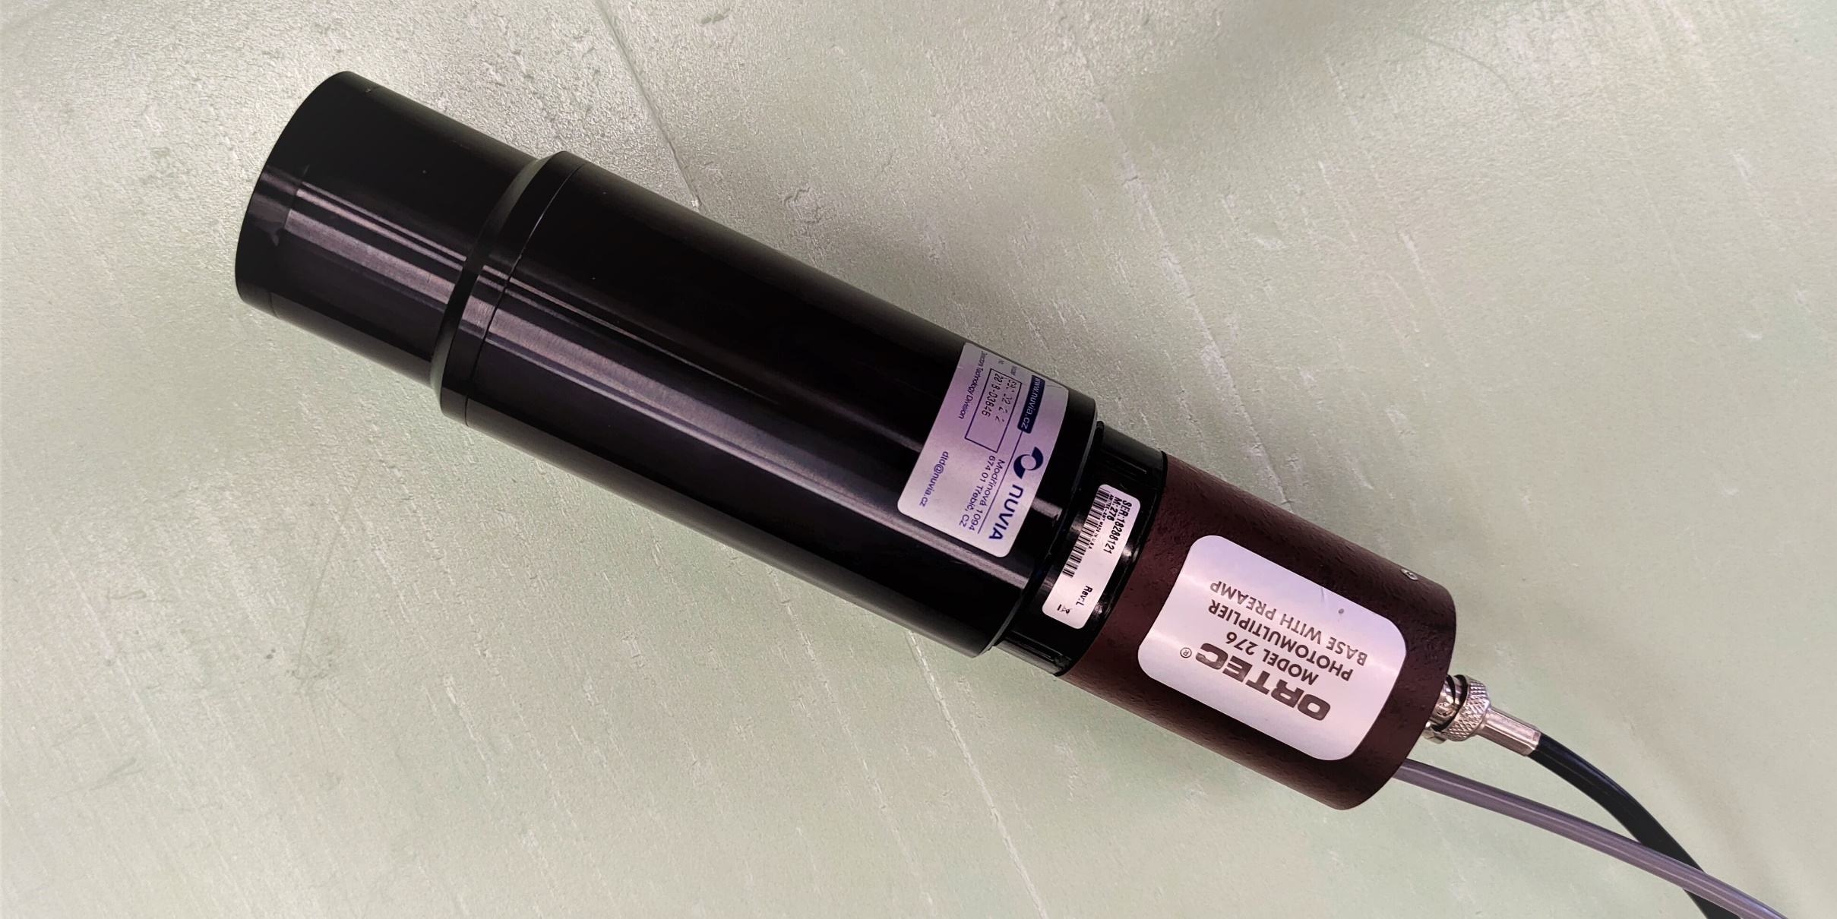
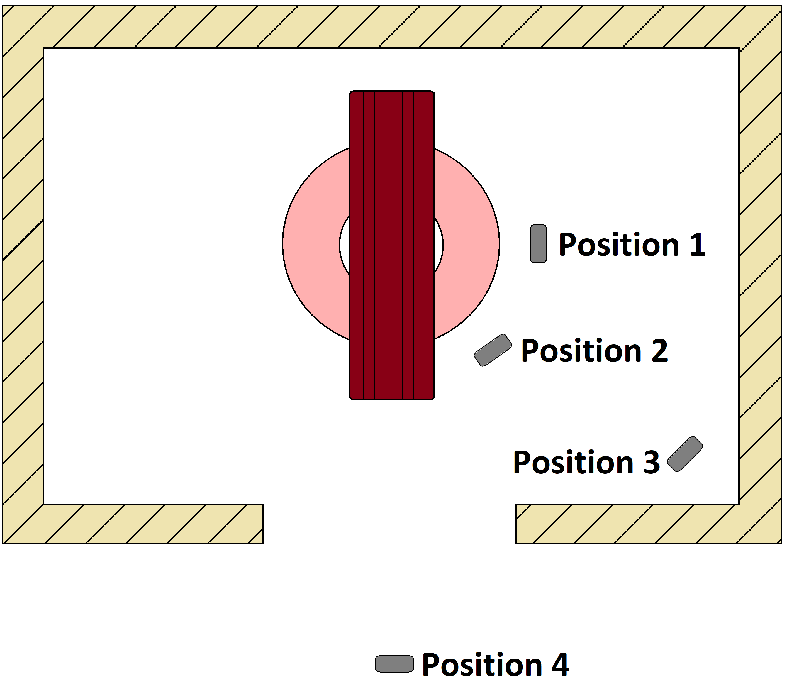
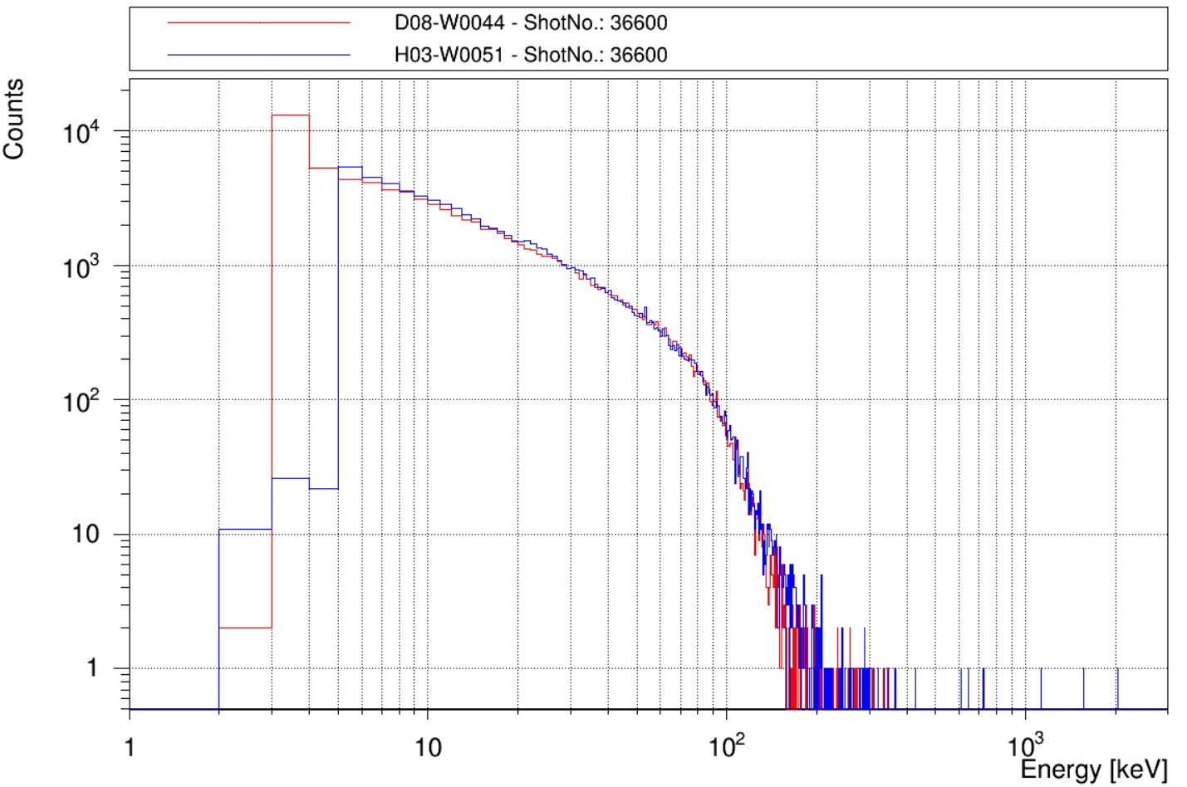
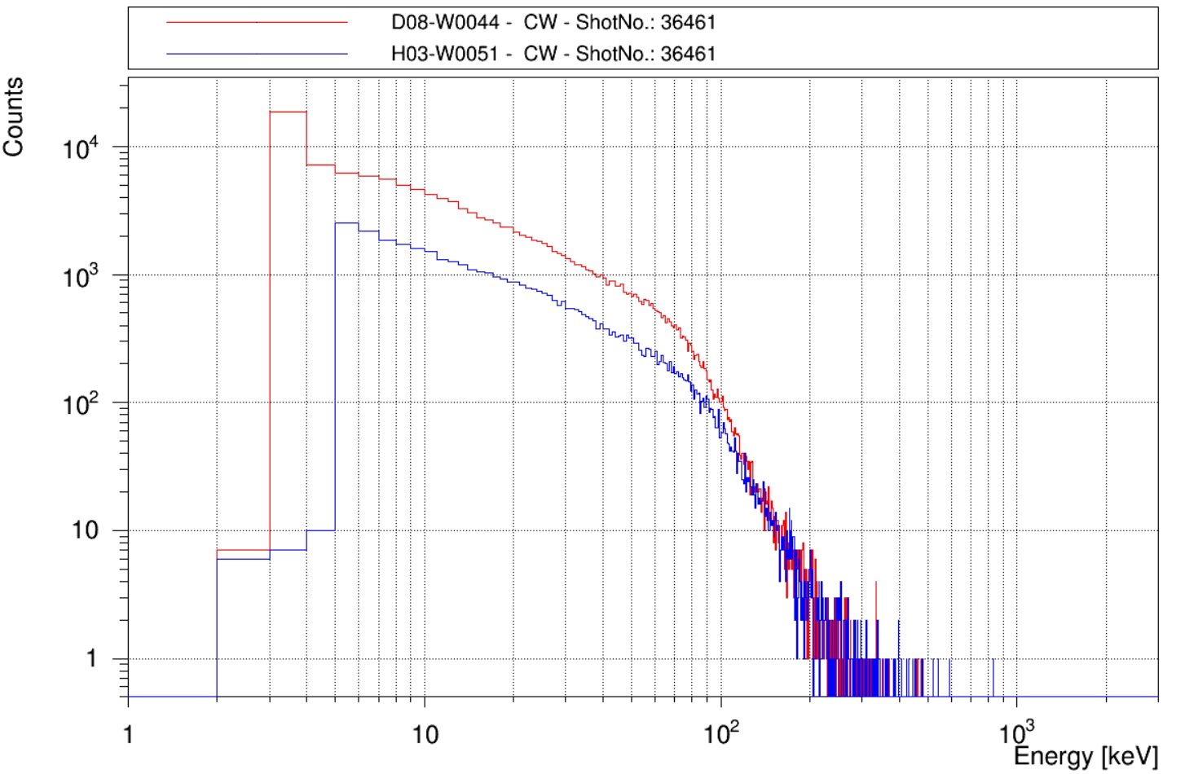
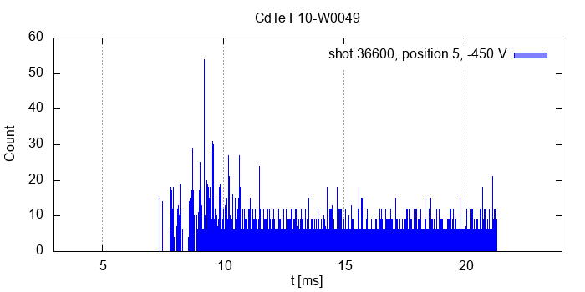
Correlations in Signals Generated by Runaway Electrons in the GOLEM Tokamak measured using the Timepix3 Detection Modules
Štěpán Malec, Vladimír Linhart, Vojtěch Svoboda
Faculty of Nuclear Sciences and Physical Engineering of the Czech Technical University in Prague, Břehová 7, 115 19 Prague 1, Czech Republic
Tokamak Golem
Remotely-operated small
tokamak
Major radius = 0.4 m
Minor radius = 0.085 m
Toroidal field B_{t} < 0.8 T
Plasma current I_{p} < 8 kA
Discharge duration cca 13 ms
Electron temperature Te below 70 eV (with a runaway component of the order of hundreds keV)
V. Svoboda, B. Huang, J. Mlynar, G.I. Pokol, J. Stockel, and G. Vondrasek, “Multimode Remote Participation on the GOLEM Tokamak”, Fusion Engineering and Design, vol. 86, no. 6-8, pp. 1310–1314, 2011.
Runaway electrons
Important phenomenon that impacts many areas of plasma physics.
Electrons under strong electric field can experience unlimited “runaway” acceleration due to the decrease of electron collision frequency with increasing velocity.
Timepix3 R/O chip
General purpose R/O chip
130 nm technology
256 x 256 pixels
TOT and TOA modes used
TOA with time precision of 1.56 ns
Maximum hit rate of 40 Mhits/s/cm²
1mm Si and 2mm CdTe@TPX3
We have used 2pc and 1pc of same Timepix3 detection modules with 1 mm thick silicon and 2 mm thick CdTe sensors, respectively.
There spectroscopic qualities are shown using gamma line spectra of ¹³¹I.
HV
Figure above demonstrates thermal shift in peak position of the detection modules.
The modules were therefore thermally stabilized on 20°C.
On the right side, there is a photo illustrating a damage of a limiter of the Compass tokamak.
MLYNAR, J, O FICKER, E MACUSOVA, et al.: „Runaway electron experiments at COMPASS in support of the EURO-fusion ITER physics research“, Plasma Physics and Controlled Fusion [online]. 2019, 61(1). DOI: 10.1088/1361-6587/aae04a. ISSN 0741-3335.
Thr. level
Pixels
Signal
The tokamak Golem (see layout above and a photo on the left side) is equipped by a limited set of plasma diagnostic instruments.
A
Comp.
Counter
TOA
TOT
Thr. level
Clock signal
Correlation in energy spectra
Correlation in time evolution of detector signals
Scintillation detectors
The energy spectra were measured by two Timepix3 dete-ction modules with 1mm thick silicon sensor on two diffe-rent positions – A and B (see sketch on the right side).
The figure on the left side contains:
loop voltage,
plasma current,
chamber current,
toroidal magnetic field,
record from the CdTe pixel detector.
The record from the pixel detector shows that there are many more detected events in the first half of the discharge than in the second half, because after plasma formation is loop voltage high (high electric field) and density of plasma is low.
The figure on the right side contains the records of signals from the scintillation and the pixel detectors.
The scintillation detectors used on the tokamak Golem are:
YAP
2x CeBr
NaI(Tl)
LYSO
Event distribution in Tokamak chambre
The number of events that had an energy higher than 10 keV was measured at various positions around the tokamak. All detectors were located in the equatorial plane. Typical event count values for positions 1-4 are 15-30 hits per 100 ns and for pos. 5 it is 10-20 hits per 100 ns..
If the detectors are on the same place (e.g., place A) the resulting spectra are exactly same. This fact is demon-strated on the first figure on the left side.
Different situation is if the detectors are on different positions (e.g., pla-ces A and B) as it is visible on the next figure.
Conclusion
Acknowledgement
This work was supported by the Grant Agency of the Czech Technical University in Prague, grant No. SGS21/167/OHK4/3T/14.
We have observed angular dependence in energy spektra. This dependence could be used for estimation of speed of primary runaway electrons.
We have measured time evolutions of signals from various detectors (semiconductor pixel detectors and scintillation detectors). The evolutions are different for different detection materials. This could be caused ba different detection efficiency. Studies of these diferencies are still under way.
The number of measured events is a strongly fluctuating from discharge to discharge, therefore a lower number of events is observed only when measuring in the foyer (position 4).
The signals from the silicon detectors are different from the signals from the scintillation detectors and the CdTe detector, this may be due to the large difference between the density of senzor material of scintillation detectors and the CdTe detector compared to the Si detector.

