Slide 1
1st Research Coordination Meeting CRP on Network of Small and Medium Size Magnetic Confinement Fusion Devices for Fusion Research
Fuelling and confinement studies on the STOR-M tokamak-F13019
Chijin Xiao
University of Saskatchewan, Canada
Vienna, Oct. 8-11, 2018

Slide 2
Our Laboratory
Plasma Physics Laboratory, Department of Physics and Engineering Physics, University of Saskatchewan, Canada
Established by Prof H.M. Skarsgard in 1958 and later led by Prof. A. Hirose (1994-2017)

Slide 3
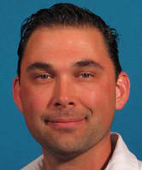



Professors in PPL
M. Bradley
L. Couedel
A. Smolyakov
C. Xiao
Plasma aided material synthesis and processing
Tokamak and Compact Torus Dense Plasma Focus
Theoretical Plasma Physics
Dusty Plasma

Slide 4
Main Facilities
STOR-M tokamak
Compact torus injector
Dense plasma focus device
ICP and microwave plasma devices

Slide 5
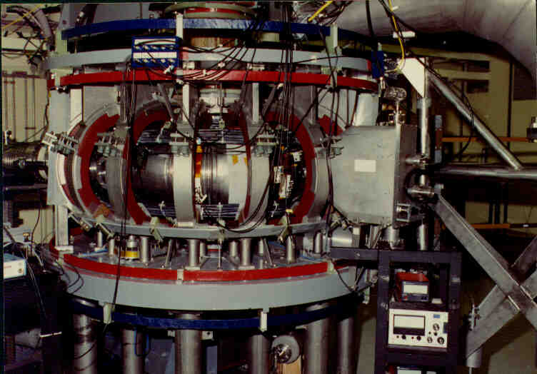
STOR-M Tokamak
Construction started in 1984
Operational since 1987
Still active as the only tokamak in Canada today

Slide 6
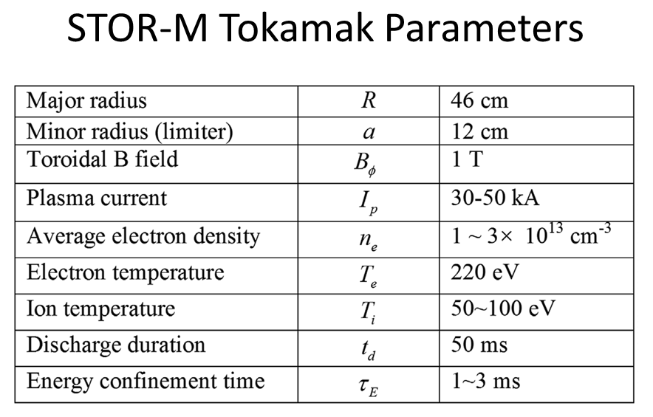

Slide 7
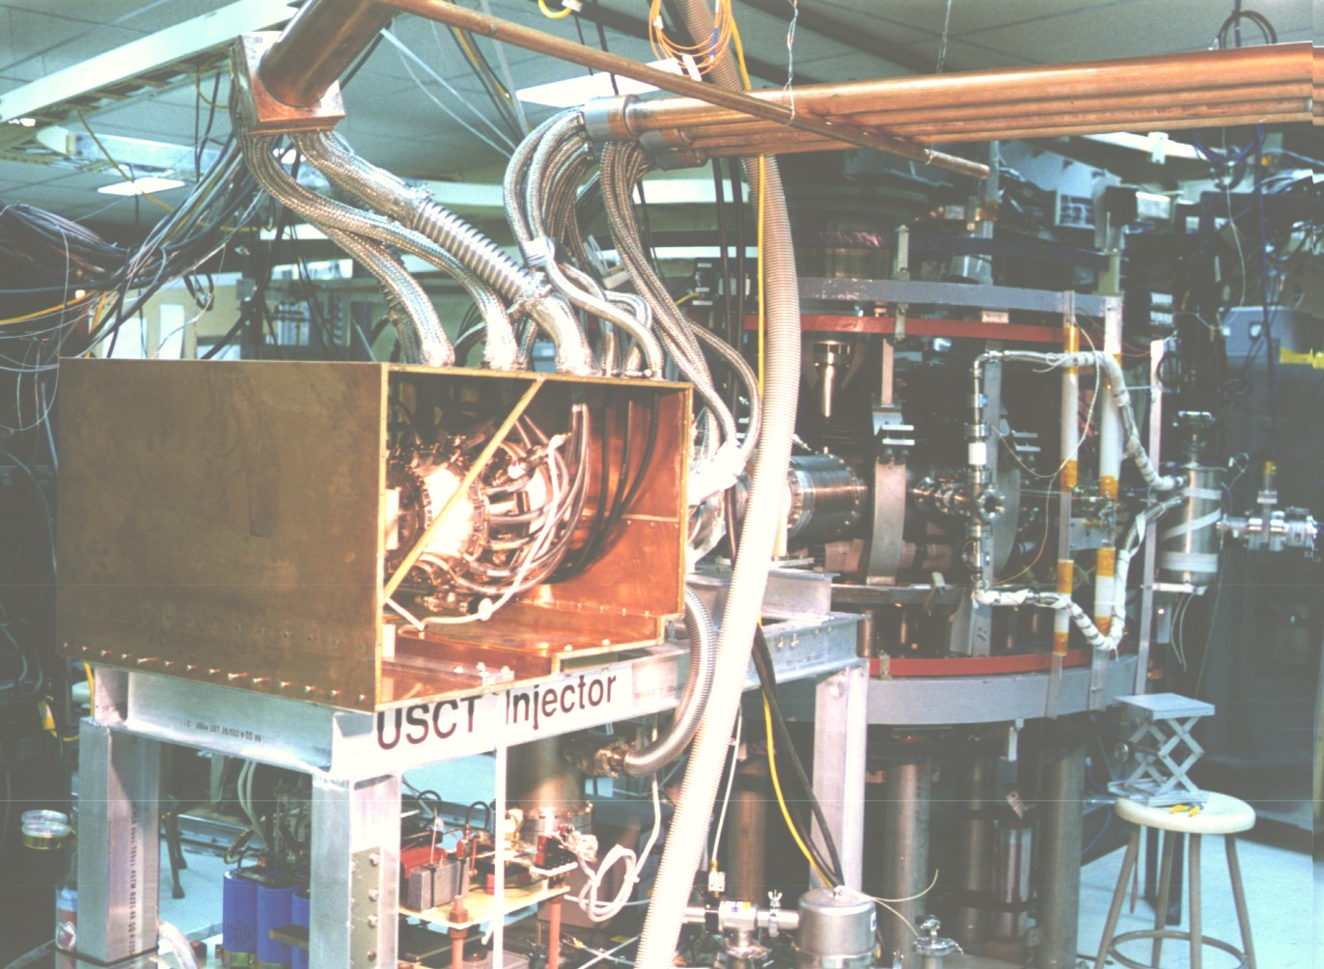

Slide 8
Main Axillary Systems and Diagnostics
Feedback position control
Resonant magnetic perturbation coils
AC operation compatible
Lithium wall coating system (Physical Vapor deposition)
4-mm interferometer
SXR pin-hole cameras
2-cm reflectometer
Mirnov coil arrays and electric probes
IDS for toroidal flow measurement

Slide 9
STOR-M experiments/expertise
Improved confinement induced by
Electrode/limiter biasing (early 1990s)
Turbulent heating
Compact torus injection
AC operation (O. Mitarai)
Compact Torus Injector (mid 1990 – now)
Resonant Magnetic Perturbations

Slide 10
Main Research Activities Proposed, 1
Revisit the improved confinement in the STOR-M tokamak
Triggering techniques: Electrode biasing, CT injection, RMP, turbulent heating
New: Combined with Lithium coating of the chamber wall
Sustainment: Combine different techniques and or repetitive triggering to sustain the improved confinement phase
Mechanism: Correlate the improved confinement with magnetic and density fluctuation properties and plasma flow measurement.

Slide 11
Main Research Activities Proposed, 2
Compact Torus injection into the STOR-M tokamak
Continue studies of momentum injection by CT injection
Try to understand momentum transport in STOR-M (Magnetic breaking and transport)
Repetitive CT operation (up to 100 Hz)
Multiple CT injection into a single STOR-M discharge

Slide 12
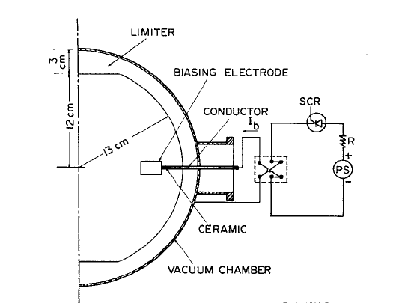
Electrode Biasing

Slide 13
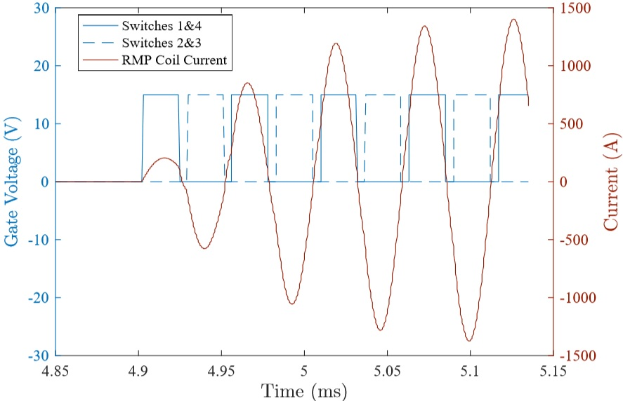
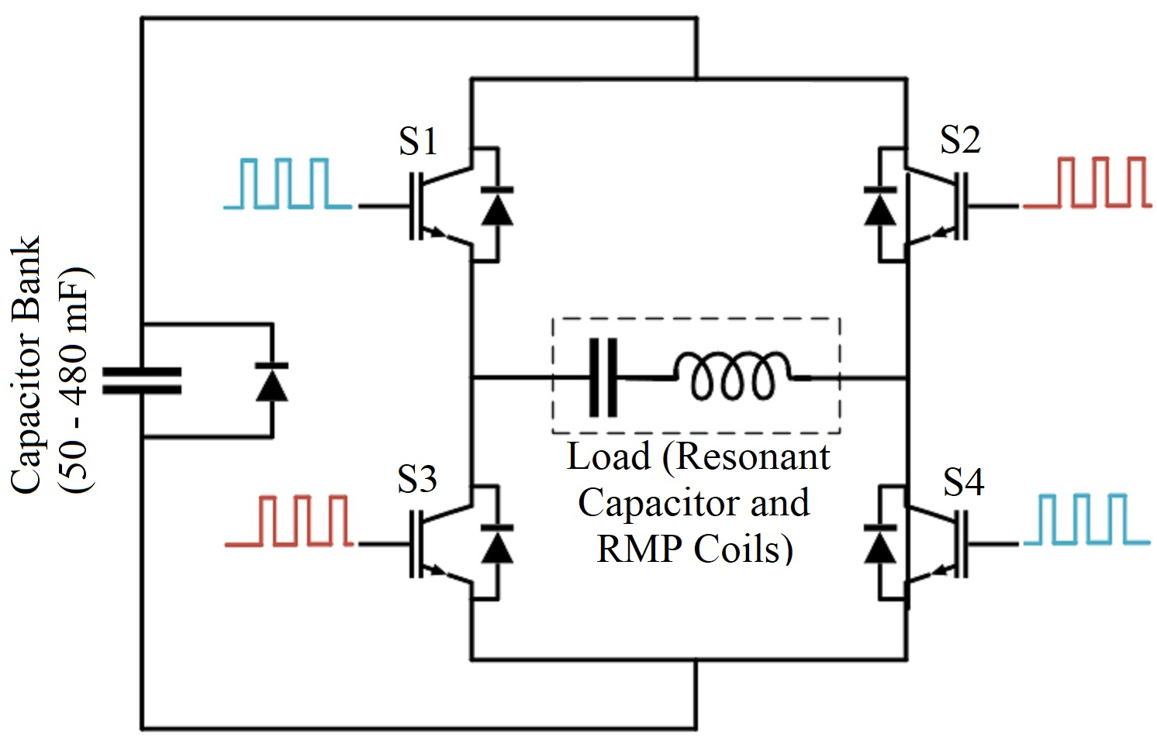
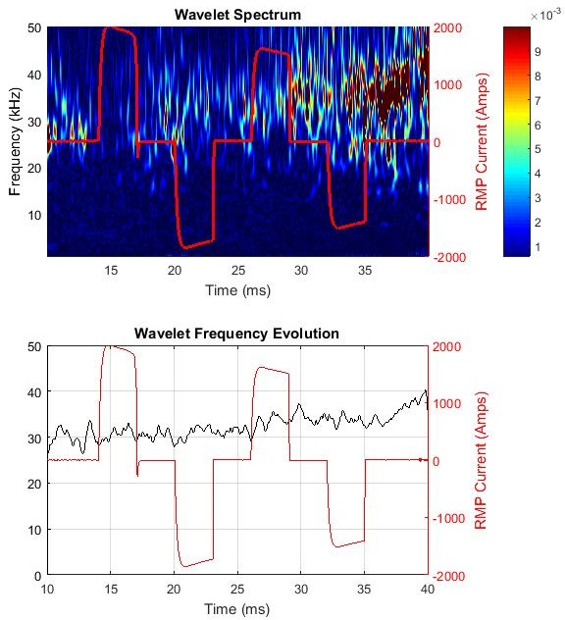
H-Bridge Circuit
LC load
R load
18

Slide 14
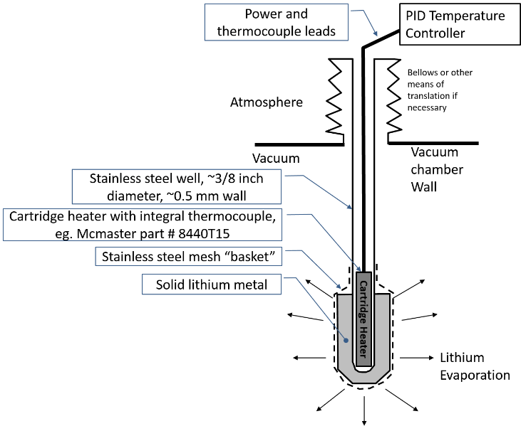
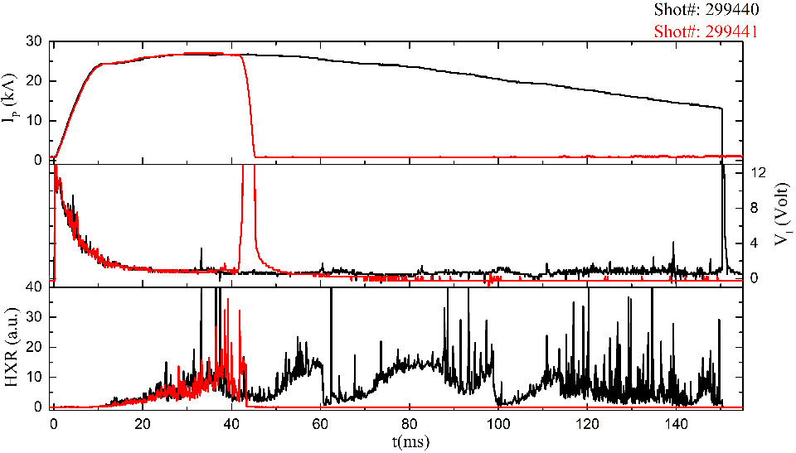
Lithium evaporator

Slide 15
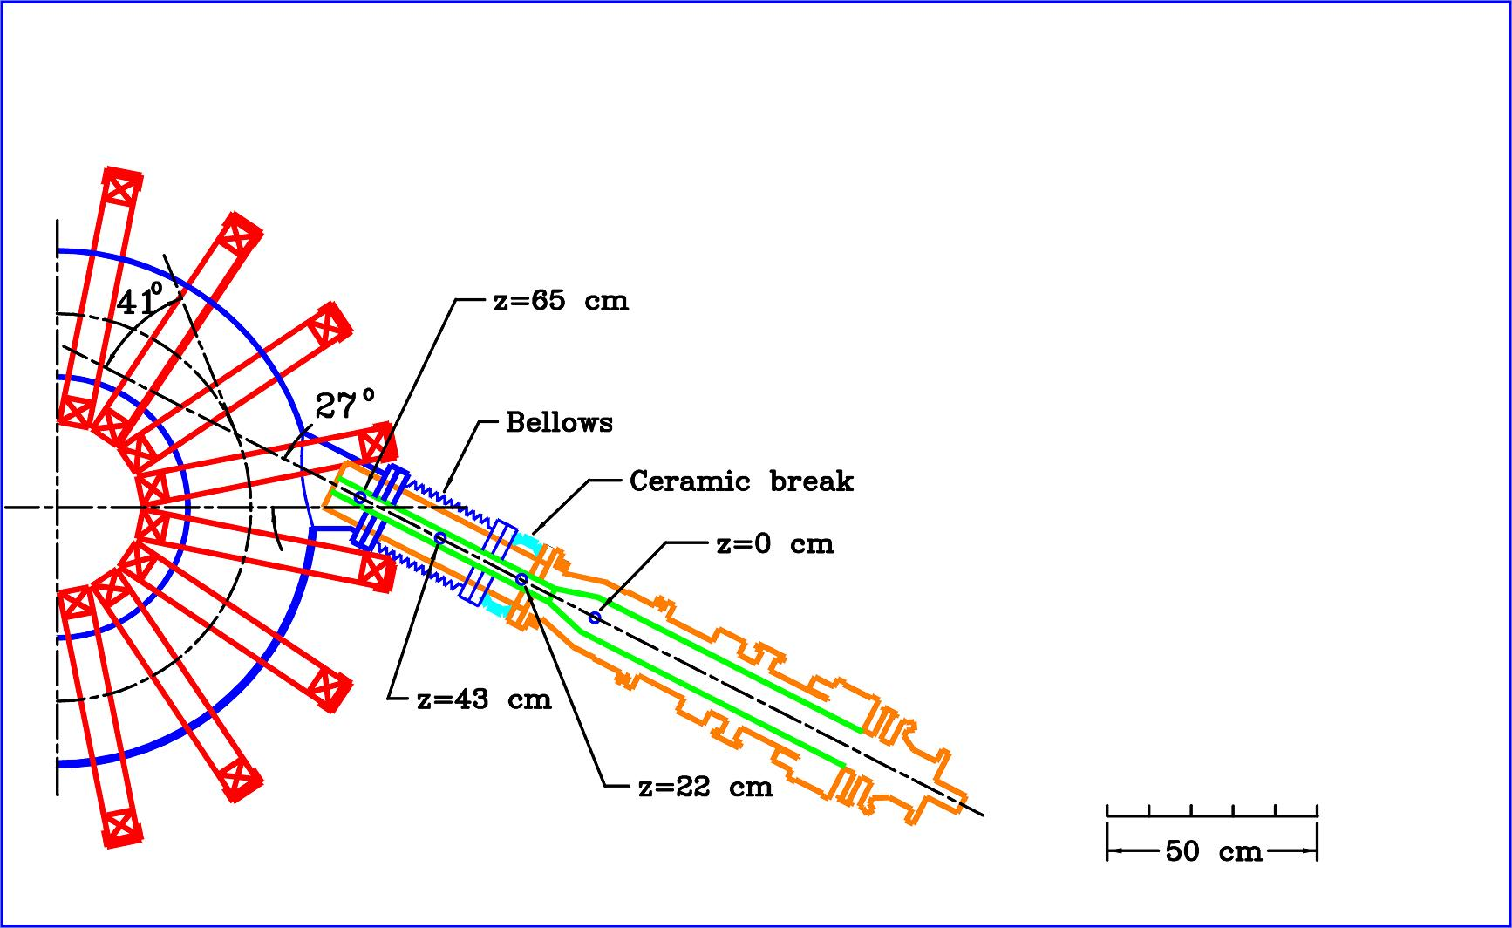
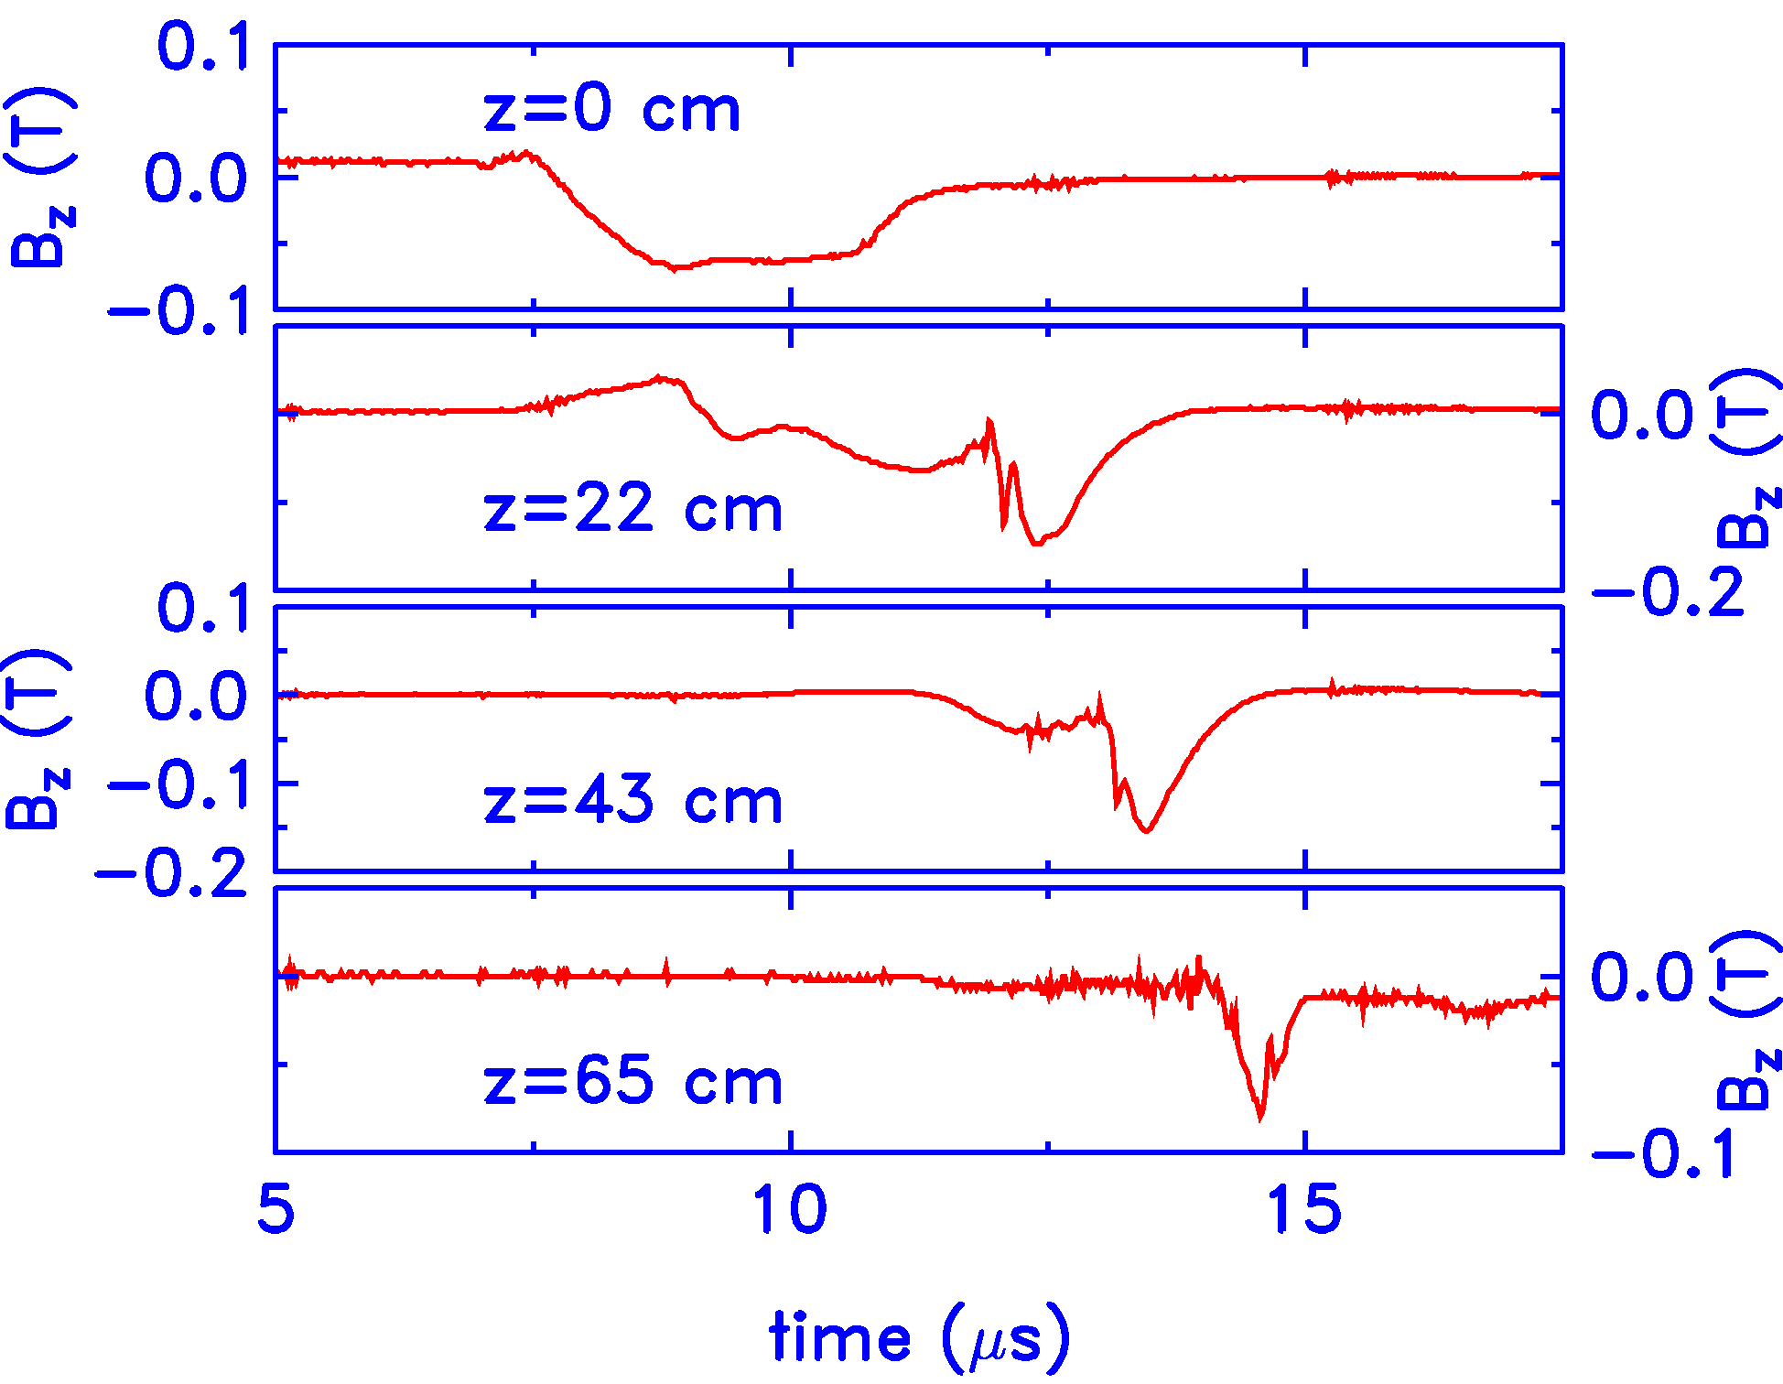
Tangential CT injection is a unique feature of USCTI/STOR-M experiments

Slide 16
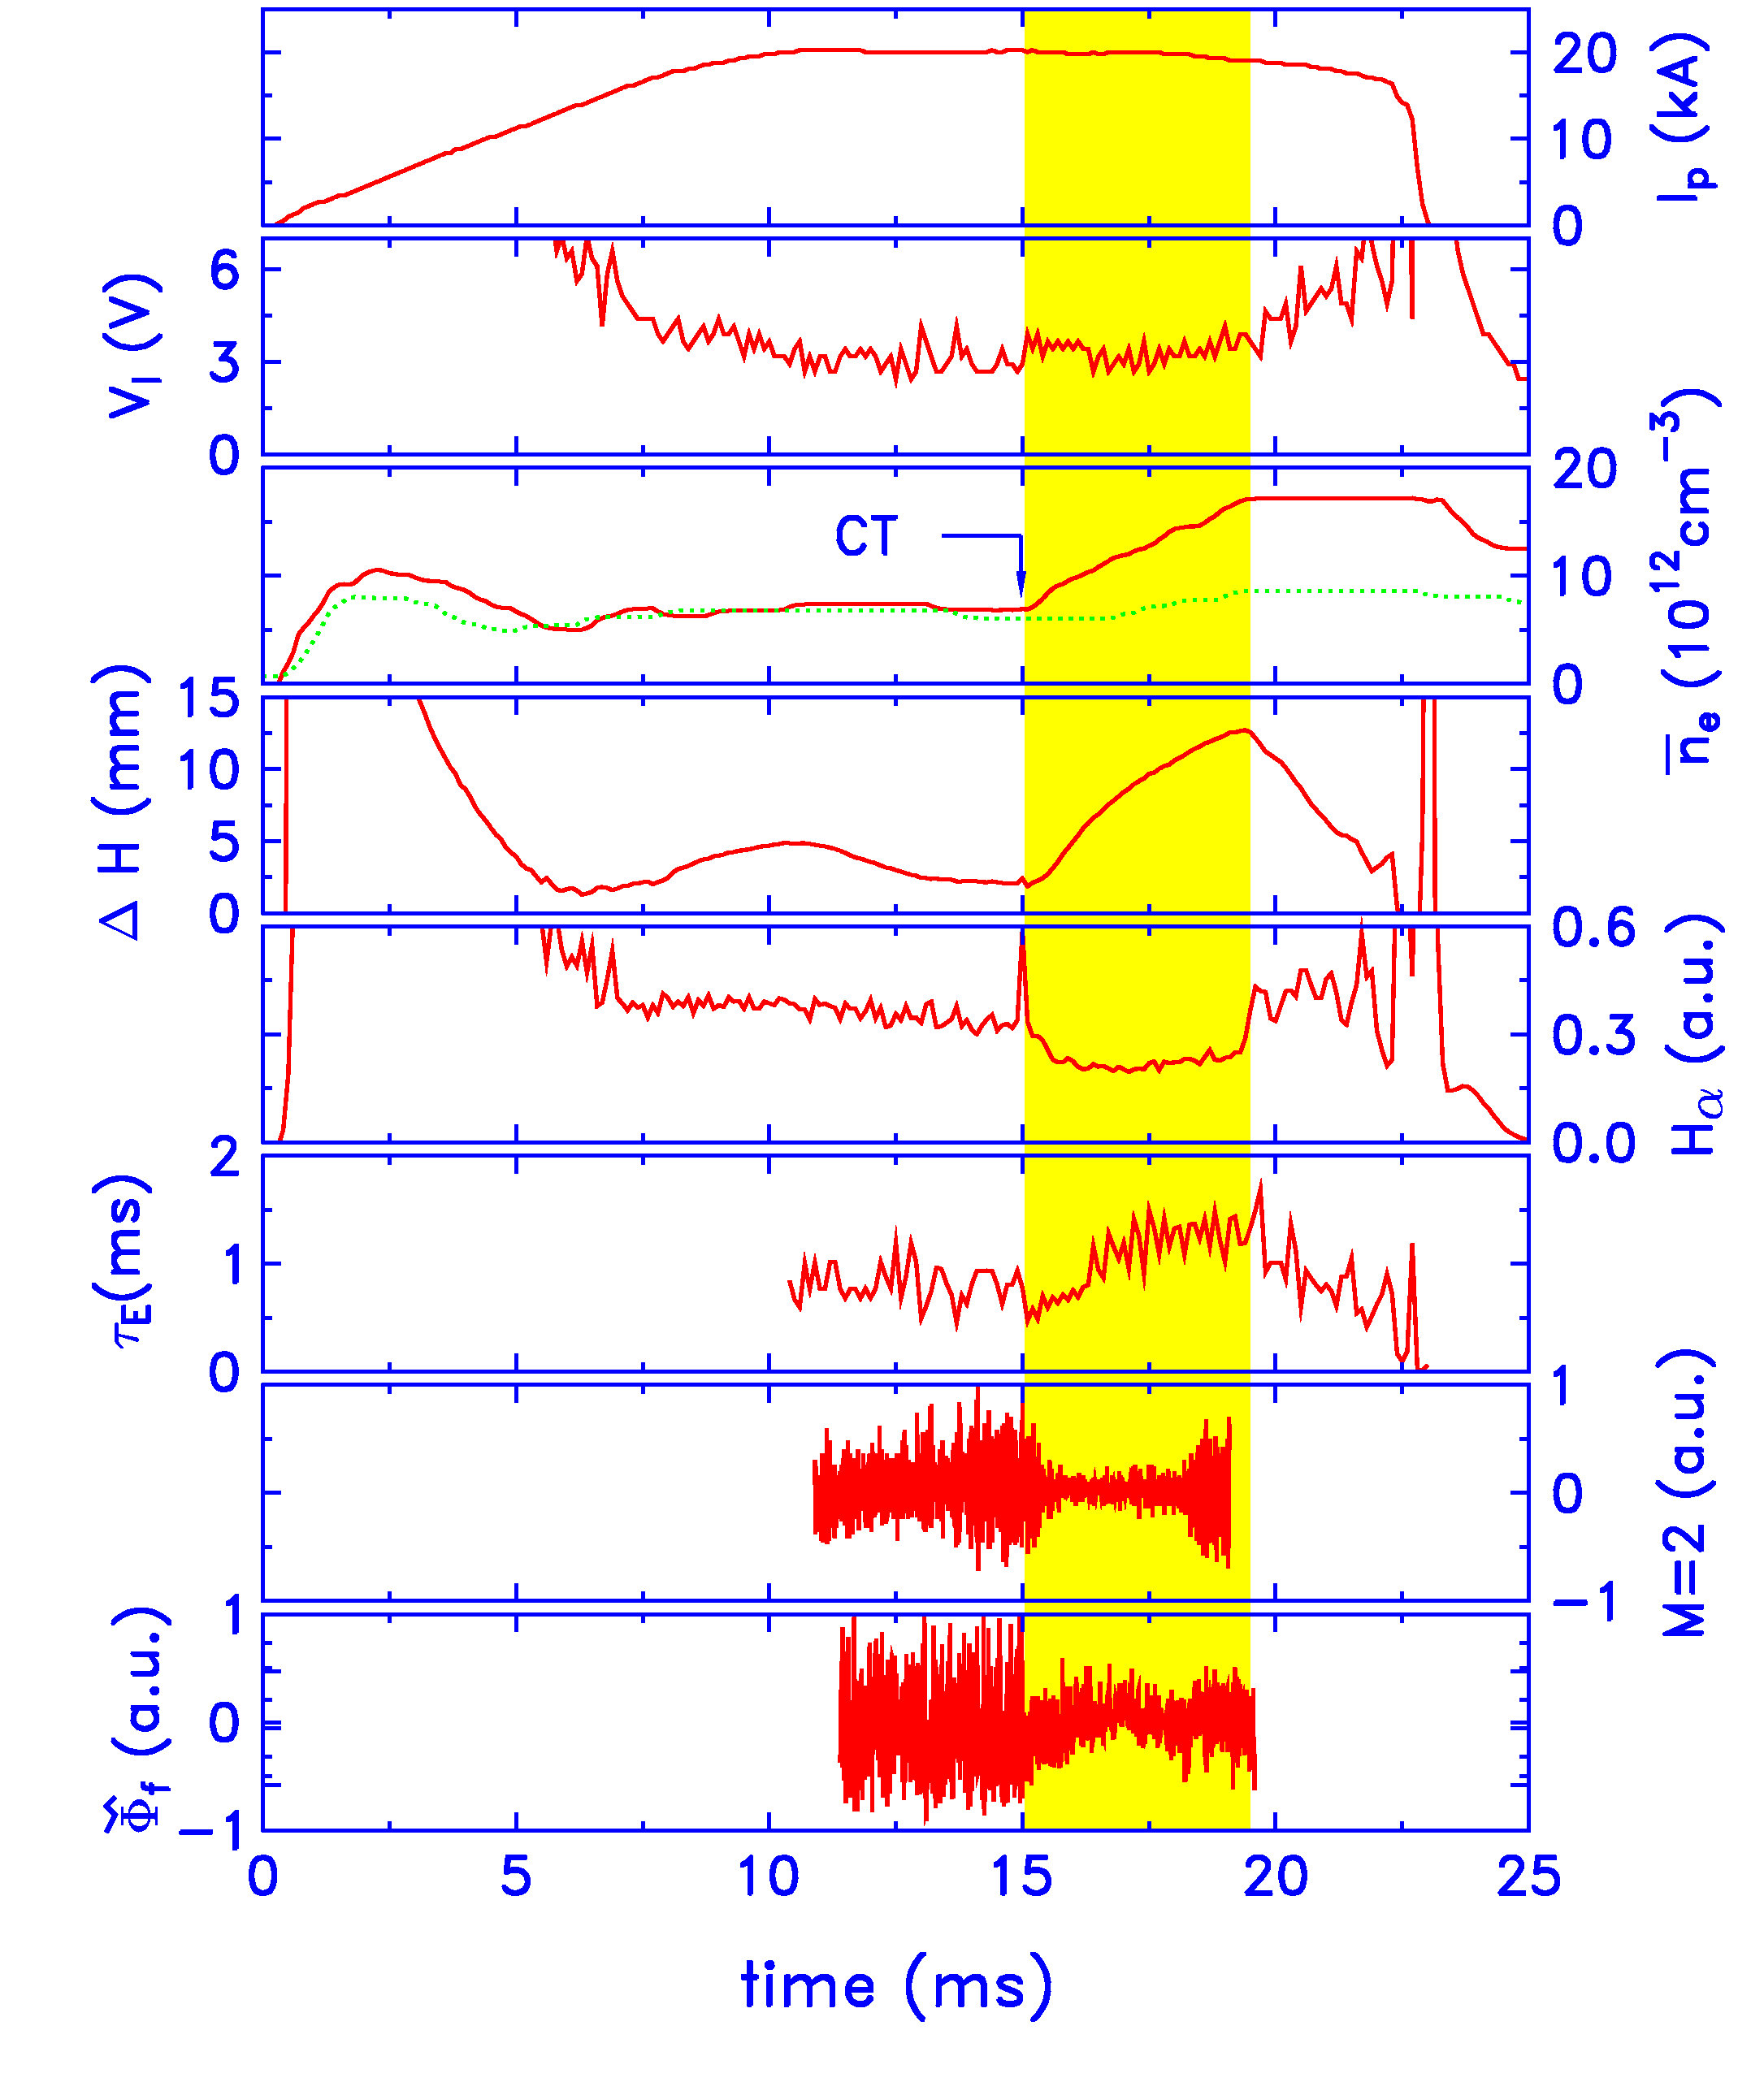
CT injection induced H-mode like discharge
Density ↑
H_{α} decrease
MHD Fluctuations ↓
Floating potential fluctuations ↓
Energy confinement time ↑

Slide 17
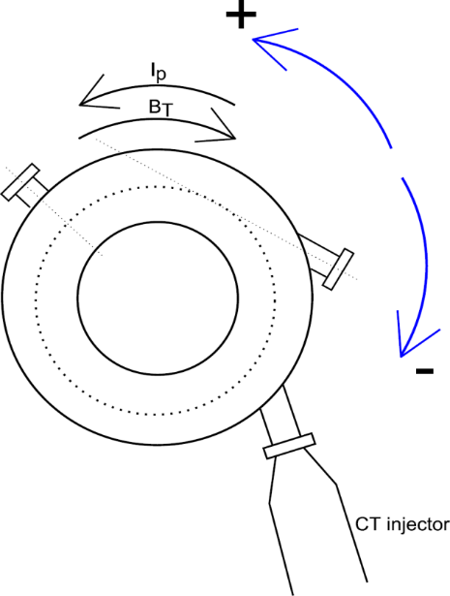
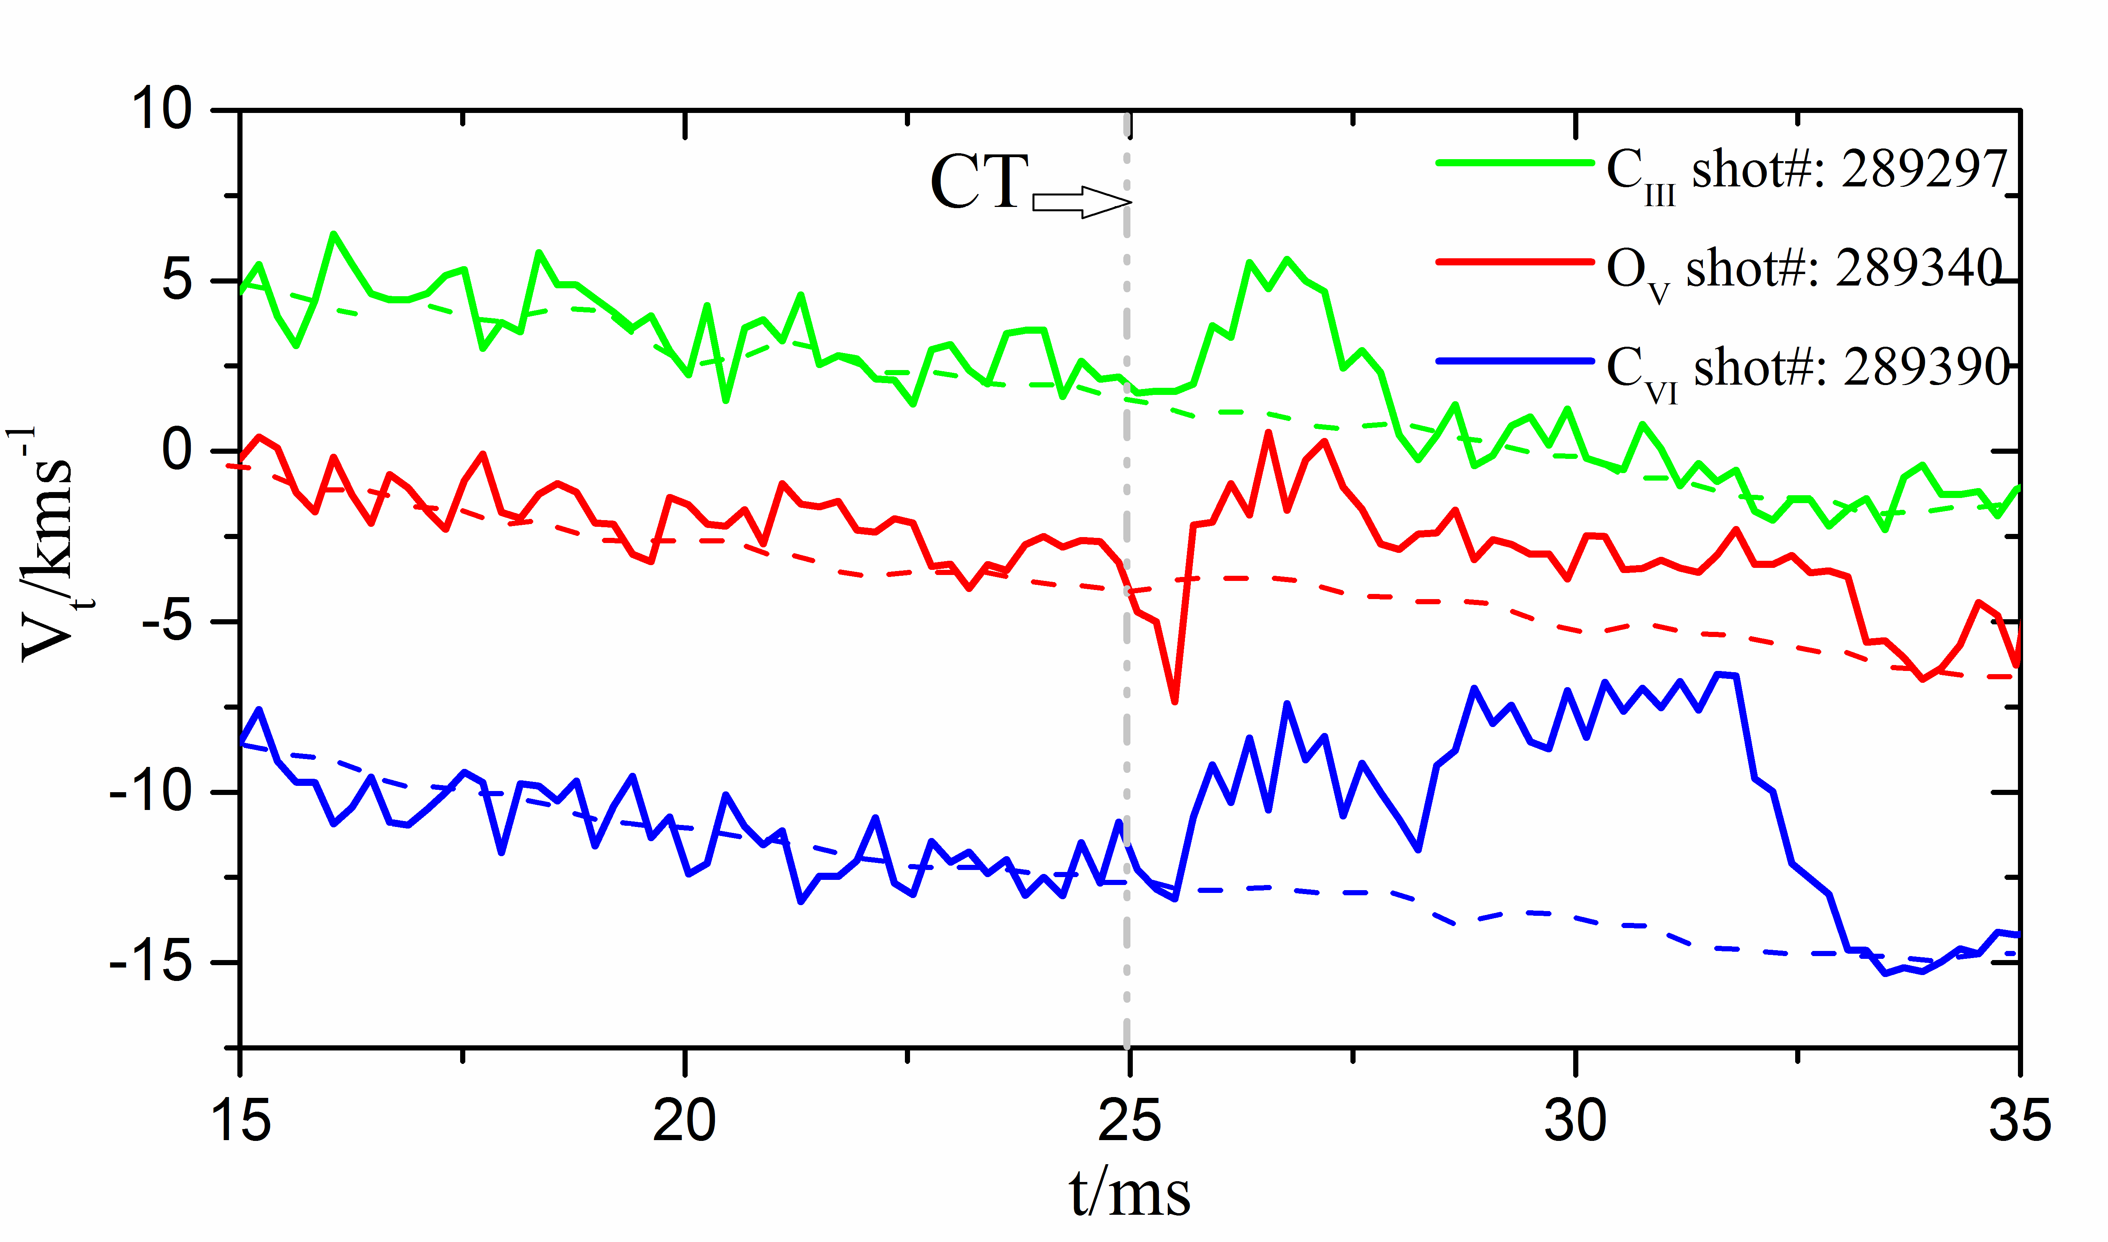

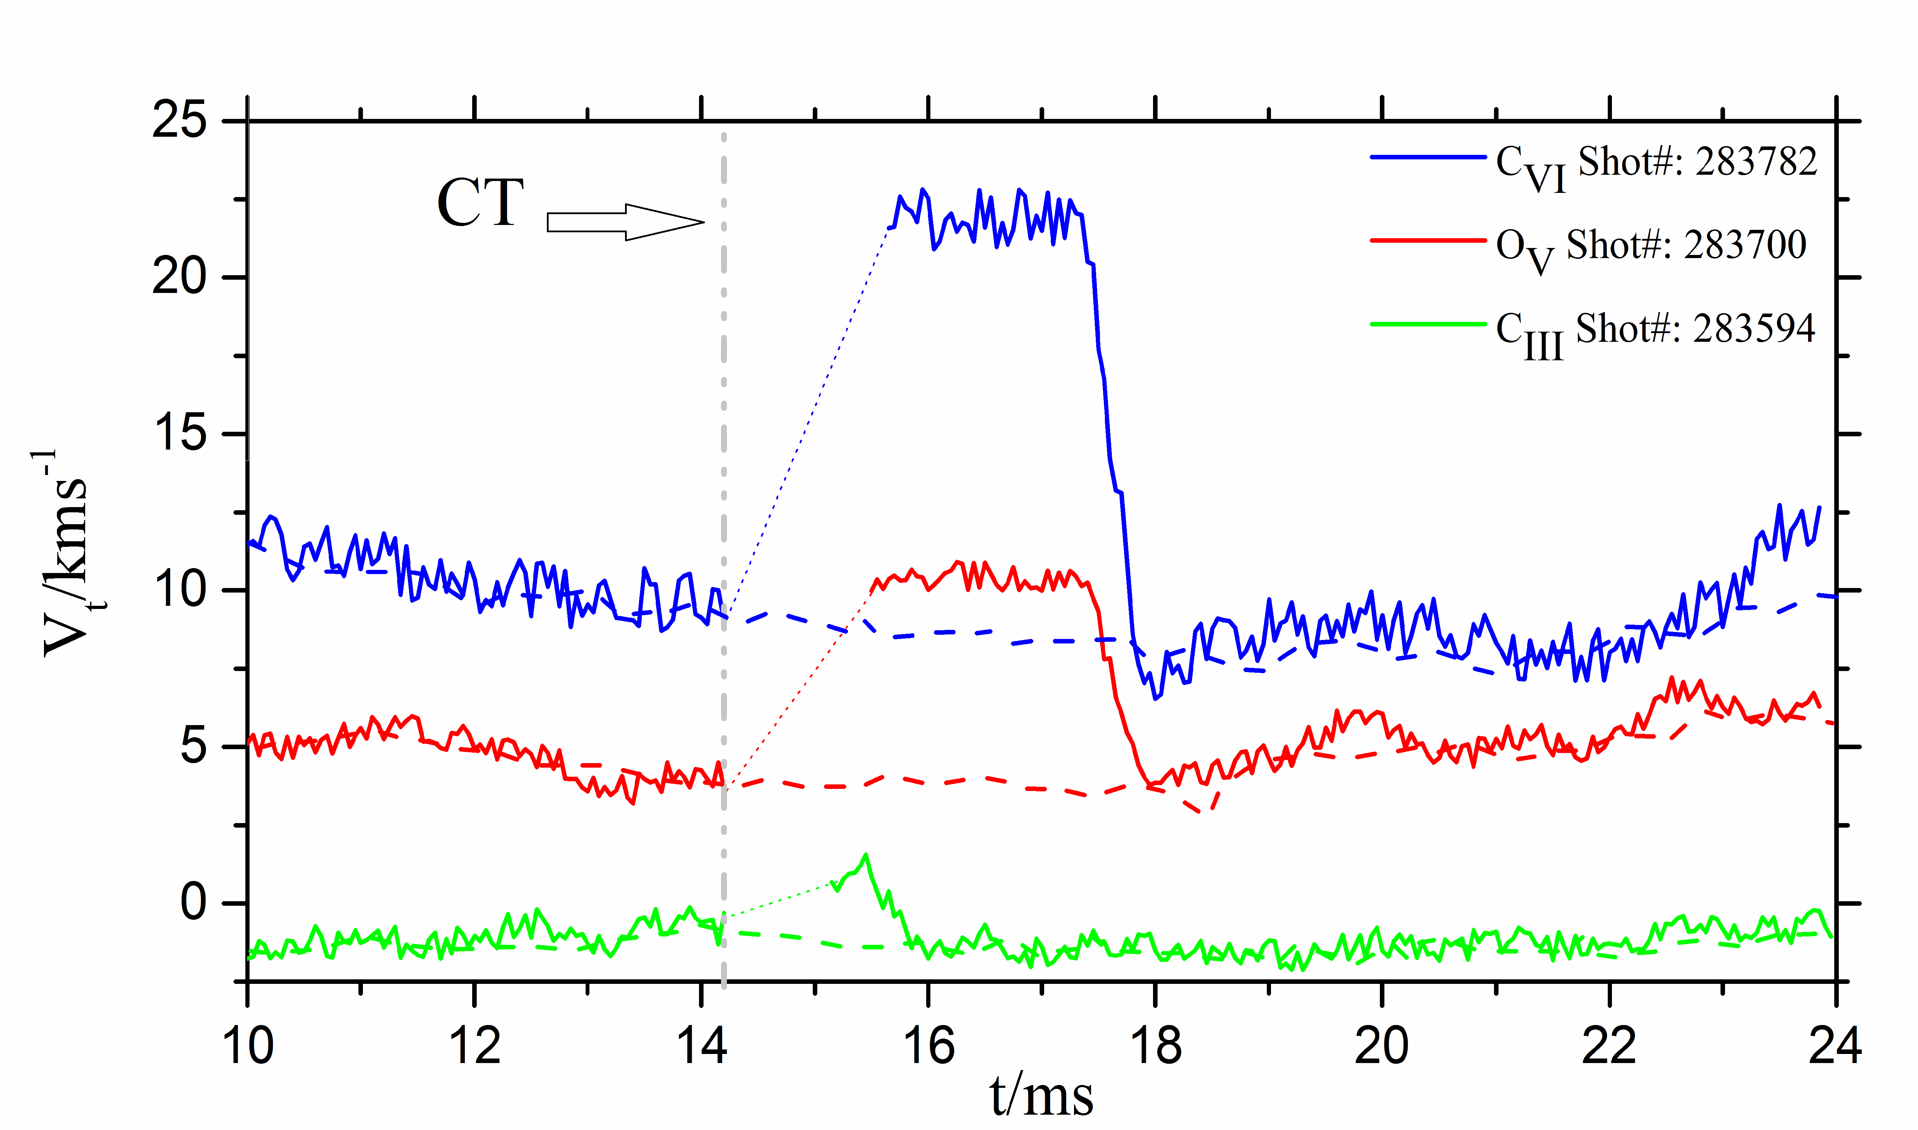
Flow modification by CT injection
v_{t}
Normal plasma current and flow direction
v_{t}
Reversed plasma current and flow direction

Slide 18
Understand Momentum Injection and Transport
Magnetic Resonant Perturbation along also modifies the toroidal flow velocity
CT injection suppresses magnetic fluctuations and modifies the flow
Need to quantify the effects of magnetic breaking and the momentum injection.
Need to understand momentum transport in STOR-M

Slide 19
Repetitive CT Operation
Repetitive CT injection is needed for steady state CT operation.
ITER size tokamak required fueling rate of 100 Hz
PPL at UofS has already produced a burst of 3 CTs at about 10 Hz
Will try to increase the rate to 100 Hz
Then to demonstrate injection of 3 CTs into a single STOR-M discharge.

Slide 20
1st Year Activities Planned
Electrode biasing under the following conditions
Characterization of STOR-M discharges with Lithium coated wall
Electrode biasing experiments with Lithium coated wall
CT operation/injection
Increase repetitive CT operation to 30Hz

Slide 21
2nd -4th Year Activities Planned, 1
Improved confinement studies
Rectangular biasing voltages pulse with different polarities or sinusoidal waveform
Inject CT into Ohmic H-mode discharges
Combine different H-mode triggering techniques to sustain the improved confinement phase
Analyze fluctuations measured by magnetic probe arrays, Langmuir Probes and reflectometer.
Effects of velocity shear on the anomalous transport

Slide 22
Collaboration (inputs)
Theoretical studies of plasma flow and momentum transport
Data analyses software/codes
Edge plasma diagnostics expertise
Data sharing (STOR-M is adopting MDSPlus database)

Slide 23
Thanks!

Slide 24
Extra slides

Slide 25

Flow modification by CT injection (normal tokamak current direction)
v_{t}
Changes of the flow velocity are along CT injection direction
(CT momentum is approximately 10 times the plasma rotation)

Slide 26

Flow modification by CT injection (reversed tokamak current direction)
v_{t}
Reversed plasma flow direction
Changes in flow velocity are still along CT injection direction

Slide 27
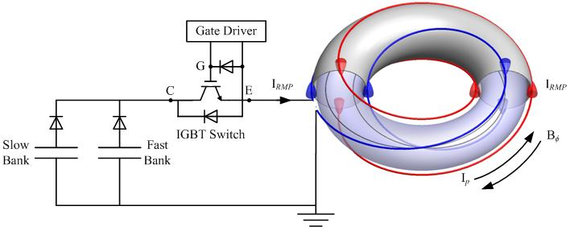
Experimental Setup -RMP
2nd bank
1st
bank
m/n=2/1 helical coils to suppress the dominant mode

Slide 28
Content of the presentation
Introduction + background of the institute on the proposed activities
Facilities / expertise available
Work to be done (1 year + 2-4 year):
Activities + task + deliverables+ comments
Tasks where collaboration is needed (one page for this)
Final goal of the activities described
Input of the activities proposed into the final goal of the Coordinated Research Project
Maximum number of slides: 25

